Slide 1
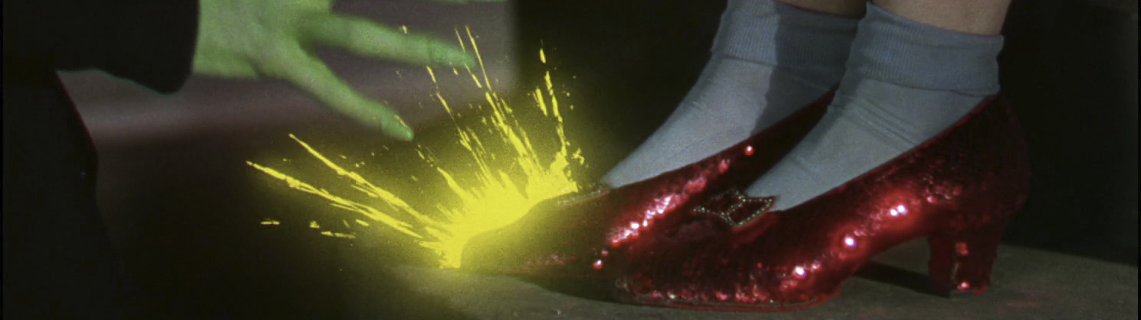
🎨 Colour
Key Knowledge
the characteristics and construction of media narratives in selected media forms
the relationship between the function of media codes and conventions to convey meaning in selected media forms
Key Skill
explain the characteristics and construction of media narratives in selected media forms
the relationship between and the function of media codes and conventions to convey meaning in selected media forms
Season: Unit 3 Media
Unit: Narrative and Ideology
Episode: The ‘C’ Words

Slide 2
🎨 Colour
Y12 Media – Ep. 01 ‘The ‘C’ Words
📢 What is colour?
Different colours can have different connotations, depending on context and culture. Colour in media products can also be manipulated in a variety of different ways. Colour can be controlled via lighting, through the setting and mise en scene, and especially now, controlled in the editing process.
Media products may have a colour palette, a set of colours that are used consistently throughout to create a tone or mood.
axisofaction.com

Slide 3
🎨 Colour
Y12 Media – Ep. 01 ‘The ‘C’ Words
📢 Elements of colour
🖍 Dominant colour
The dominant colour of a shot within a mise en scene or throughout a media product has the effect of setting the mood or tone.
axisofaction.com

Slide 4
🎨 Colour
Y12 Media – Ep. 01 ‘The ‘C’ Words
📢 Elements of colour
🖍 Contrasting Foils
Colour can be used to draw the audiences eye to something in the frame by using contrasting, or complementary colours.
axisofaction.com

Slide 5
🎨 Colour
Y12 Media – Ep. 01 ‘The ‘C’ Words
📢 Elements of colour
🖍 Colour Symbolism
Media producers use colour to specifically connect connotations to specific scenes, characters or objects. Red, for instance, is typically seen as a colour of passion, danger, romance, or violence. Green is connected with nature or sickness, blue with calm or depression. Yellow is warm and inviting or a warning. Purple is seen to be connected with royalty or other-wordly.
axisofaction.com

Slide 6
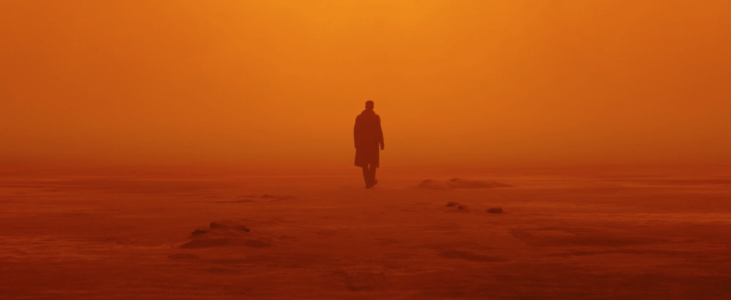
🎨 Colour
Y12 Media – Ep. 01 ‘The ‘C’ Words
‘Blade Runner 2049’ (2017), Denis Villeneuve
axisofaction.com

Slide 7
🎨 Colour
Y12 Media – Ep. 01 ‘The ‘C’ Words
‘Vertigo’ (1958), Alfred Hitchcock
axisofaction.com

