Slide 1

Comprehensive Guide to API Testing Techniques

Slide 2

Comprehensive Guide to API Testing Techniques
Introduction
Historical Background
Types of APIs (1 of 2)
Types of APIs (2 of 2)
How API Requests Work
API Testing vs. Contract Testing
Common HTTP Methods
HTTP Status Codes (Quick Overview)
API Testing Tools (1 of 2)
API Testing Tools (2 of 2)

Slide 3
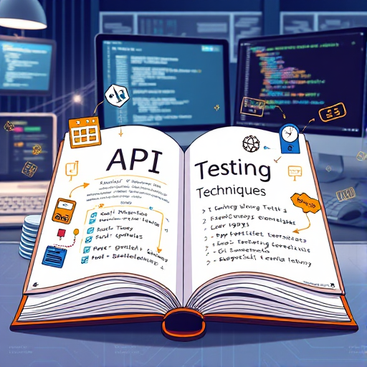
Introduction
APIs as Communication Bridges: APIs facilitate interaction between diverse software applications, enabling seamless data exchange and functionality.
Critical Role in Validation: API testing is essential for validating service-layer functionality, ensuring all integrated components perform correctly.
Early Defect Detection: Effective API testing allows teams to identify defects early, mitigating risks and reducing development costs significantly.

Slide 4

Historical Background
Pre-2000 API Complexity: Before 2000, APIs primarily relied on complex protocols like SOAP, hindering integration and development.
Introduction of REST: In 2000, Roy Fielding introduced REST, simplifying API design principles and facilitating broader adoption across platforms.
Impact on Development: The adoption of REST accelerated software development practices, promoting agility and interoperability in applications.

Slide 5

Types of APIs (1 of 2)
REST Architecture: REST is a stateless, HTTP-based architecture that efficiently handles data in JSON or XML formats.
SOAP Protocol: SOAP is an XML-based protocol offering WSDL for service definitions, error handling, and enhanced security.
Scalability Features: REST's scalability allows it to efficiently manage increasing loads and enhances performance of distributed systems.

Slide 6
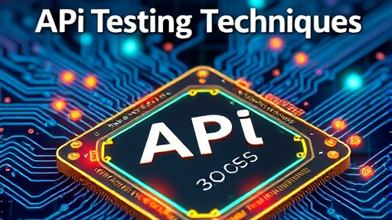
Types of APIs (2 of 2)
GraphQL Efficiency: GraphQL enables precise data retrieval based on queries, minimizing over-fetching and under-fetching of information.
WebSocket Communication: WebSocket permits two-way communication, supporting real-time updates, making it ideal for interactive applications.
Applications of WebSocket: Utilized in dynamic dashboards and chat applications, WebSocket provides instantaneous data transmission for enhanced user experience.

Slide 7
How API Requests Work
HTTP/HTTPS Protocols: HTTP and HTTPS are fundamental protocols for structuring requests and responses in web API communication.
Request Components: An API request consists of URL, method, headers, parameters, and an optional body for data.
Response Structure: Responses generally include a status code, headers indicating metadata, and a body containing the response data.

Slide 8
API Testing vs. Contract Testing
Scope of API Testing: API testing focuses on evaluating functionality, performance, and security aspects of APIs comprehensively.
Contract Testing Essentials: Contract testing specifically ensures that APIs adhere to predefined contracts/interfaces for interoperability.
Coverage Differences: While API testing reviews behavior and performance, contract testing prioritizes agreement adherence and communication efficacy.

Slide 9

Common HTTP Methods
GET Method: GET retrieves data from the server, commonly used for fetching resources without altering server state.
POST Method: POST sends data to the server for processing, ideal for creating new resources or submitting forms.
DELETE Method: DELETE removes specific resources from the server, vital for resource management and cleanup operations.

Slide 10

HTTP Status Codes (Quick Overview)
1xx Informational Codes: These status codes indicate that the request has been received and the process is ongoing.
2xx Success Codes: Codes like 200 OK and 201 Created confirm successful request processing and resource creation respectively.
3xx Redirection Codes: These codes, such as 301 Moved Permanently, inform clients about resource location changes requiring redirection.

Slide 11

API Testing Tools (1 of 2)
SOAP UI Overview: SOAP UI is a versatile tool catering to both SOAP and REST APIs, enhancing testing efficiency.
WSDL Support: It provides robust WSDL support, enabling seamless integration with SOAP services through automatic generation.
CI/CD Integration: SOAP UI can seamlessly integrate into CI/CD pipelines, allowing for continuous testing throughout the development lifecycle.

Slide 12

API Testing Tools (2 of 2)
Postman Introduction: Postman is a user-friendly API testing tool that simplifies workflows for developers and testers alike.
Scripting Capabilities: It includes powerful scripting capabilities, allowing automated tests to validate API responses and enhance reliability.
Collaboration Features: Postman facilitates team collaboration through shared workspaces, improving efficiency and communication on API projects.

Slide 13

Bruno – An Open Source Alternative
Bruno Overview: Bruno is an open-source API testing tool, enhancing collaboration and efficiency without incurring costs.
Lightweight Design: Bruno's lightweight architecture ensures fast operation, making it suitable for various testing needs and environments.
Git Collaboration Support: Bruno integrates with Git, enabling seamless version control and collaborative development for API testing projects.

Slide 14

Other Notable Open Source Tools
Hoppscotch Overview: Hoppscotch is a browser-based API testing tool supporting REST, GraphQL, and WebSocket protocols efficiently.
Insomnia's Features: Insomnia offers cross-platform capabilities with GraphQL support and environment management for seamless testing experiences.
HTTPie Innovation: HTTPie provides a user-friendly CLI and web UI, incorporating AI features for intelligent request management.

Slide 15
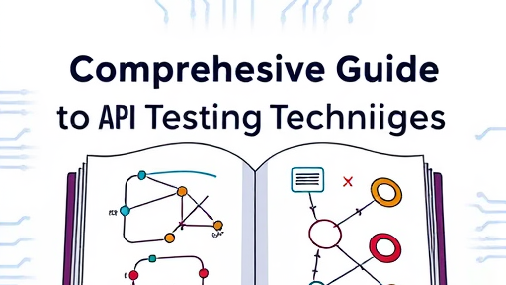
Summary
Importance of API Testing: API testing is crucial for maintaining software quality and ensures seamless interaction between application components.
Combining Testing Types: Integrating API and contract testing enhances validation, ensuring compliance with specifications and improving overall reliability.
Leading Testing Tools: Top tools like SOAP UI, Postman, and Bruno streamline API testing processes, improving efficiency and collaboration.

