Slide 1
THE FIRST NUMBER WINS
Anchoring Bias and Framing Effects
Contemporary Problem Solving — Lesson 2
Dr. Amir Konigsberg • Tel Aviv University

Slide 2

Where We Left Off
Last week we discovered three invisible prisons your brain builds without your permission:
• Visual constraints — the Nine Dots Puzzle showed your brain invents boundaries that don’t exist.
• Functional constraints — the Candle Problem showed your brain locks objects into single roles.
• Logical constraints — the Wason Task showed your brain seeks confirmation, not truth.
Today we go one level deeper. Last week was about the shape of your thinking. This week is about the starting point. Because it turns out that even when you’re trying to think clearly, the very first piece of information you encounter silently distorts everything that follows.
The biases stack. And this one might be the most dangerous of all.

Slide 3

What This Lesson Is About
Anchoring is the tendency for the first piece of information we encounter to disproportionately influence all subsequent judgments — even when that first piece of information is completely irrelevant.
It operates in every negotiation, every valuation, every estimate, every sentencing decision, and every medical diagnosis. It affects novices and experts equally. And it works even when you know it’s happening.
Today’s lesson has four parts:
1. A live experiment that demonstrates anchoring on you, right now
2. The science behind why it works
3. A case study — WeWork — showing anchoring at institutional scale
4. Framing effects: anchoring’s close cousin, and how to defend against both

Slide 4
THE EXPERIMENT
Let’s see if your brain can resist a number it knows is irrelevant.

Slide 5
A QUICK EXPERIMENT
We’re going to split into two groups.
If your birthday is January through June → you are Group A.
If your birthday is July through December → you are Group B.
In a moment I’ll show a slide for Group A. If you’re in Group B, close your eyes or look away. Then we’ll do the same for Group B.
Each group will see a question. Think of your best answer.
When I say “go,” type your answer as a single number in the Zoom chat.
Do NOT send it until I say go. Do NOT discuss. Just your number.
GROUP A: GET READY — GROUP B: CLOSE YOUR EYES

Slide 6
GROUP A ONLY
Group B — look away now.
The tallest redwood tree in the world is more than 1,200 feet tall.
What is your best estimate of the average height of redwood trees?
(Answer in feet. Remember your number — do NOT type it yet.)
GROUP A: REMEMBER YOUR NUMBER — GROUP B: KEEP LOOKING AWAY

Slide 7
GROUP B ONLY
Group A — look away now.
The tallest redwood tree in the world is more than 85 feet tall.
What is your best estimate of the average height of redwood trees?
(Answer in feet. Remember your number — do NOT type it yet.)
GROUP B: REMEMBER YOUR NUMBER

Slide 8
EVERYONE
TYPE YOUR NUMBER
IN THE CHAT NOW.
Just the number. Nothing else.
GROUP A (JAN–JUN): YOUR NUMBER | GROUP B (JUL–DEC): YOUR NUMBER

Slide 9
THE RESULTS
GROUP A
Saw: “...more than 1,200 feet...”
Average estimate:
___________
GROUP B
Saw: “...more than 85 feet...”
Average estimate:
___________
Same question. Different irrelevant number. Different answer.

Slide 10
THE FIRST NUMBER WINS.
Both groups were asked the same question. The only difference was one irrelevant sentence — containing one irrelevant number. That number pulled your estimate toward it. Not because you chose to use it. Because your brain used it automatically, without asking your permission.
This is anchoring. And it just happened to every single one of you.

Slide 11
THE SCIENCE
Why Anchoring Works — and Why You Can’t Simply “Decide” to Ignore It

Slide 12

The Discovery: Tversky & Kahneman, 1974
In their landmark 1974 paper in Science, Amos Tversky and Daniel Kahneman described a simple experiment. They spun a rigged wheel of fortune in front of subjects. The wheel was fixed to land on either 10 or 65.
Then they asked: “What percentage of African countries are members of the United Nations?”
Subjects who saw 65 estimated significantly higher than those who saw 10 — even though a random number from a wheel is obviously irrelevant to African geopolitics.
Tversky and Kahneman proposed that when people make numerical estimates under uncertainty, they start from an initial value — the anchor — and adjust from it. The critical finding: the adjustment is almost always insufficient. People stop adjusting too early, leaving their final estimate biased toward the anchor.
The anchor does not need to be relevant. It does not need to be plausible. It just needs to be there.

Slide 13
TWO MECHANISMS OF ANCHORING
ANCHORING & ADJUSTMENT
You start at the anchor and deliberately adjust away from it.
The problem: you stop adjusting too early.
Example: “I know 1,200 feet is too high, so let me come down... 400 sounds right.” (It’s still pulled toward the anchor.)
SELECTIVE ACCESSIBILITY
The anchor activates information in memory that is consistent with it.
The problem: the anchor primes your thinking, not just your number.
Example: hear “$47 billion” and your brain automatically retrieves reasons a company might be worth that much. The anchor shapes what evidence you consider.
The second mechanism is why even people who “know about anchoring” are still anchored.

Slide 14

Expertise Doesn’t Protect You
One of the most important findings in anchoring research: it affects experts as much as novices.
• Judges:
Englich, Mussweiler & Strack (2006) gave German judges identical case files but different prosecution demands. Higher demands produced sentences that were 8 months longer — and the judges denied being influenced.
• Real estate agents:
Northcraft & Neale (1987) had professional agents appraise the same house after receiving different listing prices. The listing price shifted their “independent” valuations by $11,000 on average.
• Doctors:
Brewer et al. (2007) found that physicians’ diagnostic estimates were anchored by initial probability estimates in the referral, even when those estimates were clearly unreliable.
If judges, doctors, and real estate agents can’t resist it, neither can you.

Slide 15

CASE STUDY
WeWork and the $47 Billion Phantom

Slide 16
WeWork: The Setup
Founded in 2010 by Adam Neumann and Miguel McKelvey. The core business: lease large office spaces on long-term contracts, subdivide them, and rent desks to freelancers and startups on short-term contracts.
This is a real estate arbitrage business. Respectable. Potentially profitable. But fundamentally not a technology company.
Yet by January 2019, WeWork was valued at $47 billion.
Nine months later, its IPO was pulled, Neumann was ousted, and the valuation collapsed to roughly $8 billion. By 2023, WeWork filed for bankruptcy.
The question is not “was Neumann a fraud?” The question is: how did so many smart people believe a co-working company was worth $47 billion?
The answer is anchoring.

Slide 17
Anchor 1: The Tech Label
Neumann’s first and most important move was linguistic.
He never called WeWork a real estate company. He called it a “technology platform” and later a “community company” whose mission was to “elevate the world’s consciousness.”
This is a framing anchor. By placing WeWork in the mental category of “tech,” he activated a completely different set of valuation expectations:
• Tech companies are valued at 10–20x revenue.
• Real estate companies are valued at 1–2x revenue.
The same company, with the same revenue, in two different categories, produces a 10x difference in perceived value. The word “tech” was the invisible anchor that made every subsequent number seem plausible.
This is selective accessibility in action: the label “tech” activates a mental model where hypergrowth, winner-take-all dynamics, and massive multiples are normal.

Slide 18

Anchor 2: SoftBank’s $4.4 Billion Investment
In 2017, Masayoshi Son — founder of SoftBank, the largest technology investment fund in the world, backed by Saudi and Abu Dhabi sovereign wealth — invested $4.4 billion in WeWork at a $20 billion valuation.
The implicit anchor:
“If the most powerful tech investor on the planet thinks it’s worth $20 billion, who am I to disagree?”
This is authority anchoring. The credibility of the source amplifies the anchor’s power. SoftBank’s involvement didn’t just set a number — it signaled to every subsequent investor that the number was legitimate.
Each funding round after SoftBank used the previous round’s valuation as the new anchor. $20B became $35B became $47B. Every investor’s “independent” analysis started from the number that came before.

Slide 19
Anchor 3: The Comp Set
WeWork’s pitch deck compared the company not to IWG/Regus — its actual competitor, a profitable co-working business valued at roughly $4 billion — but to Amazon, Uber, and Salesforce.
Every pitch deck is a framing exercise. This one was designed to anchor the investor’s mental model at tech-company multiples.
By the time an investor sat down to do their own analysis, the frame was already set:
• Category: technology platform (not real estate)
• Comparable companies: Amazon, Uber, Salesforce (not IWG)
• Previous valuation: $20B+ (anchored by SoftBank)
Their “independent” analysis was anything but independent. The anchors were already embedded in their starting assumptions.

Slide 20
Anchor 4: Internal Culture as Reinforcing Loop
Inside WeWork, the $47 billion valuation became the anchor for everything: employee expectations, hiring budgets, office leases, corporate spending.
Neumann reportedly told employees the company would eventually be worth $10 trillion.
This created a reinforcing loop:
• The valuation justified the spending
• The spending “proved” the valuation was real
• Anyone who questioned it was questioning the anchor
By this point, the $47 billion number was woven into the identity of the organization. Questioning the valuation meant questioning your colleagues, your equity, your career bet, and your CEO’s vision.
The anchor had become unfalsifiable.

Slide 21
The Collapse: When the Anchor Broke
In August 2019, WeWork filed its S-1 (IPO prospectus). For the first time, the public market — thousands of independent analysts evaluating simultaneously — looked at the numbers.
They found: $1.9 billion in losses (2018), bizarre governance (Neumann had supermajority voting control), and no credible path to profitability. The “elevate the world’s consciousness” mission statement appeared in a financial filing.
Within six weeks: valuation dropped from $47B to $8B. IPO pulled. Neumann ousted.
The edifice collapsed not because new information appeared, but because the anchoring environment changed.
In private markets, each investor’s valuation was anchored by the previous round. In public markets, thousands of analysts evaluated independently, breaking the anchoring chain.
The lesson: anchoring survives in closed systems. It breaks in open ones.

Slide 22
THE WEWORK LESSON
WeWork is not a story about one crazy CEO.
It is a story about anchoring at institutional scale.
LINGUISTIC ANCHOR
“Tech company” set the frame
FINANCIAL ANCHOR
SoftBank’s $4.4B set the number
SOCIAL ANCHOR
Amazon/Uber comp set the expectations
CULTURAL ANCHOR
Internal valuation made it self-reinforcing
At every step, someone could have asked: “What is this company actually worth based on its cash flows?” But once the $47 billion was planted, every subsequent judgment orbited around it.

Slide 23
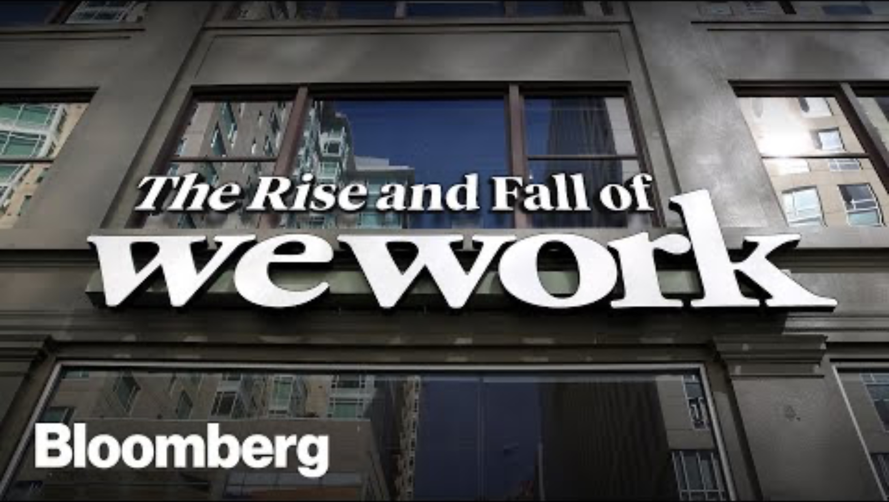

Slide 24
FRAMING EFFECTS
Same Data. Different Lens. Different Decision.

Slide 25
THE ASIAN DISEASE PROBLEM
Tversky & Kahneman, 1981
GAIN FRAME
A disease is expected to kill 600 people. Two programs are proposed:
Program A: 200 people will be saved.
Program B: 1/3 chance that 600 will be saved, 2/3 chance that nobody will be saved.
LOSS FRAME
A disease is expected to kill 600 people. Two programs are proposed:
Program C: 400 people will die.
Program D: 1/3 chance that nobody will die, 2/3 chance that 600 people will die.
Programs A and C are mathematically identical. So are B and D. But the choice flips.

Slide 26
WHAT HAPPENS
GAIN FRAME
~72% choose Program A
(the certain option)
People are risk-averse when thinking about gains. “Let’s save the 200 for sure.”
LOSS FRAME
~78% choose Program D
(the risky option)
People are risk-seeking when trying to avoid losses. “Maybe we can save everyone.”
Same numbers. Same outcomes. Same expected value.
But the way it was described — the frame — flipped the preference.
If a single sentence can reverse your decision about saving 600 lives, what does that say about every decision you make based on how someone else presents the options?

Slide 27
The Science: Prospect Theory
Framing effects are explained by prospect theory (Kahneman & Tversky, 1979), which won Kahneman the 2002 Nobel Prize in Economics.
Three key principles:
• Reference dependence:
People evaluate outcomes relative to a reference point (usually the status quo), not in absolute terms.
• Loss aversion:
Losses loom larger than gains. Losing $100 feels about twice as painful as gaining $100 feels good.
• Diminishing sensitivity:
The difference between $0 and $100 feels much larger than the difference between $1,000 and $1,100 — even though both are $100.
Together, these explain why framing works: by changing whether an outcome is presented as a gain or a loss relative to the reference point, you change how people evaluate it.

Slide 28

Framing Is Everywhere
• Medicine:
“This surgery has a 90% survival rate” vs. “This surgery has a 10% mortality rate.” Same number. Different patient choices. McNeil et al. (1982) showed this affects both patients and doctors.
• Marketing:
“95% fat-free” vs. “Contains 5% fat.” Same yogurt. Different purchase decisions.
• Politics:
“Estate tax” vs. “Death tax.” Same policy. The label shifts public support by 10–15 percentage points in polling.
• Negotiation:
Presenting a concession as something you’re “giving up” (loss frame) makes it feel more significant than presenting it as something you’re “offering” (gain frame). Skilled negotiators frame deliberately.
Anchoring sets the number. Framing sets the lens. WeWork used both.

Slide 29
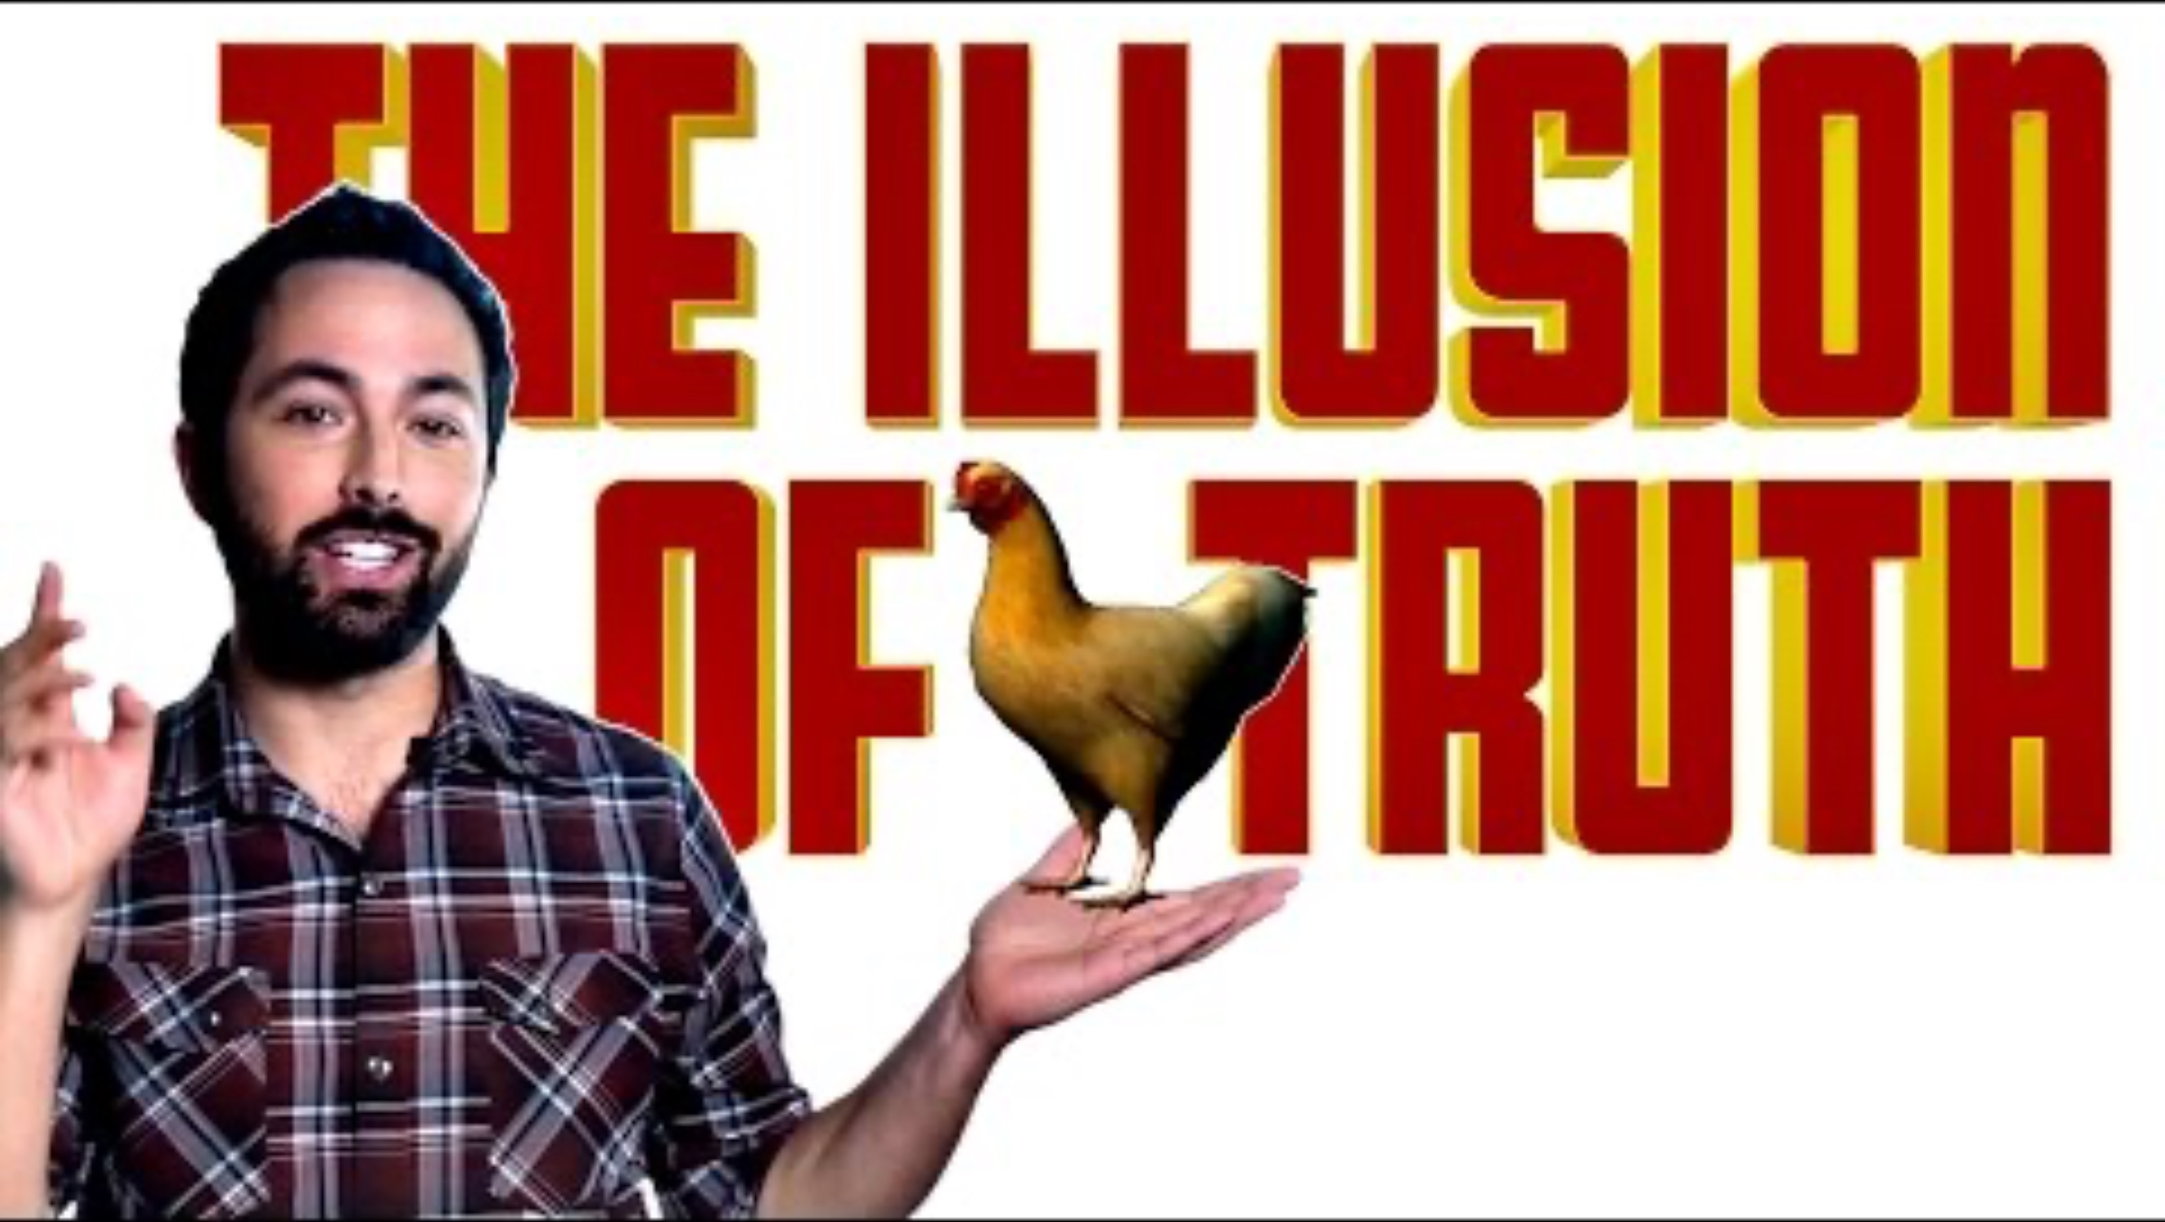

Slide 30

SO WHAT DO WE DO?
Practical Defenses Against Anchoring

Slide 31
Five Defenses Against Anchoring
1. Consider the opposite
Before committing to an estimate, deliberately generate reasons it might be much higher or much lower. This forces adjustment beyond the anchor.
2. Generate your own anchor first
Before entering a negotiation or valuation, do your own independent analysis. Your self-generated anchor partially immunizes you against external ones.
3. Ask: “Where did this number come from?”
If the first number in any analysis came from someone else, treat it as contaminated. Start over from raw data.
4. Use ranges instead of point estimates
Ranges force you to consider both directions, making any single anchor less dominant.
5. Change the process
In critical decisions, withhold the anchor from the decision-maker. Some organizations have analysts prepare valuations before seeing the asking price. This is structural debiasing — the only truly reliable defense.

Slide 32

Where Does Anchoring Show Up in Your Life?
• Salary negotiation:
If your employer names a salary first, you’ve been anchored. The first number on the table determines the outcome more than any other factor. Always research market rates beforehand so you have your own anchor.
• Real estate:
The listing price shapes your perception of value, even when you know listing prices are strategic. This is why “over-asking” works: even if the final price is lower, it’s still pulled upward by the listing.
• Pricing:
Every “original price” crossed out next to a sale price is an anchor. The sale looks like a bargain relative to it — even if the original price was never real.
• Your own decisions:
Think of a major decision you made recently. What was the first piece of information you encountered? Did it shape everything that followed?

Slide 33

Looking Ahead: Lesson 3
Anchoring distorts the starting point of your thinking. But what happens when there is no specific starting number — when you have to judge based on whatever comes to mind?
That is availability bias: the tendency to judge frequency and probability by how easily examples come to mind. If something is vivid, recent, or dramatic, your brain treats it as common — whether it is or not.
Next week’s case study: in the year after September 11, 2001, an estimated 1,600 additional Americans died in car accidents — because fear of flying, driven by the availability of vivid media coverage, led them to drive instead.
The bias that was supposed to protect them killed them.
We’re building a catalog of the ways your brain betrays you. Anchoring is the starting point. Availability is the filter. Next week, we add the filter.

Slide 34
The first number wins.
Know it. Name it.
Build systems to defend against it.

Slide 35

Reading for Next Week
Essential
• Daniel Kahneman, Thinking, Fast and Slow — Chapters 11–13 (Anchors, The Science of Availability, Availability and Affect).
These three chapters cover today’s lesson and set up next week’s.
• Tversky & Kahneman, “Judgment Under Uncertainty: Heuristics and Biases” (1974), Science. The original paper. 15 pages. Accessible and foundational.
Recommended
• Reeves Wiedeman, Billion Dollar Loser: The Epic Rise and Spectacular Fall of Adam Neumann and WeWork (2020).
The full WeWork story. Reads like a thriller.
• Dan Ariely, Predictably Irrational — Chapter 1 (“The Truth About Relativity”).
Anchoring in consumer pricing, told with brilliant experiments.

Slide 36
Watching for Next Week
Documentary
• WeWork: Or the Making and Breaking of a $47 Billion Unicorn (Hulu, 2021). 90 minutes.
Watch for the anchoring chain: the tech label, SoftBank’s investment, the comp set, the internal culture.
Talks & Explainers
• Daniel Kahneman, “Thinking, Fast and Slow” — Google Talk (YouTube, ~1 hour).
Kahneman walks through anchoring, framing, and prospect theory in his own words.
• Veritasium, “The Illusion of Truth” (YouTube, 18 min).
Excellent visual explainer on how repeated exposure creates anchoring-like effects on belief.
• TED Talk: Dan Ariely, “Are We in Control of Our Own Decisions?” (17 min).
Anchoring and framing in organ donation, pricing, and healthcare — funny and eye-opening.

