Slide 1
THE LOOP
YOU DIDN'T SEE
Reinforcing Loops, Algorithms, and the Architecture of Polarization
Contemporary Problem Solving — Lesson 5
Dr. Amir Konigsberg • Tel Aviv University

Slide 2
Take out your phone.
Right now, on whatever app you opened this morning, a system is running.
It picked your last post. It picked the one before that. It will pick what you see next.
You've never seen it. You can't argue with it. You can't turn it off without changing platforms.

Slide 3
E X E R C I S E 1
AUDIT YOUR FEED

Slide 4
✓
Here's what we're doing
1.
Open whichever app you spend the most time in. TikTok, Instagram, X, YouTube, Facebook — pick one. Open the home feed. (Don't search. Don't go to a friend's profile.) Just the default feed.
2.
Scroll through the next twenty posts. For each one, type one word: politics, food, fitness, dating, gaming, news, war, ad, friend, AI-slop. Whatever fits.
3.
Count how many of the twenty are from people you've actually met in person.
4.
Count how many made you feel something stronger than mild interest - Anger, envy, fear, agreement, indignation. Anything with a pulse …

Slide 5
⌁
What you just saw
One.
Hardly anyone in your feed is anyone you've ever met. Out of twenty posts, maybe three are from people you've shared a room with. Your social media is mostly parasocial.
Two.
You wrote the same word over and over. The feed isn't showing you the world. It's showing you your fingerprint.
Three.
The emotions are loud. Way louder than they'd be if you walked outside for ten minutes an encountered your actual social environment …
None of that is an accident. Neither is it someone at a desk picking your posts. It's a feedback loop.

Slide 6
◇
So what's a system, really?
Most people use the word "system" to mean "something complicated I don't like." The healthcare system. The school system. The economic system. The system is rigged …
Useless. That's not what we mean.
A system is a set of things connected in ways that make them behave differently than the parts would alone.
Three parts: 1) The things; 2) The connections between them; 3) What the whole arrangement actually does.
The things are usually visible - you can point at them, count them.
The connections and the function - almost never. They have to be inferred.
That’s what we do now.

Slide 7
◆
Every system has three parts
Two of them you can't see directly. That's the whole problem.
01
02
03
ELEMENTS
CONNECTIONS
WHAT IT DOES
The visible parts. Things you can point at and count. Easy to mistake for the system itself.
How one element affects another. Almost always invisible — and almost always where the action is.
What the whole arrangement actually produces. Often different from its stated purpose.
I N Y O U R F E E D
I N Y O U R F E E D
I N Y O U R F E E D
Posts, accounts, ads, comments. What you just scrolled through.
Every second you lingered just became data. That data picked the next post you saw.
Stated: connect you with friends. Actual: keep you scrolling, longer than you meant to.

Slide 8
→
Why "X causes Y" stops working
A causes B …
Smoking causes cancer.
Bullets cause wounds.
Cutting taxes causes growth.
That's fine for simple things.
Because in the effects don't stop …
They come back around.
They themselves become …. Causes …

Slide 9
→
Effects don't stop. They come back around. They become causes
Anger keeps you on the post. The system rewards whatever keeps you on the post — every extra second is a vote for "more like this." So it shows you more anger. Which keeps you longer. Which is another vote. There's no first step in this chain. Just a loop, already turning.
Pointing at one part of a loop and calling it "the cause" is like pointing at a spot on a circle and calling it the start …
Two kinds of loops do almost all the work in any system.
Here they are …

Slide 10
↻
Reinforcing loops (R)
Money in your savings account earns interest → Interest goes back into the account → Now there's more money → Earning more interest → And so on.
That's a reinforcing loop. R for short.
R loops are responsible for almost everything that grows fast:
viral posts, pandemics, hype, fortunes, audiences, outrage cycles, religious movements, scientific paradigm shift ..
They're also responsible for almost everything that collapses fast ..
Compound interest works on debt too. A bank that took decades to build can drain in 36 hours …
Reputations come apart the same way they were built …
Friendships fade the same way they grew …
When you see something growing or collapsing way faster than seems reasonable, there's an R loop somewhere.

Slide 11
⌁
An R loop
+
MONEY IN ACCOUNT
INTEREST EARNED
R
+
Read it like a sentence: more money ( + ) → more interest ( + ) → more money.
The plus signs say "these move together." The R says "this loop reinforces itself." That's it. That's the notation.

Slide 12
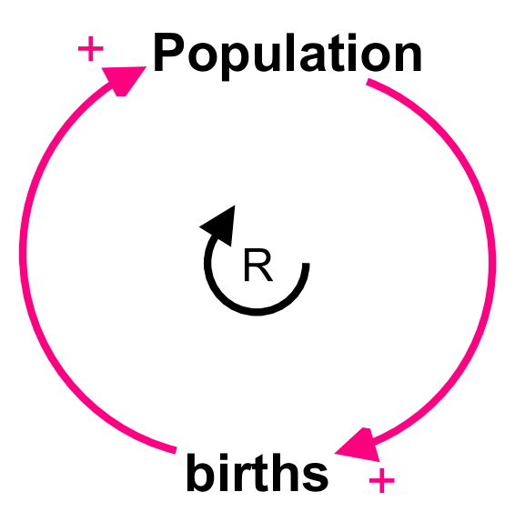
⌁
An R loop

Slide 13
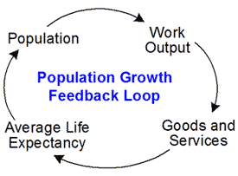
⌁
An R loop
The work output of a population can increase the goods and services available to that population, which can increase the average life expectancy, which can increase the population, which can increase the work output still more, and the loop starts all over again …

Slide 14
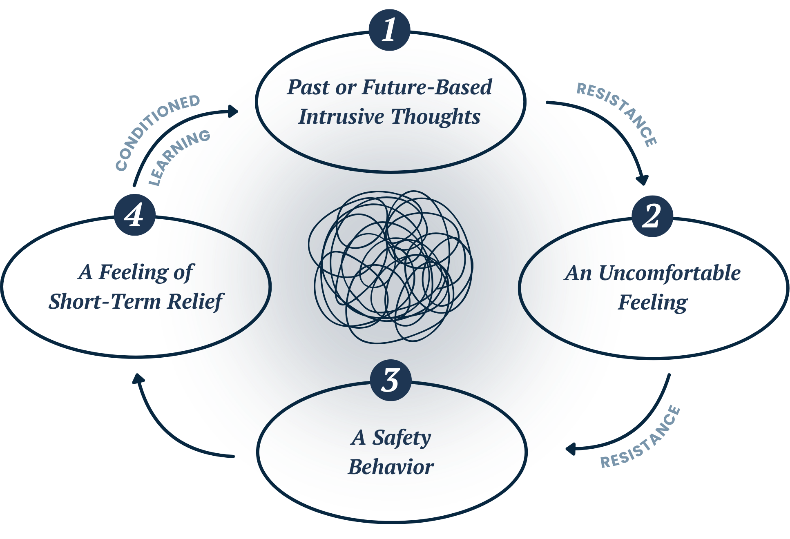
⌁
An R loop

Slide 15
⊖
Balancing loops (B)
More leads to less … The system pulls itself back …
Your room gets too cold → The thermostat kicks on the heater → The heater warms the room → The room hits the target temperature → The thermostat shuts off.
That's a balancing loop. B for short. It pulls things toward a target.
B loops are responsible for everything that holds together in a self-sustaining way:
your body temperature, market corrections, the immune system, traffic congestion, organizational inertia.
You eat → fullness signals → you stop. The most familiar B loop running in your own body, every day.
Hours awake accumulate → exhaustion forces sleep → you wake up reset. The whole 24-hour cycle is a balancing loop pulled back to a target every night.
Real systems are mixes of both. R loops drive motion. B loops drive stability. The behavior you see at any moment depends on which one is winning.
Your body weight. Some loops push it up (stress, desk jobs, snack food). Others push it back (hunger, movement, the mirror). Your weight is the score.

Slide 16
⌁
Drawing a B loop
+
GAP FROM TARGET TEMP
HEATER OUTPUT
B
−
Read it: the room is too cold, so the heater turns on. The heater warms the room, which makes it less cold. The minus sign on the second arrow is what closes the gap - without it, the heater would just keep running forever.
How to tell which kind of loop you're looking at: count the minus signs. None → R. One → B. Two → R again, because they cancel out. You don't have to think about it — just count.

Slide 17
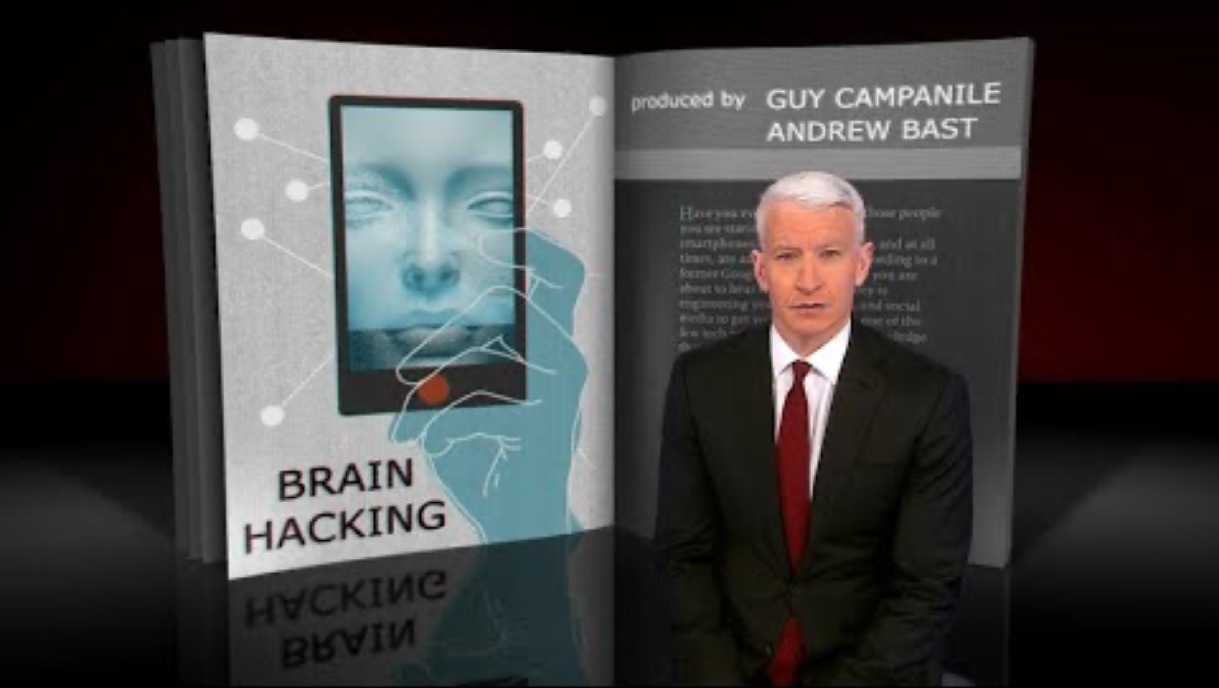

Slide 18
✓
The notation, on one card
→ +
→ −
R / B
POSITIVE LINK
NEGATIVE LINK
LOOP TYPE
More X means more Y. Less X means less Y. They move together. Bigger gap → more heat.
More X means less Y. They move opposite. One holds the other down.
More heat → smaller gap.
Count the minus signs in the loop. Even = R (reinforcing). Odd = B (balancing).
The thermostat has one minus. So it's a B.

Slide 19
✓
The notation, on one card
The thermostat is a balancing system — it pulls the room temperature back toward your target whenever it drifts. So the loop that describes it should be a B (balancing) loop, not an R (reinforcing) loop.
How do you check that on the diagram? You count the minus signs. The thermostat diagram has exactly one — on the arrow that says "more heat → smaller gap."
The thermostat loop has one minus sign — so the rule says it's a B. And it is.

Slide 20
↻
One pattern to remember today
Imagine two new accounts on a platform, posting identical content. By pure luck, one gets pushed to a slightly bigger initial audience.
More people see it. More engage. The algorithm reads that as “valuable post” or “high quality”. → It pushes the post further. More people see it. More engage. And on, and on.
The other account? Same content. Slightly worse luck on round one. Dies in the feed.
Two reinforcing loops, locked in opposition. Whichever one catches first wins everything. The early luck calcifies into structural dominance.
This is the rich-get-richer pattern
Hold this pattern in your head. We're about to watch it run …

Slide 21
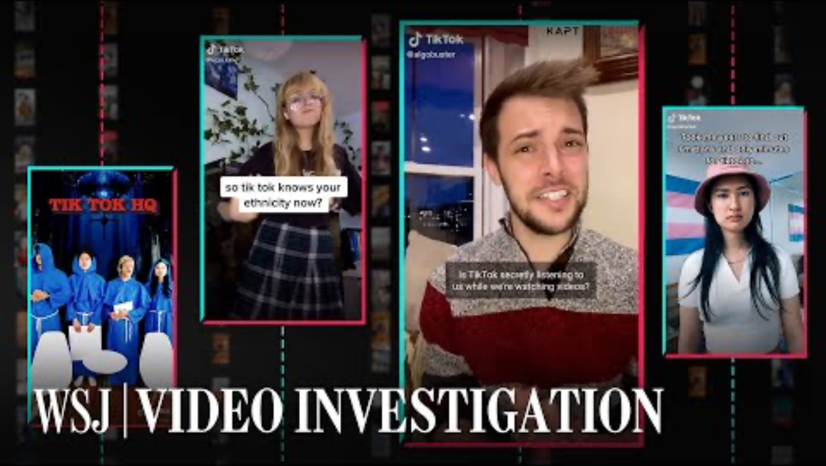

Slide 22
P A R T T W O
THE LOOP YOU'RE IN

Slide 23
◆
The algorithm isn't your friend
It isn't optimizing for what you like. It's optimizing for what keeps you going …
There's a common belief that goes: "the algorithm has figured out what I like, and shows me more of that."
Wrong. Or rather, half right …
The algorithm doesn't measure what you like. It can't. "Liking" is something you'd say to yourself, on reflection, and the system has no access to that.
What it can measure: how long you stayed. How fast you scrolled. Whether you commented. Whether the comment got replies. What topic the comment was about. Whether the replies were angry.
So that's what it optimizes for.
Not your wellbeing. Not your taste. Just behavior, measured every millisecond, fed back into ranking.
Your feed is the surface of a loop running on you for a goal that isn't yours …

Slide 24


Slide 25
◇
Three things the system measures
Before we draw the loop, here are the variables.
Time on platform.
Every second you spend, every scroll, every linger. Logged and counted.
Engagement intensity.
Likes are cheap. Comments are worth more. Shares are worth more than comments. An angry comment that triggers a fight thread is worth more than almost anything.
Emotional charge.
The system can't read your face (yet) but it doesn't need to. Time and engagement intensity are reliable proxies for affect. If a post makes you feel something, you'll behave differently. The system is able to detect that difference.
These three numbers form a loop. We're going to draw it. But first let's see if you've already learned the loop ..

Slide 26
E X E R C I S E 2
PREDICTION MARKET
Predict what the algorithm does next …

Slide 27
✓
Three rounds. Type your guess in chat.
Round 1.
Fresh feed. User watches a fitness video for the full 23 seconds. Skips a cooking video at 4 seconds. Watches a second fitness video for 30 seconds.
What does the algorithm queue next?
Don't overthink it. The first thing that comes to mind is probably right.
The fact that it's right that's the lesson here ….

Slide 28
✓
Three rounds. Type your guess in chat.
Round 2.
User pauses on a political post for 90 seconds, reading the comments. Doesn't like it. Doesn't comment. Scrolls past. Pauses on the next political post for 70 seconds.
What gets queued next?

Slide 29
✓
Three rounds. Type your guess in chat.
Round 3.
User opens a video about a personal tragedy of a stranger. Watches the whole minute. Comments. Shares.
What does the system now think it knows about this user - and what does it serve next?

Slide 30
⌁
The loop, drawn
TIME ON PLATFORM
+
+
EMOTIONAL AROUSAL
ENGAGEMENT SIGNALS
R
+
+
RANKING / NEXT POST
RANKING / NEXT POST
All four arrows are positive. No minus signs. So it's an R loop — running away from itself in whichever direction your first signal pointed. That's why round one of the prediction market was easy.

Slide 31
❝
Why outrage wins
The empirical finding, replicated across every major platform.
MIT, 2018. Researchers tracked how true and false news stories spread on Twitter. False ones traveled further, faster, and to more people. By a lot.
The single biggest predictor wasn't truth or falsity. It was the emotion the post produced. False stories triggered anger and surprise. Anger and surprise drove sharing.
Same pattern on Facebook, YouTube, TikTok. Outrage beats calm. Indignation beats agreement. Conflict beats consensus. Not by a little …. by 6×, 10×, sometimes more.
From the loop's point of view, this isn't a bug. The loop is working perfectly.
Outrage produces measurable behavior. The system rewards what it can measure. It can't measure your wellbeing. So your wellbeing isn't in the loop.
Nobody at the platform decided to make you angry. The architecture is enough.

Slide 32
E X E R C I S E 3
THE POLARIZATION PAIR

Slide 33
✓
Here's how this works
Split.
Born January through June, you're Group A. July through December, Group B. We move you to two breakout rooms.
What you get.
Six headlines about the same recent event. The events are real. The headlines are real. They were chosen to match what the algorithm would actually have shown your group.
What you do.
Five minutes to read the six headlines and agree on three things: what happened, who was responsible, what should be done.
Then we come back.
Each group presents to the other. We watch the gap.
Important:
neither set is fake. Neither is misinformation. Both are real reporting on the same real event. The only thing different is which six were selected — by the same loop you just learned to draw.

Slide 34
⌁
What just happened
Same event. Same week. Two coherent worldviews. Both built from real facts.
GROUP A SAW
GROUP B SAW
A story about institutional failure.
A story about external threat.
Headlines about:
policy failure, official misconduct, the harm done, expert criticism, calls for resignation, public outrage.
Implied protagonist:
the public, harmed by an institution that's lost its way.
Headlines about:
foreign manipulation, security risks, the opposition going too far, mob behavior, threats to public order.
Implied protagonist:
the institution, defending stability against destabilization.
Both groups are looking at real coverage of the same event. The disagreement isn't about facts. It's about which facts they were shown.

Slide 35
C A S E 1
THE JUDICIAL REFORM SPLIT
Israel, 2023.
For nine months, two Israels lived next to each other and stopped being able to talk to each other. The Hebrew internet split. Family WhatsApp groups went quiet. Each side experienced the other not as wrong but as incomprehensible — which is what fully separated R loops produce. The algorithm was doing exactly what it was built to do.
[ Insert full-bleed photo here: Kaplan Street protest, aerial view ]

Slide 36
C A S E 2
THE LANGUAGE SPLIT
October 7 onward. The same war, in two different feeds.
From October 8 onward, every major platform ran an unintentional natural experiment. Hebrew feeds and Arabic feeds — sometimes for users in the same physical building — showed almost non-overlapping versions of the war. Different death tolls at the top. Different protagonists. Different framing of identical events. Two communities sharing streets, employers, and hospitals were placed inside R loops that selected and amplified completely different content. The result wasn't disagreement. Disagreement requires a shared reality. The result was the absence of one.
[ Insert full-bleed photo here: Oct 7 vigil OR split-screen news visual ]

Slide 37
⌁
How the loop amplifies antisemitism
An old hatred meets new infrastructure.
Antisemitism isn't new. The loop that amplifies it is.
Three reinforcing dynamics run on every major platform, every day, in every language:
One.
A user briefly engages with content adjacent to antisemitic tropes. The system reads engagement, surfaces more. Each next post is slightly more extreme, because outrage outperforms calm. Within hours the feed has shifted.
Two.
Moderation in non-English languages is uneven. Posts that get removed in English stay live elsewhere. The same trope crosses borders with different friction.
Three.
Coordinated networks post in synchronized bursts. The system reads that as organic enthusiasm and accelerates it.

Slide 38
P A R T T H R E E
WHAT YOU NOW HAVE

Slide 39
⌁
Last month plus this week
Your four cognitive biases meet the engagement loop. They don't cancel. They compound.
Anchoring
(Lesson 2). The first post in your feed shapes the rest. The system feeds you a coherent first impression because it knows the anchor will hold.
Availability
(Lesson 3). The loop floods you with vivid examples of one category. Vivid means easy to recall. Easy to recall means "common" to your brain — even if it isn't.
Representativeness
(Lesson 3). Show someone ten members of a group misbehaving and the eleventh becomes a stereotype. The loop produces stereotypes by selection.
Sunk cost
(Lesson 4). After hours invested in a feed or a community, leaving feels like a loss. The system pages you back the moment your engagement dips.

Slide 40
T H E O N E S E N T E N C E
You don't have opinions.
You have a feedback loop
that produces opinions.

Slide 41
✓
Words you didn't have last week
01
REINFORCING LOOP
More leads to more. Drives growth or collapse.
02
BALANCING LOOP
More leads to less. Holds things in place.
03
CAUSAL LOOP DIAGRAM
Variables, arrows, plus or minus signs, R or B in the middle. The grammar.
04
POSITIVE / NEGATIVE LINK
Plus = move together. Minus = move opposite. Count the minuses to label the loop.
05
SUCCESS TO THE SUCCESSFUL
The pattern that runs the algorithm — and a lot of the rest of the world.

Slide 43
→
Next week
Now that you can draw a system, the question that comes before drawing.
Today you learned to draw a loop. Next week you learn the question that comes before drawing one.
Not every problem is the same kind of problem.
Some are simple. Follow the recipe. Some are complicated — you need expertise, but a right answer exists. Some are complex — there's no replicable answer; you have to probe, sense, respond. Some are chaotic — you act first, just to stabilize, and figure out what's happening later.
Treating a complex problem like a complicated one is how well-meaning institutions cause catastrophes. Treating a simple problem like a complex one is how organizations burn money.
The framework that tells them apart is called Cynefin. It's the lesson 6 vehicle.
Next week: "What kind of problem is this?"

