Slide 1
DIFFERENT KINDS OF PROBLEMS
Problem Solving in Uncertain and Unfamiliar Circumstances
Contemporary Problem Solving — Lesson 6
Dr. Amir Konigsberg • Tel Aviv University

Slide 2
Some problems are hard to solve until you know what kind of problem it is

Slide 3

C A S E 1
Leaking kitchen faucet
You call a plumber. The plumber fixes it. End of problem.

Slide 4

C A S E 2
Waking up to a sharp chest pain
You go to the ER. They run tests. The tests narrow it down.

Slide 5

C A S E 3
Your 15-year old son barely talks to you
There is no expert to call. There is no test that returns a result.

Slide 6

C A S E 4
There's a fire in the kitchen
You don't analyze. You don't experiment. You act, then think.

Slide 7
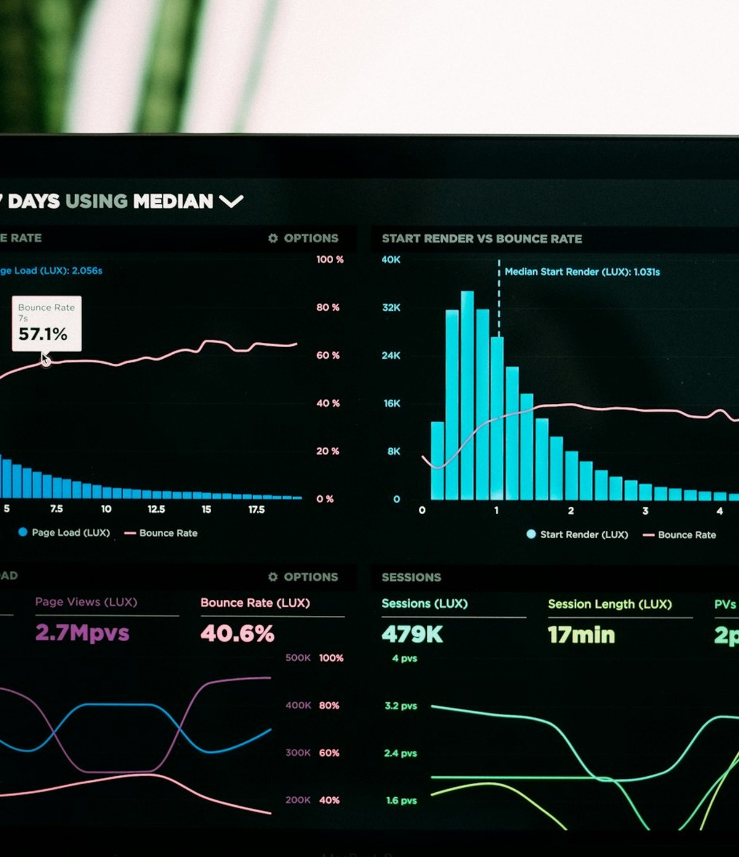
C A S E 5
Your startup's user growth has plateaued at 40K monthly users, and its been like this for six months
Hire a growth consultant? Run experiments? Rebuild the product?

Slide 8

C A S E 6
You've read fifty articles about losing weight. You haven't lost weight.
The information was never the problem.

Slide 9

C A S E 7
Forty years of the war on drugs and the drugs keep coming
The response keeps producing the problem the response is for.

Slide 10

C A S E 8
January 2020. A new virus has appeared in a city you've never heard of
Some governments will treat it like Case 2. Some like Case 3. Some like Case 4.

Slide 11
S T O P . N O T I C E .
What were you doing as you considered those examples? How were you trying to problem solve?
You were classifying. Without being asked. Without a framework. Without instruction.

Slide 12
P A R T O N E
The most costly mistake
Most expensive failures come from a specific misclassification: Treating a complex problem as if it had a known answer

Slide 13
T H E M I S T A K E
Treating a complex problem as if it had a known answer
Calling for an expert when no expert can help …
Demanding a plan when no plan can survive contact with the situation …

Slide 14
E X A M P L E 1
Wall Street, 2007.
Major banks built risk models on the assumption that mortgage defaults could be predicted with enough data and the right experts.
The models worked beautifully — until they didn't. The crash followed.
What kind of problem did the banks think they were solving? What was it actually?

Slide 15
T H E A N S W E R
A complex problem treated as a knowable one
The banks treated mortgage default risk as Complicated - a problem with a knowable answer, given enough data and the right expertise.
But it was Complex. Mortgage defaults were embedded in a system of housing markets, consumer behavior, credit chains, and regulator response. Cause and effect could only be understood in retrospect, and by then it was too late.
The experts weren't wrong. They were the wrong kind of response.

Slide 16
E X A M P L E 2
Baghdad, 2003.
Fifty years of US military doctrine assumed war meant identifying an enemy and defeating them.
The Iraq insurgency was dispersed, networked, and recomposing itself faster than any plan could track.
What kind of problem did the doctrine assume? What was it actually?

Slide 17
T H E A N S W E R
A complex insurgency treated as a known kind of war.
The doctrine assumed war was Complicated — find the enemy, apply force, achieve victory.
The insurgency was Complex. The "enemy" had no fixed location, no clear hierarchy, and recomposed itself in response to every American action. Every raid produced new recruits.
Three years and tens of thousands of lives to admit it was the wrong kind of doctrine.

Slide 18
B A G H D A D , 2 0 0 3 — C O N T E X T
A doctrine built for one kind of war, applied to another.
Major combat operations ended in three weeks. The insurgency lasted years.
WHAT THE DOCTRINE ASSUMED
WHAT THE WAR ACTUALLY WAS
A clear enemy with a hierarchy.
Front lines and held territory.
Defeat the leadership → win.
Body counts measure progress.
Dozens of factions, shifting alliances.
Every road, every market, every checkpoint.
Every action reshaped the system.
Successful raids often produced new recruits.
2003: Invasion. 2006: Doctrine rewritten (Field Manual 3-24, the first US counterinsurgency doctrine in decades). 2007: Surge implements it. Violence drops.

Slide 19
D I S C U S S I O N
If you had run AIG's risk department in 2007 —
what would you have to have noticed
to suspect you were running the wrong kind of analysis?

Slide 20
P A R T T W O
There are four kinds of problems.
Each kind has a different shape. Each requires a different kind of response.

Slide 21
K I N D 1 O F 4
Simple problems
Cause and effect are obvious.
HOW YOU RESPOND
Sense → Categorize → Respond
EXAMPLES
A leaky faucet. A loan payment. A jammed printer.
WHAT GOES WRONG
You stop paying attention. The problem changes and you don't notice.

Slide 22
K I N D 2 O F 4
Complicated problems
Cause and effect are knowable, but only with expertise.
HOW YOU RESPOND
Sense → Analyze → Respond
EXAMPLES
A car making a strange noise. Drilling for oil. A legal dispute.
WHAT GOES WRONG
The experts disagree. Or one expert insists on the wrong answer.

Slide 23
K I N D 3 O F 4
Complex problems
Cause and effect can only be understood in retrospect.
HOW YOU RESPOND
Probe → Sense → Respond
EXAMPLES
Raising a child. Running a startup. Treating a chronic illness.
WHAT GOES WRONG
Every solution generates new problems you didn't anticipate.

Slide 24
K I N D 4 O F 4
Chaotic problems
There is no relationship between cause and effect — yet.
HOW YOU RESPOND
Act → Sense → Respond
EXAMPLES
A fire. A bombing. A market collapse in real time.
WHAT GOES WRONG
You keep acting in chaos mode after stability has returned.

Slide 25
All four kinds, side by side.
Adapted from Snowden & Boone, Harvard Business Review, 2007.
THE PROBLEM
WHAT YOU DO
DANGER SIGN
WATCH FOR
SIMPLE
Repeating patterns. Clear cause and effect.
Best practice. Delegate. Automate.
Complacency. Oversimplification.
A simple problem upgrading to chaos when ignored too long.
COMPLICATED
Many possible answers. Expertise required.
Good practice. Bring in experts.
Analysis paralysis. Experts dismissing outsiders.
Disagreement that doesn't resolve through more data.
COMPLEX
No right answer exists. Understood only in retrospect.
Emergent practice. Probe. Experiment safely.
Falling back to command and control. Demanding plans.
Every solution producing new problems.
CHAOTIC
No discernible cause and effect. Turbulence.
Novel practice. Act first. Stabilize.
Acting in chaos mode after stability returned. Cult of the leader.
Decisive action — but only as long as it's needed.
This table is a tool, not an answer. It gives you a vocabulary for arguing about which kind you're in.

Slide 26
E X E R C I S E — I N C L A S S
Five minutes.
Pick a problem you are stuck on right now.
A real one. Work, family, health, money, a relationship, a decision.
Write — don't type.

Slide 27
F O U R Q U E S T I O N S
1.
Write one sentence describing the problem.
2.
Which of the four kinds have you been treating it as?
3.
Which kind might it actually be?
4.
What would change if you treated it as that kind?
Question 4 is the one that matters.

Slide 28
A F T E R Y O U W R I T E
What shifted?
You don't have to share what you wrote. Volunteers describe what changed when they answered question 4.

Slide 29
Why we get the kind wrong.
The same biases we already studied push us toward predictable misclassifications.
LESSON 2 · ANCHORING
Once we name a problem one way, it is hard to rename it.
LESSON 3 · AVAILABILITY
Recent vivid examples make new problems feel like familiar ones.
LESSON 4 · SUNK COST
The more we have invested in a response, the harder to admit it is the wrong kind.

Slide 30
Before next week.
A S S I G N M E N T
Take the problem you wrote about today and go deeper.
Write down — actually write — what you would have to see to know your classification is wrong.
R E A D I N G
Snowden & Boone, "A Leader's Framework for Decision Making" — Harvard Business Review, November 2007. ~12 pages.
Recommended: Rittel & Webber, "Dilemmas in a General Theory of Planning" (1973). The original wicked-problems paper.

Slide 31
You can't solve a problem
until you know what kind of problem it is.
Naming is half the work.

