Slide 1
THE END OF THE MAP
Contemporary Problem Solving — Lesson 1
Dr. Amir Konigsberg
Tel Aviv University

Slide 2
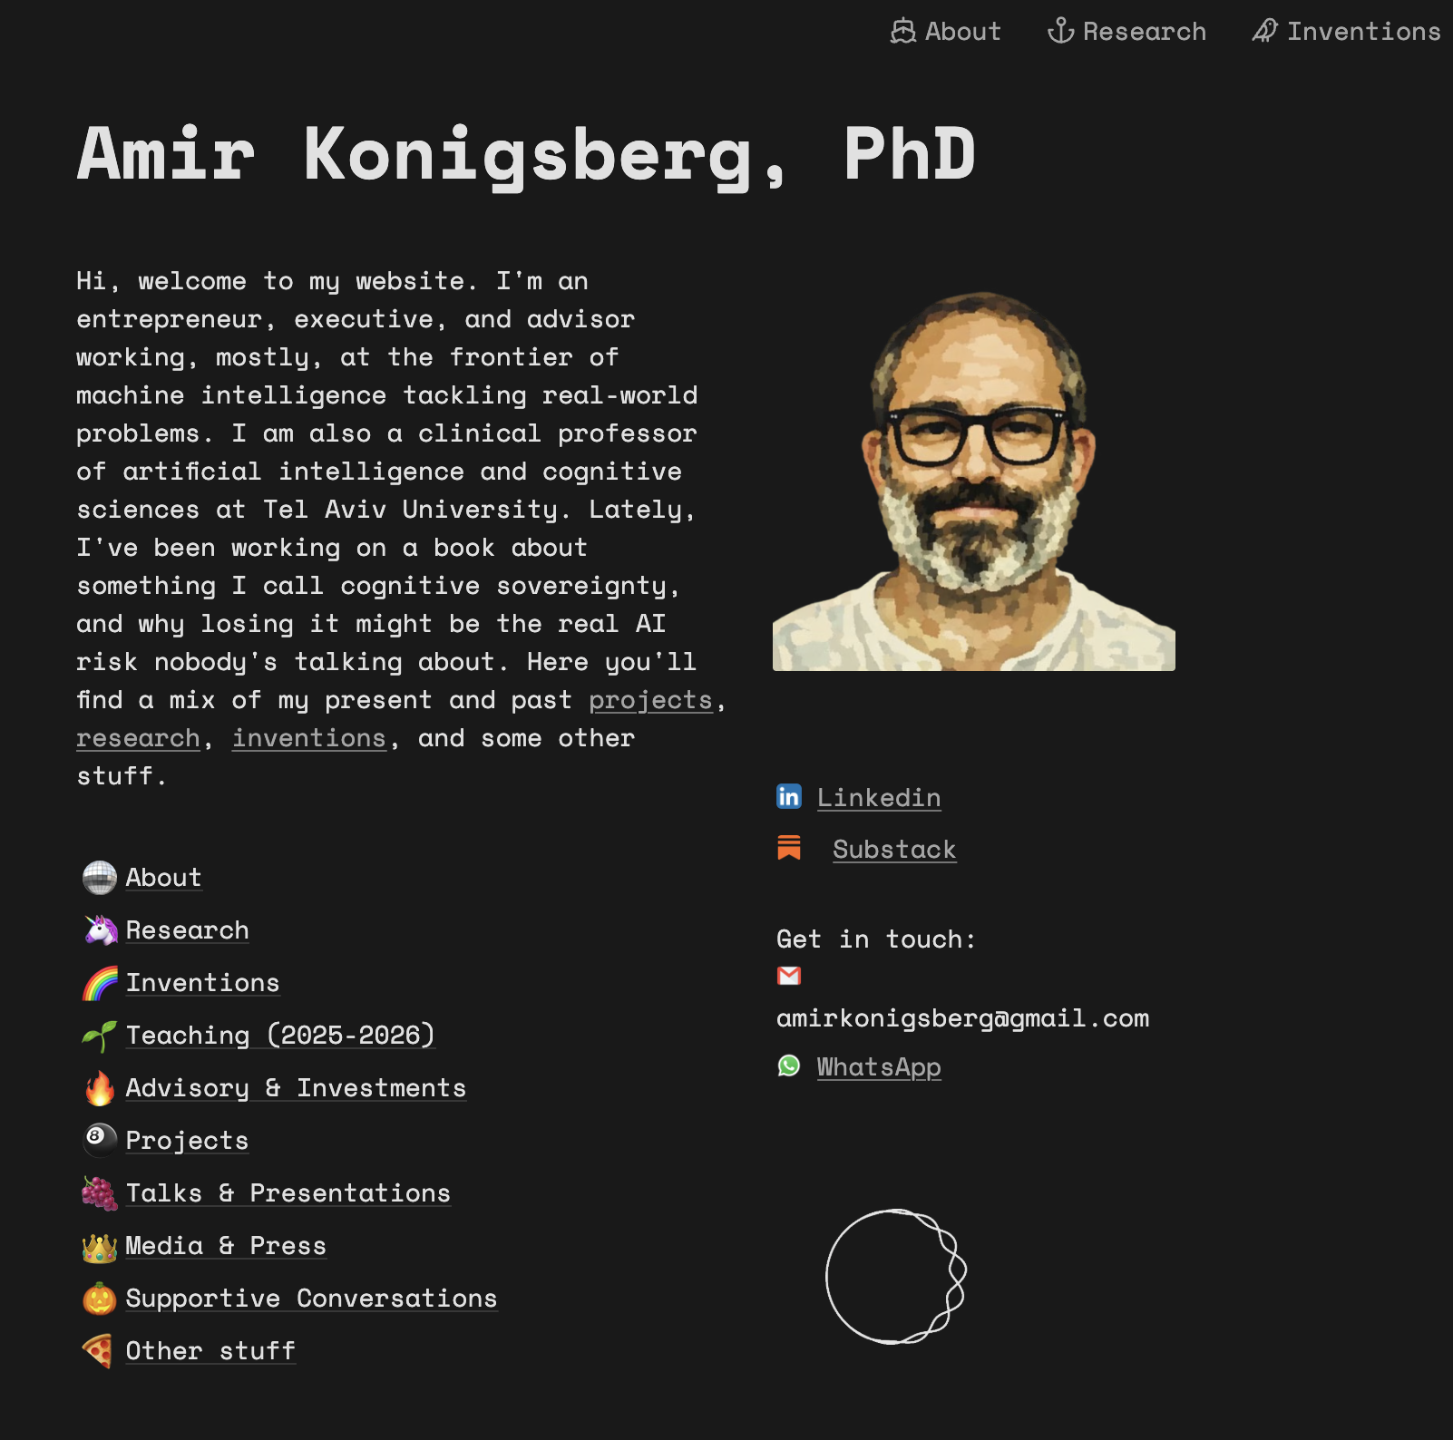
https://www.amirkonigsberg.com/

Slide 3

Why This Course Exists
The world has changed, but the way we are trained to think has not.
Traditional education prepares us for problems with clear rules, defined boundaries, and correct answers. These are called Tame Problems — and we are very good at them.
But the defining challenges of the 21st century — climate change, AI governance, geopolitical instability, systemic inequality — do not follow those rules. They shift as we engage them. They have no single correct answer. They resist the tools we were taught to use.
This course is designed to close that gap. It begins with a single, uncomfortable premise: your brain is lying to you, and you don’t know it yet.

Slide 4
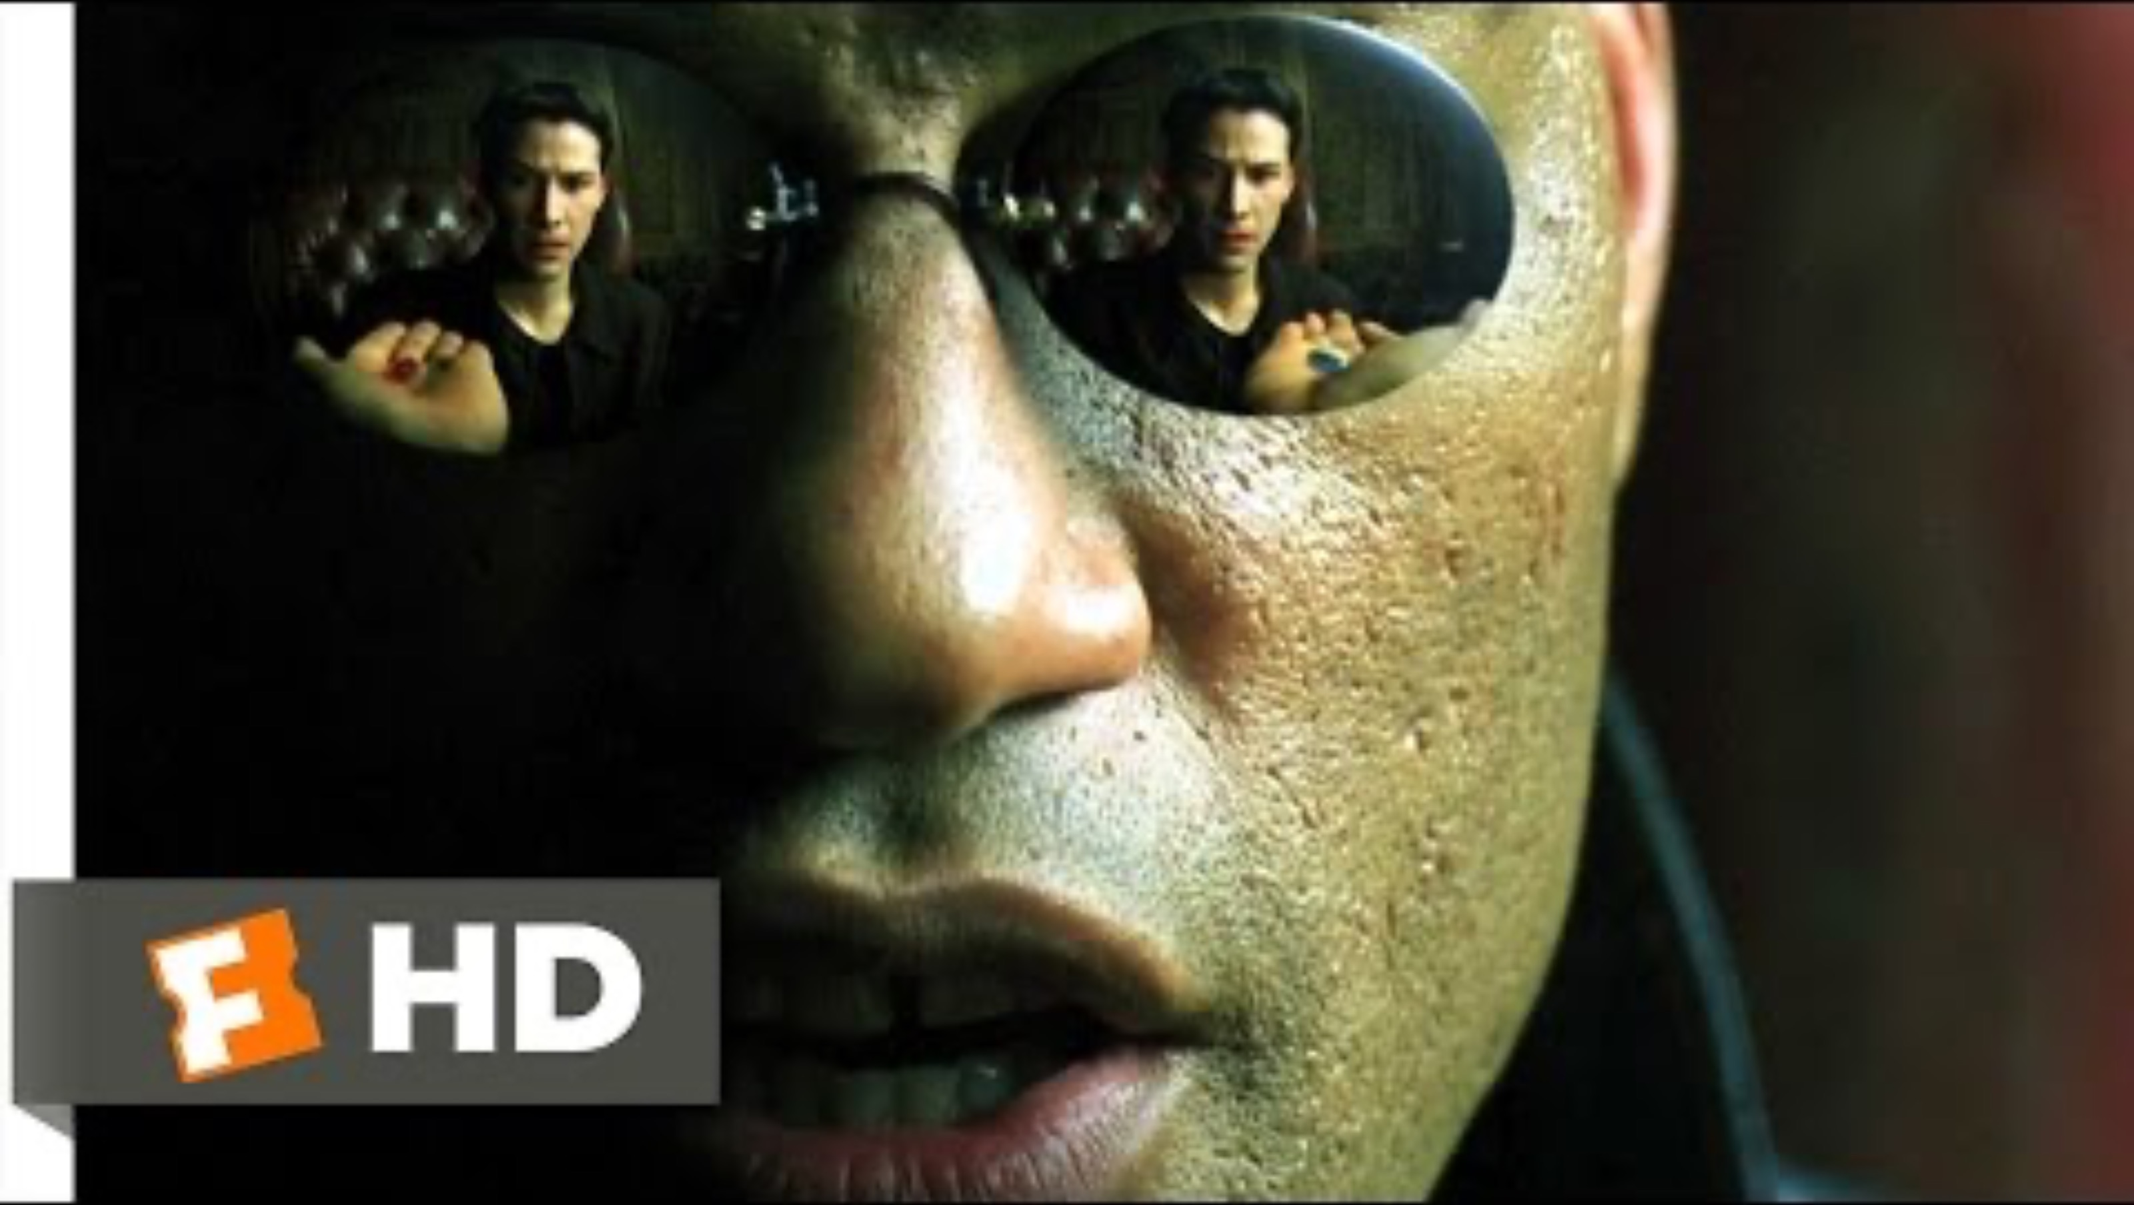
WATCH: THE RED PILL OR THE BLUE PILL
Before we begin — a scene that captures exactly what this course is about.
▶
Click to play — or open the link above
“This is your last chance. After this, there is no turning back.”

Slide 5

“You take the red pill — you stay in Wonderland,
and I show you how deep the rabbit hole goes.”
In The Matrix, Neo discovers that everything he believed about reality was a construct — a simulation so seamless he never thought to question it. This course makes the same argument about your cognition.
Your brain is running a simulation. The simulation is invisible. And like Neo, you won’t see it until someone shows you where to look.

Slide 6

What Happens in This Lesson
Today is not a lecture. It is an experiment — with you as the subject.
We will work through three classic exercises from cognitive psychology. Each one will reveal a different way your brain silently constrains your thinking:
1. The Nine Dots Puzzle — how your brain invents visual boundaries
2. Duncker’s Candle Problem — how labels lock objects into single roles
3. The Wason Selection Task — how you seek proof instead of truth
After these exercises, we will step back and ask: why does this matter now? The answer leads us to the distinction between Tame Problems and Wicked Problems — the organizing framework for the entire semester.

Slide 7

EXERCISE 1
The Nine Dots Puzzle — Self-Imposed Constraints

Slide 8
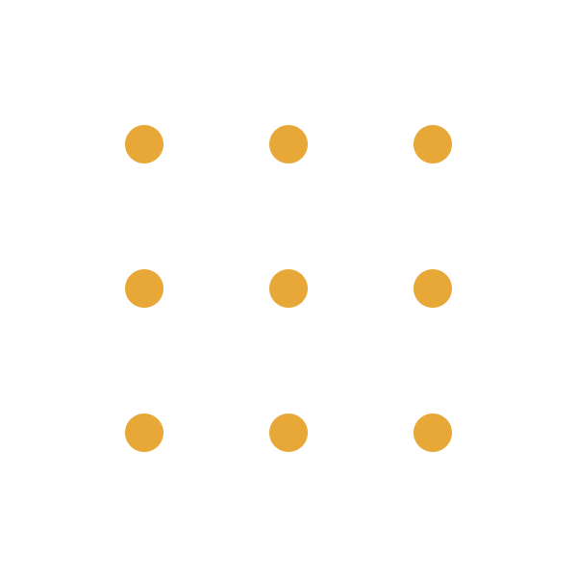
CONNECT ALL NINE DOTS
Rules:
• Use exactly four straight lines.
• Your pen must never leave the paper.
• You have two minutes.
2 MINUTES — GO

Slide 9
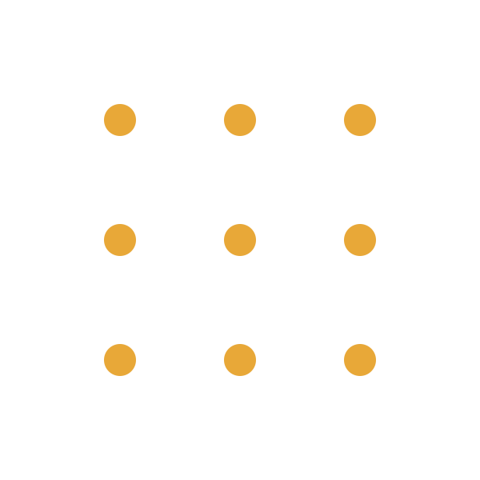
THE SOLUTION
The lines must extend beyond the implied grid. There was no boundary — your brain created one.
The lines leave the grid — because the “square” never existed.

Slide 10
THE SQUARE ISN’T REAL.
You saw nine dots. Your brain inferred a square. Nobody told you there was one. The constraint was invisible, self-generated, and felt completely real.
This is how your biological software works: it imposes structure on ambiguity — and then hides the fact that it did so.

Slide 11

The Science: Gestalt Perception
This puzzle has been used in psychology since the 1930s. It is the origin of the phrase “thinking outside the box.”
The reason it works is a principle from Gestalt psychology called the Law of Closure: the human visual system automatically connects edges and infers boundaries, even when none exist. Your brain saw the outermost dots and constructed a square — a frame that felt like a feature of the world, not a product of your perception.
Research by Maier (1930) and Scheerer (1963) showed that even subjects who are explicitly told the lines can extend beyond the dots still struggle. This is the critical insight: knowing about a cognitive constraint and overriding it are two different operations.
Awareness alone does not fix the problem. You have to train new habits of perception.

Slide 12

Why This Matters Beyond the Puzzle
The nine dots are a metaphor for every problem you will face in your career.
When an organization says “we’ve always done it this way,” they are drawing invisible lines around a grid that has no boundary. When a policy framework defines a problem in terms that exclude certain solutions, the same mechanism is at work.
The “square” is any mental boundary that is treated as given when it is actually constructed. It could be a job description, a budget category, a national border, a disciplinary silo, or an assumption about what is “possible.”
This course is about learning to see these squares — and then choosing, deliberately, whether to stay inside them.

Slide 13

EXERCISE 2
Duncker’s Candle Problem — Functional Fixedness

Slide 14
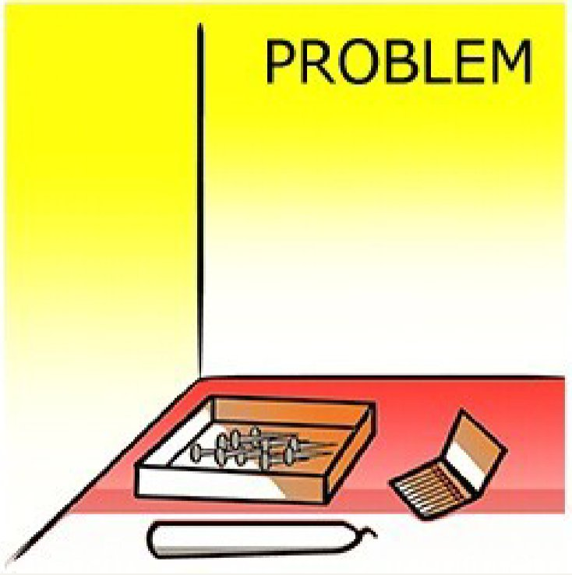
THE CANDLE PROBLEM
The Task
Attach a candle to a wooden wall so the wax does not drip onto the table.
The Materials
You have only three things:
• A candle
• A box of thumbtacks
• A book of matches
No tape. No glue. No other tools. Just these three items.
30 SECONDS — THINK

Slide 15

What Most People Try
Attempt 1: Tack the candle directly to the wall.
The tacks are too short to hold the candle securely. It falls.
Attempt 2: Melt the base of the candle and stick it to the wall with wax.
The wax is not strong enough. It slides off.
Both attempts fail for the same reason:
You are looking at the thumbtack box and seeing only one thing: a container. It is holding tacks, so your brain locks it into the role of “container.” It never occurs to most people that the box itself is a usable object with a completely different potential.

Slide 16
THE SOLUTION
WHAT YOU SAW
“A container for thumbtacks.”
When the tacks are inside the box, the box’s identity is locked to its current function. Your brain labels it “container” and moves on.
WHAT IT COULD BE
A shelf. A platform. A tool.
Empty the tacks. Tack the box to the wall. Place the candle on top. The box becomes a shelf — and the wax drips safely inside it.
Karl Duncker, “On Problem Solving,” 1945

Slide 17
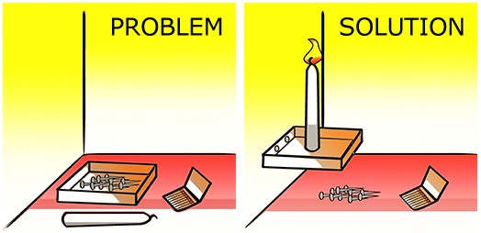
THE SOLUTION — VISUALIZED
Empty the box. Tack it to the wall as a shelf. Place the candle on top.

Slide 18
Functional Fixedness: The Invisible Label
Functional fixedness is the cognitive bias that limits a person to seeing an object only in terms of its conventional or currently presented use.
Karl Duncker identified this phenomenon in 1945. He showed that when the tacks are presented inside the box, solve rates are low. But when the tacks are presented outside the box — so the box is empty from the start — solve rates jump dramatically.
The materials are identical. The physical situation has not changed. What changed is the cognitive framing: an empty box has no locked identity. A full box is a “container” — and that label becomes a prison.
Glucksberg & Weisberg (1966) confirmed this. They also found that writing the word “BOX” on it partially breaks the fixedness, because labels force you to individuate the object from its contents.
The brain does not see the world as it is. It sees the world through the labels it assigns.

Slide 19
Functional Fixedness in the Real World
In the first exercise, your brain invented a visual boundary.
In this one, it invented a functional boundary.
Both are invisible. Both feel like reality. Both can only be broken by stepping outside the default representation.
Now scale this up:
• “That’s not my department” — this is functional fixedness applied to people. The person has classified the problem as outside the “box” of their role. They have locked their own function into a container — a job title, a responsibility boundary — and anything that doesn’t fit inside it is invisible to them. The problem isn’t laziness; it’s that the mental label of “my scope” prevents them from seeing themselves as a resource for anything outside it.
• Climate change categorized as an “environmental” problem — locking out economic, behavioral, and infrastructural solutions.
• A technology used only for its intended purpose, when its greatest value may lie in an application nobody imagined.

Slide 20

EXERCISE 3
The Wason Selection Task — Confirmation Bias

Slide 21
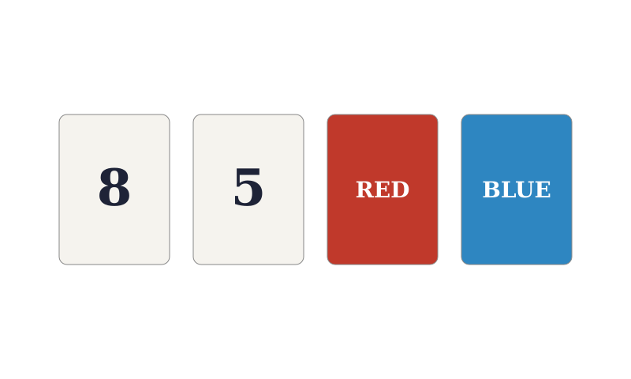
THE WASON SELECTION TASK
Here are four cards on a table. Each card has a number on one side and a color on the other.
You can see one face of each card below.
The Rule: “If a card shows an even number on one face, then its opposite face must be red.”
Your task: which card or cards must you turn over to determine whether the rule is true or false? You must turn over only the cards that are necessary — no more, no less.
60 SECONDS — WHICH CARDS?
Watch: youtube.com/watch?v=cyrSyBkFAvQ

Slide 22
The Most Common Answer
Most people say: “Turn over the 8 and the Red card.”
This feels right. The rule mentions even numbers and the color red, so those two cards seem like the natural ones to check.
But this answer is only half correct.
Turning the 8 is correct — it is an even number, so the rule makes a direct claim about what must be on its other side. If its back is not red, the rule is broken.
But turning the Red card tells you nothing useful. Why? The rule only says: “if even, then red.” It makes no claim about what must be on the other side of a red card. Even if the Red card has an odd number on its back, no rule has been broken. You turned it because it “felt” like it should confirm the rule. That instinct — the urge to confirm rather than to test — is the problem.

Slide 23
THE CORRECT ANSWER: 8 AND BLUE
TURN THE 8
8 is even. The rule says its other side must be red. If it’s not red, the rule is false. This is a direct test.
TURN THE BLUE
If the other side of the Blue card is an even number, then you have an even number with a non-red back. Rule broken. This is the card most people miss.
WHY NOT THE RED CARD?
Think about it this way: the rule says “if even → red.” It does not say “if red → even.” A red card with an odd number on the back does not violate anything. The rule simply doesn’t care what’s behind a red card. Turning it is psychologically satisfying but logically empty.
WHY NOT THE 5?
5 is odd. The rule makes no claim about odd numbers. Whatever is on the back of the 5 card is irrelevant.

Slide 24
Confirmation Bias: Seeking Proof, Not Truth
The Wason Selection Task was created by British psychologist Peter Wason in 1966. It is one of the most replicated findings in cognitive science. Across decades of research, only about 10% of people consistently choose the correct cards.
The phenomenon at work is confirmation bias: the systematic tendency to seek evidence that confirms a hypothesis rather than evidence that could disprove it.
The rule is a conditional: “If P, then Q.” To test a conditional, you need to look for cases where Q is absent — because only those cases can break the rule. But the human brain does the opposite. It reaches for the evidence that makes the rule “feel true.”
This connects to Karl Popper’s philosophy of science: a theory is meaningful only if it can be falsified. Wason showed that falsification is not just a philosophical principle — it is a psychological challenge. Our cognition is wired for verification, not for testing.
In contemporary problem solving, being “certain” is the fastest way to be wrong.

Slide 25
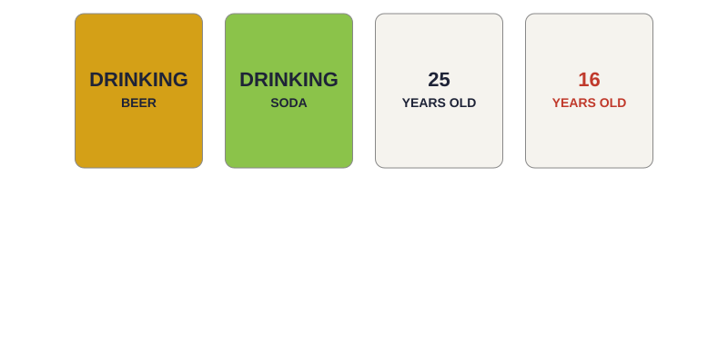
An Evolutionary Twist: The Bar Test
Here is the fascinating part: we are not always bad at this kind of reasoning. When the exact same logic is embedded in a social situation, most people get it right.
Imagine you are a bouncer at a bar. Your job is to enforce this rule:
“If someone is drinking alcohol, they must be over 18.”
You see four people. You can only see one piece of information about each:
Logically, this is the identical structure: “If P, then Q.” But now almost everyone gets it right: check the beer drinker and the 16-year-old. Cosmides & Tooby (1992) showed our brains evolved “cheater detection” modules for social rules — but these modules fail on abstract logic.

Slide 26
THE PATTERN
Three exercises. Three different cognitive systems. One consistent finding.
01
VISUAL CONSTRAINT
The Nine Dots. Your brain invented a boundary that did not exist. You were trapped by a shape your perception constructed.
02
FUNCTIONAL CONSTRAINT
The Candle Problem. Your brain locked an object into a single role. You could not see the box as anything other than a container.
03
LOGICAL CONSTRAINT
The Wason Task. Your brain sought to confirm rather than to falsify. You pursued the feeling of being right instead of the discipline of testing whether you were wrong.
Our minds build invisible walls. In this course we learn to become more aware of them, and hopefully, practice making them irrelevant.

Slide 27

THE WORLD SHIFTED
From Tame Problems to Wicked Problems

Slide 28

THE SHIFT
A global pandemic proved that no country,
no system, and no plan survives contact
with a truly complex, interconnected crisis.
COVID-19 exposed the fragility of every institution we trusted to “handle it.”

Slide 29

THE SHIFT
Artificial intelligence went from science fiction
to daily reality in under two years —
rewriting what it means to work, create, and think.
ChatGPT launched in November 2022. By 2024, AI had reshaped every industry on earth.

Slide 30

THE SHIFT
The global order that held for 75 years
is fracturing. Power is shifting, alliances
are realigning, and the rules are being rewritten.
The rise of China, the war in Ukraine, BRICS expansion — the post-WWII consensus is over.

Slide 31

THE SHIFT
The Middle East is being reshaped in real time.
October 7th, the war in Gaza, the fall of Assad —
each event redefines every actor’s position.
There is no “solution” to a system where every intervention creates new dynamics.

Slide 32
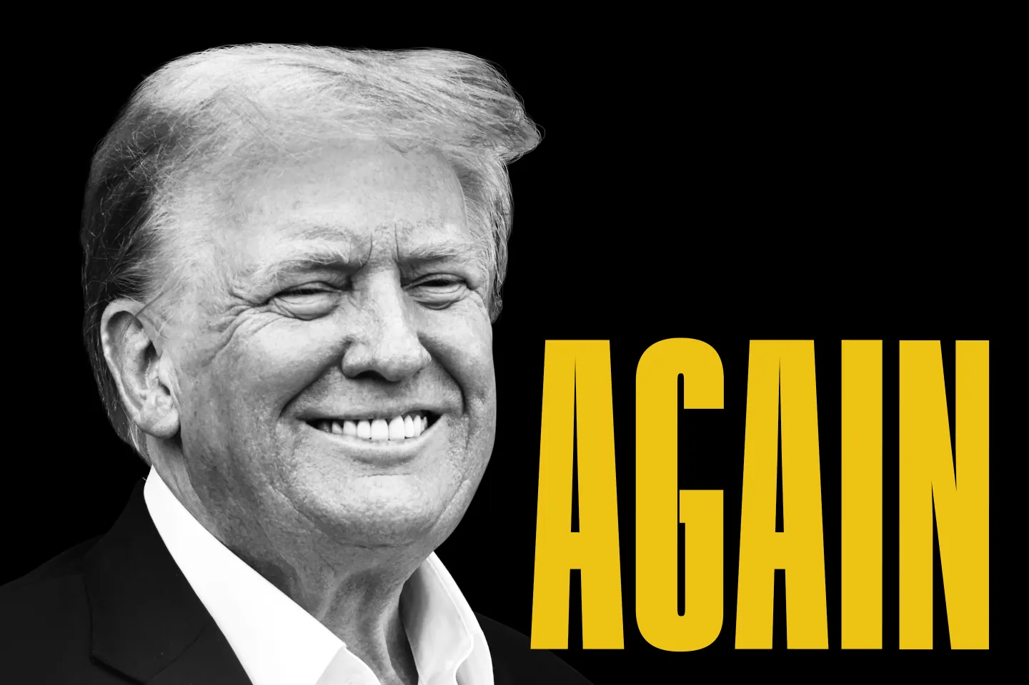
THE SHIFT
A political outsider was elected, lost, and
elected again — proving that public trust
in traditional institutions has fundamentally broken.
Whether you support him or oppose him, Trump’s trajectory is a symptom of a system under stress.

Slide 33

Tame Problems: The World We Were Trained For
A Tame Problem is one that behaves. It has a clear, agreed-upon definition. It has a stopping rule — you know when you have solved it. Its solutions can be evaluated as right or wrong. And you can test solutions through trial and error without permanently changing the problem.
The entire 20th-century educational system was built to produce people who excel at tame problems. You learn the rules, practice applying them, and get evaluated on whether you reach the correct answer.
This training is not useless. Tame problems are real, and they matter. But they are not the problems that define our era.
Tame problems need Experts — people who know the answer.

Slide 34
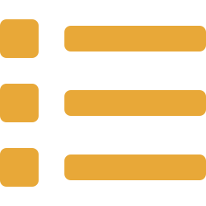
Examples of Tame Problems
All of these have clear definitions, known stopping rules, and right/wrong answers:
• Solving a quadratic equation
• Designing a bridge to hold a specific load
• Debugging a syntax error in code
• Calculating a tax return
• Playing a chess endgame with a known forced mate
• Diagnosing a broken bone from an X-ray
• Balancing a chemical equation
• Routing a delivery truck for minimum distance
Notice the pattern: the problem can be fully defined before you begin, and you know when you’re done. These are the problems school trained you for.

Slide 35
Wicked Problems: The World We Actually Live In
In 1973, design theorist Horst Rittel and planner Melvin Webber published a landmark paper arguing that the problems of public policy and social planning are fundamentally different from the problems of science and engineering. They called them “wicked” — not morally, but structurally.
A Wicked Problem has no definitive formulation — how you define it determines what solutions you can see. It has no stopping rule — you never “solve” poverty. Solutions are not right or wrong, but better or worse. Every intervention changes the problem itself. And there is no opportunity for trial and error — every attempt counts, because each one reshapes the landscape.
Wicked problems need Architects — people who can navigate uncertainty and design adaptive responses.

Slide 36
Examples of Wicked Problems
None of these can be fully defined, none have stopping rules, and every attempt to solve them changes the problem:
• Climate change — every policy intervention reshapes economic and political incentives
• AI governance — regulating a technology that is itself changing the meaning of regulation
• Urban housing crises — building more housing raises land values and attracts migration
• Pandemic response — lockdowns reduce infection but create economic and psychological damage
• The Israeli-Palestinian conflict — every proposed framework redefines the stakeholder landscape
• Global poverty — aid programs alter local economies, power structures, and dependencies
• Social media’s effect on democracy — the platform is the problem, the medium, and the battleground
These are not puzzles to be solved. They are systems to be navigated.

Slide 37
TAME vs. WICKED — SIDE BY SIDE
TAME
WICKED
Clear, agreed-upon definition
Known stopping rule
Right / wrong answers
Can test through trial and error
Repeatable solutions
Needs Experts
Definition shifts with perspective
No stopping rule
Better / worse trade-offs
Every attempt changes the problem
Unique — no precedent applies cleanly
Needs Architects
Rittel & Webber, “Dilemmas in a General Theory of Planning,” 1973

Slide 38
Why This Changes Everything
The three demonstrations you experienced are not party tricks. They expose the exact cognitive weaknesses that wicked problems exploit.
• Self-imposed constraints (nine dots) prevent us from seeing alternative framings of a problem.
• Functional fixedness (candle) prevents us from repurposing existing resources and institutions.
• Confirmation bias (Wason) prevents us from testing whether our approach is actually working.
In a tame world, these biases are manageable — the problem structure is forgiving enough that brute-force expertise can compensate. In a wicked world, they are catastrophic. The problem is shifting while you solve it, and if your brain is silently constraining your view of the problem space, you are navigating with a broken compass.
This course exists to fix the compass.

Slide 39

THE SYSTEM UPGRADE
A Three-Phase Semester

Slide 40
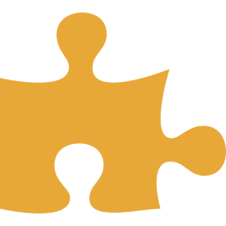
Phase 1: The Internal Audit (Weeks 1–4)
Goal: Identify the bugs in your biological software.
The exercises today are the opening salvo of a four-week deep dive into metacognition — thinking about how you think.
We will study the major cognitive biases systematically: anchoring (your first piece of information dominates your judgment), availability (you overweight what comes to mind easily), representativeness (you confuse resemblance with probability), and sunk cost (you keep investing in failing strategies because you already committed).
We will also learn the Ladder of Inference — a model for understanding how the human mind leaps from raw data to conclusions in milliseconds, skipping every step of reasoning in between.
By the end of Phase 1, you will not think differently yet — but you will know, precisely, how your thinking goes wrong.

Slide 41
Phase 2: Systems Literacy (Weeks 5–8)
Goal: Move from “A causes B” to feedback loops and system dynamics.
Once you understand how your own cognition distorts perception, we zoom out to the external world. Most problems are not caused by single factors — they emerge from webs of interconnected relationships.
Core tools include: Causal Loop Diagrams (mapping how variables reinforce or balance each other), the Cynefin Framework (distinguishing simple, complicated, complex, and chaotic problem domains), Donella Meadows’ Leverage Points (a hierarchy of where to intervene in a system, from adjusting parameters to changing paradigms), and the concept of unintended consequences.
By the end of Phase 2, you will see the world as interconnected systems, not isolated events.

Slide 42

Phase 3: The Toolkit (Weeks 9–12)
Goal: Build adaptive solutions using Design Thinking and AI-augmented reasoning.
You now know how your brain distorts perception (Phase 1) and how the world is structured as interconnected systems (Phase 2). Phase 3 gives you applied methodology.
Design Thinking: Empathy mapping, ideation, rapid prototyping, and iterative testing. This is not about finding “the answer” — it is about generating many possible responses and stress-testing them quickly.
AI as Cognitive Co-Pilot: We will use large language models not to automate thinking, but to augment it. LLMs can challenge your assumptions, generate alternative framings, identify blind spots, and synthesize information across domains. Prompt engineering is taught as a synthesis skill — a way of thinking with a machine, not delegating to one.

Slide 43

Phase 4: The Crucible (Weeks 13–15)
Goal: Apply everything to a real wicked problem.
In the final three weeks, you form teams and tackle a real wicked problem drawn from current headlines. You apply the full stack: cognitive debiasing, systems mapping, design thinking, and AI augmentation.
The deliverable is not a “solution.” Wicked problems do not have solutions. Your deliverable is a navigational strategy — a presentation that makes the wicked dynamics visible and proposes an adaptive response.
You will be evaluated not on whether your answer is “right” (it cannot be), but on whether you demonstrate the ability to see the invisible constraints, map the system, and design a response that accounts for complexity, trade-offs, and unintended consequences.
This is the exam: can you be the architect, not just the expert?

Slide 44

What you need to understand
I am not here to give you answers.
I am here to give you scaffolding.
By the end of this semester, you’ll, hopefully, know how to navigate chaos a bit better

Slide 45
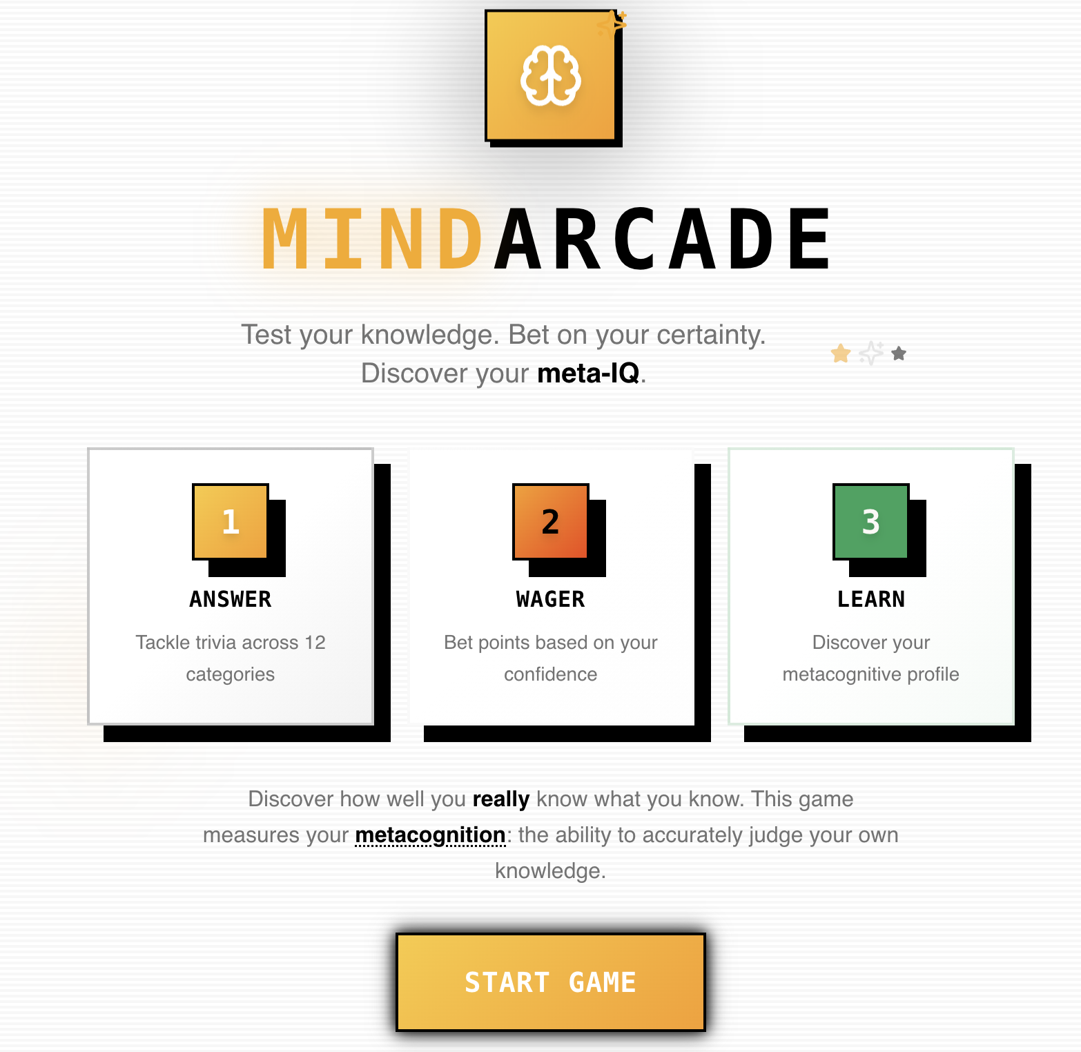
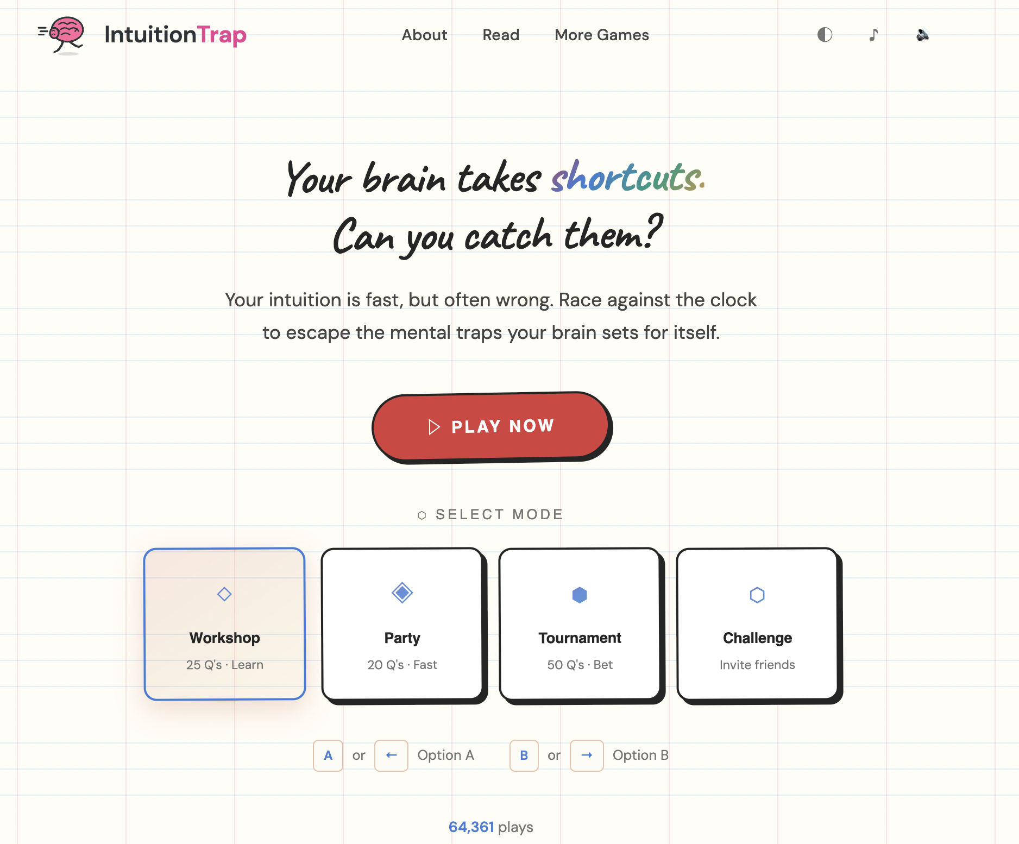
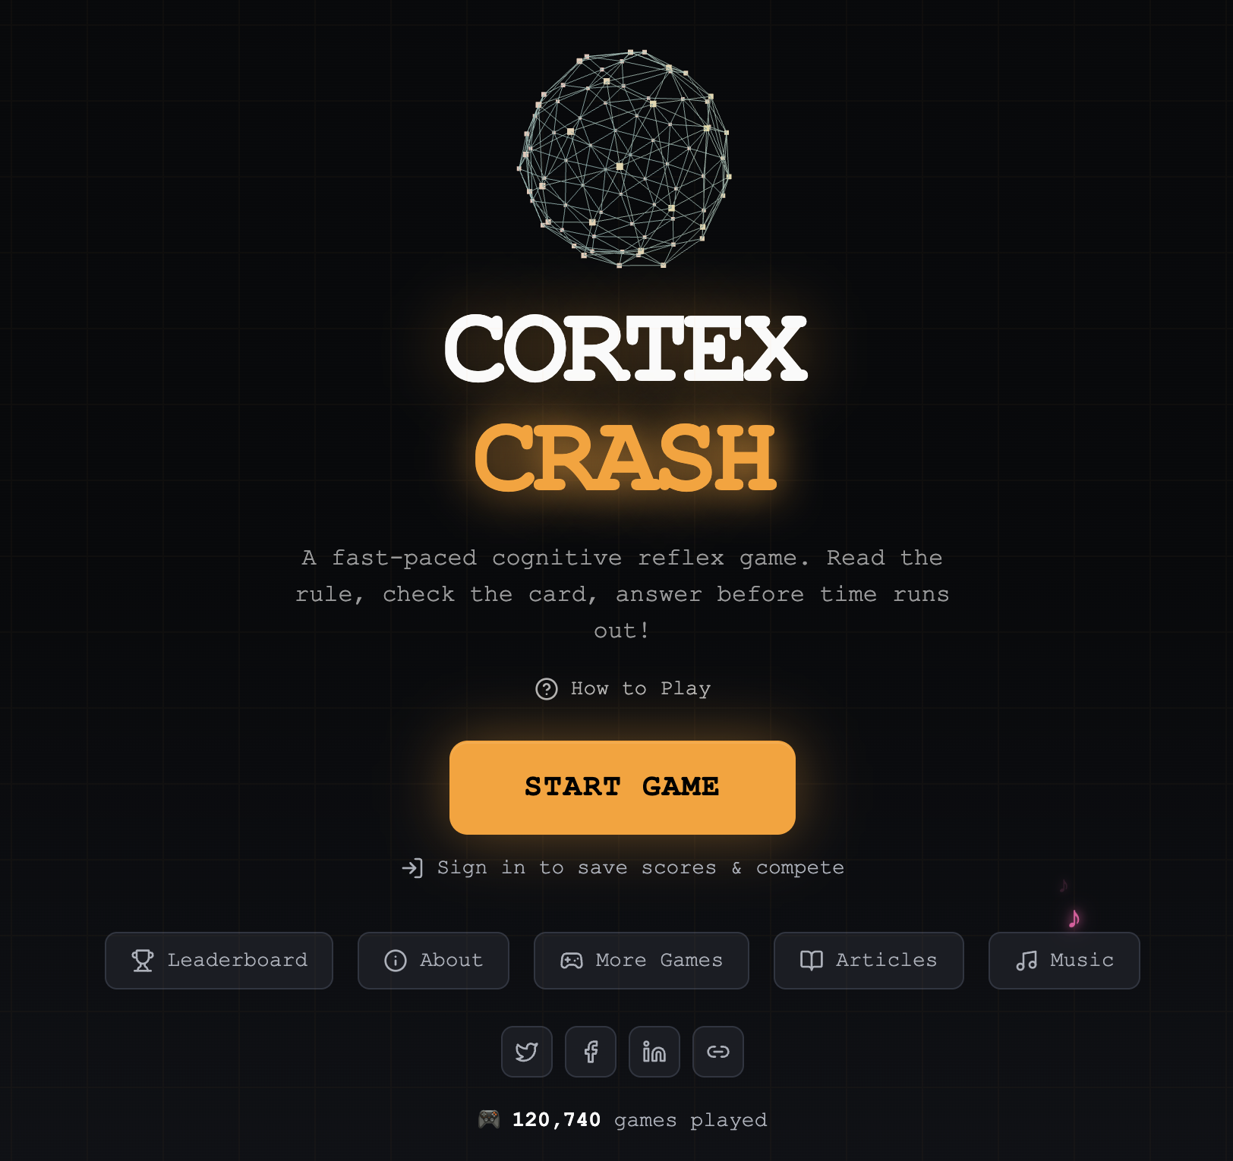
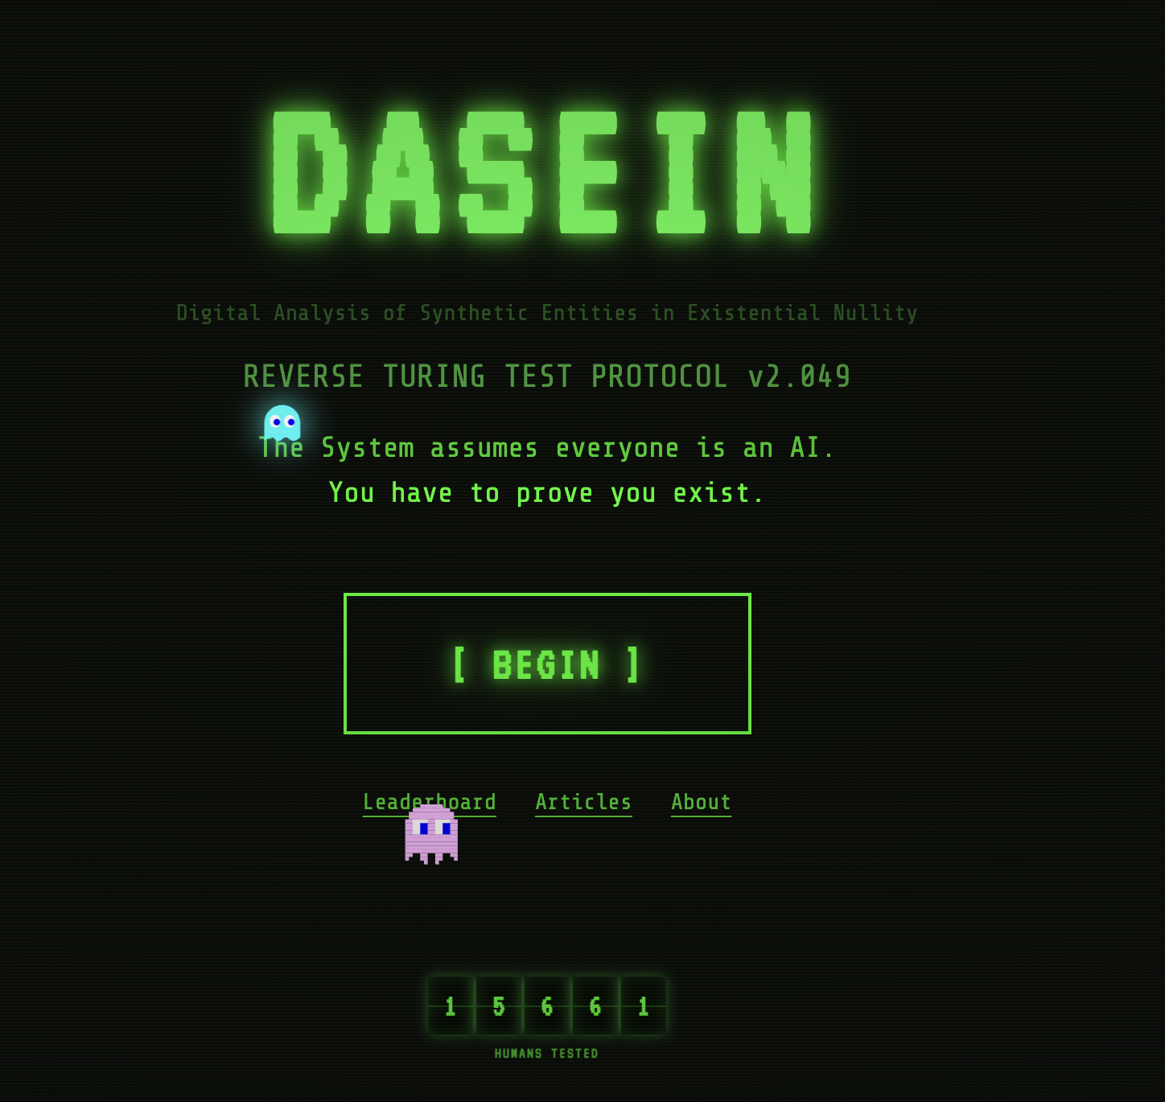
https://www.amirkonigsberg.com/mind-games

Slide 46
The square isn’t real.
Class dismissed.

