Slide 1
WHAT YOU CAN RECALL
IS NOT WHAT IS REAL
Availability Bias and the Representativeness Heuristic
Contemporary Problem Solving — Lesson 3
Dr. Amir Konigsberg • Tel Aviv University

Slide 2

Where We Are in the Catalog
We are building a catalog of the ways your brain betrays you:
Lesson 1: The shape of thinking — your brain invents invisible constraints (the square, the box, the confirmation instinct).
Lesson 2: The starting point — the first number you encounter silently distorts every judgment that follows (anchoring).
Lesson 3 (today): The filter — your brain selects evidence based on what it can recall, not on what is real (availability).
Today we ask: how does your brain decide what is dangerous, what is common, and what is probable?

Slide 3

A QUICK QUIZ
Let’s test how well you know what’s actually dangerous.

Slide 4
QUESTION 1
Which is more likely to kill you?
A) Shark attacks
B) Falling coconuts
ANSWER: Coconuts (~150/yr vs ~10 shark deaths)
Type A or B in the chat

Slide 5
QUESTION 2
Which is more likely to kill you?
A) Terrorism
B) Bathtub drownings
ANSWER: Bathtub drownings (~350/yr vs ~50–100 terrorism deaths)
Type A or B in the chat

Slide 6
QUESTION 3
Which is more likely to kill you?
A) Plane crashes
B) Road accidents
ANSWER: Road accidents (1.35 million/yr vs ~300 plane crash deaths)
Type A or B in the chat

Slide 7
QUESTION 4
Which is more likely to kill you?
A) Gun homicides
B) Heart disease
ANSWER: Heart disease (700,000/yr — 35x more than gun homicides)
Type A or B in the chat

Slide 8
QUESTION 5
Which is more likely to kill you?
A) The flight itself
B) The drive to the airport
ANSWER: The drive to the airport. Flying is ~100x safer per mile.
Type A or B in the chat

Slide 9
QUESTION 6
Which is more likely to kill you?
A) A stranger kidnapping your child
B) Your child drowning in a swimming pool
ANSWER: Drowning in a pool. A child is ~100x more likely to drown in a backyard pool than to be kidnapped by a stranger.
Type A or B in the chat

Slide 10
QUESTION 7
Which is more likely to kill you?
A) A vending machine
B) A wolf
ANSWER: A vending machine. Vending machines kill ~2–4 Americans/yr (falling on people). Wolf attacks: ~0 in the US per year.
Type A or B in the chat

Slide 11
QUESTION 8
Which is more likely to kill you?
A) An asteroid impact in your lifetime
B) A fireworks accident in your lifetime
ANSWER: Roughly equal odds (~1 in 75,000). But nobody lies awake worrying about fireworks.
Type A or B in the chat

Slide 12
QUESTION 9
Which is more likely to kill you?
A) Being killed by your own furniture
B) Being killed in a mass shooting
ANSWER: Furniture (crushing/falling) kills ~30–50 Americans/yr. Mass shootings: similar range. But one dominates your fear and the other doesn’t.
Type A or B in the chat

Slide 13
So how does your brain decide what is dangerous?
By recalling examples.
And what your brain can recall is shaped
not by reality, but by vividness, recency,
and media coverage.
Your risk perception is calibrated by television,
not by statistics.

Slide 14
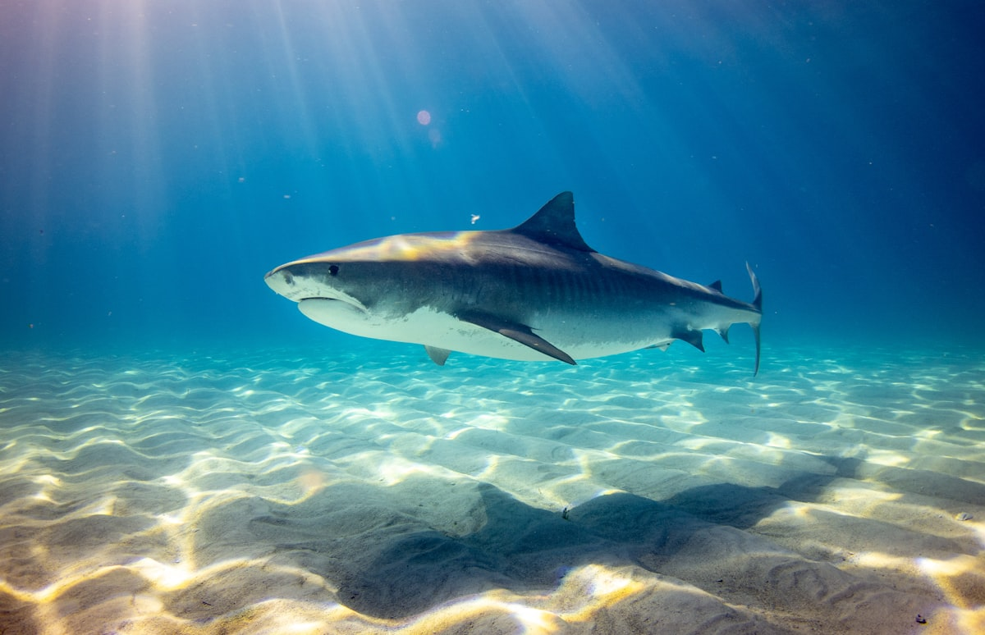
SHARK
You just pictured one.
~5
people killed by sharks per year, worldwide.
Mosquitoes kill 700,000.

Slide 15

PLANE CRASH
You can picture the wreckage right now.
~300
people die in plane crashes per year.
3,700 die in car crashes. Every single day.

Slide 16
NUCLEAR
You thought of a mushroom cloud. Not a cooling tower.
Safest
energy source per terawatt-hour. Safer than solar. Safer than wind.
But Chernobyl gave us an image. And the image won.

Slide 17
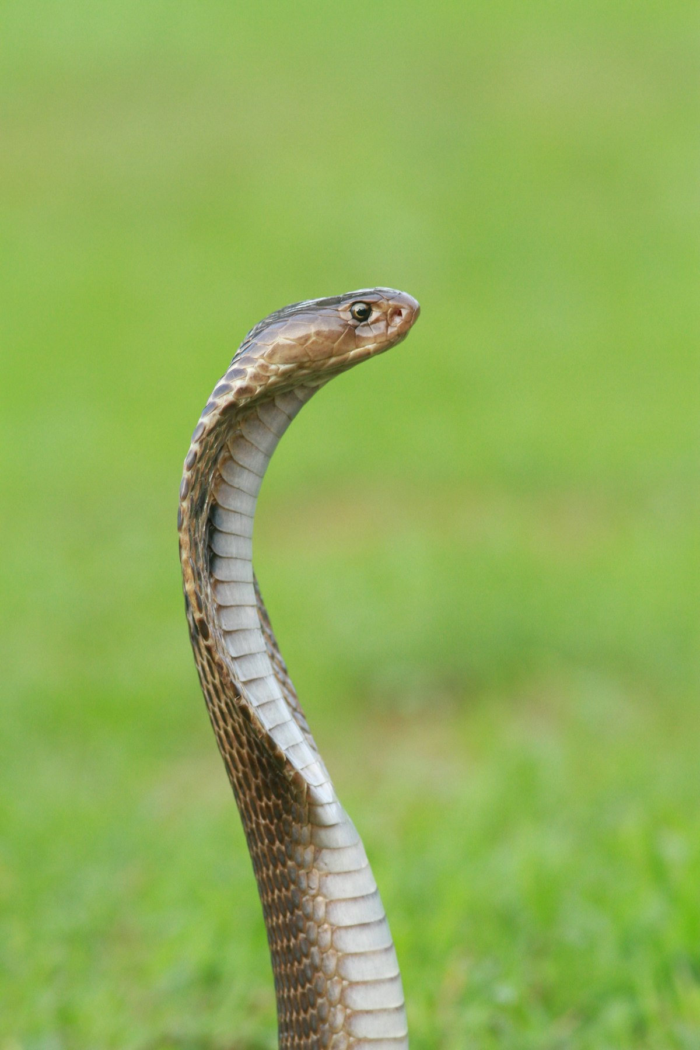
SNAKE
Your pulse just changed. Even from a word on a screen.
~0
snake deaths per year in Israel, Europe, or the US.
But the fear is hardwired. 100 million years of evolution built this reflex.

Slide 18
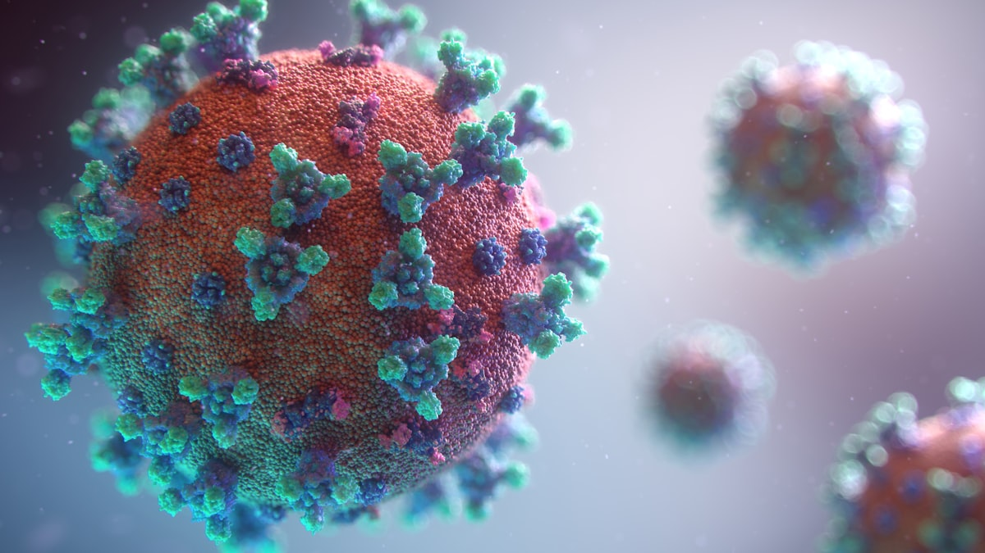
PANDEMIC
You remember the fear. You don’t remember the base rates.
1 in 100,000
risk of blood clots from AstraZeneca vaccine.
The disease itself was 1,000x more dangerous. But the side-effect stories were more vivid.

Slide 19
BREAKING
NEWS
This is the machine.
It selects what you see. It determines what you can recall.
It calibrates your fear. It decides what feels dangerous
and what feels safe.
And it is optimized for attention, not for accuracy.

Slide 20

THE NEWS IS NOT A MAP OF REALITY.
IT IS A HIGHLIGHT REEL OF EXCEPTIONS.
You overestimated every dramatic, media-covered risk and underestimated every quiet, mundane one. Your risk perception is calibrated by vividness, not by data.

Slide 21
THE SCIENCE
Why Your Brain Confuses “Easy to Recall” with “Common”

Slide 22

The Availability Heuristic
Defined by Tversky and Kahneman (1973): people assess the frequency of a class or the probability of an event by the ease with which instances come to mind.
This heuristic is not irrational by design. In most natural environments, things that are easy to recall actually are more common. If you can easily think of ten friends who own a Toyota, Toyotas probably are common in your area.
The problem arises when something other than actual frequency makes an event easy to recall. There are four amplifiers that hijack the system:
1. Vividness
2. Recency
3. Emotional intensity
4. Media coverage
Let’s look at each one.

Slide 23

Amplifier 1: Vividness
A plane crash is more vivid than a car accident. But why?
Vividness is a function of sensory detail, concreteness, and imagery. A plane crash produces fire, wreckage, debris fields, rescue crews, grieving families on camera. It occupies your visual imagination completely. You can picture it.
A car accident on a highway is mundane. You’ve driven past one. There’s a dented bumper, some glass, maybe an ambulance. It doesn’t burn into your memory. It doesn’t make the news. It doesn’t become a story.
Yet car accidents kill roughly 1.35 million people per year worldwide. Plane crashes kill about 300.
The vivid event is 4,500 times less deadly — but it occupies 4,500 times more mental real estate.
Vividness hijacks availability because your brain retrieves memories by how detailed and image-rich they are, not by how frequent they are. A single detailed memory of a plane crash outweighs a thousand blurry impressions of passing a fender-bender.

Slide 24
Amplifier 2: Recency
If there was an earthquake last month, how likely does the next one feel?
After the 2011 earthquake in Japan, earthquake insurance purchases spiked around the world — including in regions with no seismic risk. After every major hurricane, flood insurance sales surge in the affected area and then gradually decline back to baseline over 2–3 years.
The statistical probability hasn’t changed. What changed is how easily the event comes to mind.
Recency hijacks availability because your brain treats “I can recall this quickly” as evidence for “this happens often.” A recent event is stored in short-term memory, is rich in emotional context, and comes to mind with zero effort. An event from five years ago requires effortful retrieval — so it feels less probable.
Your brain confuses “easy to remember” with “likely to happen.”
This is why risk perception is highest immediately after a disaster and decays over time — even though the actual risk hasn’t moved.

Slide 25

Amplifier 3: Emotional Intensity
Events that made you feel something are easier to recall. And that changes everything.
Fear, outrage, grief, shock — these emotions act as a highlighter on memory. Psychologists call this “flashbulb memory”: emotionally charged events are stored with more detail, more context, and more vividness than neutral events.
You can probably tell someone exactly where you were on October 7th. You cannot tell them where you were on October 6th. The emotional charge of the event burned it into your memory with a specificity that ordinary days do not receive.
The consequence for risk perception: events that generated strong emotions feel more probable, because they are more available. A terrorist attack that killed 10 people generates more fear than heart disease that kills 700,000 — because terror is emotionally concentrated and heart disease is emotionally diffuse.
Your brain does not count events. It weighs them by how much they made you feel.
This is why dread risks (catastrophic, concentrated, uncontrollable) dominate our fears, while statistical risks (distributed, chronic, familiar) remain invisible.

Slide 26
Amplifier 4: Media Coverage
The most powerful amplifier of all — because it controls the other three.
Media does not just report vivid events — it makes events vivid. It replays the footage. It adds music. It interviews the survivors. It runs the story for days. By the time the cycle is over, an event that affected a handful of people has been experienced emotionally by millions.
Media does not just cover recent events — it keeps them recent. A plane crash from last Tuesday is replayed on the anniversary, in documentaries, in safety segments. The recency never fully decays.
Media does not just reflect emotional intensity — it amplifies it. The selection algorithm (what gets covered, what leads the broadcast, what trends on social media) is optimized for emotional arousal, not for statistical significance.
The result: media acts as a systematic availability distortion engine.
It takes rare, vivid, emotional events and makes them the most available information in your cognitive environment. Your brain, which judges probability by availability, concludes that these events are common. They are not. They are just loud.

Slide 27
WYSIATI
What You See Is All There Is
Your brain constructs the most coherent story it can from the information available — and it does not account for what it doesn’t know.
If plane crashes are all you see in the news, your brain builds a model of the world in which plane crashes are common. The millions of uneventful flights are invisible — they never enter the calculation.
Daniel Kahneman, Thinking, Fast and Slow

Slide 28
CASE STUDY
The 1,600 Who Died Because of a Cognitive Bias

Slide 29
September 11, 2001
On September 11, 2001, approximately 3,000 people died in terrorist attacks. In the weeks that followed, the images of planes hitting buildings were replayed thousands of times.
Americans became deeply afraid to fly. So they drove instead.
Gerd Gigerenzer, a German risk researcher, analyzed US traffic fatality data for the twelve months after 9/11. He found a significant spike: approximately 1,600 additional Americans died in car accidents compared to the baseline — deaths attributable to the shift from flying to driving.
1,600 people. More than half the number killed in the attacks themselves.
The cognitive bias that was supposed to protect them — the instinct to avoid the vivid risk — killed them by driving them toward a risk that was statistically far more dangerous.

Slide 30
THE CHAIN
01
THE ATTACK
3,000 people died. Images were horrific and unprecedented.
02
MEDIA SATURATION
Footage replayed on loop for weeks. Cable news ran it 24/7.
03
AVAILABILITY SPIKE
Flying became linked to the most vivid imagery in memory. Perceived risk skyrocketed.
04
BEHAVIORAL SHIFT
Millions chose to drive instead of fly. A “rational” response to perceived risk.
05
1,600 EXCESS DEATHS
Driving is far more dangerous per mile. The shift killed 1,600 additional people.
“What feels safe” is not the same as “what is safe.” Their feelings were calibrated by television, not by statistics.

Slide 31

Dread Risk: Why We Fear the Wrong Things
Gerd Gigerenzer coined the term “dread risk” to describe the human tendency to fear catastrophic events — many people dying at once in a dramatic way — far more than distributed events — the same number dying one by one, invisibly, over time.
• A plane crash kills 200 people at once → front page news for a week.
• Car crashes kill 100 people every day → barely mentioned.
The total deaths are similar. But the dread is completely different. Our brains evolved to respond to sudden, concentrated threats (a predator, an explosion, a stampede). They did not evolve to respond to slow, distributed threats (heart disease, air pollution, car accidents).
The result: we systematically overprotect against dramatic risks and systematically ignore mundane ones. This is not a quirk. It is a structural feature of human cognition.
And the media amplifies it, because dramatic risks make better stories than mundane ones.

Slide 32

THE LINDA PROBLEM
When Resemblance Hijacks Probability

Slide 33
MEET LINDA
Linda is 31 years old, single, outspoken, and very bright. She majored in philosophy. As a student, she was deeply concerned with issues of discrimination and social justice, and also participated in anti-nuclear demonstrations.
Which is more probable?
A) Linda is a bank teller.
B) Linda is a bank teller and
active in the feminist movement.

Slide 34
THE ANSWER: A
Most of you chose B. But B is logically impossible to be more probable than A.
Why? Because “bank teller AND feminist” is a subset of “bank teller.” A more specific claim can never be more probable than a less specific one. This is the conjunction fallacy.
You chose B because Linda’s description resembles a feminist. You judged probability by resemblance, not by logic.
This is the representativeness heuristic: the tendency to judge how probable something is by how much it “looks like” a typical case, rather than by base rates or logical rules.
Kahneman & Tversky, 1983

Slide 35

Representativeness in the Real World
Availability distorts what comes to mind. Representativeness distorts how you evaluate what comes to mind. Together, they form a double filter that systematically warps your perception of reality.
• Profiling:
Judging someone’s threat level by how much they “look like” a stereotypical threat, rather than by actual base rates.
• Hiring:
“This candidate looks like a successful engineer” (representativeness) vs. “What does the data say about which traits predict success?” (base rates).
• Medical diagnosis:
Symptoms “look like” a rare disease, so the doctor tests for it first, ignoring the far more probable common diagnosis.
• Investing:
“This startup looks like Uber in 2012” is representativeness. The base rate of startup success is ~10%, regardless of resemblance.

Slide 36

AVAILABILITY IN REAL TIME
How Media Distorted Vaccine Risk Perception

Slide 37
COVID Vaccines: The Availability Distortion
During the 2021–2022 vaccination campaigns, media extensively covered rare side effects: blood clots from AstraZeneca (~1 in 100,000–500,000), myocarditis from mRNA vaccines (~1–5 in 100,000, overwhelmingly mild).
These events were real. They were also extraordinarily rare.
But the coverage created an availability spike: people could easily recall stories of vaccine side effects, so the perceived risk of vaccination increased dramatically. Meanwhile, the risk of COVID itself — which was orders of magnitude larger — received less vivid coverage. Aggregate death counts are not as memorable as individual side-effect stories.
The result: millions delayed or refused vaccination based on a risk perception that was inverted from reality.
The available evidence (dramatic individual stories) overwhelmed the statistical evidence (vastly greater risk from the disease).

Slide 38
The Structural Problem With News
This is not a media conspiracy. It is a structural feature of how news works.
“100 million people received the vaccine without incident” is not a story.
“One person developed blood clots after the vaccine” is.
The media’s job is to report the newsworthy, and the newsworthy is, by definition, the unusual. The result: a systematic overrepresentation of rare events and underrepresentation of common ones.
This perfectly feeds availability bias. Your brain sees a steady stream of exceptions and builds a model of reality dominated by those exceptions. The overwhelming normalcy — the millions of uneventful flights, the billions of safe vaccine doses — is invisible because it is not memorable.
The media is not lying to you. It is giving you a selection of reality optimized for attention, not for accuracy. And your brain, which judges probability by what it can recall, treats that selection as if it were the whole picture.

Slide 39
THE DOUBLE FILTER
Two biases. One distorted worldview.
AVAILABILITY
Distorts what comes to mind.
Vivid, recent, emotional events feel common. Mundane, statistical realities feel rare. Your brain confuses “easy to recall” with “probable.”
REPRESENTATIVENESS
Distorts how you evaluate it.
Things that “look like” a prototype feel probable. Base rates are ignored. Resemblance hijacks probability.
Together, they determine not just what you think about, but what you think is true.
And both are systematically wrong.

Slide 40

CALIBRATING YOUR COMPASS
Tools for Seeing Through the Filter

Slide 41
Five Tools for Calibrating Risk Perception
1. Seek base rates
Before making a risk judgment, ask: “What is the actual probability?” Look it up. Don’t trust your gut.
2. The newspaper test
“Would this make the news?” If yes, it is almost certainly rare. The news covers exceptions. If something is truly common, it is not newsworthy.
3. Invert the question
Instead of “how many times has this gone wrong?” ask “how many times has this gone right?” The denominator matters.
4. Compare, don’t isolate
Never evaluate a risk in isolation. Always compare it to the alternative. “Flying is dangerous” is meaningless without “compared to what?”
5. Time-delay your reaction
After consuming alarming news, wait 24 hours before making any decision based on it. The vividness fades; the statistics remain.

Slide 42

Looking Ahead: Lesson 4
We’ve now covered three bias families:
• Invisible constraints (the shape of thinking)
• Anchoring (the starting point of thinking)
• Availability and representativeness (the filter of thinking)
Lesson 4 completes Phase 1 with the bias that locks you in once you’ve started: the sunk cost fallacy and escalation of commitment.
Why do smart people keep investing in failing strategies? Why did the Concorde project continue for 30 years after both governments knew it was economically unviable? Why did the Afghanistan war last 20 years when internal assessments repeatedly identified the strategy as failing?
Next week: “Too Deep to Quit.”
The bias that was supposed to protect them killed them. The bias that was supposed to keep them committed bankrupted them. The pattern is always the same: the brain’s shortcuts are not neutral. They have costs.

Slide 43
The news is not a map of reality.
It is a highlight reel of exceptions.
If you navigate using a highlight reel,
you will fear the shark when the coconut is what will kill you.

Slide 44

Reading for Next Week
Essential
• Daniel Kahneman, Thinking, Fast and Slow — Chapters 14–16 (Linda, Causes and Statistics, Regression to the Mean). Covers representativeness, base rate neglect, and how we confuse stories with data.
• Gerd Gigerenzer, “Dread Risk, September 11, and Fatal Traffic Accidents” (2004), Psychological Science. The original 9/11 driving death analysis. 8 pages.
Recommended
• Gerd Gigerenzer, Risk Savvy: How to Make Good Decisions (2014). Accessible, practical, full of examples of availability bias in medicine, law, and finance.
• Nassim Nicholas Taleb, The Black Swan (2007) — Chapters 5–6. Taleb on narrative fallacy and how we construct stories from noise. Complements the representativeness material.

Slide 45
Watching for Next Week
Documentary
• The Fog of War (2003, dir. Errol Morris). Robert McNamara reflects on the Vietnam War — a masterclass in escalation of commitment and sunk cost thinking. Sets up Lesson 4 perfectly. Available on most streaming platforms. 95 minutes.
Talks & Explainers
• Gerd Gigerenzer, “Risk Literacy” — RSA Talk (YouTube, 20 min). How to communicate risk and overcome availability bias. Entertaining and practical.
• Veritasium, “Survivorship Bias” (YouTube, 13 min). A related availability distortion: we only see the survivors, never the failures. Visually brilliant.
• TED Talk: Hans Rosling, “The Best Stats You’ve Ever Seen” (20 min). The antidote to availability bias — Rosling shows how wrong our intuitions about the world are, and how data corrects them.

