Slide 1


The Mysterious paradox of being a high achiever with ADHD
Casey Dixon
PCC, BCC, Msed
Dixon Life Coaching

Slide 2
high achievers
High educational attainment
Occupational success
Established relationships
How could this be?
Managing finances
Focus on health and well-being
Lack of behavioral problems
© 2020 Dixon Life Coaching, LLC | All Rights Reserved
Notes:
A couple of years ago I had one of those days.
An awesome coaching day.
I sat back after work and reflected on my day.
One client after another was insightful about their own strengths and limitations, creatively and bravely designing new ways of thinking and doing to make real, positive changes.
When I was basking in this little glow, I realized that, even though each of my clients is working toward more effectively managing their lives having ADHD, they are, each and every one, very successful adults.
High educational attainment (The all have PhDs, JDs, more than me for example)
Occupational Success (effective enough to become lawyers, professsors, doctors, systems analysts – even though they often don’t feel this way)
Established partnerships and family relationships (most are married and raising families, others are happily living independently with close family ties)
Managing finances (at least enough to get by)
Focus on health and well-being (They think about their health)
Lack of behavioral problems (they have avoided or overcome serious behavioral problems)
But, then I bumped into a mysterious paradox: How can this be?

Slide 3
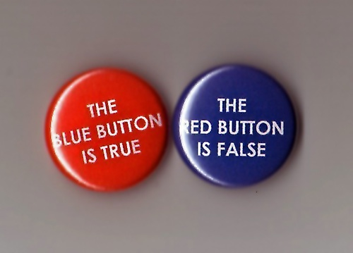
Why paradox?
Something that seems contradictory but can be true.
Paradox. Image: http://techwhirl.com
© 2020 Dixon Life Coaching, LLC | All Rights Reserved
Notes:
Why am I even asking “How this could be?”
Why was I stuck in this paradox?
Is it so contradictory for people with ADHD to become high-achieving adults?

Slide 4
Research says
(and we are told)…
ADHD predicts high risk for negative adult outcomes
© 2020 Dixon Life Coaching, LLC | All Rights Reserved
Notes:
There a a giant pile of research that shows that having ADHD predicts a ton of risk for negative adult outcomes.

Slide 5
How negative is negative?
Lower educational attainment
Occupational problems
Troubled relationships
Lower financial success
Poorer health
Behavioral problems
© 2020 Dixon Life Coaching, LLC | All Rights Reserved
Notes:
How negative is negative?
Lower educational attainment
The academic domain is often the most functionally impaired domain in adult ADHD -
Antshel et al report that Adults with ADHD complete fewer years of education, with nearly 1/3 failing to complete high school
Only 20% even attempt college, and only about 5% graduate from college
Less than 1% have graduate degree vs. 5.5%
Occupational problems
Occupational problems are shown to be the most difficult areas to treat – even with good treatment, adults with ADHD still struggle with organizing, prioritizing, communicating, and getting things done at work.
6 times more likely to be in unskilled vs. professional occupations
61% more likely to have been fired, 33% more likely to be laid off
More than half of adults with ADHD will be fired from a job at least once in their careers.
Troubled relationships
50% more likely to divorce
Lower financial success
On average, ADHD adults earn 25 % less per year than adults without ADHD. These results are consistent with an estimated 20–30 % loss in earnings attributable to ADHD AND an even greater reduction in savings (50 %) relative to non-ADHD adults
Poorer Health
LOTS of talk about this now because of the powerful research results from Russell Barkley’s study on life expectancy
risky things include substance use and abuse
STD and risky sexual behaviors
higher rates of other mental health disorders
risky driving
poor nutrition and obesity
For those who’s ADHD lasts into adulthood this can mean a reduction in life expectancy of 12 to 13 years.
Behavioral Problems
relationship problems
school expulsions
Delinquency
criminal activity and incarcerations

Slide 6
“The central mystery of adhd”
“Although they have considerable chronic difficulty in getting organized and getting started on many tasks, focusing their attention, sustaining their efforts, and utilizing their short-term working memory, all of those diagnosed with ADHD tend to have at least a few specific activities or tasks for which they have no difficulty in exercising these very same functions in a normal or even extraordinary way” (Brown, 2017, p. 6).
© 2020 Dixon Life Coaching, LLC | All Rights Reserved
Notes:
Dr. Thomas Brown, my favorite ADHD scholar, calls the paradox of doing well despite expected poor performance. the “central mystery of ADHD.” In his book, Outside the Box, he writes that, “Although they have considerable chronic difficulty in getting organized and getting started on many tasks, focusing their attention, sustaining their efforts, and utilizing their short-term working memory, all of those diagnosed with ADHD tend to have at least a few specific activities or tasks for which they have no difficulty in exercising these very same functions in a normal or even extraordinary way” (Brown, 2017, p. 6).

Slide 7
the mystery
What made the difference for the high achievers that I know?
© 2020 Dixon Life Coaching, LLC | All Rights Reserved
Notes:
So, this is the mystery - what made the difference for the high achievers with ADHD that I know?
While working with my clients and reading the studies, I identified four characteristics on high achievers with ADHD. So, today I will discuss these four characteristics and suggest a couple of steps that you can take to help yourself manage life if you are a high achiever with ADHD.

Slide 8
Unique talents and interests
Athletes, Celebrities, and CEOs…
oh my!
Simone Biles, Will Smith, Paul Orfela, Richard Branson, Jim Carrey, Justin Timberlake, Wendy Davis, Michael Phelps, Adam Levine, Howie Mandel, Paris Hilton, David Blaine, Terry Bradshaw, Josh Freeman, Cammi Granato, Ryan Gosling, Woody Harrelson, Solange Knowles…
© 2020 Dixon Life Coaching, LLC | All Rights Reserved
Notes:
The first characteristic of high achievers with ADHD IS THAT THEY HAVE AND USE UNIQUE TALENTS AND INTERSTS
We see this in the media…
Athletes
Rock Stars
Olympians
Actors
CEOs

Slide 9
But what about the rest of us?
My clients (high achievers with ADHD)
Academics who have unique interests in esoteric areas of study, like Caribbean Literature, Organizational Allyship, Artificial Intelligence, Urban Water Management, Hydrolic Engineering, Tropical Ecology… You get the idea.
Attorneys who have unique talents leading them into the practice of specialized areas of law, like entertainment law, human rights, immigration, family law, employment litigation, federal and government law, etc…
Other professionals who are interested and talented in the visual arts, computer science, business, finance, organizational leadership, medical, and on and on…
© 2020 Dixon Life Coaching, LLC | All Rights Reserved
© 2020 Dixon Life Coaching, LLC | All Rights Reserved
Notes:
We know from all of the experts, but particularly Dr. Thomas Brown, that despite lack of focus, poor organizational skills, inconsistent effort, procrastination, and excessive forgetfulness, Adults with ADHD can work very effectively when they have a strong personal interest in something. Interest changes brain chemistry, releasing dopamine, which drives motivation and help to improve executive functions, so in essence, ADHD symptoms are worse when adults engage in things that are not interesting to them and improve when interest steps up.
My clients (high achievers with ADHD)
Academics who have unique interests in esoteric areas of study, like Caribbean Literature, Organizational Allyship, Artificial Intelligence, Urban Water Management, Hydrolic Engineering, Tropical Ecology… You get the idea.
Attorneys who have unique talents leading them into the practice of specialized areas of law, like entertainment law, human rights, immigration, family law, employment litigation, federal and government law, etc…
Other professionals who are interested and talented in the visual arts, computer science, business, finance, organizational leadership, medicine, and on and on…
In general these are adults who followed the path of their own interests and talents. That is where they put most of their time and energy, oftentimes (intentionally or unintentionally) ignoring other aspects of life.

Slide 10
Unique talents and interests
What are your unique talents?
What are your areas of highest interest?
How can you spend more time and energy in these areas (and less elsewhere)?
What do you want to be known for?
© 2020 Dixon Life Coaching, LLC | All Rights Reserved
© 2020 Dixon Life Coaching, LLC | All Rights Reserved
Notes:
Some things you can try:
What are your unique talents?
What are your areas of highest interest?
How can you spend more time and energy in these areas (and less elsewhere)? It can help to ask yourself What do I want to be known for?
For one of my clients, Amanda, having unique interests and talents helped her get through a very rigorous private school, do pretty well in college and graduate from a very competitive law school. She landed her dream job – Amanda is vey ambitious – at a BIG law for as an associate in non-profit law. She married and had two kids. She moved into a beautiful townhome in the city and created a life that – on the outside – looks perfect. But, things were falling apart little by little. She was stressed all the time. She was dropping the ball at work, not getting enough billable hours to meet firm expectations, forgetting to touch base with clients, working later and later, and often getting to the end of the day and asking herself what the heck she did all day. Her health was starting to suffer. She did a little research and, even though several doctors told her that she was too successful and smart to have ADHD, she finally found a clinician who did a thorough work up and diagnosed her with ADHD. Medication helped, but not enough for her to function the way she expected herself to perform. So, she called me. One of the strategies that we worked on the most was how to increase her time and energy toward things of high interest and talent and decrease her time and energy spent doing things that she isn’t naturally talented at or interested in. First, we had to identify those things. She was interested in helping small non-profits in the arts to become financially viable so they could enrich her community. So, she started to work on developing business specifically in that area of law. She started handing off cases that were not in that area to younger associates. She developed educational programs that she could present to attorneys in poorer countries to help them help non-profits on their communities. These were the BIG tactics – things that changed her engagement at work. But there were also the little things. She spent more time in in-persoa and (now) virtual meetings with non-profit leaders, and less time repsonding to emails. She developed ways to make mundane tasks (inherently uninteresting) more interesting by doing them in more interesting ways. When we first started, she was terrible at logging her hours. She would spend the last day of each month recreating how she spend her time, which too hours itself and often lead to much lower reporting that if she had done it daily. So, to make hours logging more interesting, we used her natural talent for self-competition and created a charting system with goals and rewards for achievement. This helped her make the uninteresting interesting so that she could actually do it while taking away the burden of hating herself each month for not doing it. This gave her more energy and focus overall.

Slide 11
Do well in school
Obviously some people with ADHD earn PhD’s, JD’s, MD’s, PsyD’s, and Master’s Degrees.
According to research, 5-15% of ADHD adults have gone on to earn a 4-year college degree.
© 2020 Dixon Life Coaching, LLC | All Rights Reserved
Notes:
The second characteristic of high achievers with ADHD IS THAT THEY CAN DO WELL IN SCHOOL
Now – I fully acknowledge that you do not need to have an advance degree to be successful as an adult, but research tells us that people with college degrees are happier, make more money, and live longer then people without. And, some people with ADHD can do it.
Obviously some people with ADHD earn PhD’s, JD’s, MD’s, PsyD’s, and Master’s Degrees.
According to research, 5-15% of ADHD adults have gone on to earn a 4-year college degree.

Slide 12
Sometimes school is the right context
Sometimes school is a place to excel for people with ADHD with lots of external structure, support, routines, deadlines, and external accountability.
Those who excel in school or high a high IQ are often undiagnosed until later in life and are left out of the statistics on academic achievement altogether.
© 2020 Dixon Life Coaching, LLC | All Rights Reserved
© 2020 Dixon Life Coaching, LLC | All Rights Reserved
Notes:
Many people with ADHD struggle mightily in school, but for some school is exactly the right context for them to thrive within. Good schooling can provide the external structure, support, routines, deadlines, and external accountability they need to excel. Things only start to unravel when they leave school and start in the workplace which often requires them to direct and regulate themselves and manage an increased variety and number of tasks.
Those who excel in school or have a high IQ are often undiagnosed until later in life and are left out of the statistics on academic achievement altogether. Studies by Milioni, Antshel, and others have shown that a more elevated IQ can help to compensate for deficits in executive functions, thereby masking ADHD symptoms and making diagnosis more problematic. They are finding that adults with ADHD and IQs over 120 perform worse than adults without ADHD and IQs over 120 on measures of executive functions, but that their performance turns out to be solidly average. This means that high IQ ADHD adults are functioning in the normal range, but that is lower than is expected because they are so smart.
I have worked with client after client who report that they were told by clinicians – doctors and psychiatrists – that they could not have ADHD because they performed so well in school or were too smart.
But, being really smart and doing well in school do not rule out ADHD.

Slide 13
Do well in school
If you think you might have ADHD, but have done well academically, find a provider to do a diagnostic workup.
If you are finished with your education, you can still consider educational options that will help to further your ability to be successful with ADHD, like webinars and group coaching programs.
What worked for you in school? Can you find ways to implement those things now, in your work or home life?
Notes:
Here are somethings you can try:
If you think you might have ADHD, but have done well academically, find a provider to do a diagnostic workup. Do not buy into the incorrect view that you might be too successful to have ADHD. And, if you have kids or work with kids with ADHD, the same goes for them as well. Remember Amanda? Even after her diagnosis and treatment for her own ADHD, she once told me that she saw her daughter struggling with the same executive dysfuntions as herself, but that the wondered if her daughter might be too successful to get a diagnosis and treatment! Only when I asked her how hard her daughter was working to reach those levels of success did she consider getting her the help she needed.
If you are finished with your education, you can still consider educational options that will help to further your ability to be successful with ADHD, like webinars and group coaching programs.
What worked for you in school? Can you find ways to implement those things now, in your work or home life?
Marcus, a professor with ADHD, was extermetly supportive of students, especially those who were struggling in his classes, but he was often walking into class underprepared or late. He spent too much time grading and in meetings. He had grant proposals due, but either missed submission deadlines or submitted proposals that he deemed unfinished. He was tired all the time because he wasn’t sleeping well or exercising.
Implementing the things that worked for him while getting his Doctorate meant Creating a predictable structure - having a 24 hour and weekly routine or pattern that he followed to make sure he had time for sleeping, eating, exercising, class prep, teaching, office hours, managing emails, and writing and researching for proposals. He had to externalize this structure by writing it on his large white board, putting times into his calendar, setting alarms, and telling everyone else what he would be doing when. He dusted off his daily planner and kept detailed to do lists. He joined co-working groups to sit with others while he worked. He blocked external distractions as much as possible. He also enlisted an accountability partner so he could tell someone else about his progress on tasks. These were all things that worked for him while he was in school that he could implement now that he is I the workplace.
Class prep became more efficient. Fewer students were showing up to office hours so he had more time for other tasks. He starting working on proposals weel in advance of the deadlines, and submitting them on time - oten still at the last minutes, but not after the last minute! He was getting more sleep and exercise, so had more energy and focus. Using the tactics he had developed to get through his doctoral studies was the key.

Slide 14
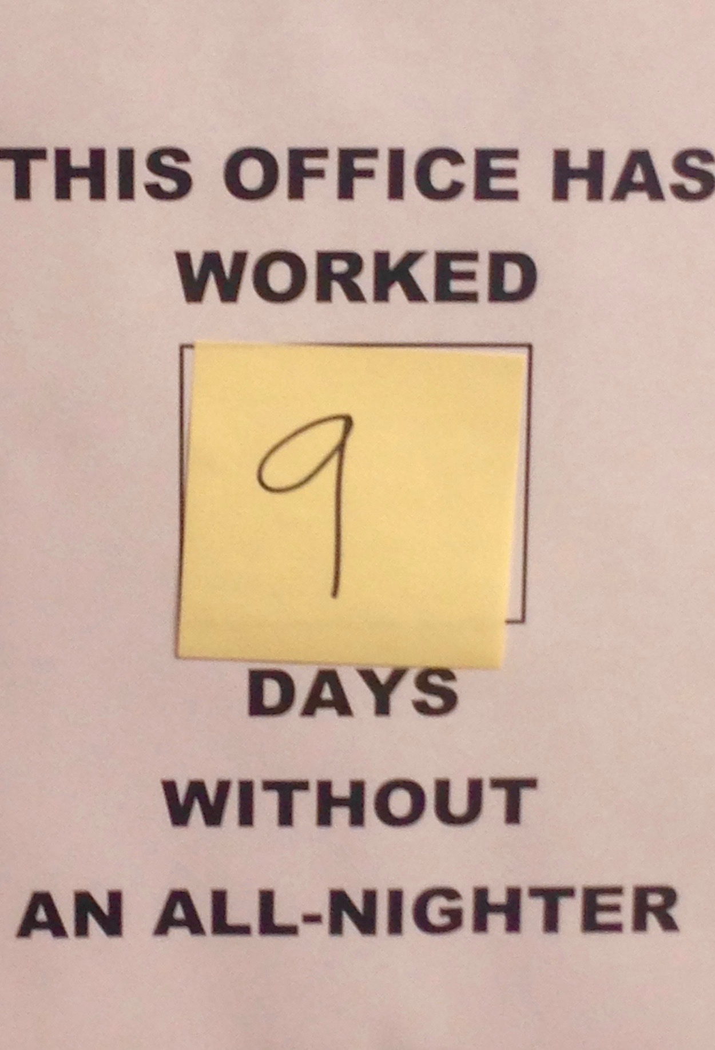
High achievers with adhd work harder
© 2020 Dixon Life Coaching, LLC | All Rights Reserved
Notes:
The third characteristic of high achievers with ADHD IS THAT THEY WORK HARDER
Typically, high achievers with ADHD will sacrifice their own well-being for the demands of the moment. This is one way that they can perform well in school or in the workplace. But this often leads to high stress and “overwhelm.” AND, long term health problems.
Amanda told me that before coronavirus – when she was still working a the office - she routinely got up from her desk at “what felt like the middle of the day” to go and grab some lunch and walk around only to see that everyone else had already left for the day and the office was empty. She said, “I was the only one left nearly every day.” Now that she is working from home, she lacks even that external cue that the workday is over, so she finds herself working well into the wee hours.
Most of the people I know with ADHD work exceptionally hard at their jobs to handle some of the inherent inefficiencies that come along with ADHD. They will work later, on weekends, or during lunch to make sure they are producing as expected (at least as expected by themselves).
Getting a doctoral degree, building your own business, or researching for essoteric areas of study are difficult enough. Imagine how hard you need to work to achieve those things when you have ADHD – when organizing, prioritizing, activating to work, avoiding distractions and managing your time are so challenging.

Slide 15
Why do adults with adhd have to work harder?
ADHD makes work harder.
Tasks often take longer.
ADHD complicates your sense of time.
Treatment requires elaborate and burdensome tactics.
Many adults with ADHD work harder to try to compensate for perceived poor performance.
© 2020 Dixon Life Coaching, LLC | All Rights Reserved
Notes:
ADHD makes life and work harder – less efficient, more complicated, less consistent, simply harder.
Often tasks take longer than they would if ADHD was not a part of the neurobiology (and sometimes, tasks take less time). – this is very dependent on where you brain chemistry is in the moment.
My clients consistently report that things take them longer then they should, that they lose track of or run out of time and end up working long days or all-nighters.
To be successful with ADHD, you need to implement elaborate tactics around planning, organizing, reminding youself etc which adds an additional burden of work to an already full plate.
Many adults with ADHD work harder to try to compensate for perceived poor performance.

Slide 16
Working harder
Notice what types of work require you to work harder and are worth the extra effort
Notice what types of work require you to work harder and are not worth the extra effort.
Set tight boundaries around working harder, especially on things that are not worthy of your hard work!
Focus on your well-being (eat, sleep, breathe, move) before you focus on your work.
© 2020 Dixon Life Coaching, LLC | All Rights Reserved
Notes:
Working harder can also mean working on the things that matter and not working on the things that do not matter to you. So, you don’t have to work hard at everything. Working harder on everything all the time is not sustainable – it’s too hard. It helps to seek alternatives to self-sacrificing your well-being to the demands of the moment.
Notice what types of work require you to work harder and are worth the extra effort
Notice what types of work require you to work harder and are not worth the extra effort.
Set tight boundaries around working harder, especially on things that are not worthy of your hard work!
Focus on your well-being (eat, sleep, breathe, move) before you focus on your work.
Susan, who is a high-tech computer systems analyst, told me that things were going pretty well at work. She kept getting promoted and now was in charge of her own team. But, she was also ignoring her own health. She was getting overweight and living on energy drinks. She had stopped exericing because she often didn’t feel well. She worked very long hours, most days at least for 12 hours. She loved her job, it was very interesting to her so it got all of her attention. But, she still had the constant fear that others would discover how hard it was for her to keep performing at such a high level, and that some day it would all unravel. After landing in the hospital three times with pneumonia, she decised to get help for her ADHD, which she felt was making her sick. She identified areas of her life and work that were worthy and focused on those areas, by spending more time with her fiancé, organizing systems for large projects at work, and getting her own systems (planning orgrnaicing scheduling) in order. She identified a couple of areas that she was spending too much time and energy on and cut back on them, like responding immediately to every team message, overexplaing herself at meetings, writing overly detailed logs. She started delegating to her team more. And, then she began focusing on her well-being. She was able to start walking her dogs each day, getting more regular sleep, and eating real food for a change. By setting tight boundaries around where she spent her precious time and energy and putting her well-being in front of her work, Susan was actually able to get more done at work and improve her health simultaneously. She still has to work harder than her peers without ADHD, but she is doing so in a more sustainable way.

Slide 17
High achievers seek support
© 2020 Dixon Life Coaching, LLC | All Rights Reserved
Notes:
The fourth characteristic of high achievers with ADHD IS THAT THEY SEEK SUPPORT
Generally, those who achieve a lot in life have support from others – their parents, a special teacher or mentor, a spouse, or a coach. This is true for adults with ADHD as well, but can be even more important. Talking to someone and seeking help can help lead to high achievement.

Slide 18
support
Diagnosis
Pharmacological treatment
Teachers, mentors, partners
Coaching
Therapy
Online webinars, ADHD conferences, group programs
Notes:
Support includes appropriate treatment for ADHD. According to research by Shaw and others, treatment for ADHD significantly improves long-term outcomes in all areas of adult functioning, like driving, obesity, self-esteem, social functioning, educational attainment, behavioral problems, and even occupational performance. Despite treatment being so critical and effective, it often does not “normalize” outcomes.
Treatment can include ADHD diagnosis, medication, and what is called “non-pharmacological” treatments like ADHD coaching. Part of being a high achiever with ADHD is seeking out support when you know you would benefit from the help, a new perspective, or a little guidance.
Getting support can mean medication treatment, CBT, group or individual coaching, etc
BUT it can also mean telling your friends about your struggles, delegating tasks that you don’t have to be you to do, asking for help from your loved ones or teachers, or associates at work... (all of which can be done without disclosing your ADHD)
One of my clients, who is a professor once told me that the single most impactful support she got for her ADHD was a laundry service. The most impactful!

Slide 19
Seeking support
Think about the support that has worked for you in the past and see if you can use any now.
List areas of your life that would benefit from greater support.
Write down steps to take to get support.
Sustain treatment and support into adulthood.
© 2020 Dixon Life Coaching, LLC | All Rights Reserved
Notes:
Here are some things to try:
Think about the support that has worked for you in the past and see if you can use any now.
List areas of your life that would benefit from greater support.
Write down steps to take to get support.
Sustain treatment and support into adulthood.
For most of my clients, getting a diagnosis of ADHD as an adults – late in life – was the beginning of getting the support they needed. But, for most, medication wasn’t enough. They were still struggling with their executive functions. So, they sought additional support. Like Leo, who is a senior partner at a small law firm. He made it all the way to partner, but was losing track of client matters, missing deadlines, spending too much time at the office, had basically missed his children’s childhoods, and was chronically stressed. He kept forgetting things, couldn’t get himself organized, avoided necessary tasks, and spent too much time on other tasks. He was fed up with himself and starting to show his frustration with impatience for others at work. When his wife joked one day that he hadn’t eaten with the family for years, he realized it was time to get some help. He spoke to his doctor, went to a psychologist and got an ADHD diagnosis and medication. He started coaching. Leo identified and wrote down the specific area of his life for which he needed support. He asked his administrative assistant to take over his calendar. He asked his paralegal and junior associated to take more of his case load. He even bought a small refrigerator for his office and had his lunches delivered. He asked the tech guy at work to spend time setting up efficient email systems and organize his files. Things started to go more smoothly. Not perfectly, but with additional support he was able to get home and eat dinner with his family once in a while and get more done at work with less stress.

Slide 20
Examining the mysterious paradox
High achievers
Do exist!
Have unique talents and interests
Can do well in school
Work harder
Seek support
© 2020 Dixon Life Coaching, LLC | All Rights Reserved
Notes:
When I bumped up against the mysterious paradox of being a high achiever with ADHD, I thought carefully about my clients. I realized that part of their experience is to exist in the paradox – to get comfortable with the seeming conotradictor nature of struggling with executive functions while performing at a high level. they must deeply understand that life outcomes are more difficult for them to achieve, while, at the same time, understand that they can use their interests and talents, their smarts, working harder at what matters, and getting support to help them achieve quite a lot.
High achievers with ADHD
Do exist!
Have unique talents and interests
Can do well in school
Work harder
Seek support
People with ADHD are not doomed to negative adult outcomes.
I KNOW this is true, because I witness it firsthand every day.

Slide 21
references
Altszuler, A. R., Page, T. F., Gnagy, E. M., Coxe, S., Arrieta, A., Molina, B. S., & Pelham, W. E., Jr (2016). Financial Dependence of Young Adults with Childhood ADHD. Journal of abnormal child psychology, 44(6), 1217–1229.
Antshel, K. M., Faraone, S. V., Maglione, K., Doyle, A. E., Fried, R., Seidman, L. J., & Biederman, J. (2010). Executive functioning in high-IQ adults with ADHD. Psychological Medicine, 40(11), 1909–1918.
Barkley, Russell (2018). ADHD Likely Reduces Estimated Life Expectancy by Young Adulthood. http://www.russellbarkley.org/factsheets/ADHD_Likely%20_Reduces_Estimated_Life_Expectancy_Barkley.pdf
Barkley, R., Murphy, K., Fischer, M. (2008). ADHD in Adults: What the Science Says. New York, NY: Guilford Press.
Brown, Thomas E. (2017). Outside the Box: Rethinking Add/Adhd in Children and Adults - a Practical Guide. Arlington, VA: Amer Psychiatric Pub.
Brown, T. E., Reichel, P. C., & Quinlan, D. M. (2009). Executive Function Impairments in High IQ Adults With ADHD. Journal of Attention Disorders, 13(2), 161–167.
CHADD. ADHD and Long-Term Outcomes. https://chadd.org/about-adhd/long-term-outcomes/
Milioni, A. L. V., Chaim, T. M., Cavallet, M., de Oliveira, N. M., Annes, M., Dos Santos, B., ... Cunha, P. J. (2017). High IQ May “Mask” the Diagnosis of ADHD by Compensating for Deficits in Executive Functions in Treatment-Naïve Adults With ADHD. Journal of Attention Disorders, 21(6), 455–464.
Shaw, M., Hodgkins, P., Caci, H., Young, S., Kahle, J., Woods, A. G., & Arnold, L. E. (2012). A systematic review and analysis of long-term outcomes in attention deficit hyperactivity disorder: effects of treatment and non-treatment. BMC Medicine, 10, 99.

Slide 22
Download this
The mysterious paradox of being a high achiever with ADHD [A Workbooklet]
https://www.dixonlifecoaching.com/the-mysterious-paradox-workbook
© 2020 Dixon Life Coaching, LLC | All Rights Reserved

Slide 23
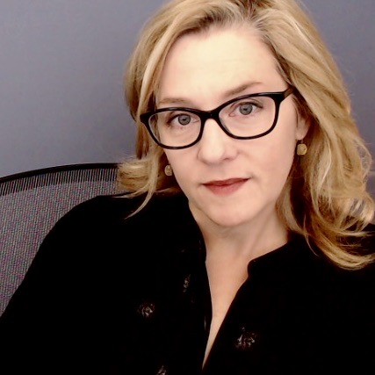
The mysterious paradox of being a high achiever with adhd
Casey Dixon is a Professional Certified Coach (ICF), Board Certified Coach (CCE-Global), Senior Certified ADHD Coach (IAAC), CTA Certified Coach, and holds a Master’s Degree in Educational Leadership.
To learn more about individual and ongoing group coaching for lawyers, professors, and other professionals with ADHD visit…
www.dixonlifecoaching.com

