Slide 1

System Analysis
Dr. Dragunov
SPRINT TO SUCCESS
System development methodologies

Slide 2

Agile Development
Agile manifesto
We are uncovering better ways of developing software by doing it and helping others do it. Through this work we have come to value:
  Individuals and interactions over processes and tools
  Working software over comprehensive documentation
  Customer collaboration over contract negotiation
  Responding to change over following a plan
That is, while there is value in the items on the right, we value the items on the left more.

Slide 3

The Cargo Cults believe that manufactured western goods ('cargo') have been created by ancestral spirits and intended for Melanesian people.

Slide 4
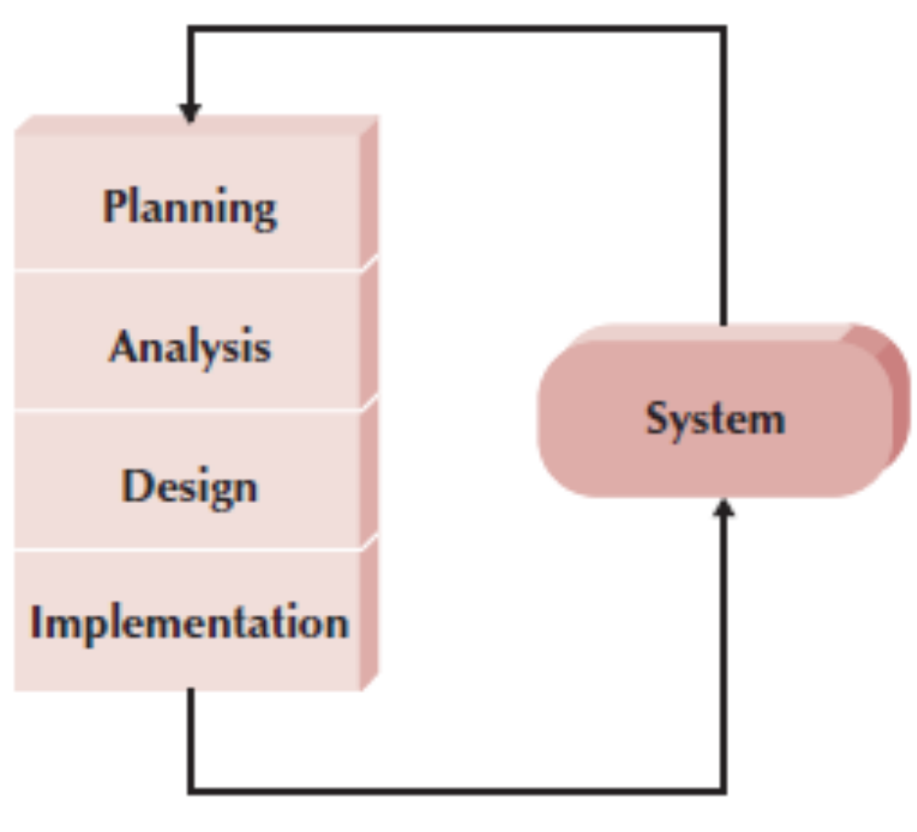
Typical Agile Development Methodology

Slide 5
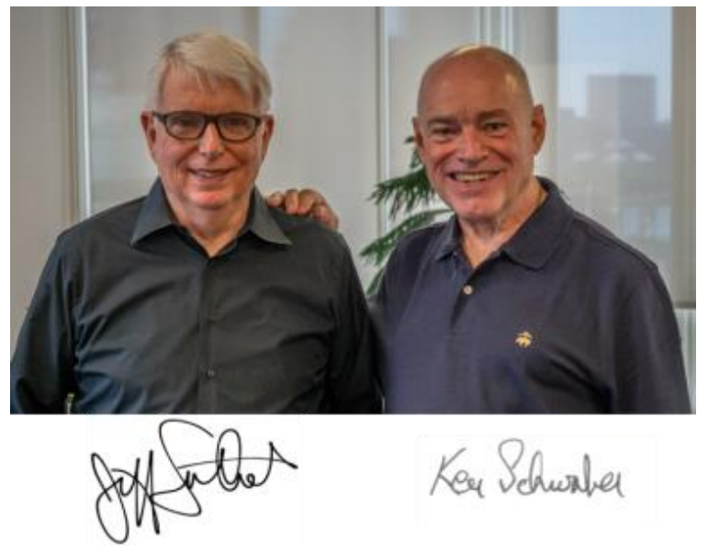
The Scrum
Scrum creators: Ken Schwaber and Jeff Sutherland

Slide 6

Scrum has been used by:
•Microsoft
•Yahoo
•Google
• Electronic Arts
•IBM
• Lockheed Martin
•Apple
Etc.

Slide 7
Scrum has been used for:
• Commercial software
• In-house development
• Contract development
• Fixed-price projects
• Financial applications
• ISO 9001-certified applications
• Embedded systems
• 24x7 systems with 99.999% uptime requirements
• the Joint Strike Fighter
• Video game development
• FDA-approved, life-critical systems
• Satellite-control software
• Websites
• Handheld software
• Mobile phones
• Network switching applications
• ISV applications
• Some of the largest applications in use

Slide 8
Definition of Scrum
Scrum: A framework within which people can address complex adaptive problems, while productively and creatively delivering products of the highest possible value.
Scrum is not a process, technique, or definitive method. Rather, it is a framework within which you can employ various processes and techniques.
The Scrum framework consists of Scrum Team members and their associated roles, events, artifacts, and rules.
Each component within the framework serves a specific purpose and is essential to Scrum’s success and usage.
The rules of Scrum bind together the roles, events, and artifacts, governing the relationships and interaction between them.

Slide 9

The Scrum Team
The Scrum Team consists of a Product Owner, the Development Team, and a Scrum Master.
Scrum Teams are self-organizing and cross-functional.
Self-organizing teams choose how best to accomplish their work, rather than being directed by others outside the team.
Cross-functional teams have all competencies needed to accomplish the work without depending on others not part of the team.
The team model in Scrum is designed to optimize flexibility, creativity, and productivity.

Slide 10

The Product Owner
The Product Owner is responsible for maximizing the value of the product resulting from work of the Development Team. How this is done may vary widely across organizations, Scrum Teams, and individuals.
• Define the features of the product
• Makes scope vs. schedule decisions
• Responsible for achieving financial goals of the project
• Prioritize the product backlog
• Adjust features and priority every sprint, as needed
• Accept or reject work results

Slide 11

The Development Team
The Development Team consists of professionals who do the work of delivering a potentially releasable Increment of “Done” product at the end of each Sprint.
A “Done” increment is required at the Sprint Review.
Only members of the Development Team create the Increment.
Development Teams are structured and empowered by the organization to organize and manage their own work.
The resulting synergy optimizes the Development Team’s overall efficiency and effectiveness.

Slide 12
Development Teams characteristics:
• They are self-organizing. No one (not even the Scrum Master) tells the Development Team how to turn Product Backlog into Increments of potentially releasable functionality;
• Development Teams are cross-functional, with all the skills as a team necessary to create a product Increment;
• Scrum recognizes no titles for Development Team members, regardless of the work being performed by the person;
• Scrum recognizes no sub-teams in the Development Team, regardless of domains that need to be addressed like testing, architecture, operations, or business analysis; and,
• Individual Development Team members may have specialized skills and areas of focus, but accountability belongs to the Development Team as a whole.

Slide 13
Development Team Size
Optimal Development Team size is small enough to remain nimble and large enough to complete significant work within a Sprint.
Smaller Development Teams may encounter skill constraints during the Sprint, causing the Development Team to be unable to deliver a potentially releasable Increment.
Having more than nine members requires too much coordination. Large Development Teams generate too much complexity for an empirical process to be useful.
The Product Owner and Scrum Master roles are not included in this count unless they are also executing the work of the Sprint Backlog.

Slide 14
• Typically 5-9 people
• Cross-functional:
• Programmers, testers, user experience designers, etc.
• Members should be full-time
• May be exceptions (e.g., database administrator)
• Teams are self-organizing
• Ideally, no titles but rarely a possibility
• Membership should change only between sprints

Slide 15



The Scrum Master
The Scrum Master is responsible for promoting and supporting Scrum as defined in the Scrum Guide.
Scrum Masters do this by helping everyone understand Scrum theory, practices, rules, and values.
The Scrum Master is a servant-leader for the Scrum Team.
The Scrum Master helps those outside the Scrum Team understand which of their interactions with the Scrum Team are helpful and which aren’t. The Scrum Master helps everyone change these interactions to maximize the value created by the Scrum Team.

Slide 16
Scrum Master Service to the Product Owner
The Scrum Master serves the Product Owner in several ways, including:
• Ensuring that goals, scope, and product domain are understood by everyone on the Scrum Team as well as possible;
• Finding techniques for effective Product Backlog management;
• Helping the Scrum Team understand the need for clear and concise Product Backlog items;
• Understanding product planning in an empirical environment;
• Ensuring the Product Owner knows how to arrange the Product Backlog to maximize value;
• Understanding and practicing agility; and,
• Facilitating Scrum events as requested or needed.

Slide 17

Scrum Master Service to the Development Team
The Scrum Master serves the Development Team in several ways, including:
• Coaching the Development Team in self-organization and cross-functionality;
• Helping the Development Team to create high-value products;
• Removing impediments to the Development Team’s progress;
• Facilitating Scrum events as requested or needed; and,
• Coaching the Development Team in organizational environments in which Scrum is not yet fully adopted and understood.

Slide 18
Scrum Master Service to the Organization
The Scrum Master serves the organization in several ways, including:
• Leading and coaching the organization in its Scrum adoption;
• Planning Scrum implementations within the organization;
• Helping employees and stakeholders understand and enact Scrum and empirical product development;
• Causing change that increases the productivity of the Scrum Team; and,
• Working with other Scrum Masters to increase the effectiveness of the application of Scrum in the organization.

Slide 19
Scrum Events
Prescribed events are used in Scrum to create regularity and to minimize the need for meetings not defined in Scrum.
All events are time-boxed events, such that every event has a maximum duration.
Once a Sprint begins, its duration is fixed and cannot be shortened or lengthened.
The remaining events may end whenever the purpose of the event is achieved, ensuring an appropriate amount of time is spent without allowing waste in the process.
Other than the Sprint itself, which is a container for all other events, each event in Scrum is a formal opportunity to inspect and adapt something.
These events are specifically designed to enable critical transparency and inspection.
Failure to include any of these events results in reduced transparency and is a lost opportunity to inspect and adapt.

Slide 20
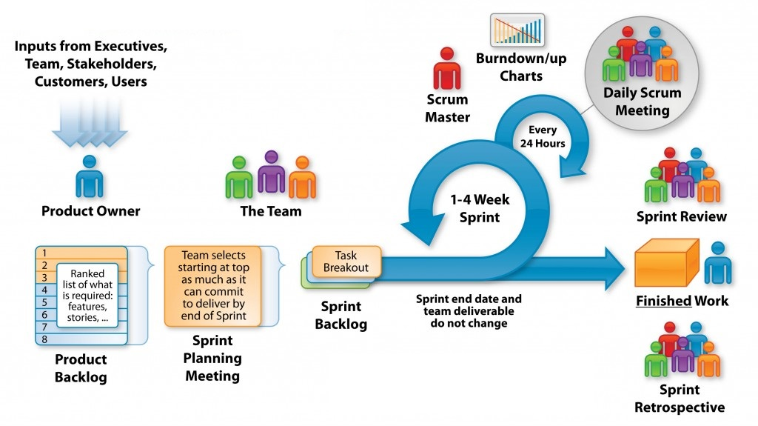
The Sprint

Slide 21
The heart of Scrum is a Sprint, a time-box of one month or less during which a “Done”, useable, and potentially releasable product Increment is created.
Sprints have consistent durations throughout a development effort. A new Sprint starts immediately after the conclusion of the previous Sprint.
Sprints contain and consist of the Sprint Planning, Daily Scrums, the development work, the Sprint Review, and the Sprint Retrospective.
During the Sprint:
• No changes are made that would endanger the Sprint Goal;
• Quality goals do not decrease; and,
• Scope may be clarified and re-negotiated between the Product Owner and Development Team as more is learned.
Each Sprint may be considered a project with no more than a one-month horizon.

Slide 22

Cancelling a Sprint
A Sprint can be cancelled before the Sprint time-box is over.
Only the Product Owner has the authority to cancel the Sprint, although he or she may do so under influence from the stakeholders, the Development Team, or the Scrum Master.
A Sprint would be cancelled if the Sprint Goal becomes obsolete. This might occur if the company changes direction or if market or technology conditions change. In general, a Sprint should be cancelled if it no longer makes sense given the circumstances. But, due to the short duration of Sprints, cancellation rarely makes sense. When a Sprint is cancelled, any completed and “Done” Product Backlog items are reviewed.
If part of the work is potentially releasable, the Product Owner typically accepts it. All incomplete Product Backlog Items are re-estimated and put back on the Product Backlog. The work done on them depreciates quickly and must be frequently re-estimated. Sprint cancellations consume resources, since everyone regroups in another Sprint Planning to start another Sprint. Sprint cancellations are often traumatic to the Scrum Team, and are very uncommon.

Slide 23
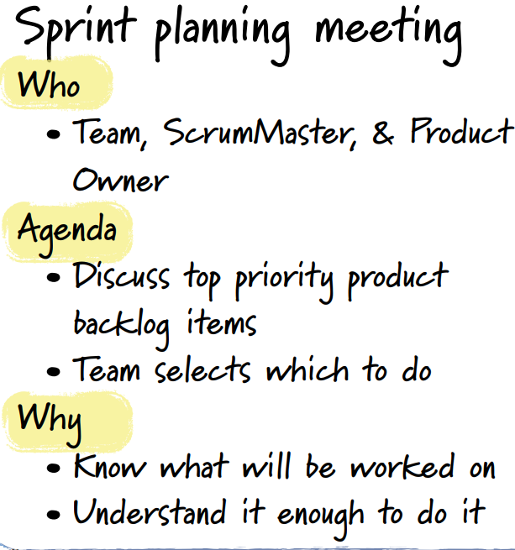
Sprint Planning
The work to be performed in the Sprint is planned at the Sprint Planning.
This plan is created by the collaborative work of the entire Scrum Team.
Sprint Planning is time-boxed to a maximum of eight hours for a one-month Sprint.
For shorter Sprints, the event is usually shorter. The Scrum Master ensures that the event takes place and that attendants understand its purpose. The Scrum Master teaches the Scrum Team to keep it within the time-box.
Sprint Planning answers the following:
• What can be delivered in the Increment resulting from the upcoming Sprint?
• How will the work needed to deliver the Increment be achieved?

Slide 24
Sprint Goal
The Sprint Goal is an objective set for the Sprint that can be met through the implementation of Product Backlog.
It provides guidance to the Development Team on why it is building the Increment. It is created during the Sprint Planning meeting.
The Sprint Goal gives the Development Team some flexibility regarding the functionality implemented within the Sprint. The selected Product Backlog items deliver one coherent function, which can be the Sprint Goal.

Slide 25
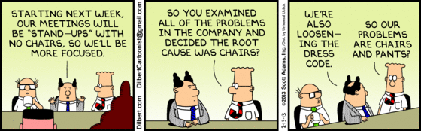
Daily Scrum
The Daily Scrum is a 15-minute time-boxed stand-up event for the Development Team.
The Daily Scrum is held every day of the Sprint. At it, the Development Team plans work for the next 24 hours.
The Daily Scrum is held at the same time and place each day to reduce complexity. The Development Team uses the Daily Scrum to inspect progress toward the Sprint Goal and to inspect how progress is trending toward completing the work in the Sprint Backlog.

Slide 26
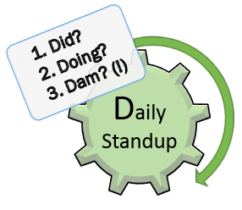
The structure of the meeting is set by the Development Team and can be conducted in different ways if it focuses on progress toward the Sprint Goal. Some Development Teams will use questions, some will be more discussion based. Here is an example of what might be used:

Slide 27
Sprint Review
• Attendees include the Scrum Team and key stakeholders invited by the Product Owner;
• The Product Owner explains what Product Backlog items have been “Done” and what has not been “Done”;
• The Development Team discusses what went well during the Sprint, what problems it ran into, and how those problems were solved;
• The Development Team demonstrates the work that it has “Done” and answers questions about the Increment;

Slide 28
Sprint Review cont…
• The Product Owner discusses the Product Backlog as it stands. He or she projects likely target and delivery dates based on progress to date (if needed);
• The entire group collaborates on what to do next, so that the Sprint Review provides valuable input to subsequent Sprint Planning;
• Review of how the marketplace or potential use of the product might have changed what is the most valuable thing to do next; and,
• Review of the timeline, budget, potential capabilities, and marketplace for the next anticipated releases of functionality or capability of the product.

Slide 29
Sprint Retrospective
The Sprint Retrospective is an opportunity for the Scrum Team to inspect itself and create a plan for improvements to be enacted during the next Sprint.
The Sprint Retrospective occurs after the Sprint Review and prior to the next Sprint Planning.
This is at most a three-hour meeting for one-month Sprints. For shorter Sprints, the event is usually shorter. The Scrum Master ensures that the event takes place and that attendants understand its purpose.
The purpose of the Sprint Retrospective is to:
• Inspect how the last Sprint went with regards to people, relationships, process, and tools;
• Identify and order the major items that went well and potential improvements; and,
• Create a plan for implementing improvements to the way the Scrum Team does its work.

Slide 30

Scrum Artifacts
Scrum’s artifacts represent work or value to provide transparency and opportunities for inspection and adaptation. Artifacts defined by Scrum are specifically designed to maximize transparency of key information so that everybody has the same understanding of the artifact
• Product backlog
• Sprint backlog

Slide 31
Product Backlog
The requirements
• A list of all desired work on the project
•Ideally expressed such that each item has value to the users or customers of the product
• Prioritized by the product owner
• Reprioritized at the start of each sprint

Slide 32
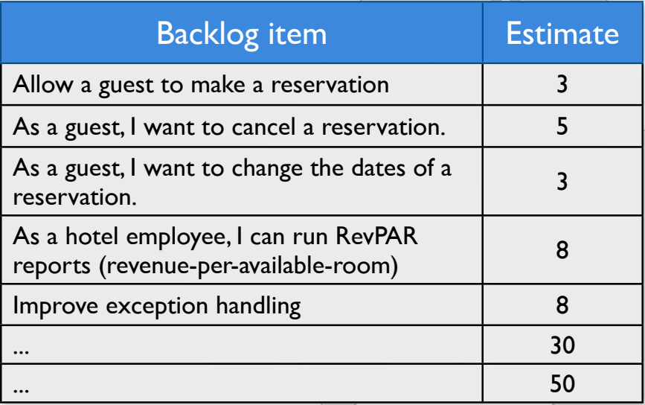
Product Backlog

Slide 33
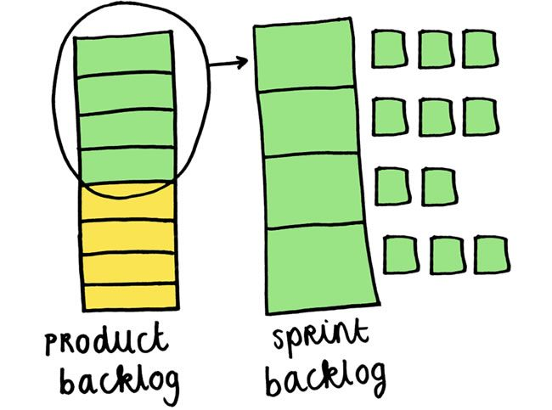
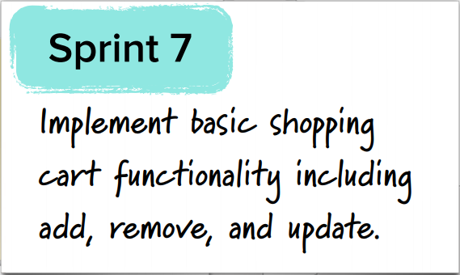
Sprint Backlog
The Sprint Backlog is the set of Product Backlog items selected for the Sprint, plus a plan for delivering the product Increment and realizing the Sprint Goal.
The Sprint Backlog is a forecast by the Development Team about what functionality will be in the next Increment and the work needed to deliver that functionality into a “Done” Increment.

Slide 34
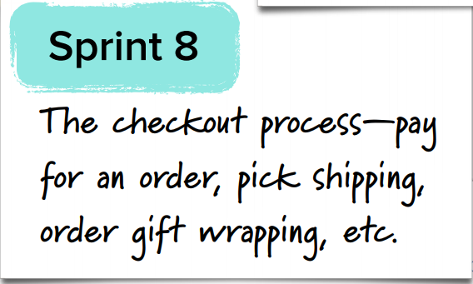
Managing the sprint backlog
• Individuals sign up for work of their own choosing
• Work is never assigned
• Estimated work remaining is updated daily
• Any team member can add, delete or change the sprint backlog
• Work for the sprint emerges
• If work is unclear, define a sprint backlog item with a larger amount of time and break it down later
• Update work remaining as more becomes known

Slide 35
Artifact Transparency
Scrum relies on transparency. Decisions to optimize value and control risk are made based on the perceived state of the artifacts.
The Scrum Master must work with the Product Owner, Development Team, and other involved parties to understand if the artifacts are completely transparent.

Slide 36
Definition of “Done”
When a Product Backlog item or an Increment is described as “Done”, everyone must understand what “Done” means.
Although this may vary significantly per Scrum Team, members must have a shared understanding of what it means for work to be complete, to ensure transparency.
This is the definition of “Done” for the Scrum Team and is used to assess when work is complete on the product Increment

Slide 37
XP

Slide 38
Extreme programming
Perhaps the best-known and most widely used agile method.
Extreme Programming (XP) takes an ‘extreme’ approach to iterative development.
  New versions may be built several times per day;
  Increments are delivered to customers every 2 weeks;
  All tests must be run for every build and the build is only accepted if tests run successfully.

Slide 39
XP and Agile principles
Incremental development is supported through small, frequent system releases.
Customer involvement means full-time customer engagement with the team.
People not process through pair programming, collective ownership and a process that avoids long working hours.
Change supported through regular system releases.
Maintaining simplicity through constant refactoring of code.

