Slide 1
System Analysis
Dr. Dragunov
System development methodologies

Slide 2
SYSTEMS DEVELOPMENT METHODOLOGIES
A methodology is a formalized approach to implementing the SDLC (i.e., it is a list of steps and deliverables).
There are many different systems development methodologies, and each one is unique, based on the order and focus it places on each SDLC phase. Some methodologies are formal standards used by government agencies, whereas others have been developed by consulting firms to sell to clients.
There are many ways to categorize methodologies. One way is by looking at whether they focus on business processes or the data that support the business.

Slide 3
Software processes can be improved by process standardization where the diversity in software processes across an organization is reduced. This leads to improved communication and a reduction in training time, and makes automated process support more economical.
Software processes
Agile
Plan-driven

Slide 4
Plan-driven and agile processes
Plan-driven processes are processes where all of the process activities are planned in advance and progress is measured against this plan.
In agile processes, planning is incremental and it is easier to change the process to reflect changing customer requirements.
In practice, most practical processes include elements of both plan-driven and agile approaches.
There are no right or wrong software processes.

Slide 5
Classes of Methodologies
Structured Development
  Waterfall Development
  Parallel Development
Rapid Application Development
  Phased
  Prototyping
Agile Development
  eXtreme Programming
  SCRUM

Slide 6
Structured Design
The first category of systems development methodologies is called structured design. These methodologies became dominant in the 1980s, replacing the previous ad hoc and undisciplined approach. Structured design methodologies adopt a formal step-by-step approach to the SDLC that moves logically from one phase to the next.

Slide 7
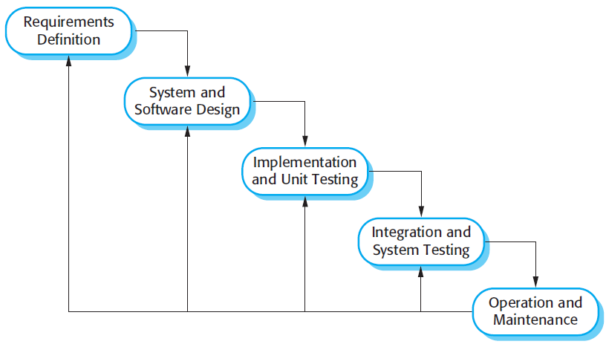
The waterfall model
The first published model of the software development process was derived from more general system engineering processes (Royce, 1970).

Slide 8
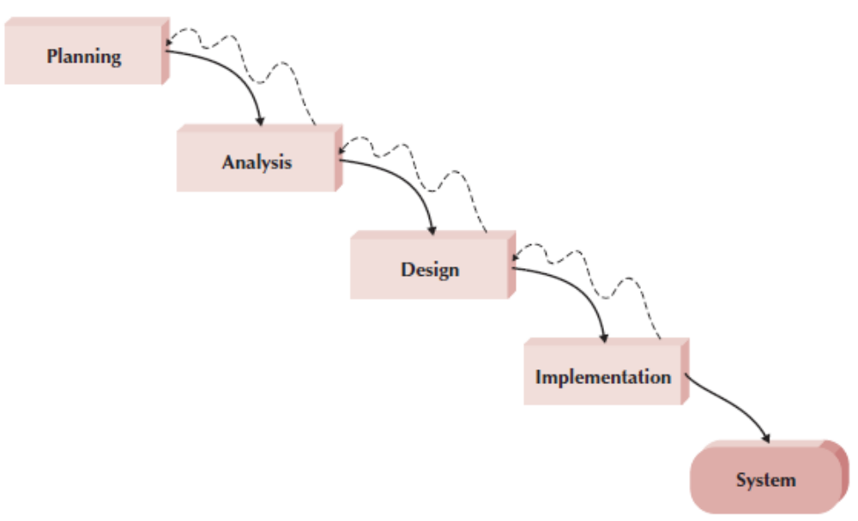

Slide 9
Because of the cascade from one phase to another, this model is known as the ‘waterfall model’ or software life cycle. The waterfall model is an example of a plan-driven process—in principle, you must plan and schedule all of the process activities before starting work on them.

Slide 10
Waterfall model problems
Inflexible partitioning of the project into distinct stages makes it difficult to respond to changing customer requirements.
  Therefore, this model is only appropriate when the requirements are well-understood and changes will be fairly limited during the design process.
  Few business systems have stable requirements.
The waterfall model is mostly used for large systems engineering projects where a system is developed at several sites.
  In those circumstances, the plan-driven nature of the waterfall model helps coordinate the work.

Slide 11
Parallel Development
Parallel development methodology attempts to address the problem of long delays between the analysis phase and the delivery of the system. Instead of doing design and implementation in sequence, it performs a general design for the whole system and then divides the project into a series of distinct subprojects that can be designed and implemented in parallel. Once all subprojects are complete, the separate pieces are integrated and the system is delivered
The primary advantage of this methodology is that it can reduce the time to deliver a system; thus, there is less chance of changes in the business environment causing rework.

Slide 12
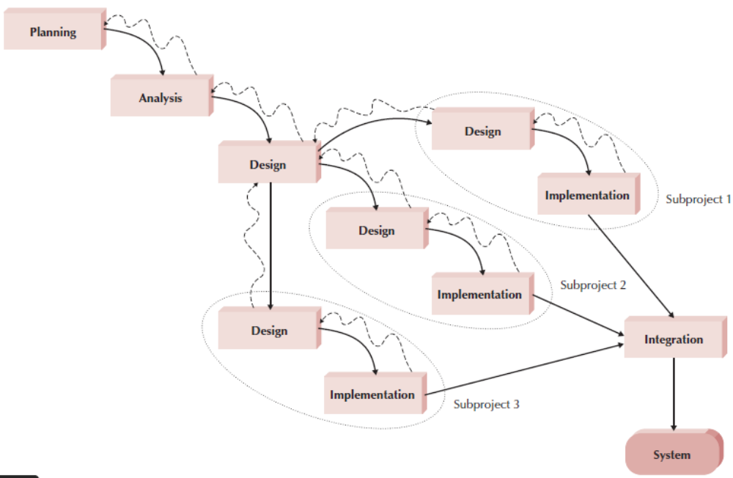
A Parallel Development-based Methodology

Slide 13
Rapid Application Development (RAD)
A second category of methodologies includes rapid application development (RAD)-based methodologies. These are a newer class of systems development methodologies that emerged in the 1990s. RAD-based methodologies attempt to address both weaknesses of structured design methodologies by adjusting the SDLC phases to get some part of the system developed quickly and into the hands of the users. In this way, the users can better understand the system and suggest revisions that bring the system closer to what is needed.
Most RAD-based methodologies recommend that analysts use special techniques and computer tools to speed up the analysis, design, and implementation phases, such as computer- aided software engineering (CASE) tools, joint application design (JAD) sessions, fourth-generation or visual programming languages that simplify and speed up programming (e.g., Visual Basic), and code generators that automatically produce programs from design specifications.

Slide 14
A Phased Development-based Methodology
A phased development-based methodology breaks an overall system into a series of versions that are developed sequentially. The analysis phase identifies the overall system concept, and the project team, users, and system sponsor then categorize the requirements into a series of versions. The most important and fundamental requirements are bundled into the first version of the system. The analysis phase then leads into design and implementation—but only with the set of requirements identified for version 1 Once version 1 is implemented, work begins on version 2. Additional analysis is performed based on the previously identified requirements and combined with new ideas and issues that arose from the users’ experience with version 1. Version 2 then is designed and implemented, and work immediately begins on the next version. This process continues until the system is complete or is no longer in use.

Slide 15
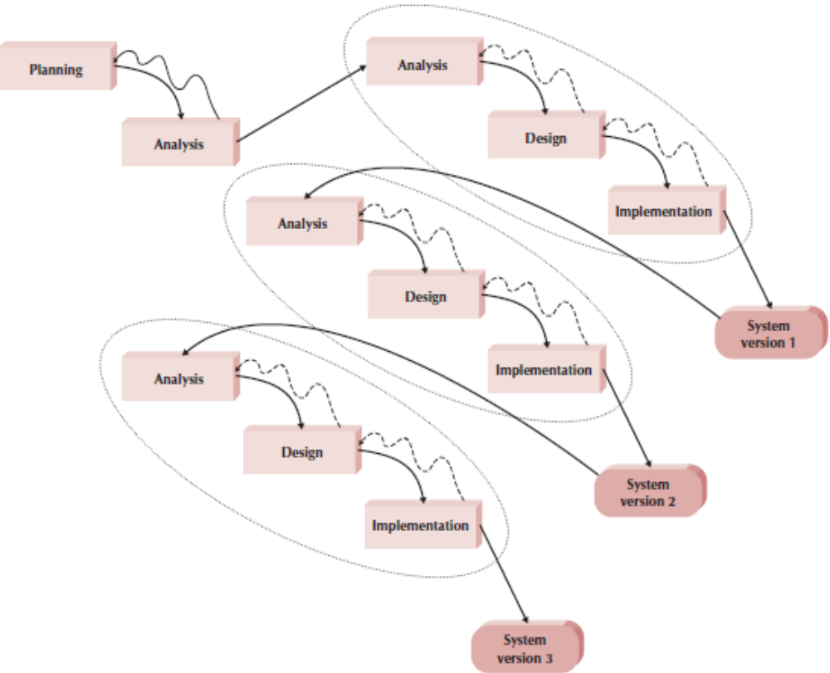

Slide 16
Advantages
Phased development–based methodologies have the advantage of quickly getting a useful system into the hands of the users. Although the system does not perform all the functions the users need at first, it does begin to provide business value sooner than if the system were delivered after completion, as is the case with the waterfall and parallel methodologies. Likewise, because users begin to work with the system sooner, they are more likely to identify important additional requirements sooner than with structured design situations.

Slide 17
Drawback
The major drawback to phased development is that users begin to work with systems that are intentionally incomplete. It is critical to identify the most important and useful features and include them in the first version and to manage users’ expectations along the way.

Slide 18
Prototyping
A prototyping-based methodology performs the analysis, design, and implementation phases concurrently, and all three phases are performed repeatedly in a cycle until the system is completed. With these methodologies, the basics of analysis and design are performed, and work immediately begins on a system prototype, a quick-and-dirty program that provides a minimal amount of features.

Slide 19
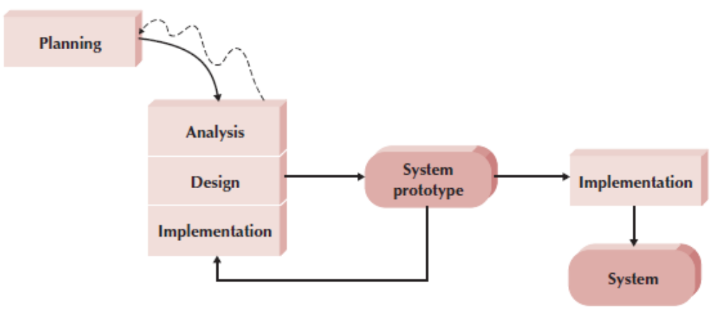

Slide 20
Prototyping
A prototype is an initial version of a system used to demonstrate concepts and try out design options.
A prototype can be used in:
  The requirements engineering process to help with requirements elicitation and validation;
  In design processes to explore options and develop a UI design;
  In the testing process to run back-to-back tests.

Slide 21
Benefits of prototyping
Improved system usability.
A closer match to users’ real needs.
Improved design quality.
Improved maintainability.
Reduced development effort.

Slide 22

The process of prototype development

Slide 23
Prototype development
May be based on rapid prototyping languages or tools
May involve leaving out functionality
  Prototype should focus on areas of the product that are not well-understood;
  Error checking and recovery may not be included in the prototype;
  Focus on functional rather than non-functional requirements such as reliability and security

Slide 24
Throwaway prototyping
Throwaway prototyping-based methodologies are similar to prototyping-based methodologies in that they include the development of prototypes; however, throwaway prototypes are done at a different point in the SDLC. These prototypes are used for a very different purpose than those previously discussed, and they have a very different appearance
Prototypes should be discarded after development as they are not a good basis for a production system:
  It may be impossible to tune the system to meet non-functional requirements;
  Prototypes are normally undocumented;
  The prototype structure is usually degraded through rapid change;
  The prototype probably will not meet normal organizational quality standards.

Slide 25
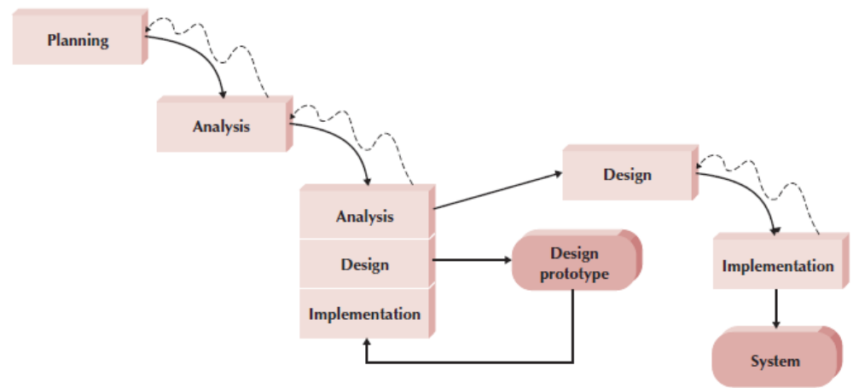
A Throwaway Prototyping–based Methodology

Slide 26
Agile Development
A third category of systems development methodologies is still emerging today: agile development. All agile development methodologies are based on the agile manifesto and a set of twelve principles.
Agile manifesto
We are uncovering better ways of developing software by doing it and helping others do it. Through this work we have come to value:
  Individuals and interactions over processes and tools Working software over comprehensive documentation Customer collaboration over contract negotiation Responding to change over following a plan
That is, while there is value in the items on the right, we value the items on the left more.

Slide 27
Software is delivered early and continuously through the development process, satisfying the customer.
Changing requirements are embraced regardless of when they occur in the development process.
Working software is delivered frequently to the customer.
Customers and developers work together to solve the business problem.
Motivated individuals create solutions; provide them the tools and environment they need and trust them to deliver.
Face-to-face communication within the development team is the most efficient and effective method of gathering requirements.

Slide 28
The primary measure of progress is working, executing software.
Both customers and developers should work at a pace that is sustainable. That is, the level of work could be maintained indefinitely without any worker burnout.
Agility is heightened through attention to both technical excellence and good design.
Simplicity, the avoidance of unnecessary work, is essential.
Self-organizing teams develop the best architectures, requirements, and designs.
Development teams regularly reflect on how to improve their development processes.

Slide 29
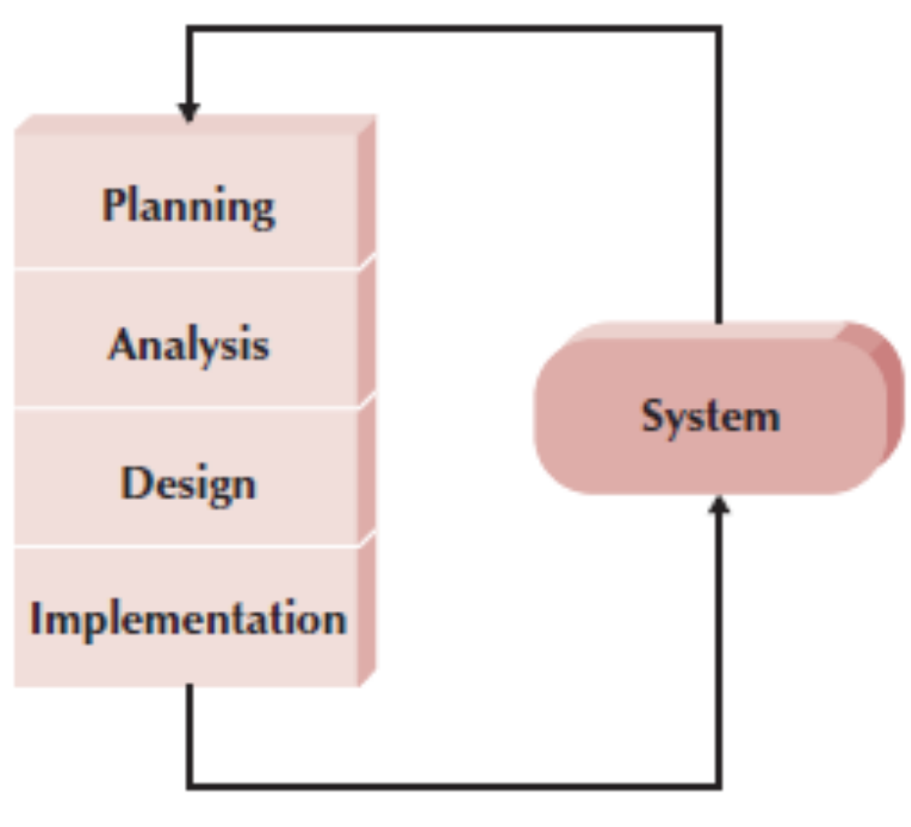
Typical Agile Development Methodology

Slide 30
Extreme programming
Perhaps the best-known and most widely used agile method.
Extreme Programming (XP) takes an ‘extreme’ approach to iterative development.
  New versions may be built several times per day;
  Increments are delivered to customers every 2 weeks;
  All tests must be run for every build and the build is only accepted if tests run successfully.

Slide 31
XP and Agile principles
Incremental development is supported through small, frequent system releases.
Customer involvement means full-time customer engagement with the team.
People not process through pair programming, collective ownership and a process that avoids long working hours.
Change supported through regular system releases.
Maintaining simplicity through constant refactoring of code.

Slide 32
Scrum
Scrum is a term that is well known to rugby fans. In rugby, a scrum is used to restart a game. In a nutshell, the creators of the Scrum method believe that no matter how much you plan, as soon as the software begins to be developed, chaos breaks out and the plans go out the window. The best you can do is to react to where the proverbial rugby ball squirts out. You then sprint with the ball until the next scrum. In the case of the Scrum methodology, a sprint lasts thirty working days. At the end of the sprint, a system is delivered to the customer.

Slide 33
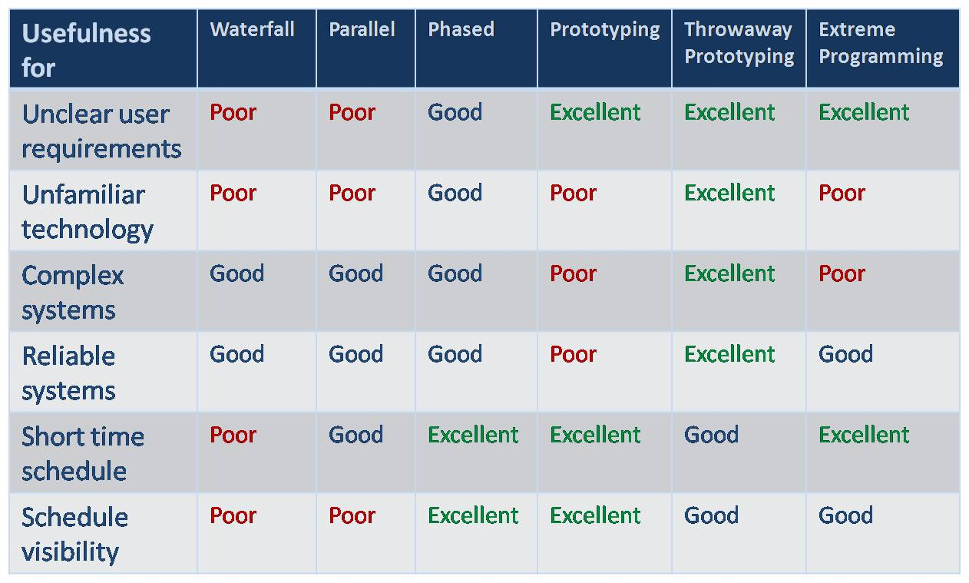
Which Methodology to Use?

