Slide 1
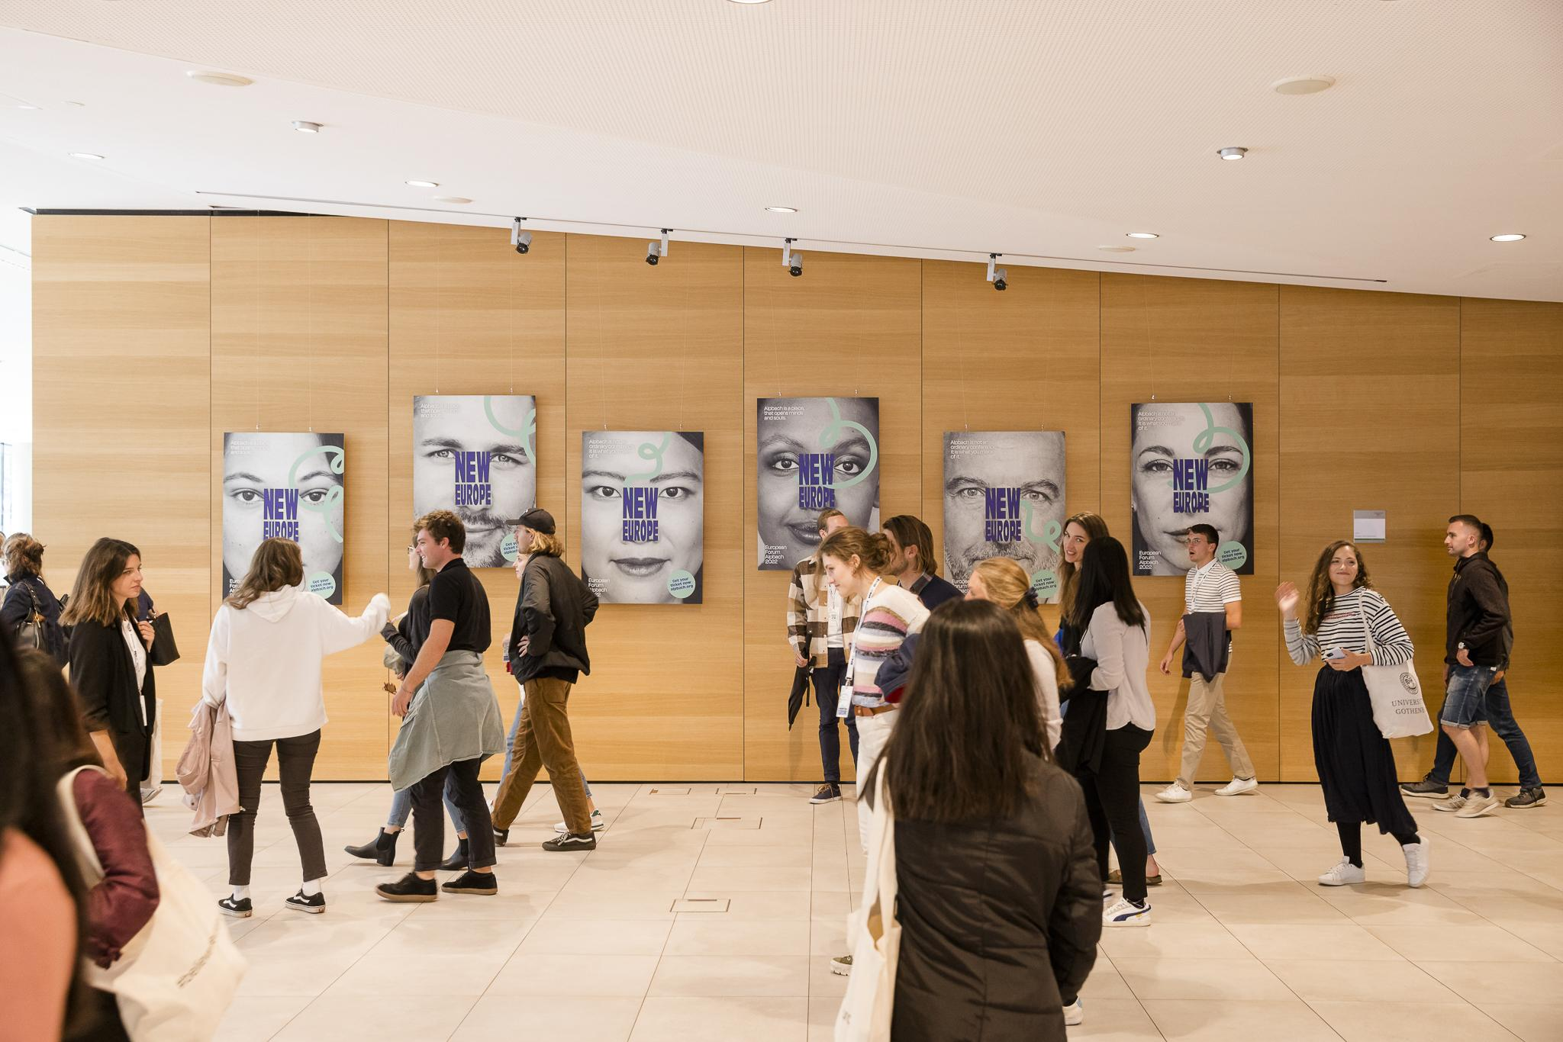



European Forum Alpbach scholarship programme 2026

Slide 2
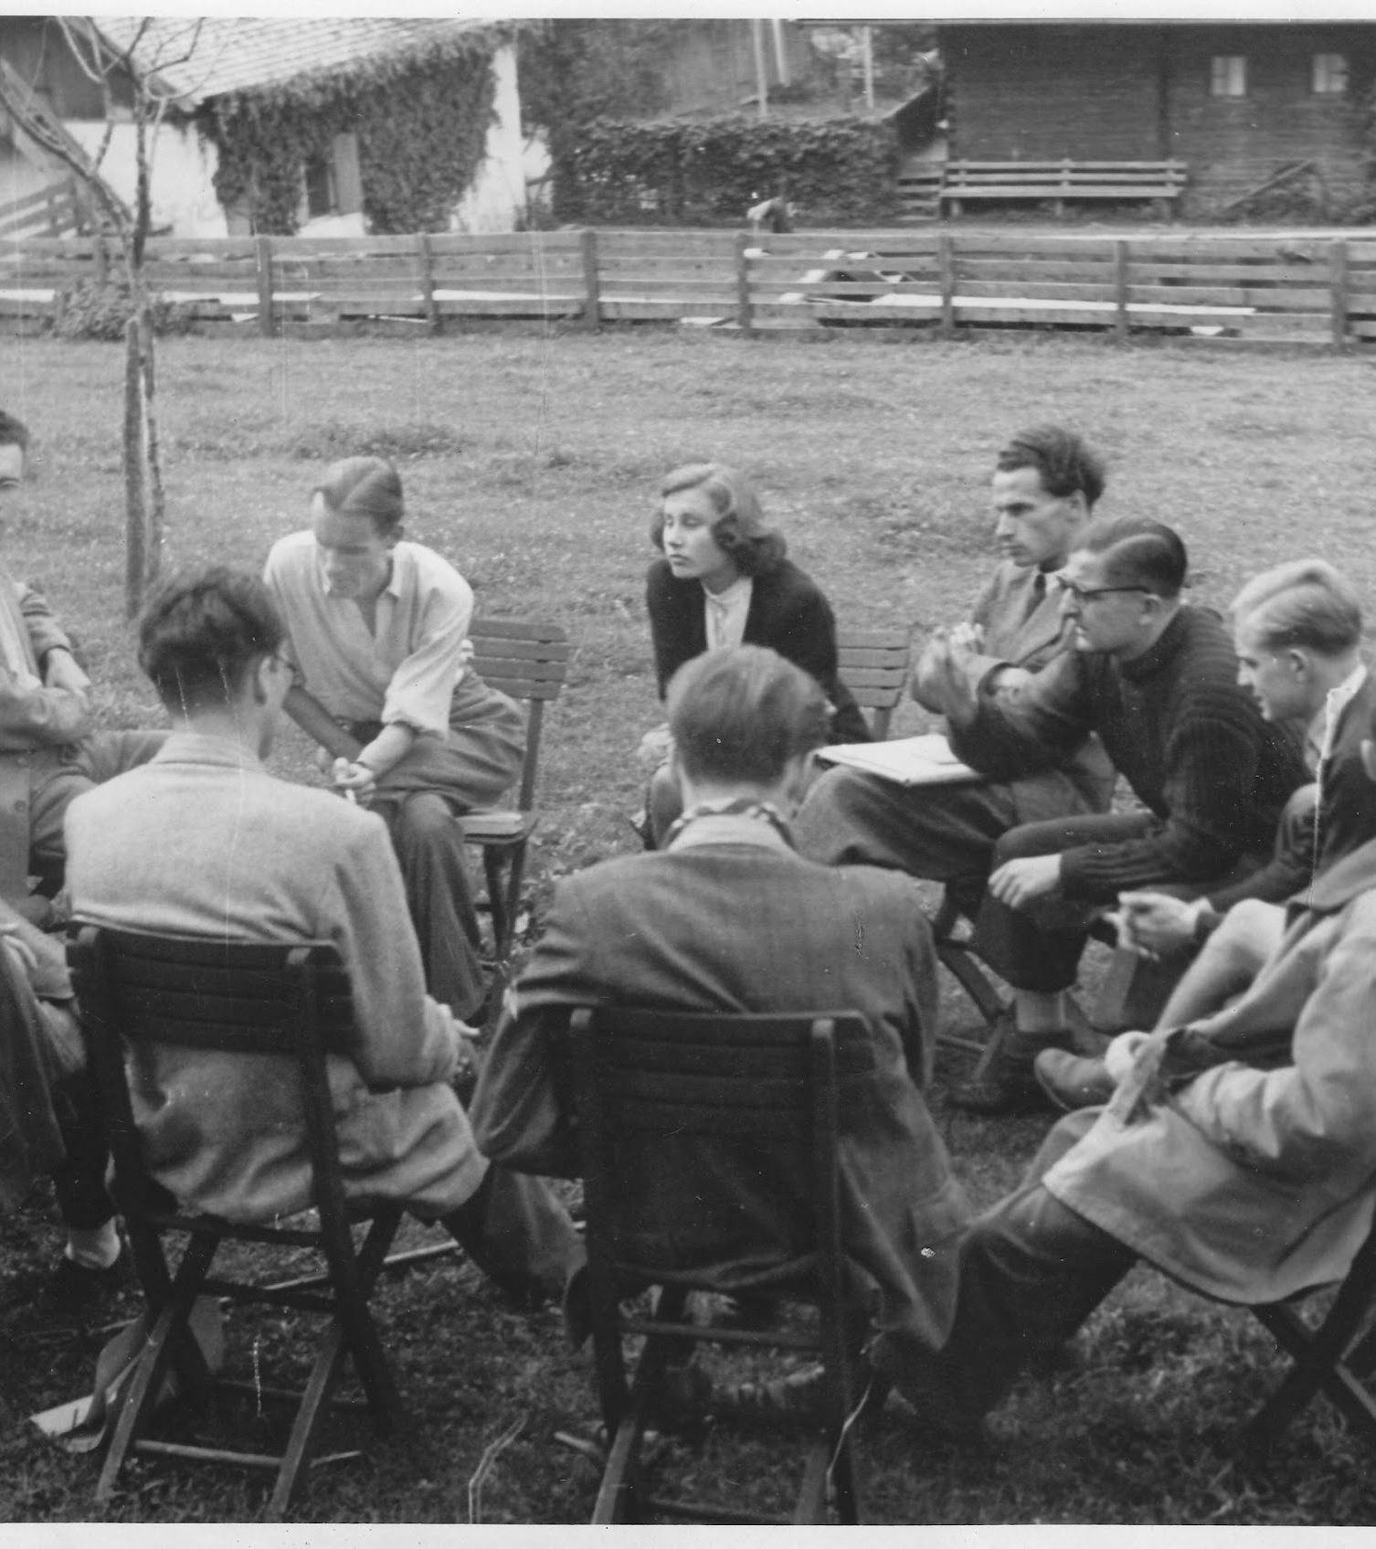
EFA HISTORY
The Forum was founded in 1945 in the Austrian mountain village of Alpbach with the intention of rebuilding and uniting Europe out of the ashes of World War II – by means of dialogue and collaboration.

Slide 3
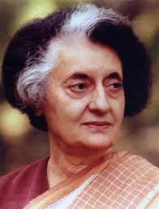
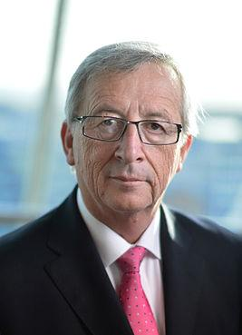
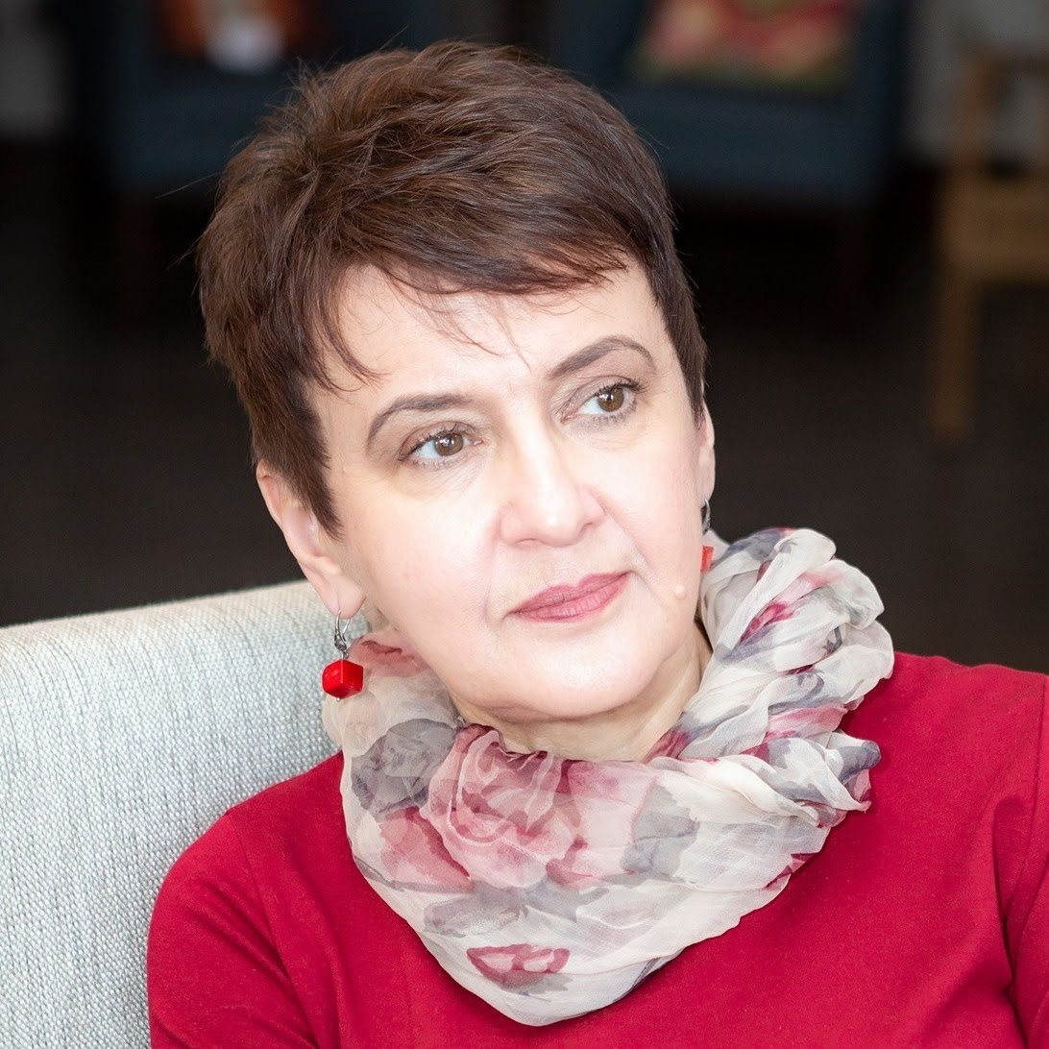
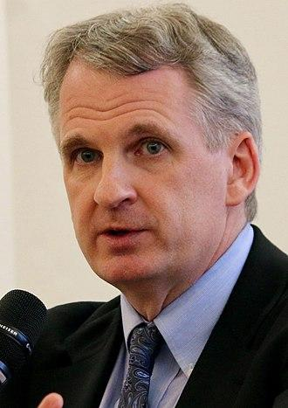
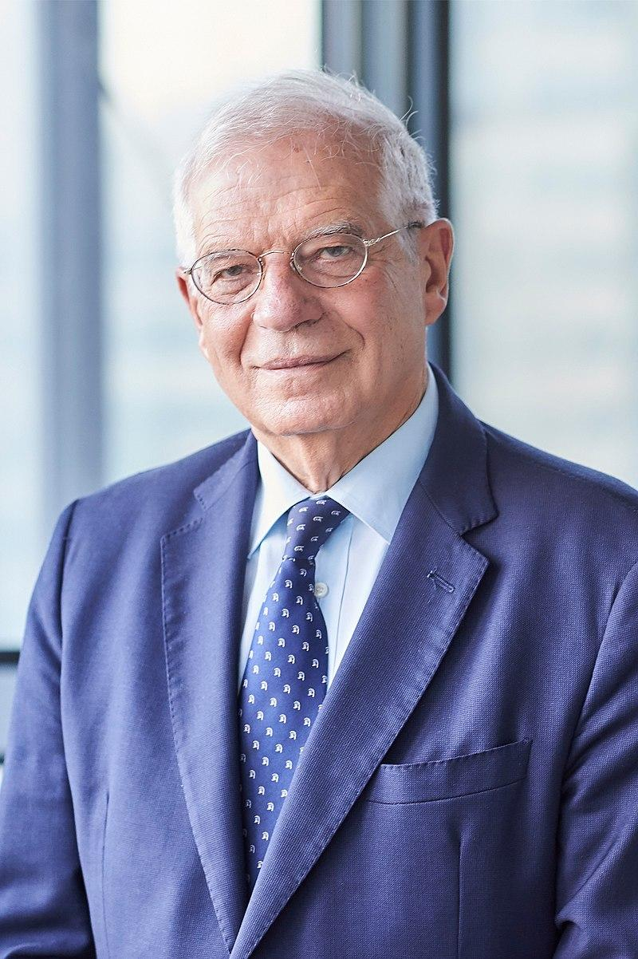
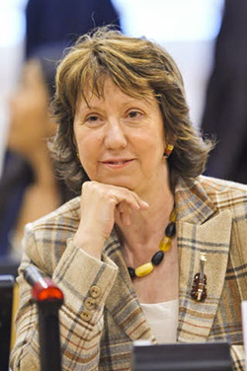
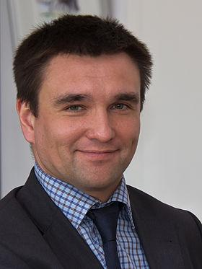
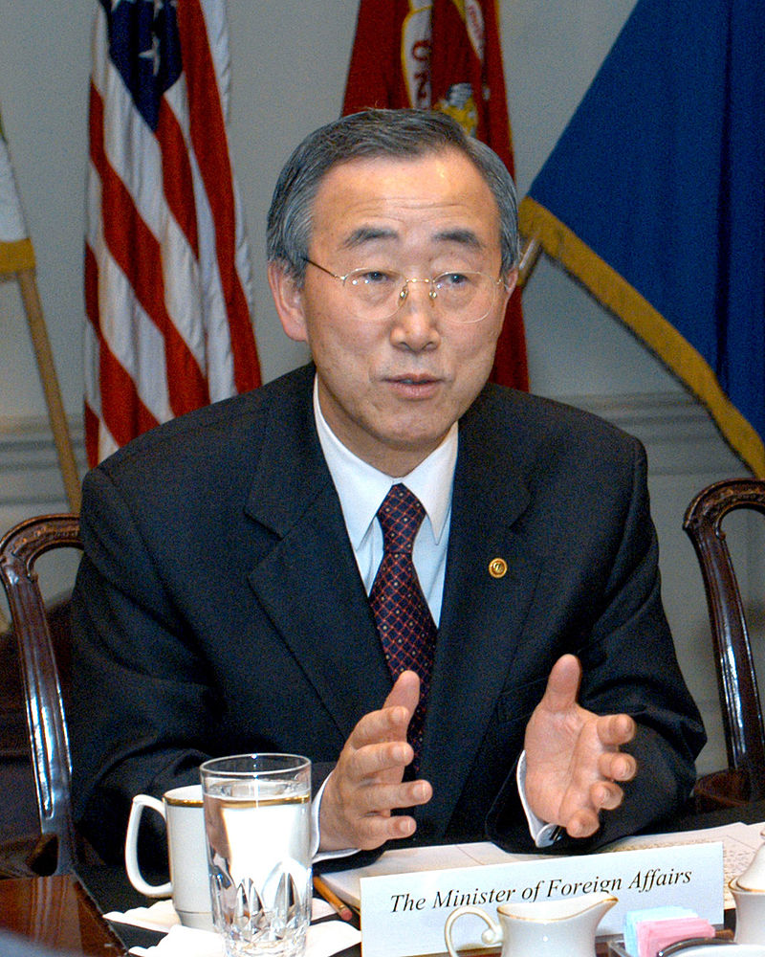
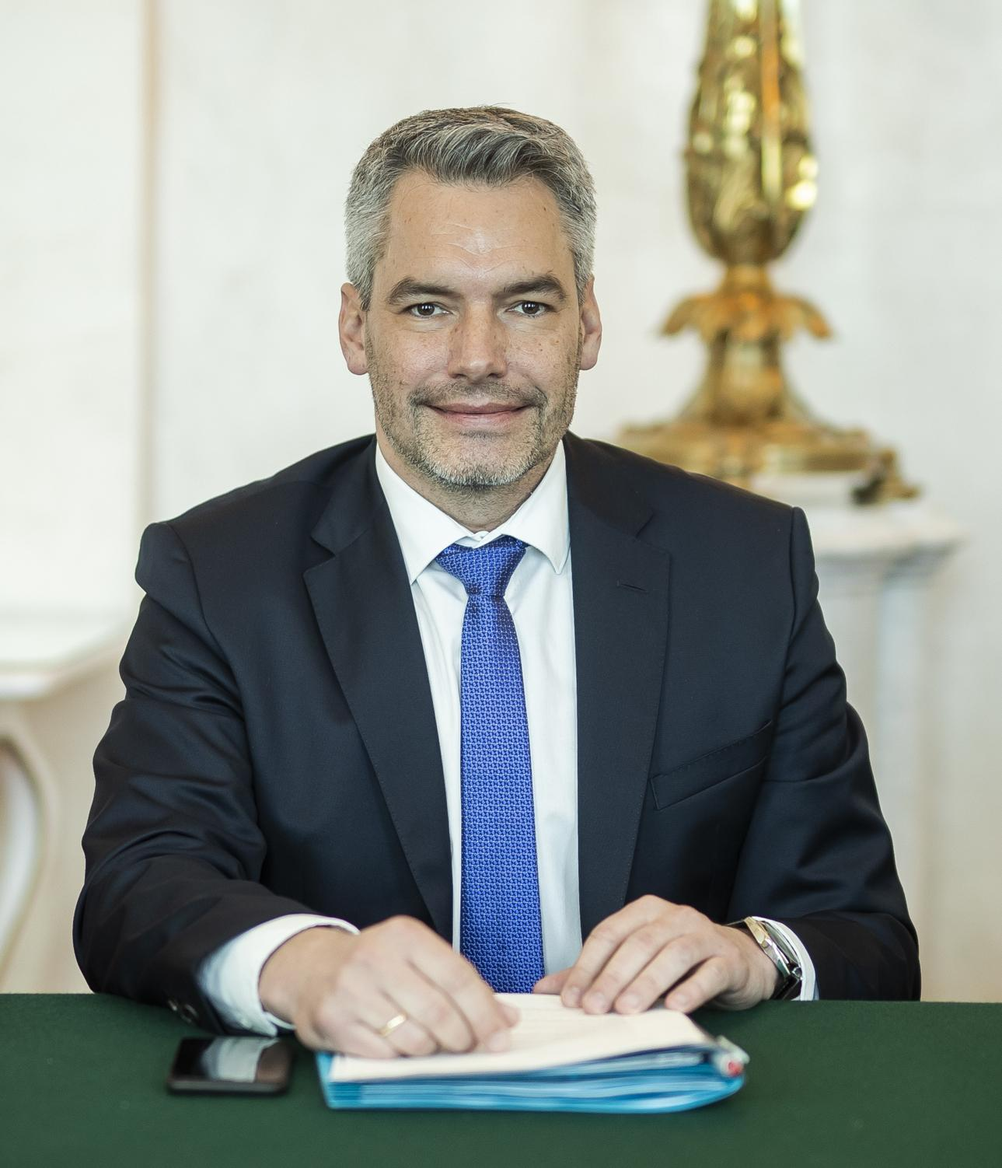
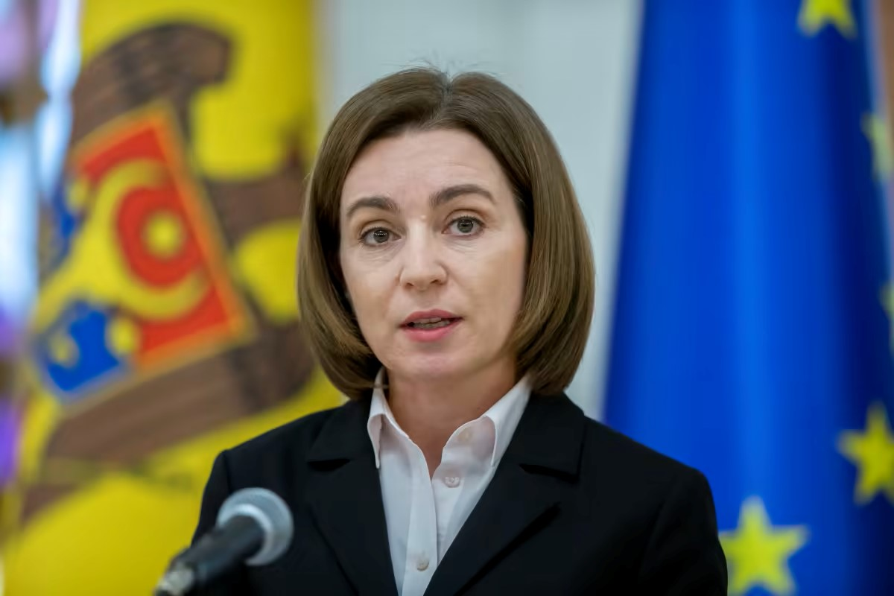
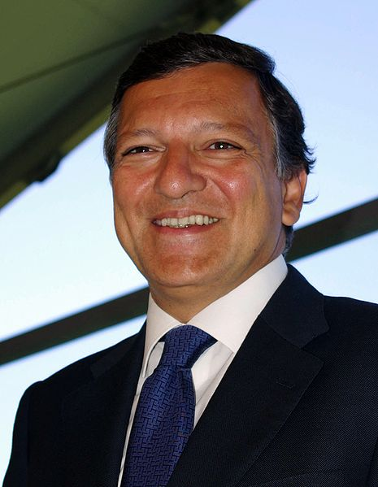
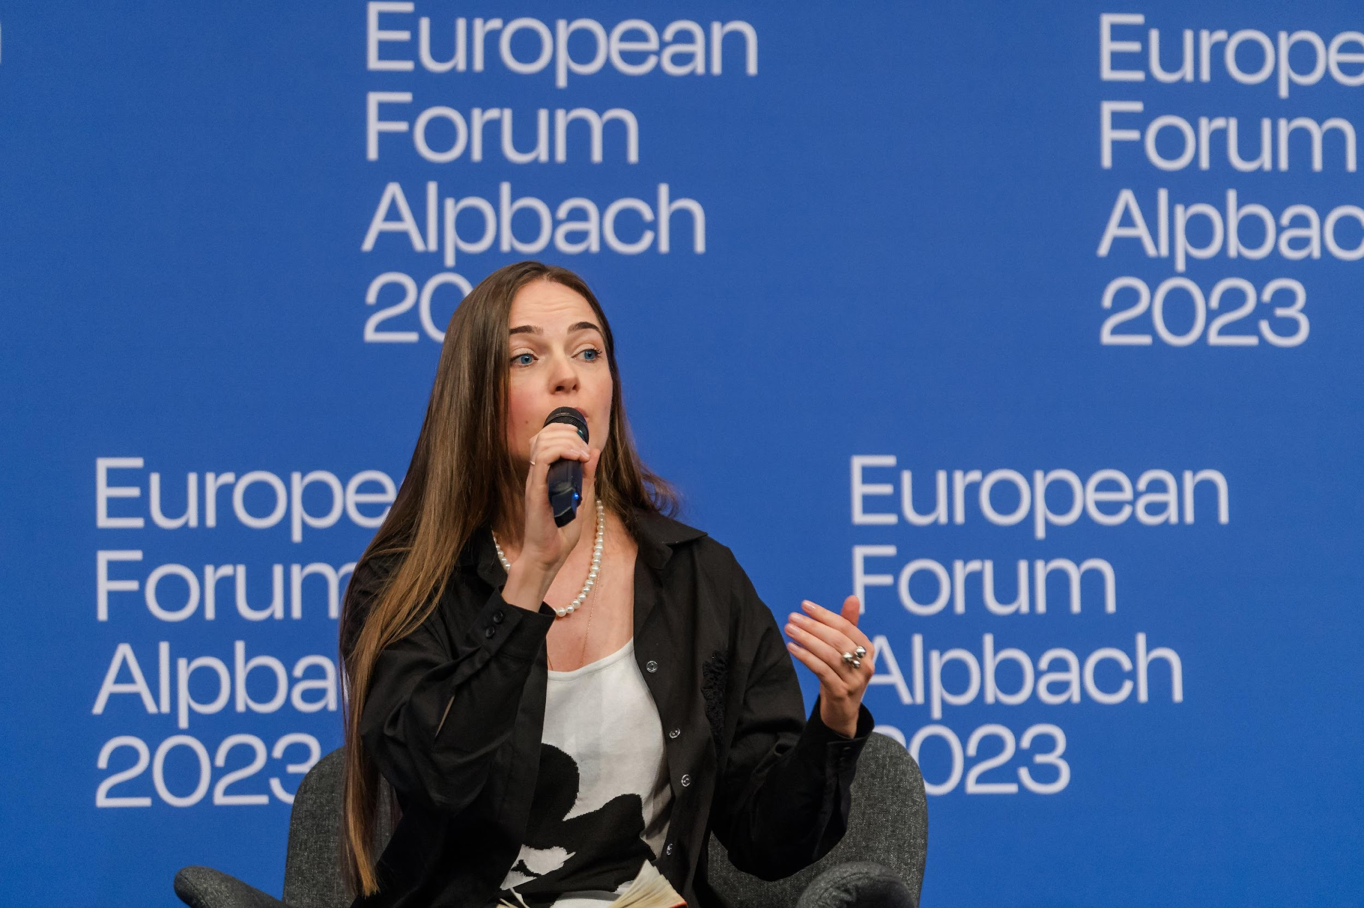
EFA HISTORY
During the following decades, personalities such as Indira Gandhi, Nobel laureates James Buchanan; Josep Borrell, Timothy D. Snyder, Oksana Zabuzhko, Oleksandra Matviichuk, Pavlo Klimkin, Jose Manuel Barroso, Jean-Claude Juncker, Maia Sandu, and Vivienne Westwood or UN Secretary General Ban Ki-moon came to Alpbach to debate global matters.

Slide 4
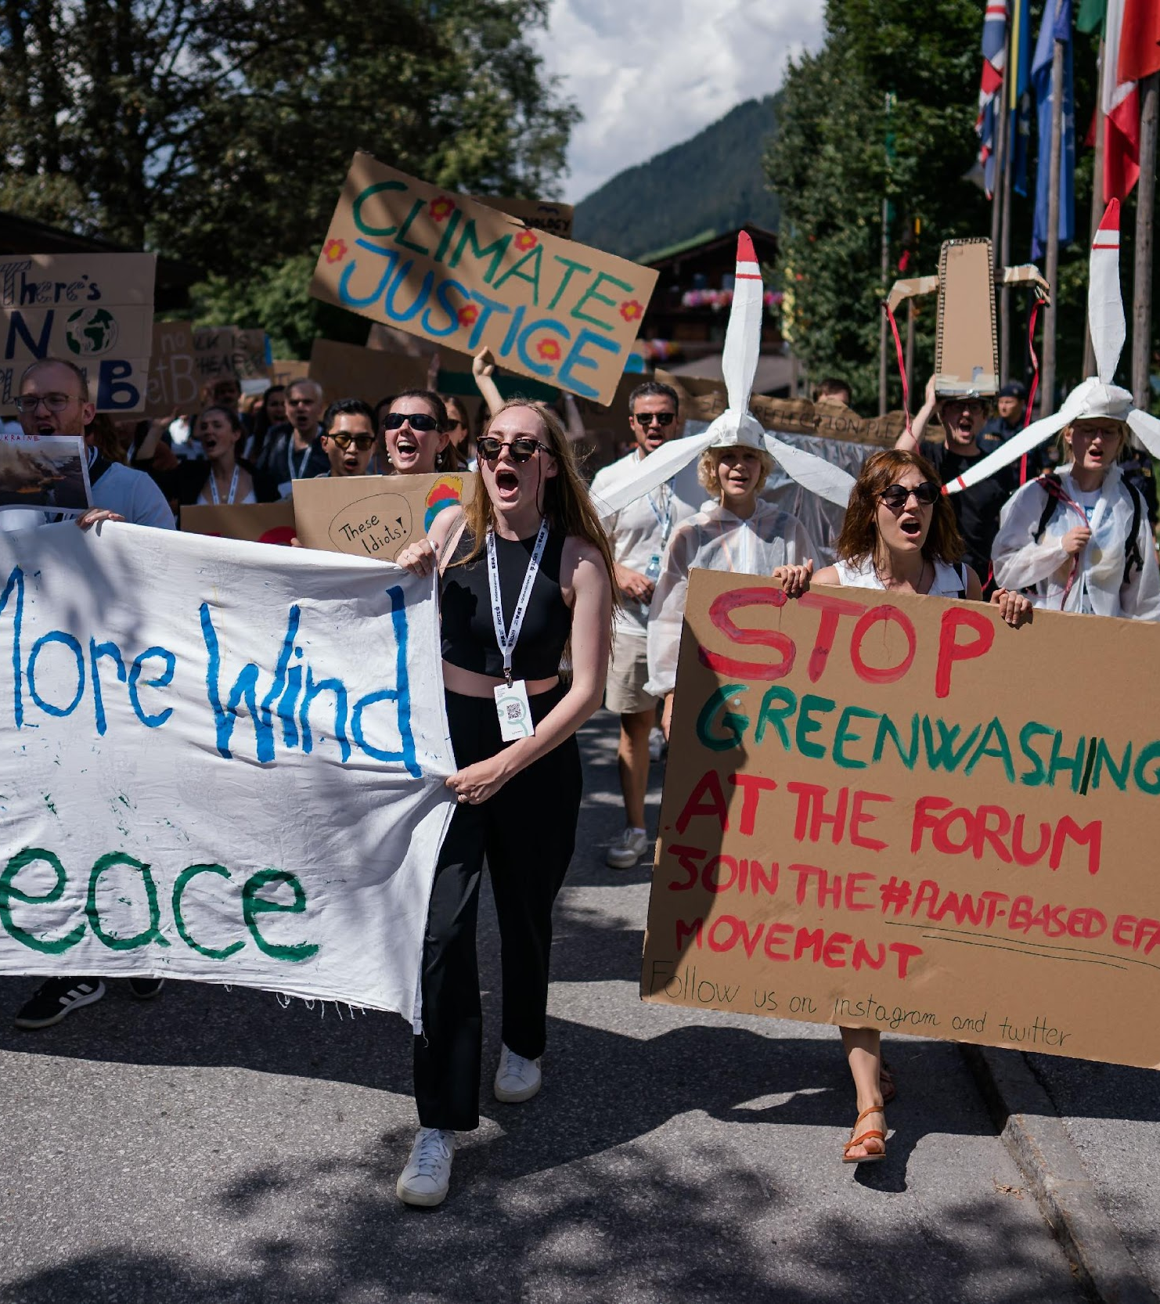
EFA Event nowadays
The European Forum Alpbach brings together leading thinkers, decision-makers, and the most innovative minds from politics, business, young people, civil society, culture, and science to drive ideas for a strong and democratic Europe.
Annually since 1945
4, 200 participants
100 nations
600 young scholarship holders
470 speakers
473 sessions

Slide 5
NGO Kyiv Initiative Group Alpbach (KIGA) was founded in 2012

Slide 6
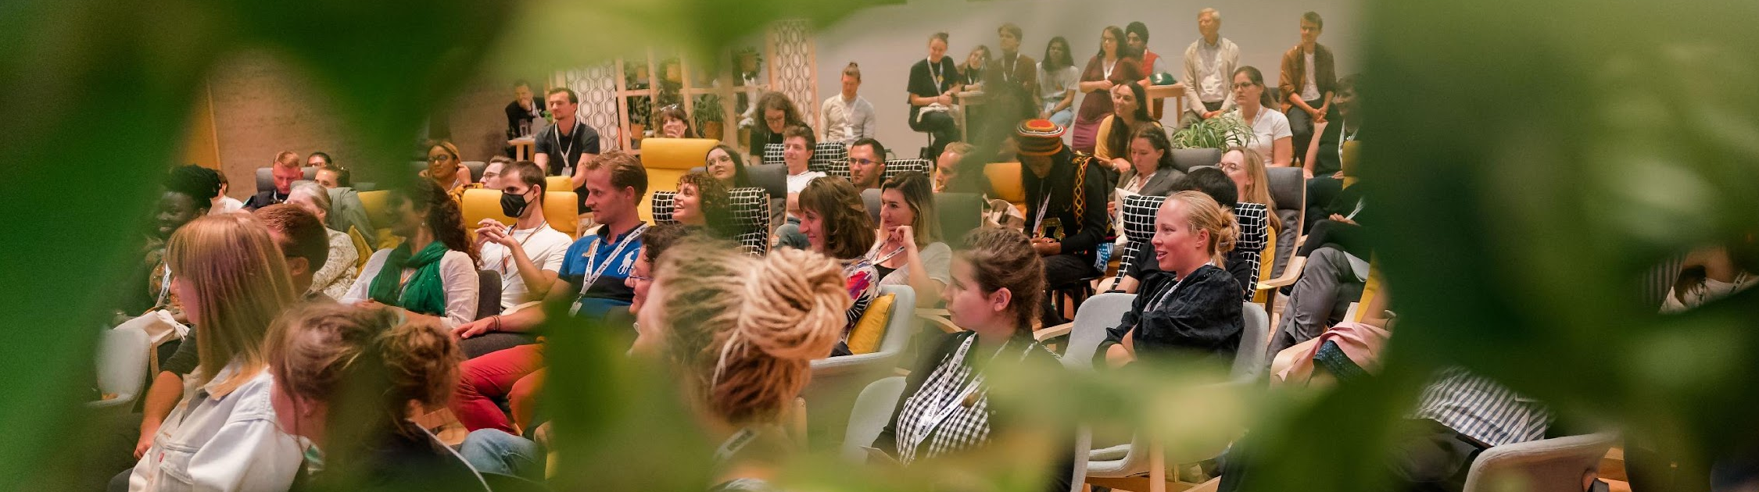



SCHOLARSHIP PROGRAMME

Slide 7
How can I apply?
Clubs with own scholarships and separate selection process:
CA Burgenland,
CA Liechtenstein,
CA Niederösterreich,
CA Upper Austria,
CA Salzburg,
CA Senza Confini,
CA Steiermark,
CA Südtirol Alto Adige,
CA Tirol,
CA Vorarlberg,
IG Wien.
Application via the EFA website:
https://www.alpbach.org/blog/scholarship-programme
Deadline at tthe end of March

Slide 8
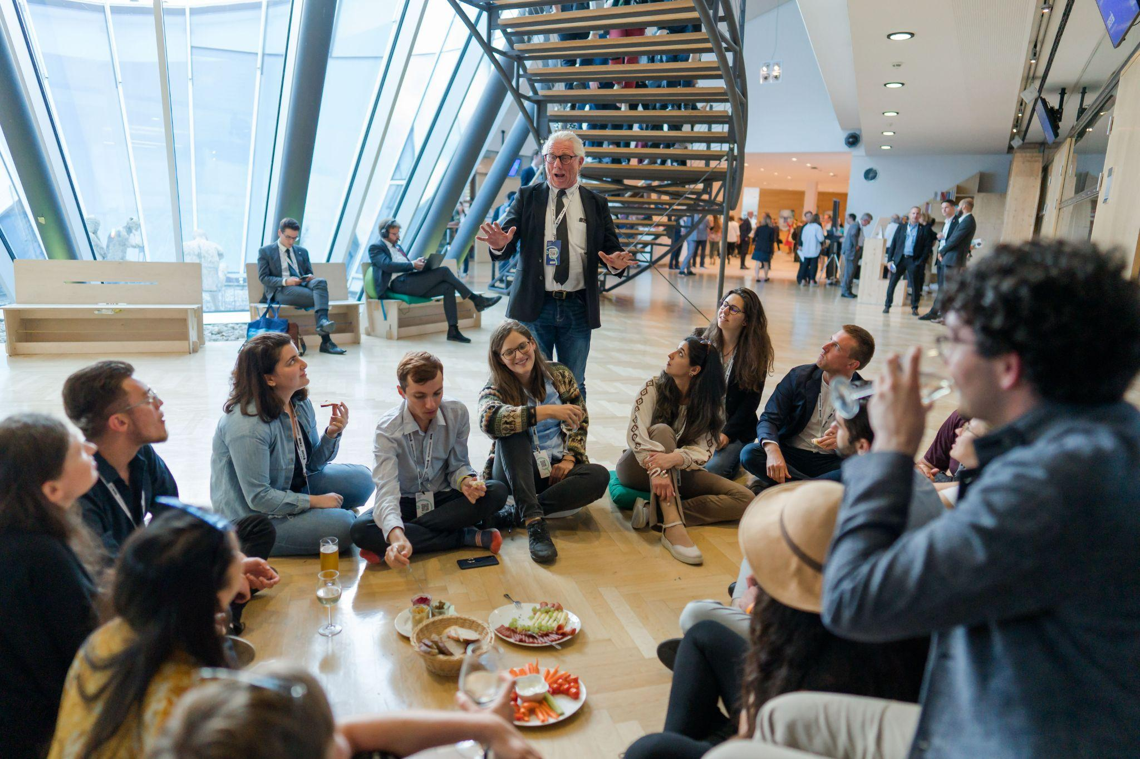
What does a scholarship cover ?
A scholarship covers:
the participation fee
accommodation with breakfast for the entire duration of EFA 26
a daily allowance of around EUR 25 per day
Travel costs are not covered by the EFA.

Slide 9
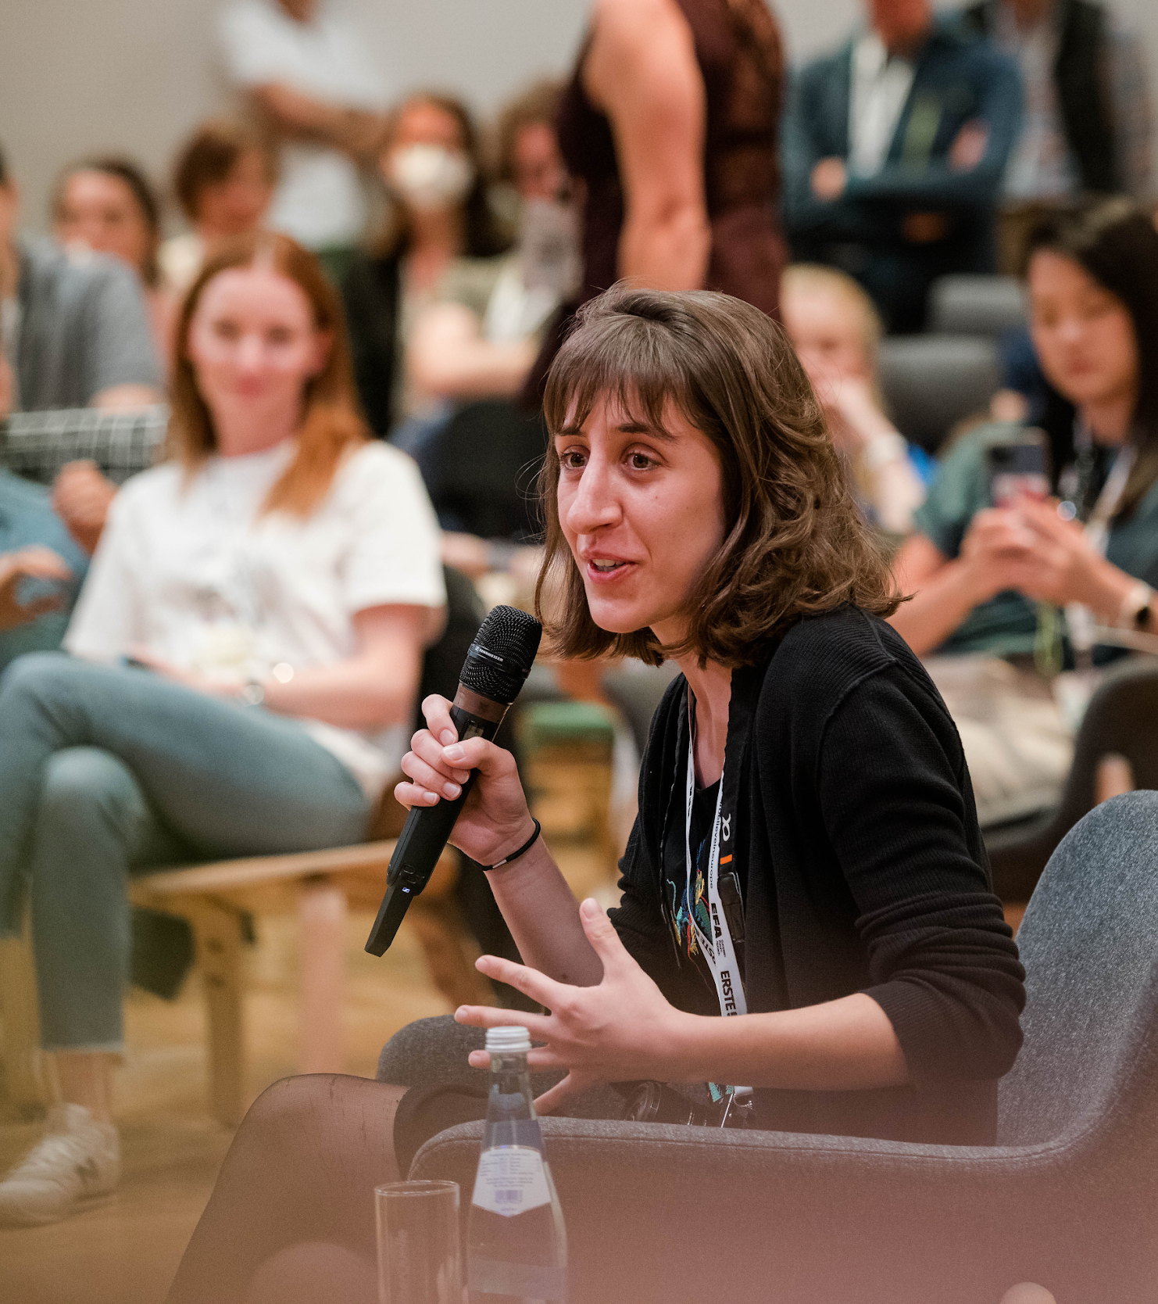
SCHOLARSHIP HOLDER PROFILE
Out of the box thinking
Open-minded thinkers and solution-seekers
Average age: 25
Young pioneers who want to make a difference in their communities and beyond.
Highly committed
Scholarship holders are active in their sectors and civil society and/or show academic success.
Various fields and sectors
In order to foster interdisciplinarity, special care is taken to select scholarship holders from different backgrounds and disciplines.

Slide 10
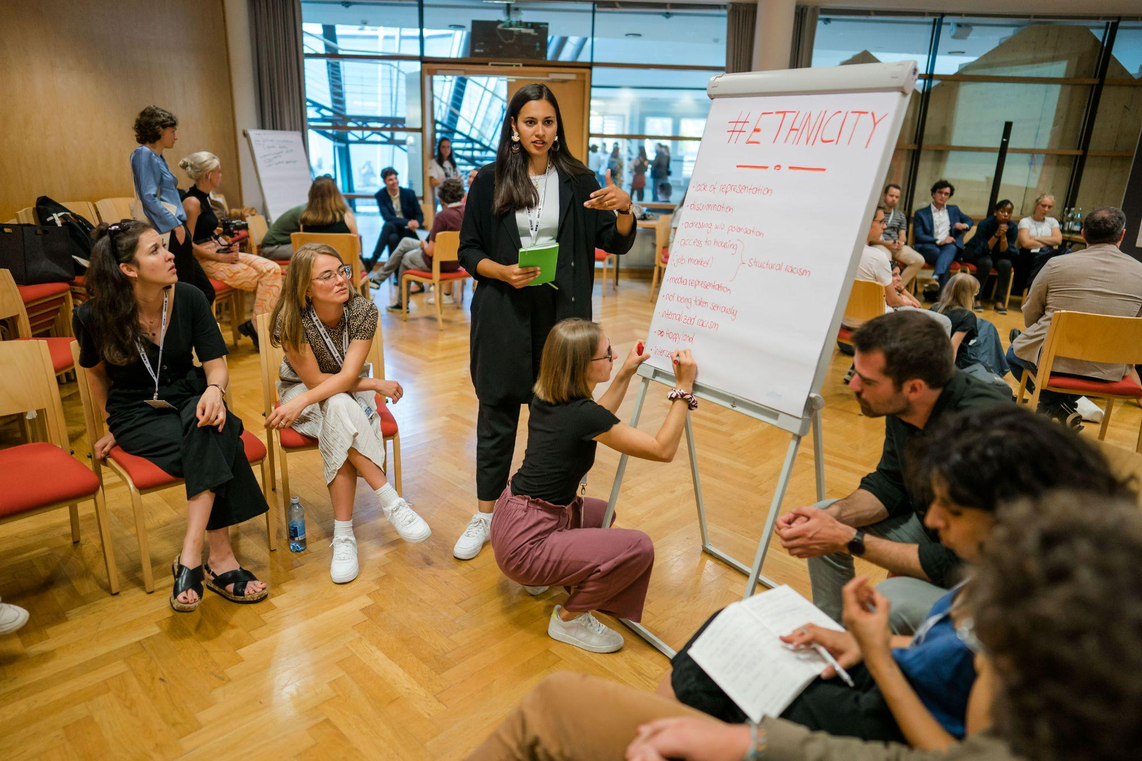
Who can apply to the EFA scholarships?
EFA HISTORY
Requirements
Age 18 – 30
First-time scholarship holder
English (Minimum B2)
Minimum 11-day Attendance (icluding Seminars and EiW Days)
EFA especially invites the participation of female talents in Science/Technology/Engineering/Mathematics (STEM), as well as talents in urban development, engineering, arts and culture, entrepreneurship, finance

Slide 11

Online
Application procedure
Via the EFA website
https://www.alpbach.org/blog/scholarship-programme

Slide 12
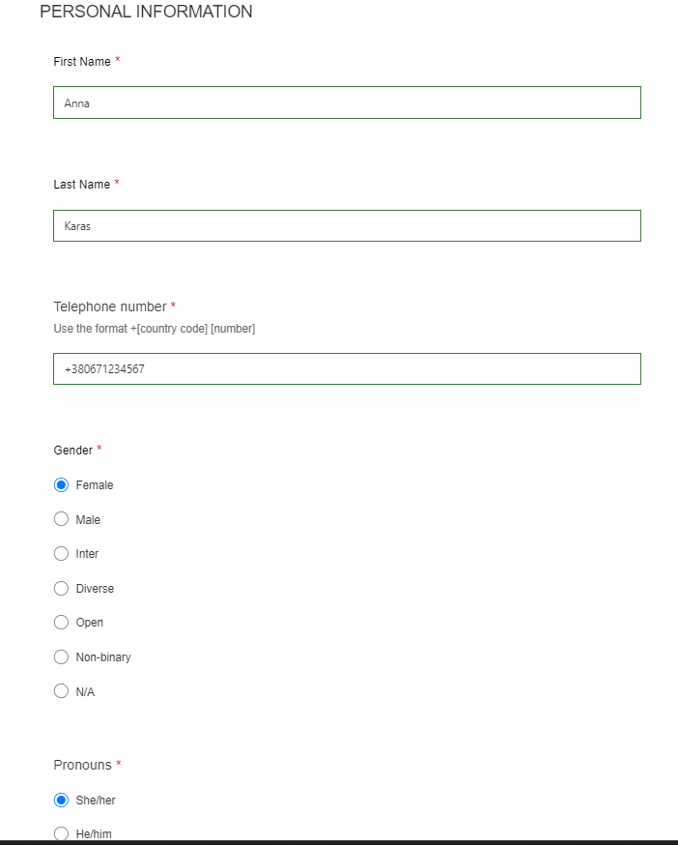
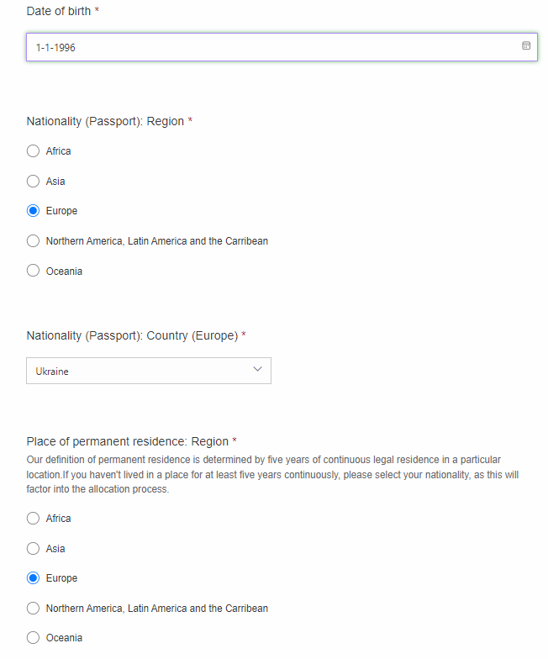

Slide 13
Keep in mind!
Minimum duration of stay: 11 days stay (that includes the whole Seminar Days and the Europe in the World Days)
Applicants will be notified about results mid-June at the latest
Approximately 7-8 scholarships will be awarded
You need to accept or decline your scholarship within 7 days after receiving EFA acceptance letter

Slide 14

Selection procedure
Selection Committee consists of the EFA representatives, engaged member of the EFA community and KIGA representatives
KIGA jury conducts online interviews
EFA jury decides and confirms the scholarship holders

