Slide 1
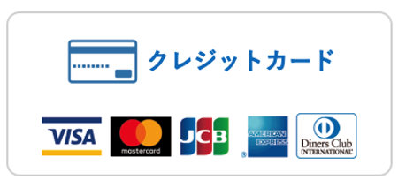



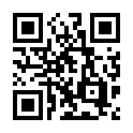
Dear Parents and Guardians
●●(month) ●●(day) 2022
●● Nursery School
Director : ●● ●●
Notification About the Introduction of Cashless Payment Service
Thank you as always for using our nursery school.
Today, we would like to inform that the payment method which has been used to pay various charges such as extended nursery fee or goods fee will change. At this time, we introduce new cashless payment service called “enpay” which cooperates with LINE app. “Enpay” is specialized for nursery school and the charges every month will be paid through this service. Therefore, please link your account of LINE app to the system of “enpay” by following way.
You can pay the charge from four choices, paying by credit card, PayPay, LINE Pay, or at convenience store (Lawson, Family Mart, Mini Stop, and Seiko Mart) through the message from “enpay” delivered to your LINE app. You can earn points by paying by credit card. You can also issue your own receipt on LINE after payment. Please see page 4 of this document for instructions on how to issue a receipt.
Means of Payment
cashless payment
credit card
convenience store
※Even if you don’t have a smartphone, tablet or LINE app, you can still pay from a paper bill. You can pay by credit card or at a convenience store using the QR code on the paper bill. So, in such cases, please contact the school staff.
※Also, please be assured that although this is a payment service using LINE, neither the school nor the management company (Enpay Co. Ltd.) will have any knowledge of your LINE account (ID, icon, etc.).
※For more information about enpay, please visit the official website of the service at the bottom right.
https://enpay.co.jp/top/

Slide 2
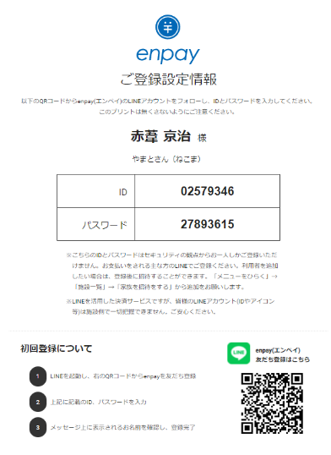



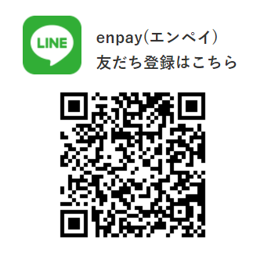
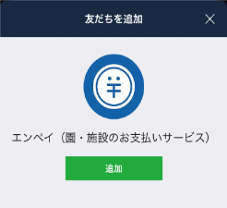
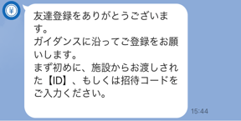


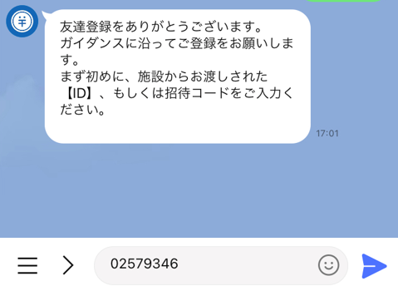



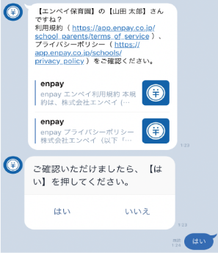
How to Register LINE
Please have the form
with your ID and PASSWORD
distributed by the school staff.
sample
Install of launch the LINE application on your smartphone.
※If you have already installed the application, there is no need to install it.
Read the QR code on the form distributed by the school staff on LINE and register enpay as a friend.
sample
When you add enpay as a friend, you will receive a message asking you to enter your ID.
First, tap the keyboard symbol
in the lower left corner of the talk screen.
Second, enter the ID (8-digit number) shown on the form
in the text input field and submit it.
You will receive a message asking you to enter your password.
Enter your password (8-digit number) in the same way and submit it.
Your name will be displayed for confirmation.
If your name is correct, tap “はい”.
If you have any questions, please send us a message from “お問い合わせ”
in LINE Talk. Our customer center will answer you.

Slide 3
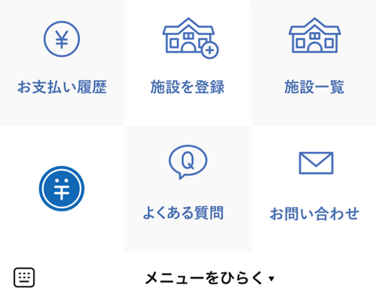
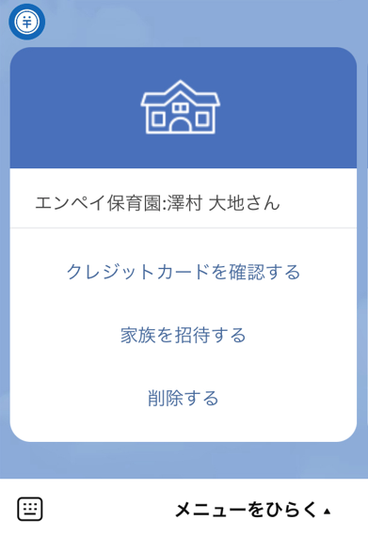
How to Unregister LINE
If you have a new cell phone or your cell phone breaks down, etc., and you can no longer use the LINE account you have already registered, you will need to re-register with a new LINE account. You must first deregister with your old account and then re-register with your new account. Please follow the steps below.
＜If you can log in with your old account＞
Tap "メニューをひらく" at the bottom of the talk screen, then tap "施設一覧”.
Tap "削除する" among the three items displayed.
Register again with a new LINE account using the ID and password distributed by the school.
sample
＜If you cannot log in with your old account＞
Please contact the school staff to unregister LINE.

Slide 4
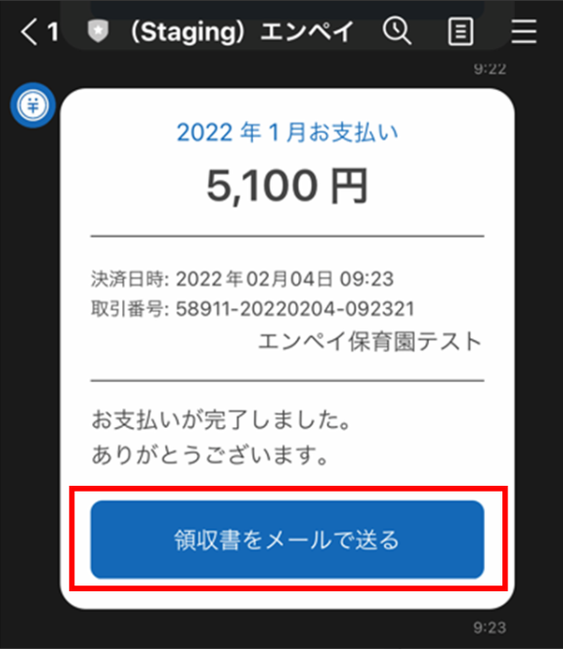
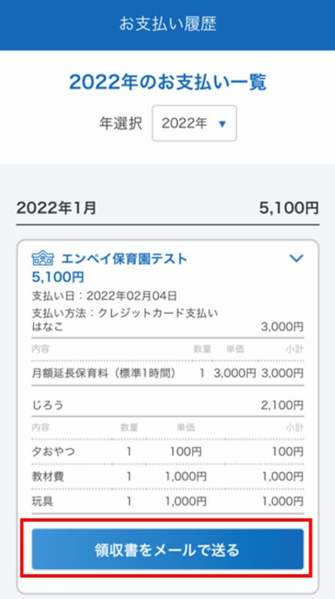
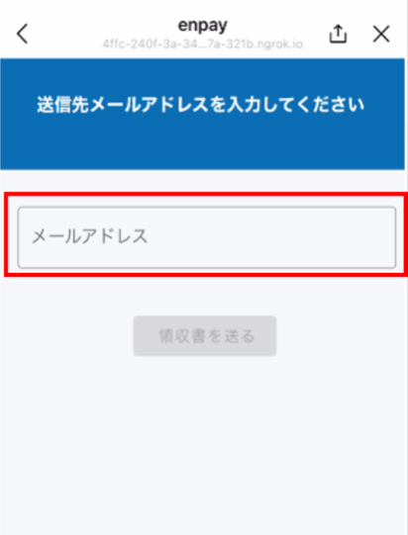
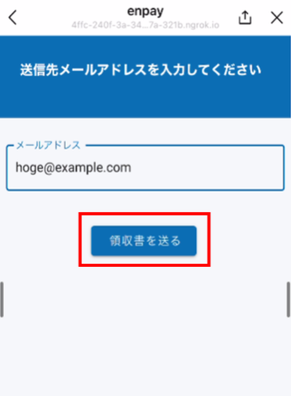
How to Issue a Receipt
1
Tap the button "領収書をメールで送る” in the "Payment Completion Notification” sent to LINE after payment.
or
Tap the button "領収書をメールで送る” under "お支払い履歴” in "メニューをひらく" on the talk screen.
2
Enter your own email address to which you want to send the receipt and tap "領収書を送る".
3
You will receive an email with a receipt attached to the email address you specified.
※Only one receipt can be issued at a time. Please note that receipts for multiple invoices cannot be issued together.
※Receipts cannot be issued for each billed expense item. If you need one, please contact the school directly.
If you have any questions, please send us a message
from “お問い合わせ” in LINE Talk.
Our customer center will answer you.

