Slide 1
Writing Primer 2:
Paragraphs & Sections
CIBO 2019
Prof. Andy Pennock

Slide 2
What is Writing?
Thinking
Communicating
  Words and Sentences
  Paragraphs and Sections

Slide 3
Practice Memo Debrief
In groups of three, practice asking and answering metacognitive about the assignment.
Read each other’s memos.
  Note about what you felt when you read them the first time through.
  Put a few thoughts together about was just done differently than yours.
  What did you identify that was done well or that could have been done differently?

Slide 4
Instructions
Select your group’s most creative problem statement.
Go to sli.do
Enter code #Z039
Have one group member enter the most creative problem statement.
Review other groups’ submissions.
Each group member should then vote on your two favorites.

Slide 5
Principles of good sentences:
1: Characters Make Good Subjects,
2: Actions Make Good Verbs,
3: Choose Words Wisely.
Look through the sample memos and find examples that abide by these principles and those that violate them.

Slide 6
Paragraphs and Sections

Slide 7
Joyous Reading?
Within one of the nation’s most threatened coastal regions lies the Eastern Shore of Virginia. Storms are intensifying and sea levels are rising at three to four times the global average here. Climate change is linked to both. Tens of millions of dollars have been spent in the past on piecemeal and reactive approaches to address the mounting challenges of climate-related hazards. The area’s vulnerability has unfortunately been exacerbated by these efforts.

Slide 8
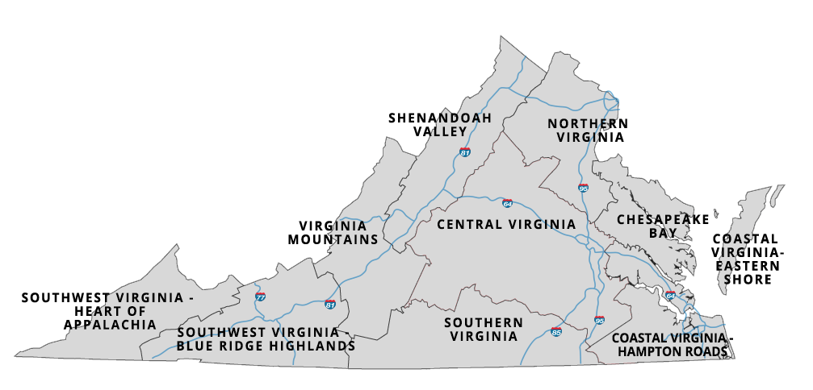

Slide 9
Better Reading?
The Eastern Shore of Virginia lies within one of the nation’s most threatened coastal regions. Sea levels here are rising at three to four times the global average and storms are expected to intensify. Both of these trends are linked, in part, to climate change. Climate-related hazards are producing mounting challenges which government has often addressed through reactive, expensive, piecemeal approaches. Often, these efforts have exacerbated the area’s vulnerability.
This is a lot better. Why?

Slide 10
Principles of good paragraphs:
Cohesion:
  Do my sentences connect together?
Coherence:
  Does my paragraph make sense as a whole?

Slide 11

Cohesion
Assertion: Sentences hold together and paragraphs are cohesive when you
  1) begin sentences with ideas that are connected to ideas that your audience is already familiar with and
  2) put new information at the end of sentences.
Notes:
Cohesion is water molecules on the hood of a car.

Slide 12
Cohesion: A good example
¹ The Eastern Shore of Virginia lies within one of the nation’s most threatened coastal regions. ²Sea levels here are rising at three to four times the global average, and storms are expected to intensify. ³Both of these trends are linked, in part, to climate change. ⁴Climate-related hazards are producing mounting challenges which government has often addressed through reactive, expensive, piecemeal approaches. ⁵Often these efforts have exacerbated the area’s vulnerability.
Notes:
Here are the subjects

Slide 13
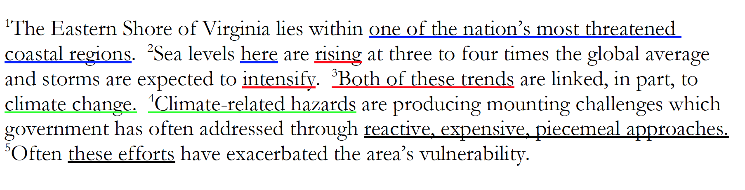
Cohesion: A good example
Notes:
Here are the subjects

Slide 14
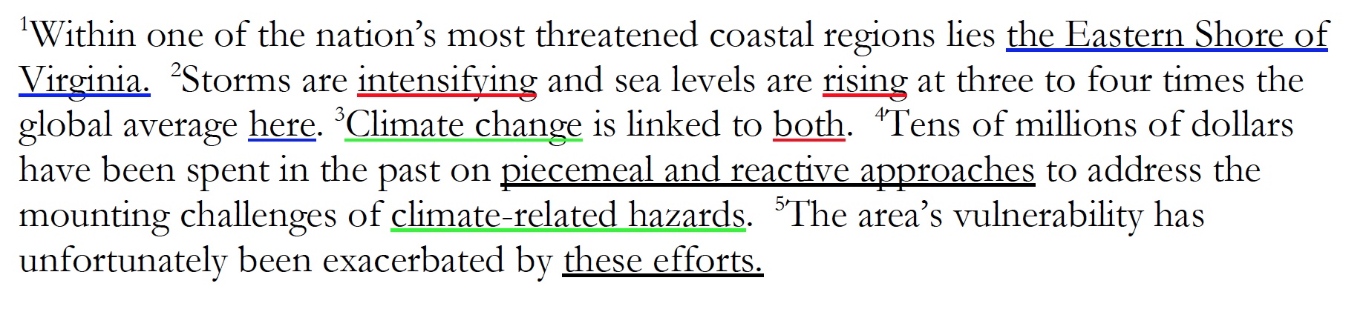
Cohesion: A bad example
Notes:
Here are the subjects

Slide 15
Cohesion: Another example
Many coastal areas are inhabited and many will need to be abandoned in coming decades as SLR continues. Tangier Island is the last inhabited island in the Chesapeake Bay. Climate change and associated sea level rise (SLR) are already impacting low-lying coastal areas, including islands, throughout the world. With the predicted SLR, much of the island’s remaining landmass is expected to be lost in the next 50 years and it will likely need to be abandoned. Since 1850, 66.75% of Tangier Island’s landmass has been lost.

Slide 16
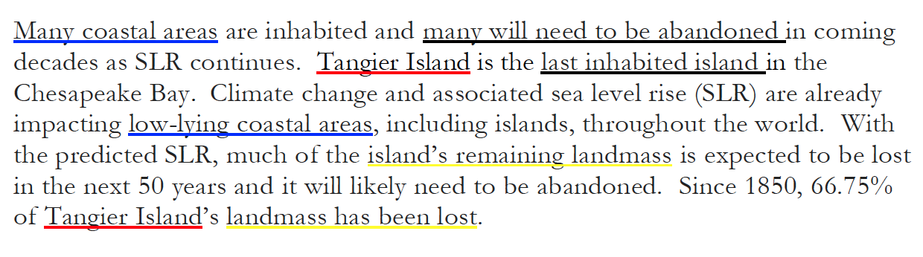
Cohesion: Another example
Notes:
Here are the subjects

Slide 17
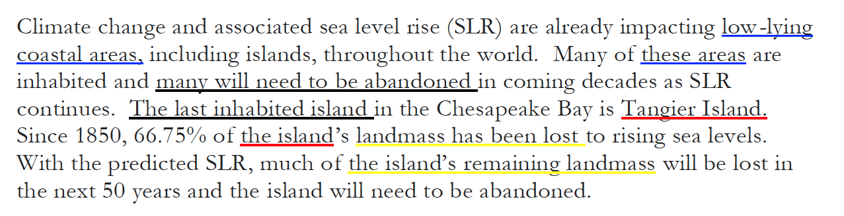
Cohesion: Rewrite

Slide 18
Looking for cohesion in your work
Read one background section.
Do the sentences hold together and are paragraphs are cohesive?
  Do the sentences begin with ideas that are connected to ideas that your audience is already familiar with
  Do they put new information at the end of sentences?

Slide 19
Coherence: Does my paragraph make sense as a whole?
Assertion: Audiences prefer paragraphs that focus on the same topic throughout.
Why does anyone write incoherently?
  Lack of sleep!
  It’s a part of the writing process (and you didn’t leave time to edit).
  An unwillingness to kill your darlings.
Subsidence is the natural process of the earth settling. The earth settling is like settling for a partner in life, you may not get what you want but it’s better than nothing. Nothing is what I wanted from the dining hall after I saw the menu today. But today was sunnier than yesterday, so I was able to get a tan on the quad.
Notes:
And here are the characters

Slide 20
Coherence: Does my paragraph make sense as a whole?
Struggles with sinking ground in coastal areas are not isolated to Virginia. Cities across the world are struggling with subsidence. In Louisiana, subsidence is caused by compacting sediment left by the Mississippi river. In the fall of 2016, the Geological Society of America released a report from a workgroup of state policy makers and scientists from across the country. The report examined the policy levers that state-level policy makers have at their disposal to slow climate change and recommended a number of potential solutions that fall into two different groups: increased regulation or instituting a national carbon tax. Unfortunately, these ideas are theoretical, as all bills that focus on national-level regulation have died due to pressure from energy companies.

Slide 21
Coherence: Does my paragraph make sense as a whole?
Struggles with sinking ground in coastal areas are not isolated to Virginia. In fact, coastal cities around the country are struggling with subsidence. For example, in Louisiana subsidence is caused by compacting sediment left by the Mississippi river. In Long Beach, California subsidence has been an issue since the 1940s when the oil boom caused huge subsidence problems that continue to threaten the city today.
To understand how these sinking areas will interact with climate change and associated sea level rise, the Geological Society of America commissioned a report in 2016. It documented the interaction of the two trends across the country as a part of a larger project on the impact of climate change across the country. The report also focused on informing state-level policy makers about what they can do to adapt to this unique set of challenges created by sinking land and rising seas.
Notes:
And here are the characters

Slide 22
Looking for cohesiveness in your work
Read the recommendations in the samples in front of you.
Does it focus cohesively on one topic?

Slide 23
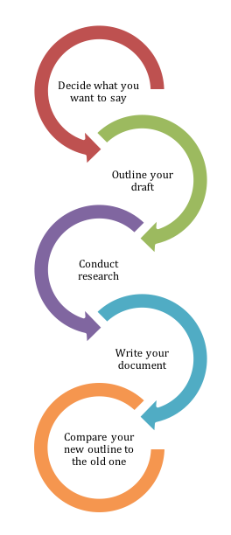
Global Coherence: Making the Document Make Sense as a Whole
Assertion: Your final product will not look much like the outline you began with because as you’ve worked on communicating, you’ve also been thinking.
True for the paragraph, even more true for the outline.
Notes:
And here are the characters

