Slide 1

Fill this out as you come in.

Slide 2

Final Exam Review
04.27.26

Slide 3
Agenda
Announcements
Brain Dump
Topics Refresher
Group Practice
Open Q&A
Quiz 11 (The Real Finale) due Tuesday, April 28 @ 9:30PM
Homework 8 due Tuesday, April 28 @ 9PM
See website for full list of office hours and locations
Notes:
For more than 10% of students, this quiz is the difference between getting the bonus and not

Slide 4
Brain Dump

Slide 5
Since the midterm, we have learned about…
Things to recall about each:
Instrumental Variables
Regression Discontinuity
Difference-in-Differences
Event Studies
Fixed Effects
Designs and assumptions
Equations, coefficients, and interpretations
Graphs (as applicable)

Slide 6
Topic Refresher

Slide 7
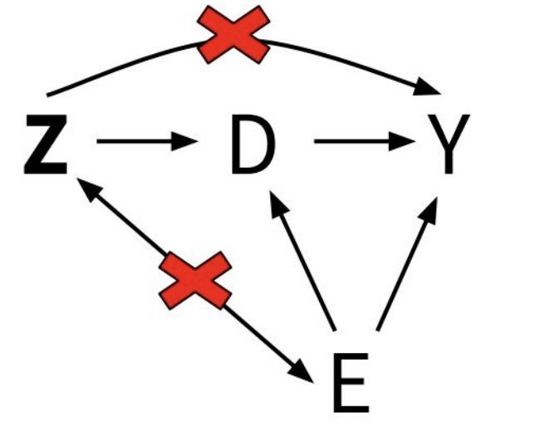
Instrumental Variables (IV) use variation in our dependent variable D that can be explained by an exogenous instrument Z to examine the effect of D on our outcome Y.

Slide 8
Instrumental Variables: Reduced Form Method
First Stage: effect of Z on D
Regress D Z → how much does our instrument affect D?
Coefficient on Z → first-stage estimate 2.
Reduced Form/ITT: effect of Z on Y
Regress Y Z → Does Y change as Z changes?
Coefficient on Z → reduced form estimate
Divide Effects: Reduced Form / First Stage
Assumptions for Unbiased Estimate
Relevance
Exclusion Restriction
Interpretation as local average treatment effect (LATE)
To interpret as LATE, also need monotonicity: Z pushes D in same direction as Z (no defiers!)

Slide 9
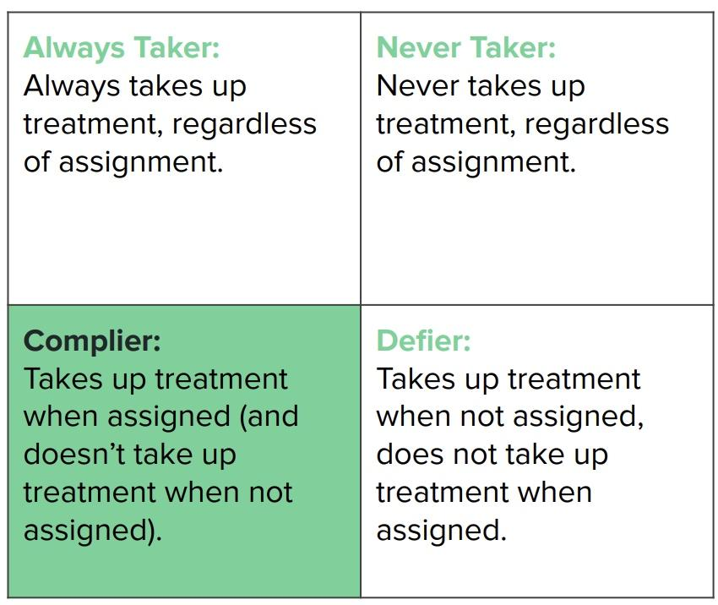
Instrumental Variables and LATE
LATE: the effect of treatment on your outcome, only for compliers.
Requirements for LATE:
Relevance
Exclusion restriction
No defiers (monotonicity); Z always pushes D in the same direction.

Slide 10
In the first stage, you regress X on Z, your instrument.
Let’s say you want to estimate the effect of education on earnings using distance from the nearest college as an instrument.
In this case, you would run the regression:
Education = 𝝱₀ + 𝝱₁Distance + 𝞮
𝝱₁ is your first-stage estimate, and tells you how much education varies with distance to the nearest college.
If the relevance assumption holds, 𝝱₁ should be non-zero.

Slide 11
In the second stage, you regress Y on Z.
Now, you would run the regression:
Earnings = 𝝰₀ + 𝝰₁Distance + 𝞮
𝝰₁ is your reduced form estimate, and tells you how much earnings vary with distance to the nearest college.
To get the local average treatment effect (LATE), you now divide your reduced form estimate by your first stage estimate:
𝝰₁ / 𝝱₁
The LATE tells you the relationship between distance to the nearest college and future earnings for those who are more likely to attend college when they live nearby.

Slide 12
Regression Discontinuity (RD): a quasi-experimental research design used to estimate causal effects when treatment assignment is based on whether an observed variable crosses a known cutoff or threshold.
This method takes advantage of “rules” and “regulations” that are not embedded in nature.
Thresholds → Treatments

Slide 13
Conditions for Regression Discontinuity
In order to apply RD, some conditions must be satisfied:
Whether or not you receive a “treatment” is determined by some score or ranking.
The score has to be continuous around the cutoff and has to be arbitrarily and exogenously determined.
We have outcomes above and below the cutoff.
People cannot game the system to receive the treatment.
In other words:
Units just below the threshold are a valid control for units just above the threshold.
There are no other jumps (“treatments”) at the discontinuity.

Slide 14
Regression Discontinuity Equation
𝑇_{i} is a dummy/indicator for whether person i received the treatment
X_{i} is the assignment variable (running var.) measuring the score or ranking of person i
C is the cutoff value
X_{i} − 𝐶 is the assignment variable centered around C.
Adding an interaction term allows us to account for changes in slope from our “control” side to our “treatment” side.

Slide 15
Difference-in-Difference
DiD allows us to compare how the outcomes for our control and treatment group evolve over time.
Key assumption: in the absence of any treatment, our treatment would have continued to follow the same trends as the control group (Parallel Trends). We can verify this by examining trends pre-treatment + with Event Studies.
Basic regression: Y = а + β₁ (Treat) + β₂ (Post) + β₃ (Treat * Post)

Slide 16
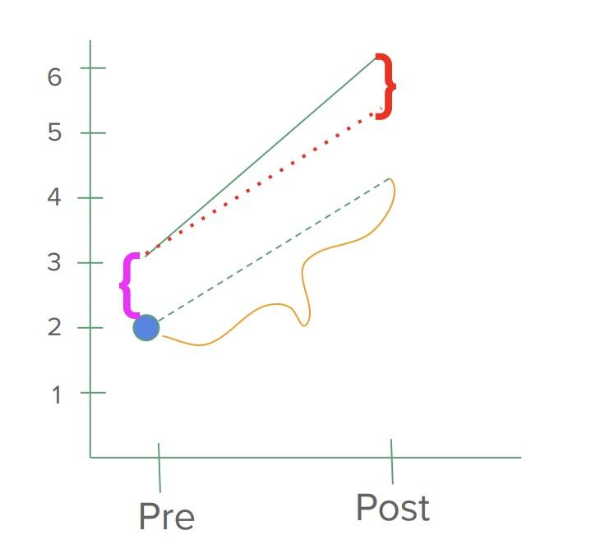
Graphing DiD
Y_{dt} = ɑ + βTreat_{d} + ץPost_{t} + 𝝳_{DD}(Treat_{d} * Post_{t}) + 𝝴_{dt}
What does ɑ capture?
The outcome for the control group in the pre period
What does β capture?
The difference between the treatment and control groups in the pre period
What does ץ capture?
The difference in outcomes for control in the pre vs post period
What does 𝝳 capture?
The difference between how the control group changed and how the treatment group changed in the pre vs post period

Slide 17
Event Studies
Plotting the difference between treatment and control (T-C) relative to a baseline difference in a given year
Can think of it as “normalizing” the difference
To support parallel trends, we want to see a relatively flat trend before treatment that straddles zero.
We have to change our regression slightly:
Before: Y = а + β₁ (Treat) + β₂ (Post) + β₃ (Treat * Post)
After: Y = а + β₁ (Treat) + β₂ (Year) + β₃ (Treat * Year₁ ) + β₄ (Treat * Year₂) + β₅ (Treat * Year₃ ) … + β_{i} (Treat * Year_{i} )

Slide 18
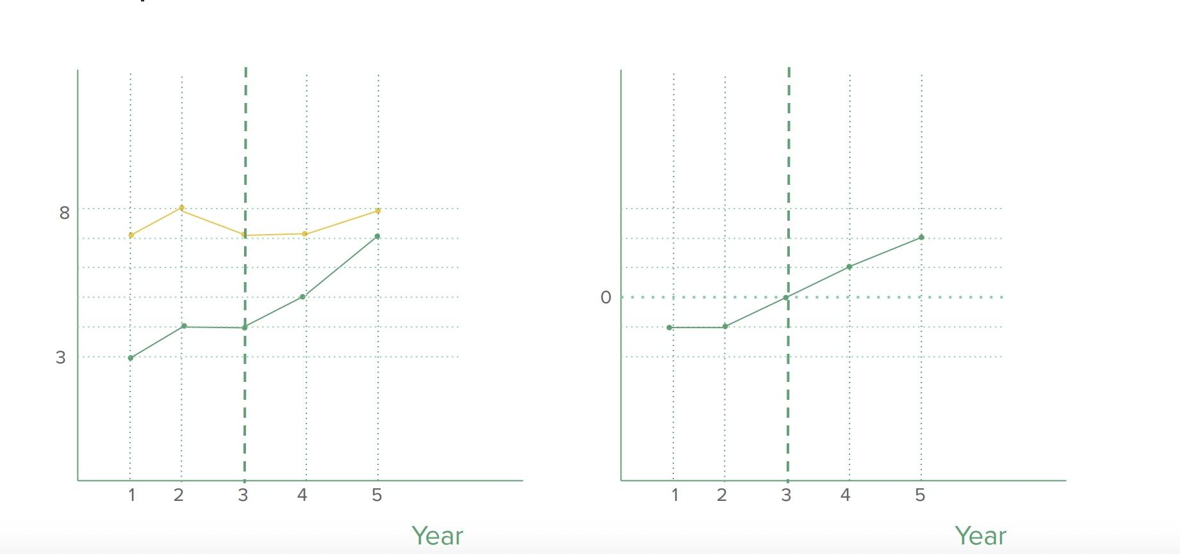
An example:

Slide 19
Group Practice (Rotation 1)

Slide 20
[insert groups here]

Slide 21
Group Practice (Rotation 2)

Slide 22
[insert groups here]

Slide 23
Open Q&A

