Slide 1

Midterm Review
02.23.26

Slide 2

Agenda
Conceptual Review & Practice
Practice Exam Review
Questions? Submit them below:
https://forms.gle/vQSVvGCjawKtjGN28

Slide 3
Write down everything you remember from the first half of the semester.
Measurement and Size
Conditional Expectation
Regression
Linear regression and mean comparison
Non-linear regressions
Bias: signing the bias and elements of a good control
Interaction terms
Log regression

Slide 4
Measurement
Measurement Scales:
Nominal: the measurement is categorical and order is irrelevant (e.g. hair color)
Ordinal: categories are ordered, but the intervals between them are unequal or unknown (e.g. places in a race)
Interval: intervals are equal, but there’s no meaningful zero (e.g. calendar years)
Ratio: intervals are equal and have a meaningful zero (e.g. income)
Good measurements should be:
Reliable: gives similar values under the same conditions (i.e. consistent)
Valid: actually measures what you’re trying to measure
Accurate: minimal measurement error

Slide 5
Conditional probability is the likelihood of a certain outcome (x) given a precondition (y) that narrows the set of possible outcomes.
P(X|Y)

Slide 6
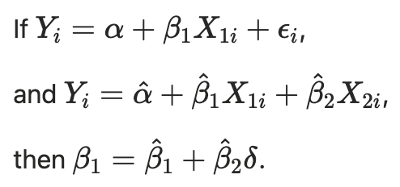
When examining bias, we can envision this diagram.
This equation also helps us understand mathematically how bias (β₂δ) impacts our estimate of the causal effect. We will talk more about signing this bias next week.
𝝴
X
Y

Slide 7
Signing the bias lets us predict how adding certain controls might affect our estimates.
The sign of the bias can be determined with Corr(OV, Y)*Corr(OV, X), where:
OV is the omitted variable you think might be causing bias
X is the treatment variable
Y is the outcome variable
OV
OV
➕/➖
➖/➕
➕/➖
➕/➖
X
Y
X
Y
Same Signs → More Positive
Opposite Signs → More Negative

Slide 8
Covariates allow us to control for factors that might affect our estimate.
Covariates should be:
Correlated with X – if not, it doesn’t explain selection and won’t change ꞵ
Correlated with Y – if not, it’s irrelevant to the outcome
NOT a potential post-treatment outcome

Slide 9
In a nonlinear regression, the effect of X on Y varies by X.
What’s the marginal effect of education on income? Hint: take the damn derivative!
If 𝛄₂ is negative, what does that mean about this relationship?
How would you find the local minimum or maximum?

Slide 10
Natural Logs
What happens if you use the natural log of your outcome variable instead of the raw number?
It allows you to estimate percentage change in your outcome variable
It reduces the effect of outliers on your estimates

Slide 11
🅿️ Practice with Natural Logs
Given the following information:
ln(Wage) ​= β₀ ​+ β₁​YrsEducation + β₂​Female + β₃YrsExperience
β₁​ = 0.075
β₂​ = -0.15
β₃ = 0.02
How would you interpret the above estimates?

Slide 12
Question 1: Job Training Program
Key Information:
The National Supported Work Demonstration (NSW) job-training program was operated by the Manpower Demonstration Research Corp (MRDC) in the mid-1970s. The NSW was a temporary employment program designed to help disadvantaged workers lacking basic job skills move into the labor market by giving them work experience and counseling in a sheltered environment
Qualified applicants were randomly assigned to training programs
The program admitted women receiving Aid to Families with Dependent Children, recovering individuals with addiction, released individuals who were found guilty of an offense, and men and women who hadn’t completed HS
MRDC collected earnings and demographic information from both the treatment and control groups at baseline and every nine months after that, as well as four baseline interviews

Slide 13
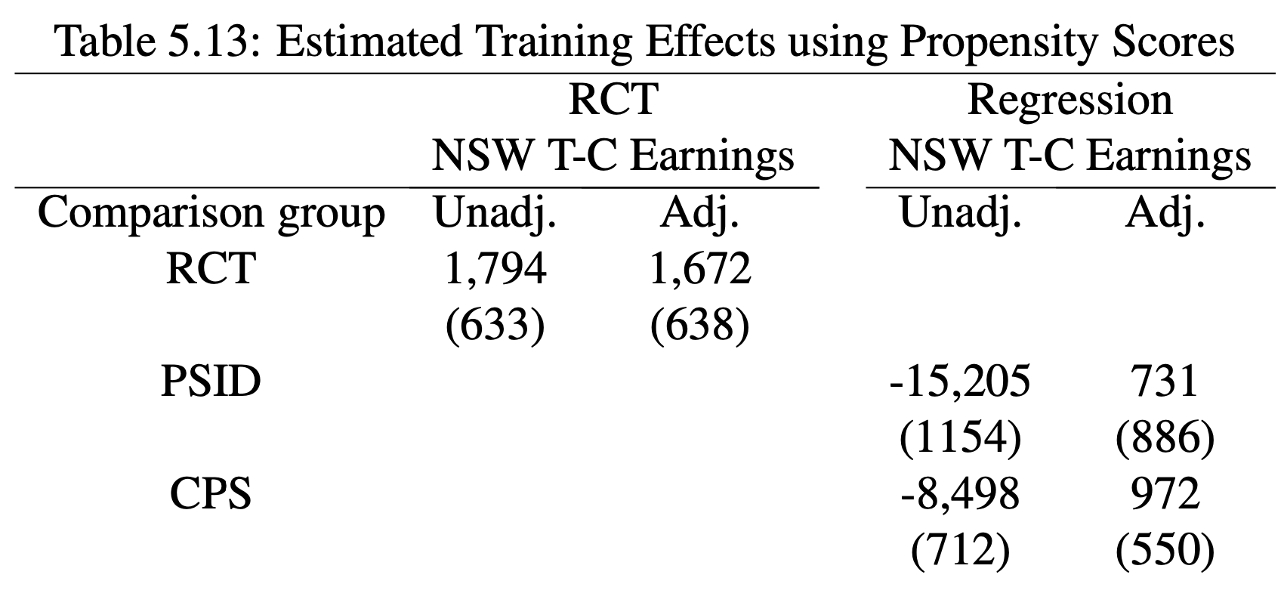
Question 1: Job Training Program

Slide 14
Question 1: Job Training Program
What regression could we use to compare the program’s effects between females and males?
If we ran the same regression using only males, the effect would be $800 and males not in the program would earn $600; using only females, the effect would be $200. We also know that females earn 85 cents for every dollar earned by a male. How would we use this information to calculate the coefficients in the above regression?

Slide 15

β₀ = earnings for a non-female who is not in the program = $600
β₁ = the marginal effect when female = 0, or the marginal effect for males, which is $800
β₃ is the difference in the effect of the program between females and males; if the effect for females is $200 and β₁ is $800, the effect must be -600
200 = 800 + β₃
β₀ + β₂ is the average earnings for females not in the program. We know females earn 85% of what males earn, so β₀ + β₂ must be $510.
510 = 600 + β₂
β₂ = -90
Therefore, the full regression is:

Slide 16

Question 2: CEOs and Salary
Suppose you estimate a simple regression of CEO salary (in $ 1,000) on firm profits (in $ 1,000,000s) and obtain the following result:
Suppose the "true model" includes firm size. Since we have omitted company size in the model above, how is the coefficient on profits likely to be biased?
If we assume firm size is positively correlated with profits and CEO salary:
Corr(Firm Size, Profits) = +
Corr(Firm Size, Salary) = +
Then the sign of the bias is positive, so our estimate of beta will be more positive than the true beta.
What’s a situation in which our estimate would be more negative than the true value of beta?

Slide 17
Questions on anything we’ve covered so far?

Slide 18
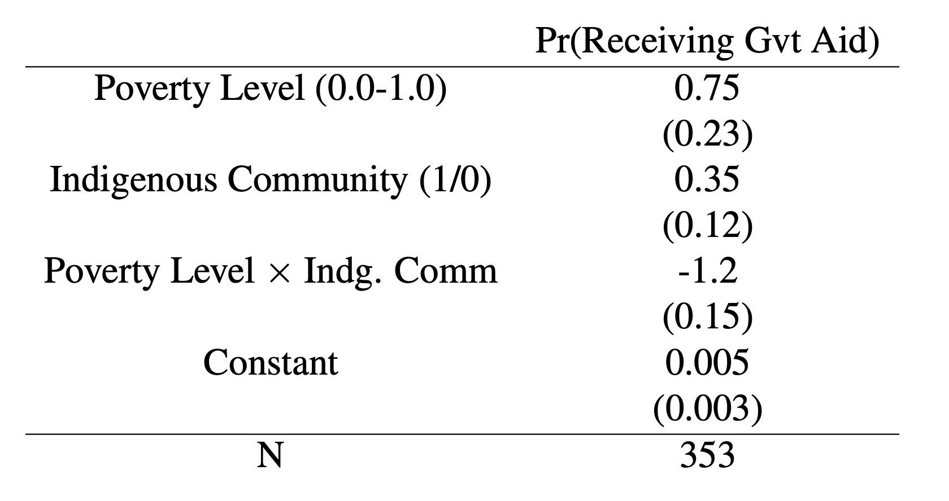
Question 3: APP Example
How do we interpret each of these coefficients?
What is the marginal effect of being indigenous for a county with a 10% poverty level?
First, take the derivative with respect to indigenous:
Pr(aid) = 0.35-1.2*poverty
Now plug in the poverty level:
Pr(aid) = 0.35-1.2*0.1
The marginal effect of being indigenous for a county with a 10% poverty level is 0.23.

Slide 19
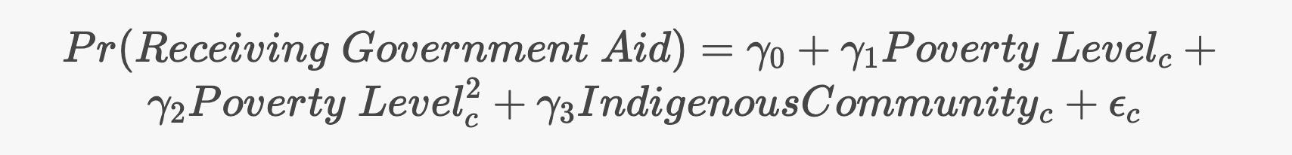
The same student runs the following regression to capture nonlinear returns to poverty:
Where 𝛄₀ is 3.99, 𝛄₁ is 0.12, 𝛄₂ is -0.01, and 𝛄₃ is -0.3. What is the full relationship between poverty level and the probability of receiving government aid?
First, take the derivative with respect to poverty level for the marginal effect: 0.12 - 0.01*PovertyLevel.
Next, set it equal to zero and solve to find the local maximum.
How do we know it has a local maximum?

Slide 20
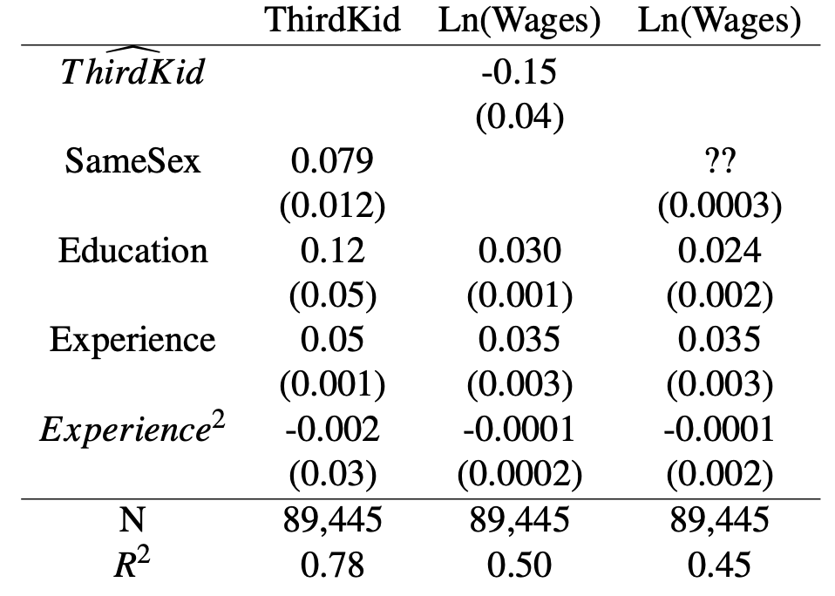
Question 4: Three Times the Charm
How much would wages change (in dollars) if experience increases by 2 years? Assume the mean wage in the sample is $25/hr.

Slide 21
🅿️ Practice with Natural Logs
Given the following information:
ln(Wage) ​= β₀ ​+ β₁​YrsEducation + β₂​Female + β₃YrsExperience
β₁​ = 0.075
β₂​ = -0.15
β₃ = 0.02
How would you interpret the above estimates?

