Slide 1
Navigating the future: Harnessing ai for credit union excellence
John Ragsdale

Slide 2
Unravelling ai
AI – Artificial Intelligence
  Broad field – How to get machines to think like humans
AI
ML – Machine Learning
  Machines can learn on their own without being explicitly programed
ML
DL – Deep Learning
  A more complex version of ML – Takes multiple layers of data to produce a complex response
Gen AI
ASR/NLP
DL
ASR/NLP – Automatic Speech Recognition / Natural Language Processing
  ASR – Converting Speech to text
  NLP – Understanding language (ex: chat bot)
Gen AI – Generative AI
  Takes DL and ASR/NLP and combined them – generates a new output using portions of data (tokens)

Slide 3




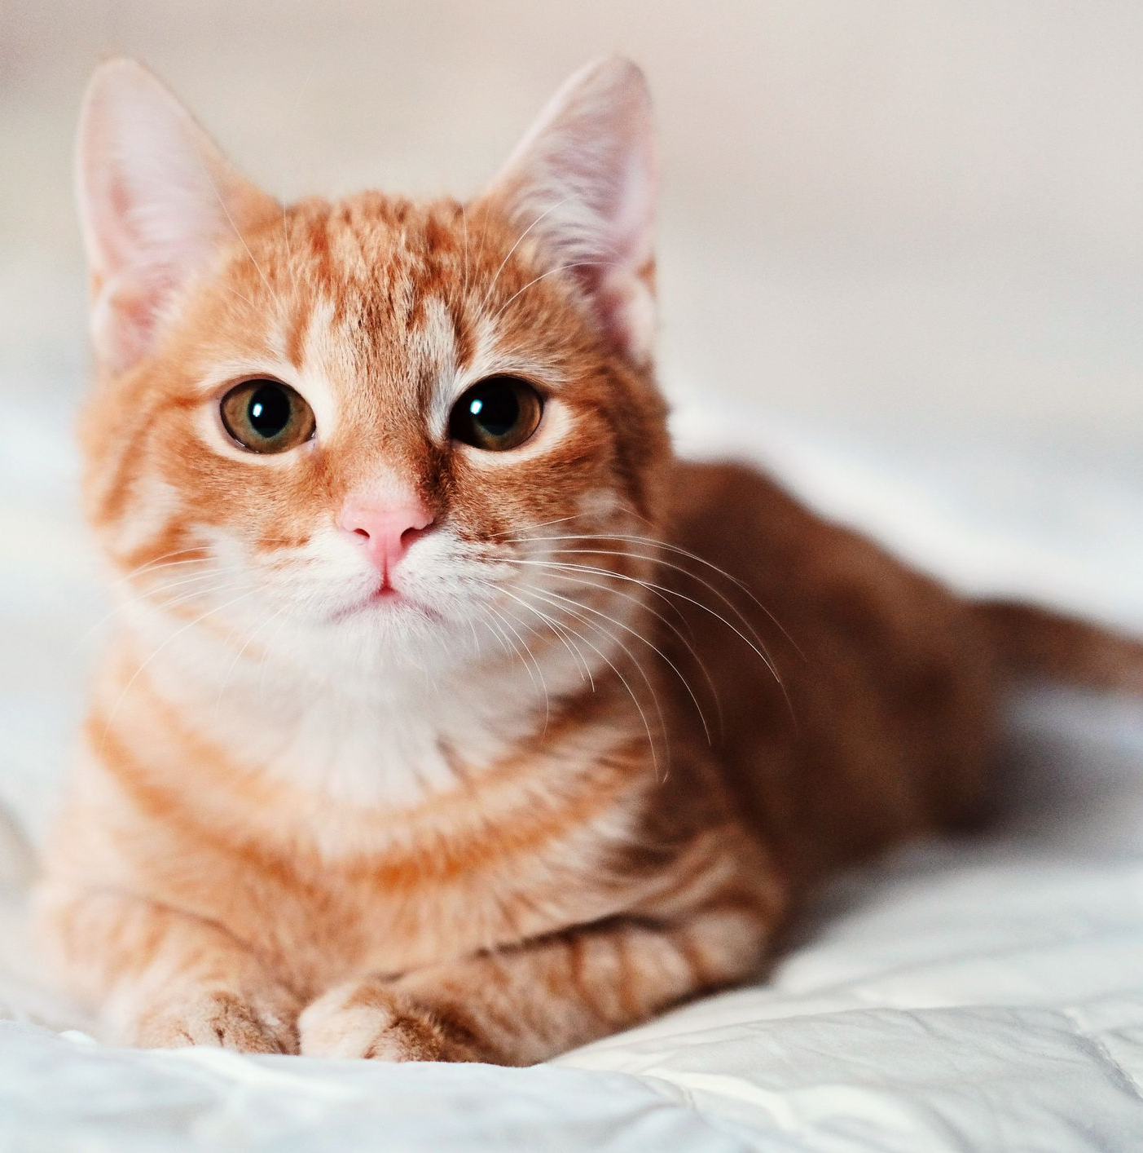




Machine Learning
CAT
CAT
DOG
CAT
DOG
DOG
CAT
The idea that machines can learn on their own.
They do this by using either:
- real world data
or
- data that has been tagged by humans
Training Data
Input
Output
CAT
DOG

Slide 4

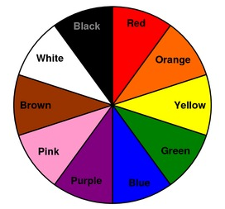
Deep Learning
Training Data #1
CAT
CAT
DOG
CAT
DOG
DOG
CAT
Training Data #2
Starts to look more like a human brain:
Instead of pulling from one source of data, the machine pulls from multiple layers of data to understand in more depth to produce a more detailed output
Input
BROWN DOG
Output

Slide 5

Generative ai
Instead of trying to take a complex input and predict the next thing, Gen AI and looks at groupings of text or images and is now trying to GENERATE a new output (text, sound, image, video, etc.)
  Looks at the relationship of the words or images and finds out what relationship or grouping of words (or images, video, sound, etc.) makes sense to put out
EX: Instead of a giving the machine an image of a cat or dog and having it say what it is, you can tell the machine what you want, and it will GENERATE a brand-new output
Open AI – Dall-E: “A picture of a cat in front of a credit union giving the credit union money”

Slide 6
Ai is about humans
“AI will not replace you, but a person using ai will”
why
Flip the script
Issues with reliability and hallucinations make “human-in-the-loop” essential
Let’s change Artificial Intelligence to Augmented Intelligence
Ai as a sidekick
If you give a roofer the choice between a hammer and a nail gun, most will choose the nail gun – easier and faster
But if the person does not know how to use the nail gun, they could hurt themselves or someone else

Slide 7
Human-in-the-loop
DEVELOP AN ETHICAL RESPONSIBILITIES FRAMEWORK
PUT POLICIES AND PROCEDURES IN PLACE
CREATE SANDBOXES IN I.T. STACK
DISTRIBUTION MODEL: FORM COMMUNITIES OF PRACTICE

Slide 8
The next generation employee
  As we embrace AI, it's crucial to understand the human-in-the-loop model. This approach synergizes human intelligence with AI's efficiency. Humans guide AI, improving its outputs and ensuring quality.
Roles in AI Workflows:
  Prompt Engineer:
    In this emerging role, the employee crafts prompts for AI systems. It's about understanding what AI can do and how to instruct it effectively. This role is pivotal in shaping AI responses.
  Output Verifier:
    After AI processes the information, the Output Verifier steps in. They ensure the AI's work is accurate and relevant. This role is our quality checkpoint, safeguarding our standards.
Evolving Job Landscape:
  Our jobs are evolving. We're moving from traditional roles to positions that blend our skills with AI's capabilities. It's less about manual tasks and more about managing AI, solving complex problems, and strategizing.
Skills for the Future:
  This evolution means we need to focus on critical thinking, adaptability, and understanding technology. Staying updated with AI advancements is key.

Slide 9
Prompt engineering
The art of getting the LM to do what you want it to do
3 parts of an effective Prompt
Context
  External information or additional context that can steer the model to better responses.
Instruction / Input
  A specific task or instruction you want the model to perform.
  The input or question that we are interested in finding a response to.
Output Indicator
  The type of format of the output.

Slide 10
Prompt engineering
Context
  “You are a …”
  “(I am/we are) doing, creating, launching, etc.…”
  Background & Goal
    Ex: You are the CMO at a $150m asset size community credit union in Georgia. Launching a new onboarding strategy for new members to help cross sell other CU products and make the member more “sticky”.
Instruction / Input
  What do you want it to do?
    Ex: Create me a digital implementation strategy that is cost effective but is efficient in our goal.
Output Indicator
  Almost endless options
    Simple: bullet point, paragraph, formula, outline, report, etc.
    EX: I want this in a hybrid format that opens with our goal of this new initiative in paragraph format. Follow up with a bullet list of ideas, notes, etc. Finish with an outline of a solid strategy we can work off moving forward.

