Slide 1
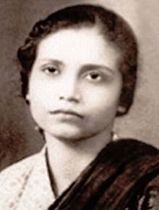
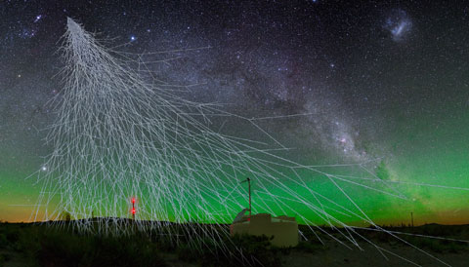
Bibha Chowdhuri was a particle physicist, known for her work studying cosmic rays and for the discovery of the meson. She was the first woman particle physicist in India and is likely the first Indian woman to earn a Ph.D. in physics.
Image: Sky & Telescope
Image: Wikipedia

Slide 2
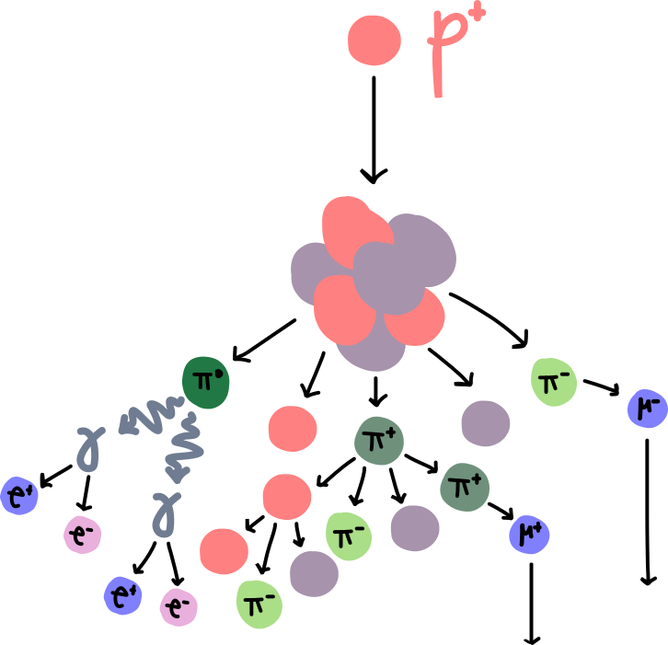
Cosmic rays
Cosmic rays are charged particles (mostly protons and nuclei) that were discovered in the early 1900s by experiments which found that ionizing radiation increased with height above the Earth’s surface.
In the 1930s, when Bibha Chowdhuri was studying particle physics during her MSc, cosmic rays were the easiest way to study high energy interactions and look for new particles, since particle accelerators were just starting to be invented.
cosmic ray proton
When cosmic rays enter the atmosphere, they interact with atmospheric nuclei and produce showers of particles, called air showers. The shower itself and the particles it contains tells us about the composition, energy, and direction of the original cosmic ray. Additionally, the interactions of secondary, tertiary, etc. particles can be studied as the shower descends toward Earth’s surface.
atmospheric nucleus

Slide 3
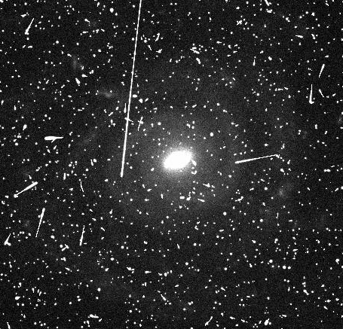
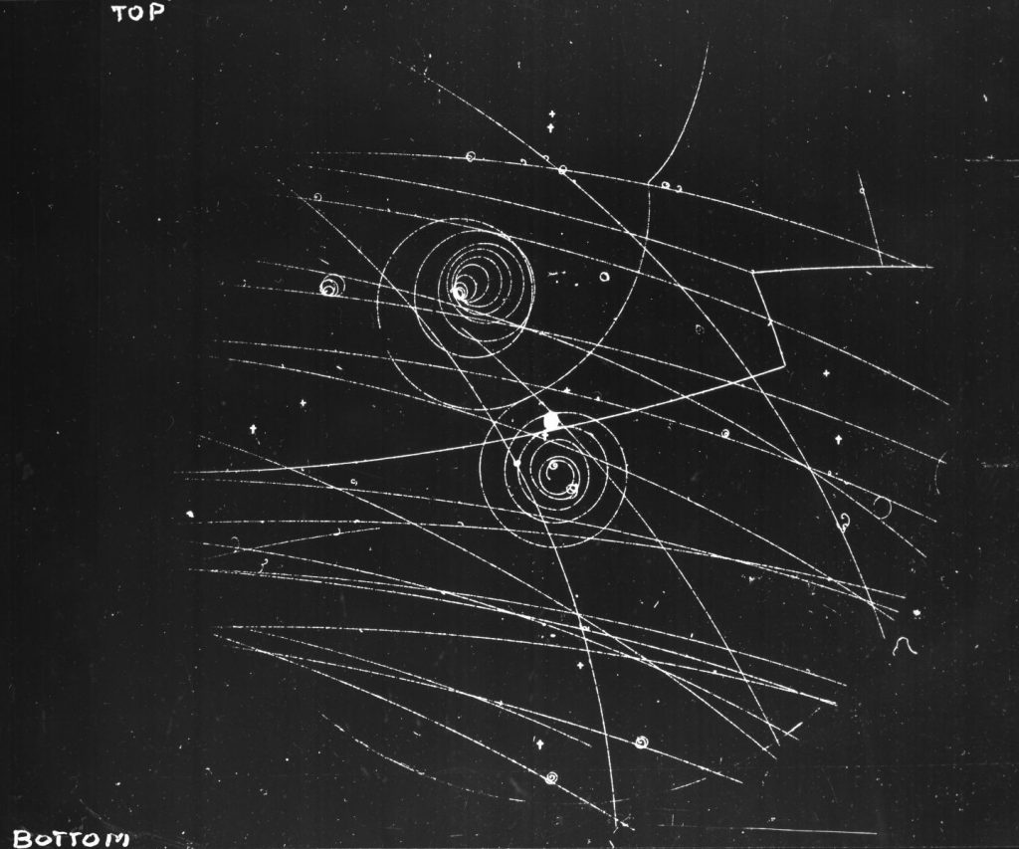
Detecting cosmic rays
Before Chowdhuri, cloud chambers had been used to observe the condensation tracks left by ionizing particles travelling through supersaturated vapour. Particles leave tracks that are unique to their charge and mass, allowing for the fluxes of a given particle to be determined, for interactions between particles to be seen, and for new particles to be identified.
The challenge with cloud chambers was that it was not possible to image the particle tracks at the time, so Chowdhuri’s work focused on using photographic plates to image and preserve the interactions of cosmic rays with the plate material, much like the cosmic ray streaks in CCD images that we consider to be noise in astronomical data today!
A cloud chamber showing particle tracks, including electrons and positrons curling under the influence of a magnetic field. Image: CERN
Cosmic ray “artifacts” (streaks) in an optical CCD image of a galaxy.

Slide 4
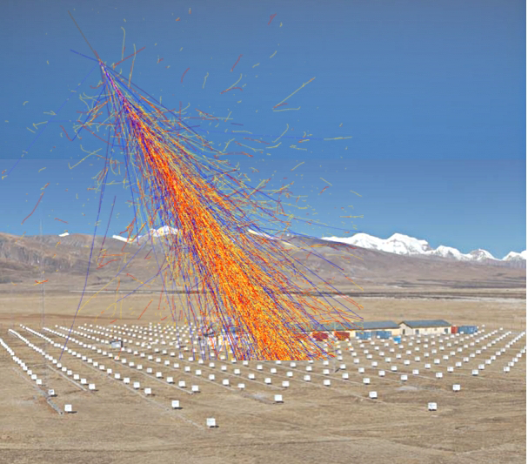
Detecting cosmic rays
Cosmic ray air showers hit their maximum number of particles at a few thousand kilometers above sea level, depending on the original cosmic ray’s energy. Below this altitude, the particles have lost significant energy and can no longer create more shower particles, losing the remainder of their energy through ionization and excitation of atmospheric particles.
To get sufficient cosmic ray flux for their photographic plate observations during her MSc, Chowdhuri and her supervisor (Debendra Mohan Bose,) travelled by camel up to altitudes of 4300m in the Himalayas. They placed detectors at different altitudes to study how flux changed with altitude
Current generation cosmic ray detectors also directly detect particles from cosmic ray air showers and are found at similar altitudes. The Tibet AS-gamma experiment is located at a similar altitude in the Himalayan mountains in Tibet.
The Tibet AS-gamma experiment with a simulated cosmic ray shower. Image: APS

Slide 5
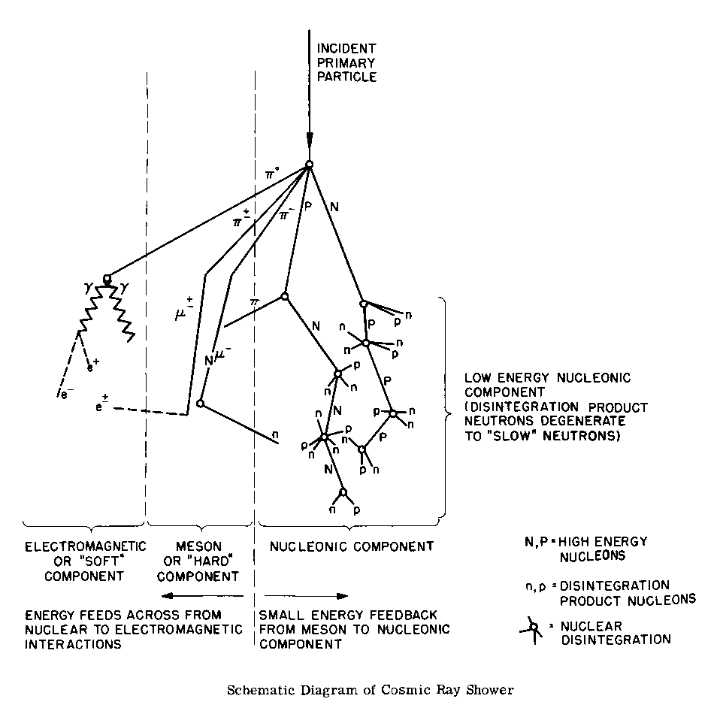
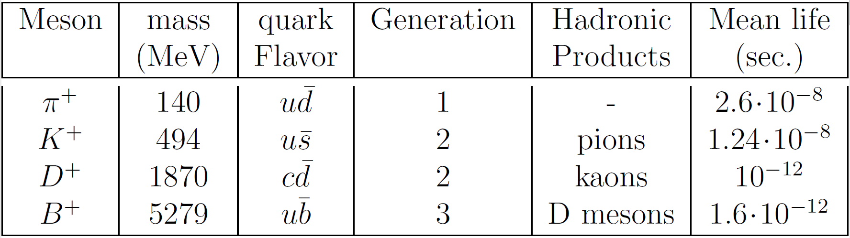
Discovering mesons
Mesons are hadronic (composite) subatomic particles, which consist of a quark and antiquark bound together by the strong interaction.
They are unstable particles, produced naturally in cosmic ray interactions, which quickly decay into lighter mesons or stable particles, such as electrons, neutrinos, and photons, or can sometimes interact with other particles to produce muons or neutrinos.

Slide 6
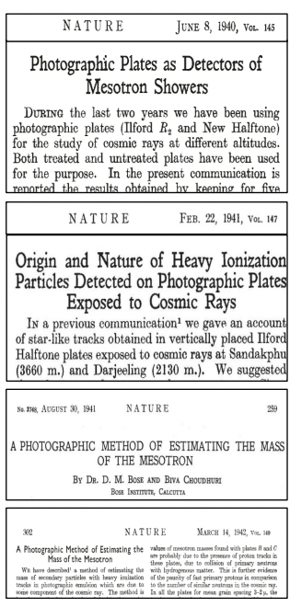
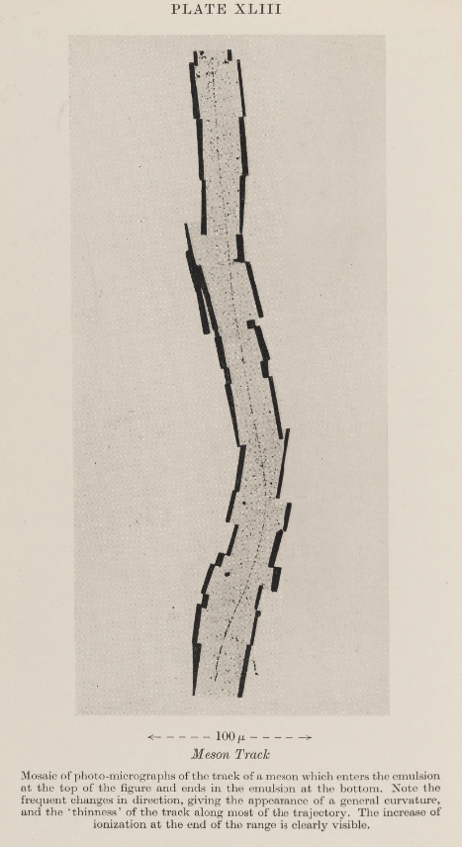
Discovering mesons
Chowdhuri and Bose found anomalous tracks in their photographic plate data, which they linked to the newly theorized mesotron (later meson), leading to four publications in Nature. However, they were unable to obtain an accurate mass measurement with the plates used in their initial setup.
During WWII, an embargo on the export of photographic plates from India made it impossible for Chowdhuri and Bose to repeat the experiment with more sensitive plates. Later, Cecil Powell would replicate this experiment, which led to the Nobel Prize in 1950 for the discovery of the pion.

Slide 7
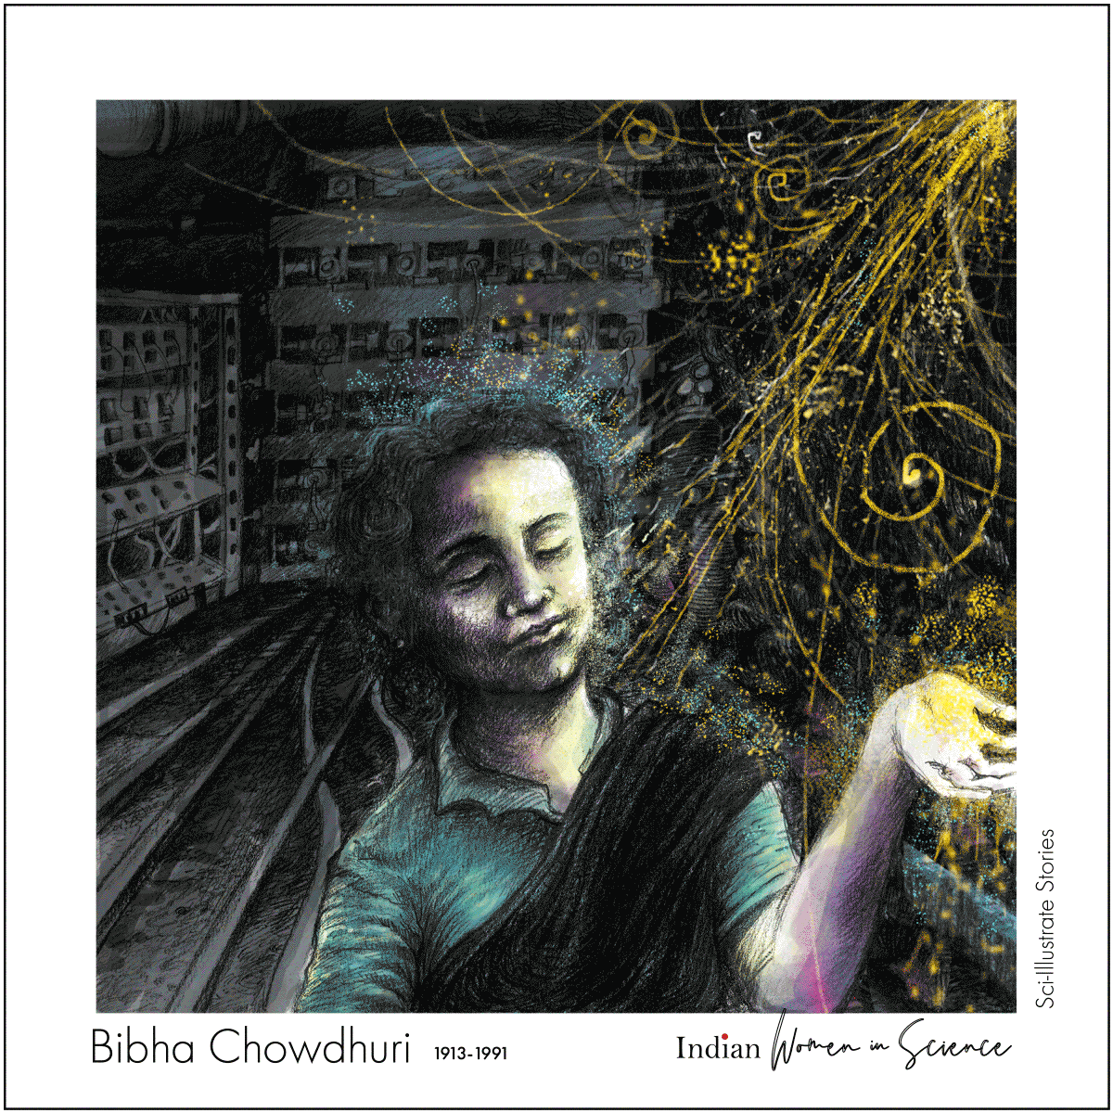
Chowdhuri went on to pursue a PhD at the University of Manchester and submitted her thesis “Extensive Air Showers associated with Penetrating Particles” shortly after Blackett won the Nobel Prize for his discovery of the pion.
Art by: Arghya Manna
Chowdhuri continued to study and teach physics for the rest of her life in India, France, and the USA. Though Blackett acknowledged her work in contribution to his Nobel Prize, she received no recognition in India and was completely overlooked in particle physics history as a prominent physicist.
Though she was overlooked during her life, Bibha Chowdhuri is now finally gaining recognition for her work and has been recognized in a German-language biography and in an article written by the Cherenkov Telescope Observatory – an upcoming observatory that will detect gamma-rays through the air shower techniques that Chowdhuri pioneered.

Slide 8
Further reading
CTAO article: https://www.ctao.org/news/building-from-diversity-article-bibha-chowdhuri/
BOSE, D., CHOUDHURI, B. A PHOTOGRAPHIC METHOD OF ESTIMATING THE MASS OF THE MESOTRON. Nature 148, 259–260 (1941). https://doi.org/10.1038/148259a0 (https://www.nature.com/articles/148259a0)
Amazing Women in History article: https://amazingwomeninhistory.com/bibha-chowdhuri-indian-physicist/
Wikipedia page: https://en.wikipedia.org/wiki/Bibha_Chowdhuri

