Slide 1
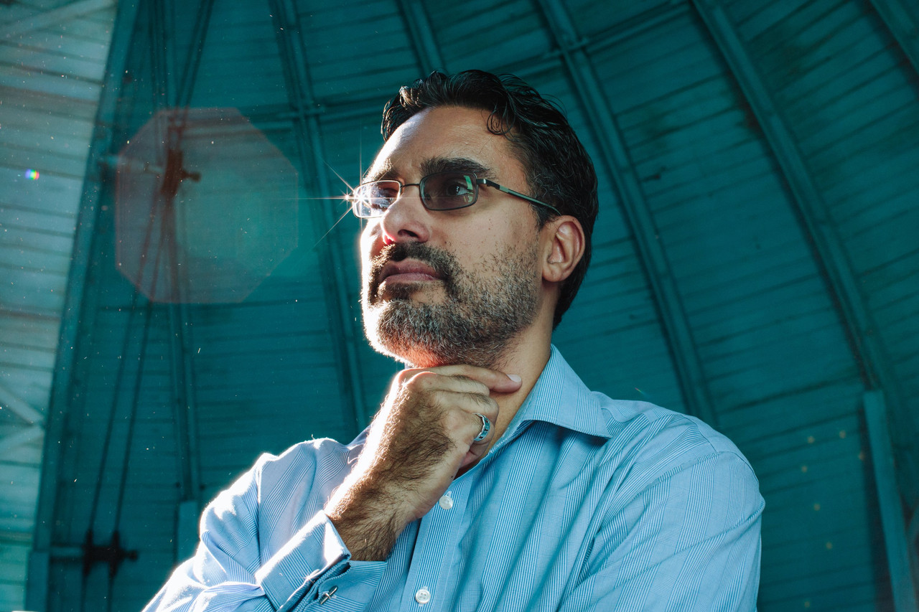
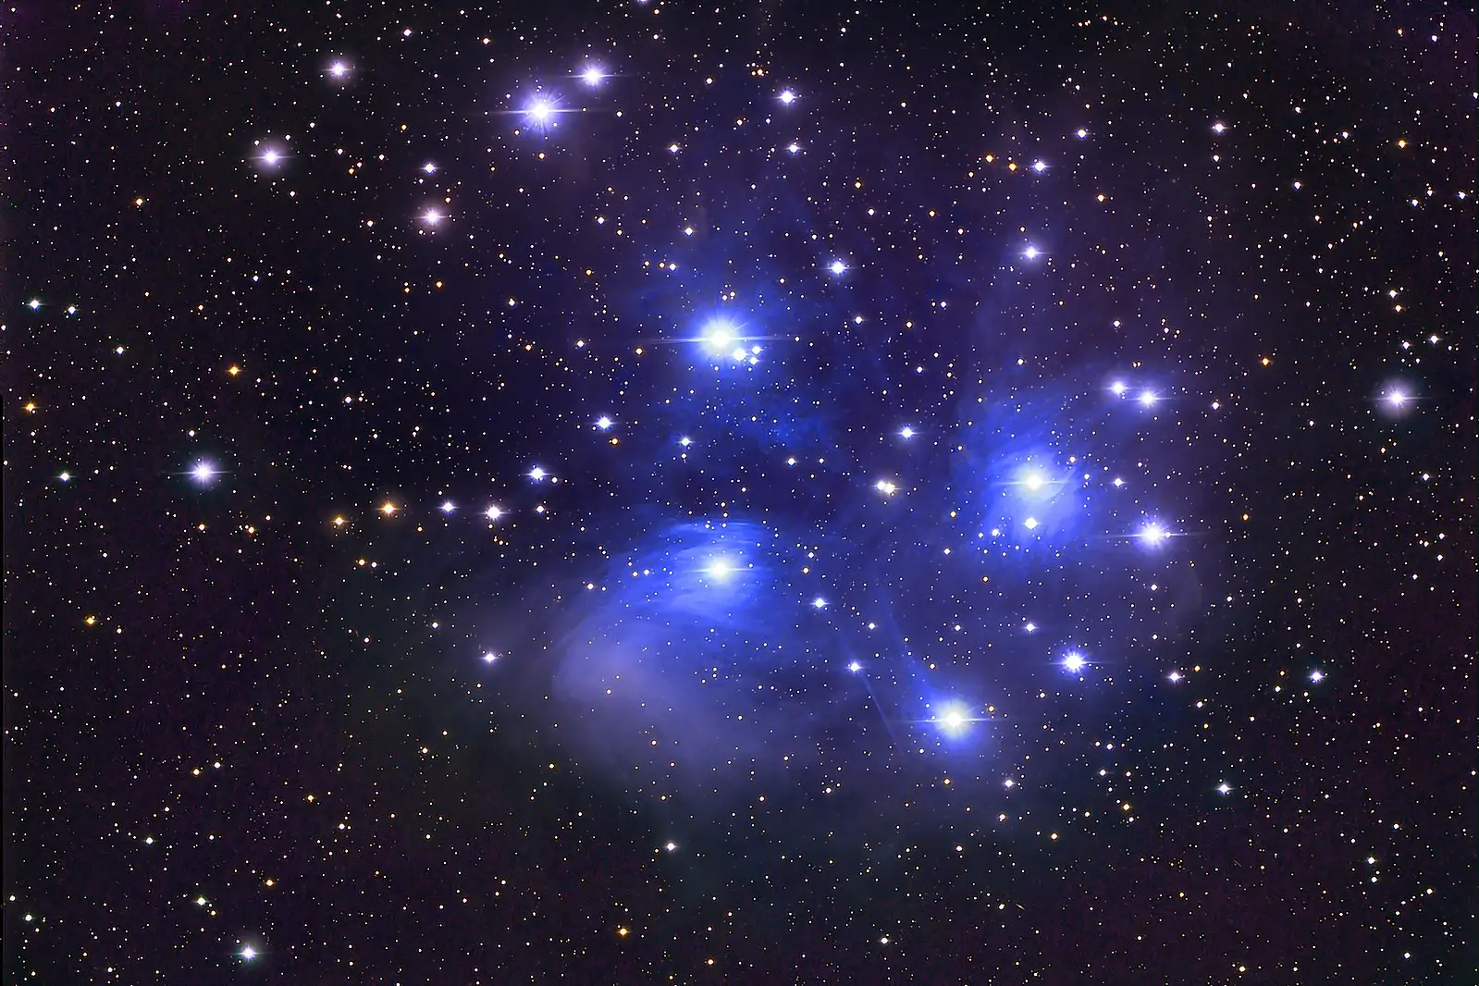
Marcel Agüeros is a Puerto Rican professor of astronomy at Columbia University working in stellar astrophysics. He uses observations of low-mass stars to calibrate the relationship between their age, rotation and magnetic activity. He has made significant contributions to understanding the life cycles of stars, star clusters, and binary star systems.
He also serves as a faculty mentor for the Columbia National Osterbrock Leadership Program where he trains future scientific leaders in physics.

Slide 2
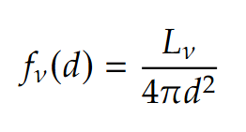
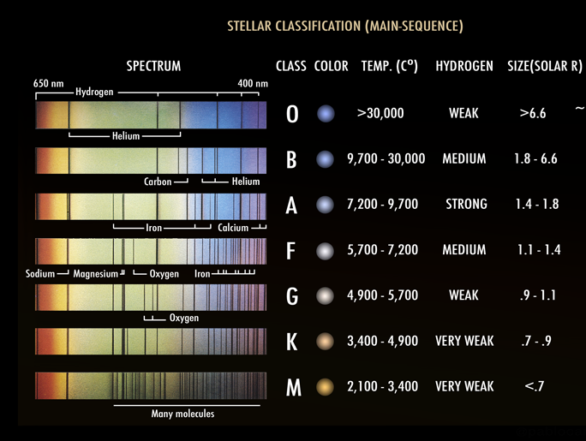
Observation techniques and instrumentation used by Marcel Agüeros
Agüeros’ work involves using spectrography and photometry to catalog groups of stars, from which he can extract information such as age estimates.
Flux to luminosity and distance relation
Stars are categorized according to their spectral type. By simply looking at their color and absorption spectrum, astronomers can rapidly determine a star’s general chemical composition.
Photometry involves measuring the flux (intensity of light) coming from a star. From this, the luminosity or distance from the star can be determined.

Slide 3
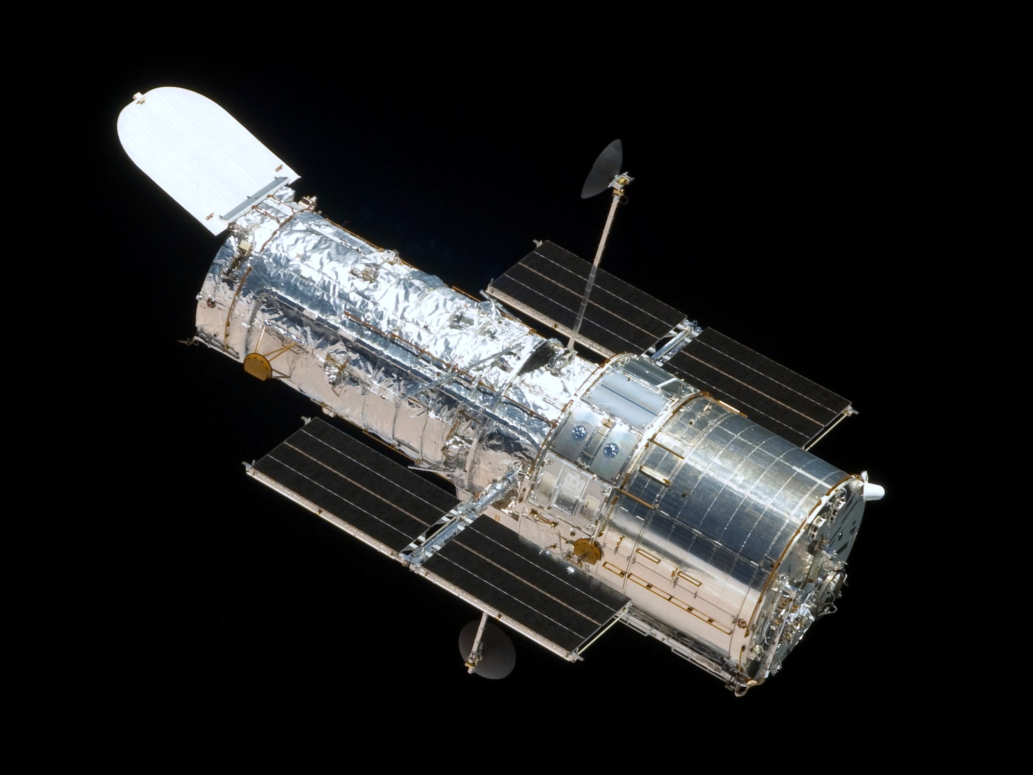
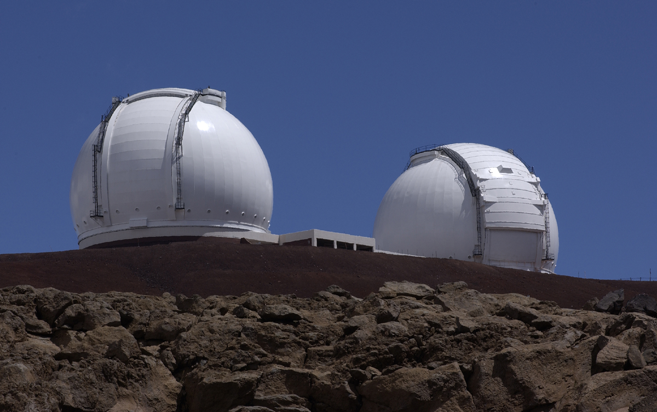
Observation techniques and instrumentation used by Marcel Agüeros
He makes use of a variety of cutting-edge telescopes to accomplish his research, such as the Hubble Space Telescope, Pan-STARRS, and Keck Observatory in Hawaii.
Hubble and Keck are equipped with spectrographs, specialized instruments used to decompose the absorption spectrum of far away stars. Pan-STARRS has the world’s largest astronomical camera, able to monitor changes in brightness from objects such as supernovae.
Hubble Space Telescope
Keck telescopes, Hawaii

Slide 4
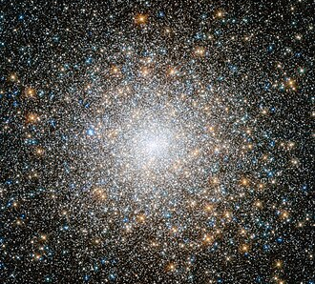
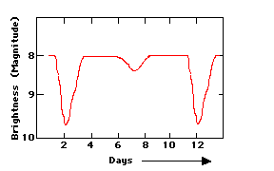
Marcel Agüeros has discovered new star clusters and stellar populations
Agüeros is involved in identifying and studying new star clusters within the Milky Way. This research has provided insights into the ages, metallicities, and evolution of stars in different regions of our galaxy.
One of Agüeros's latest papers describes the discovery of previously unknown star clusters using data from Pan-STARRS and the Sloan Digital Sky Survey (SDSS). He accomplished this by studying the light curves from these datasets.
Light curve from an eclipsing binary

Slide 5
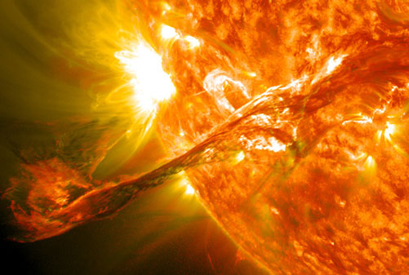
Marcel Agüeros studies magnetic activity and stellar flares
Agüeros studies magnetic activity in low-mass stars, particularly the impact of stellar flares on the stars themselves and their surrounding environments. Such stars (like red dwarfs) are known to exhibit strong magnetic activity, but the exact nature of these flares and their variability was not fully understood until recent studies.
Agüeros and colleagues found that low-mass stars can experience exceptionally powerful flares, releasing large amounts of energy in short periods and altering the atmospheres and habitability of exoplanets orbiting in close proximity.
A stellar flare

Slide 6
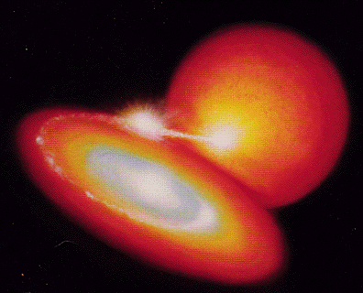
Marcel Agüeros studies interacting binary star systems
Agüeros also works on binary and multiple star systems, investigating how such stellar bodies interact, exchange mass, and affect each other’s evolution. These systems are particularly interesting for studying stellar life cycles, especially in close binary systems, where stellar material can be transferred between stars.
Cataclysmic Variables
This work has highlighted how these interactions can lead to the formation of cataclysmic variables, a binary system composed of a white dwarf and a low mass star.
Low mass star
White Dwarf

Slide 7

Marcel Agüeros is an advocate for diversity in higher level physic-related studies
Prof. Agüeros has worked on increasing the numbers of women and underrepresented minorities in the sciences since starting graduate school. At the University of Washington, he helped create the Pre-Major in astronomy Program, where first-year underrepresented students interested in astronomy are exposed to research, and which now has over 100 alumni.
His is a recipient of an NSF CAREER award and of the Presidential Early Career Award for Scientists and Engineers (PECASE), and he has won Columbia University Lenfest Distinguished Faculty Award, its Presidential Teaching Award for Faculty, and its Faculty Service Award.

Slide 8
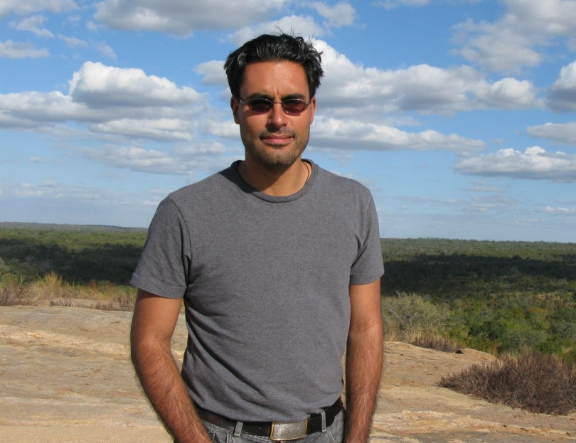
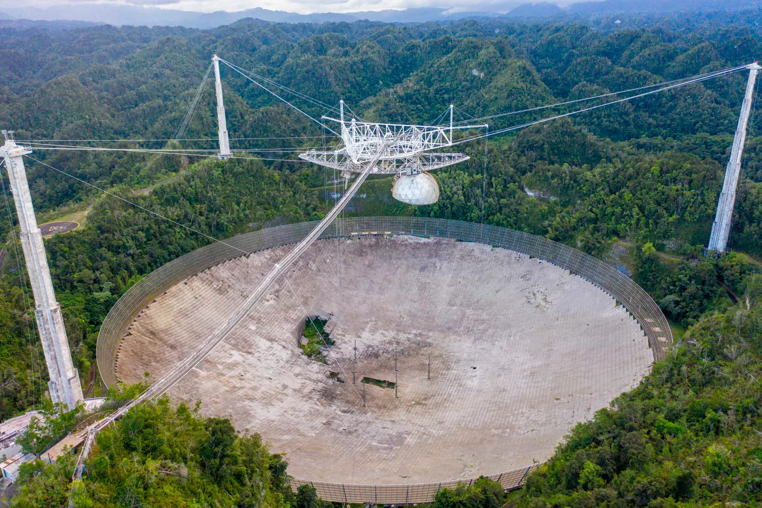
Dr. Agüeros is very proud of his Puerto Rican heritage. In a journal article written by Ciencia Puerto Rico, he expresses that a pivotal moment in his scientific journey was when he participated in a summer internship at the Arecibo Observatory.
“At that point my research experiences hadn't been particularly rewarding. But I had a really great time working (in Arecibo) with Dr. Kiriaki Xiluri, a terrific mentor. I think that experience made me imagine I could be an astronomer, even if it took another 10 years before I got comfortable saying: I am an astronomer!"

Slide 9
Resources:
News article: https://www.cienciapr.org/en/monthly-story/marcel-agueros-junction-world-class-astronomy-and-passion-diversity
Webpage: https://lsstdiscoveryalliance.org/programs/catalyst-fellowship/mentors/marcel-agueros/
Research papers : https://inspirehep.net/authors/1037060
Bridge Program to PHD: https://bridgetophd.facultydiversity.columbia.edu/directory/marcel-agueros
Images:
stars , slide 1: https://exoplanetes.umontreal.ca/en/research/astrophysique-stellaire/
Marcel Agüeros, slide 1: https://www.wsj.com/articles/an-astronomers-most-beloved-telescope-1483553781
Stellar Classification. Slide 2: https://en.wikipedia.org/wiki/Stellar_classification
Hubble space telescope, slide 3: https://en.wikipedia.org/wiki/Hubble_Space_Telescope
Keck telescopes, slide 3: https://en.wikipedia.org/wiki/W._M._Keck_Observatory
Star cluster, slide 4: https://en.wikipedia.org/wiki/Star_cluster
Light curves, slide 4: https://imagine.gsfc.nasa.gov/science/toolbox/timing1.html
Stellar Flare, slide 5: https://skyandtelescope.org/astronomy-news/which-keplers-stars-flare/
Cataclysmic variable, slide 6: https://heasarc.gsfc.nasa.gov/docs/objects/cvs/cvstext.html
Marcel Agüeros, slide 8: https://www.cienciapr.org/en/monthly-story/marcel-agueros-junction-world-class-astronomy-and-passion-diversity
Arecibo Observatory, Puerto Rico, slide 8: https://www.forbes.com/sites/davidthier/2020/12/02/remembering-the-collapsed-arecibo-observatorys-famous-video-game-level/

