Slide 1
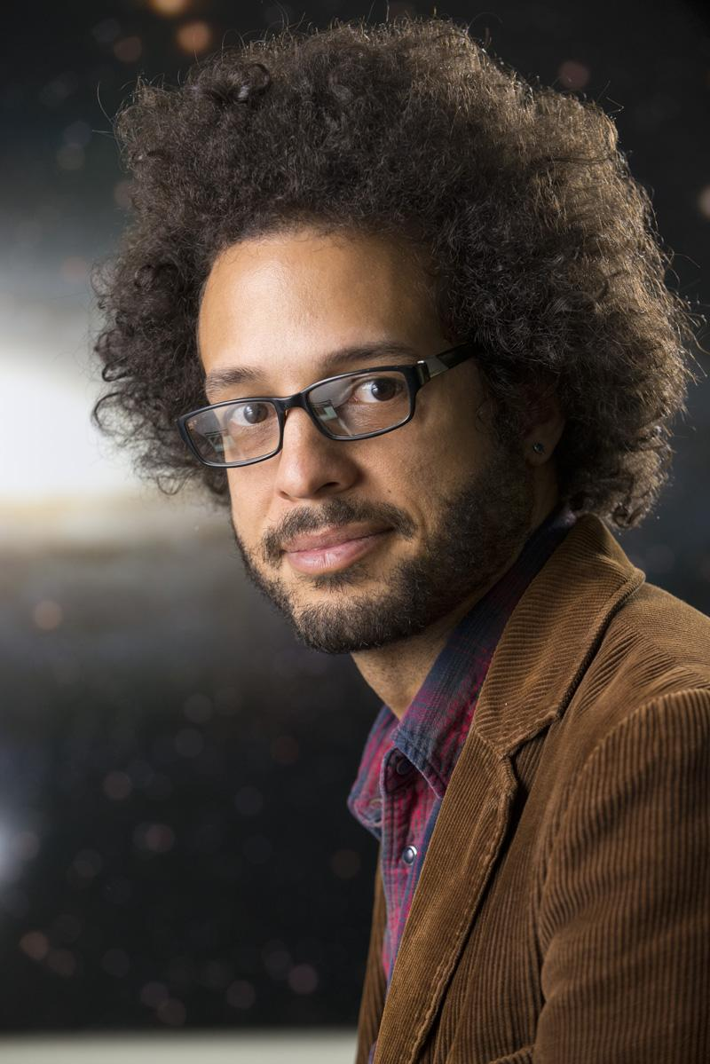
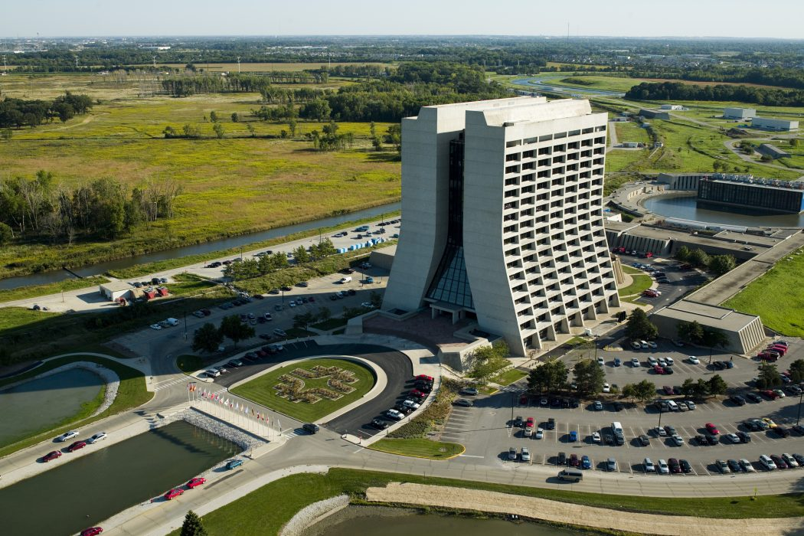
Brian Nord is an astrophysicist and AI researcher at the Fermi National Accelerator Laboratory. Nord investigates the applications of machine learning in astronomy, with a focus on galaxy evolution and gravitational lensing. A pioneer in the domain of cosmological survey simulation and design, Nord has spearheaded numerous collaborations, including the Deep Skies Lab.
Fermi National Accelerator Laboratory, Illinois

Slide 2
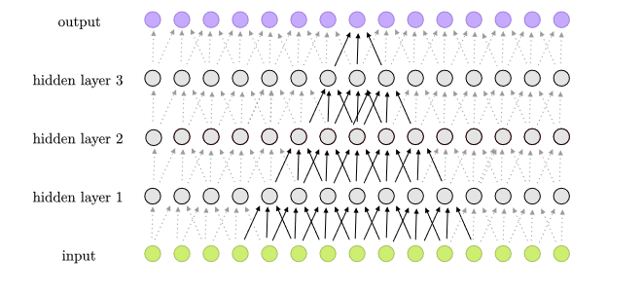
Brian Nord is an astrophysicist and AI researcher at Fermi National Accelerator Laboratory. Nord investigates the applications of machine learning in astronomy, with a focus on galaxy evolution and gravitational lensing.
What does an AI researcher/astronomer do?
Convolutional Neural Networks (CNNs) are a type of deep learning model used for analyzing visual data, such as images and videos. CNNs are effective in tasks like image classification and object detection, which make them useful for processing the large, complex data sets that come from telescopes.
Example of a neural network

Slide 3
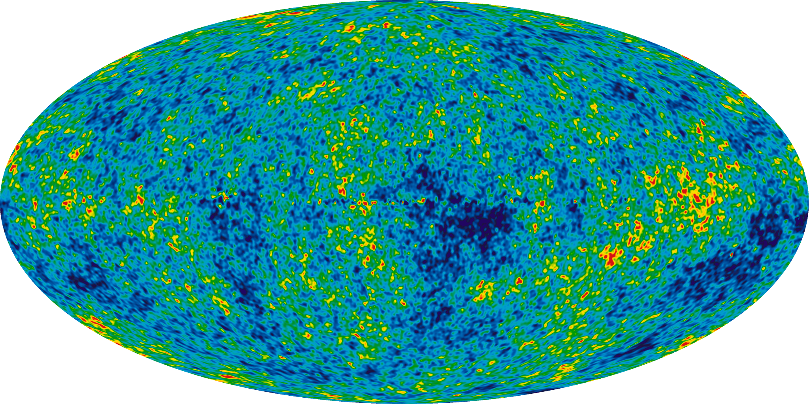
Brian Nord is an astrophysicist and AI researcher at Fermi National Accelerator Laboratory. Nord investigates the applications of machine learning in astronomy, with a focus on galaxy evolution and gravitational lensing.
How does that impact astronomy?
Nord uses CNNs to separate noise from signal in maps of the Cosmic Microwave Background (CMB), a bath of microwave radiation which serves as a key piece of evidence supporting the Big Bang Theory.
By training the network to identify the effects of gravitational lensing, Nord can improve the resolution and accuracy of large CMB maps, allowing for a better glimpse into early-universe physics.
Heat map of the Cosmic Microwave Background

Slide 4
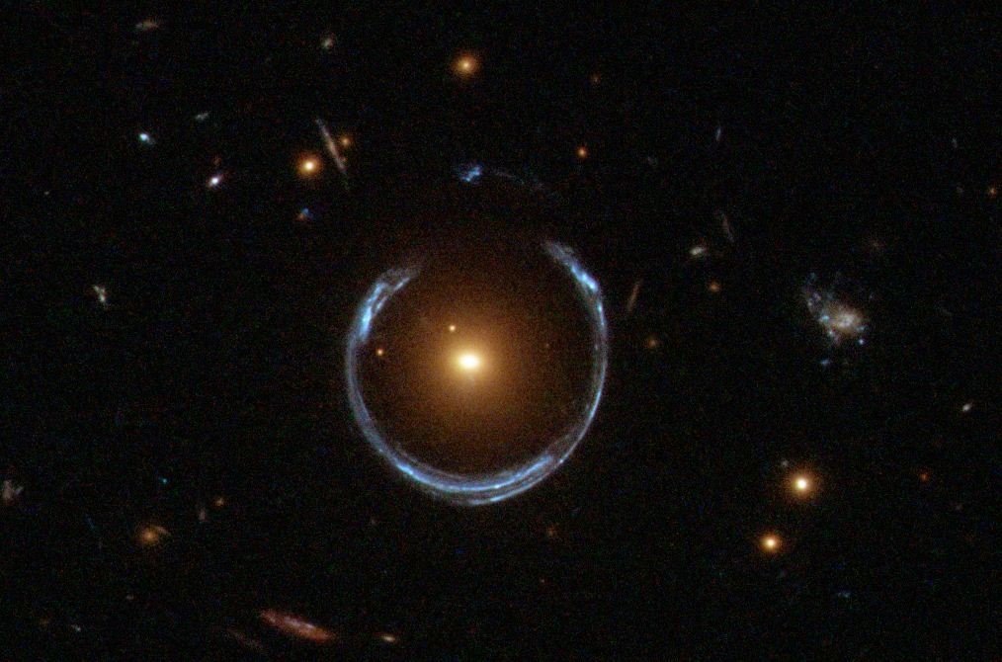
Brian Nord is an astrophysicist and AI researcher at Fermi National Accelerator Laboratory. Nord investigates the applications of machine learning in astronomy, with a focus on galaxy evolution and gravitational lensing.
What is Gravitational Lensing?
As light travels through space, its path can be warped by the presence of massive objects, such as clusters of galaxies or stars. This warping effect is known as gravitational lensing.
Gravitational lensing can distort the apparent positions and brightness of stars and galaxies in star maps. To accurately model the universe’s structure and evolution, the effect of lensing must be taken into account, or removed entirely through a process called de-lensing.
A gravitational lens.

Slide 5
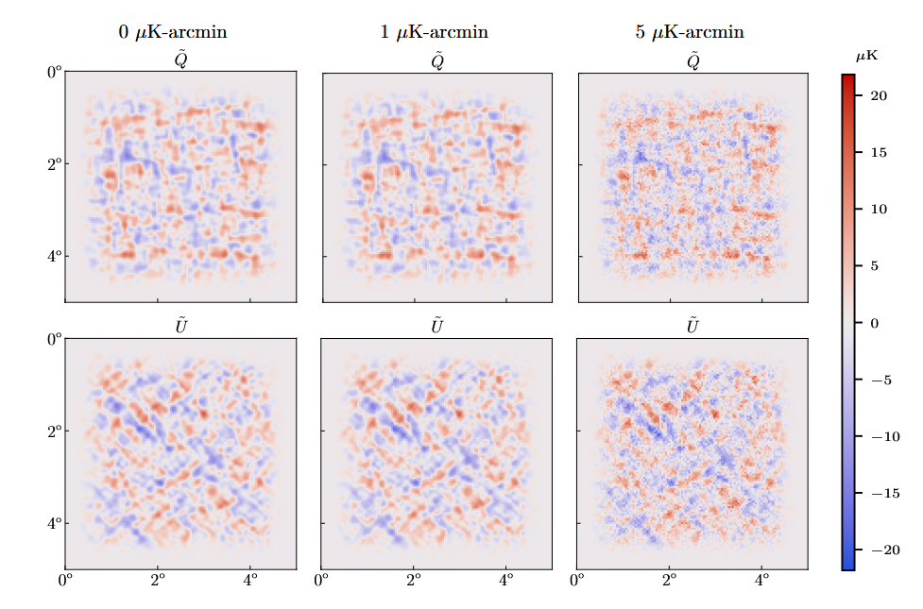
Brian Nord is an astrophysicist and AI researcher at Fermi National Accelerator Laboratory. Nord investigates the applications of machine learning in astronomy, with a focus on galaxy evolution and gravitational lensing.
De-lensing is done using a type of feed-forward deep neural network called a Residual U-Net (ResUNet).
Each layer is sensitive to features at increasingly larger scales, allowing for both local and global information to propagate through the network.
Once the process is finished, the network can effectively map lensed CMB images to de-lensed ones and quantify the amount of lensing present in an image.
Simulated CMB maps with different amounts of noise

Slide 6
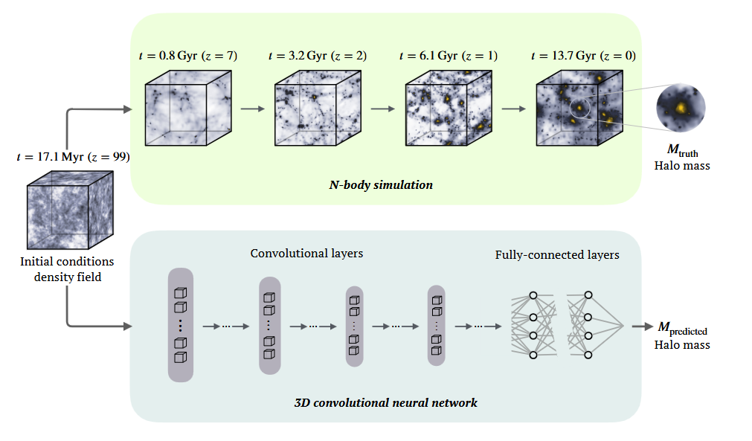
Brian Nord is an astrophysicist and AI researcher at Fermi National Accelerator Laboratory. Nord investigates the applications of machine learning in astronomy, with a focus on galaxy evolution and gravitational lensing.
Nord’s work continues to improve the sensitivity and accuracy of astronomical data analysis.
Outside of the CMB, Nord has applied novel techniques in machine learning to identify redshift galaxy mergers and simulate cosmological structure formation.

Slide 7
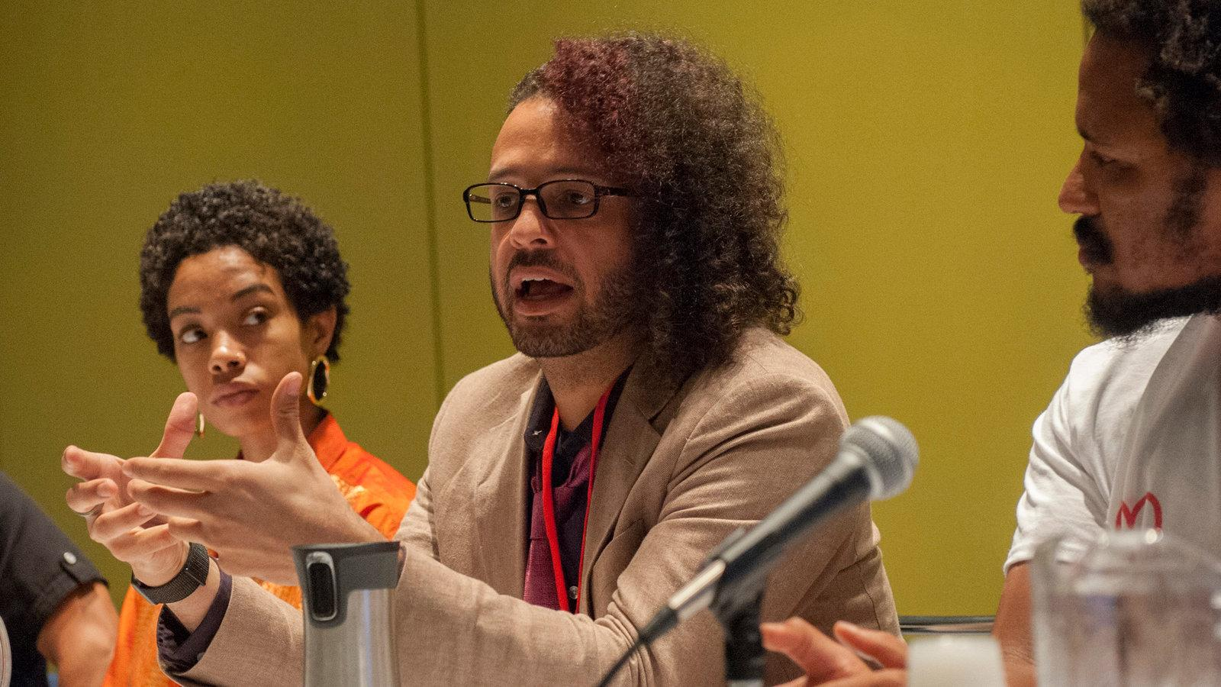
Brian Nord is an astrophysicist and AI researcher at Fermi National Accelerator Laboratory. Nord investigates the applications of machine learning in astronomy, with a focus on galaxy evolution and gravitational lensing.
Nord is an outspoken advocate for BIPOC communities in science. In 2020, Nord co-created #Strike4BlackLives, an international walk-out in protest of police brutality. He is also a co-author of ThisIsBlackLight.com, a curriculum for learning about Black experiences.
Notes:
Image source NYT

Slide 8
Resources:
Brian Nord’s website: http://briandnord.com/
Wikipedia: https://en.wikipedia.org/wiki/Brian_Nord
“Becoming Interplanetary”: https://www.loc.gov/item/2021692387/
Images:
Brian Nord, slide 1: http://briandnord.com/bio
Fermilab, slide 1: https://50.fnal.gov/the-birth-of-fermilab/
Neural Network, slide 2: https://en.wikipedia.org/wiki/Convolutional_neural_network#/media/File:1D_Convolutional_Neural_Network_feed_forward_example.png
Wilkinson heat map of the CMB, slide 3: https://en.wikipedia.org/wiki/Cosmic_microwave_background#/media/File:WMAP_2012.png
Brian Nord, slide 6: https://www.nytimes.com/2020/06/10/science/science-diversity-racism-protests.html

