Slide 1

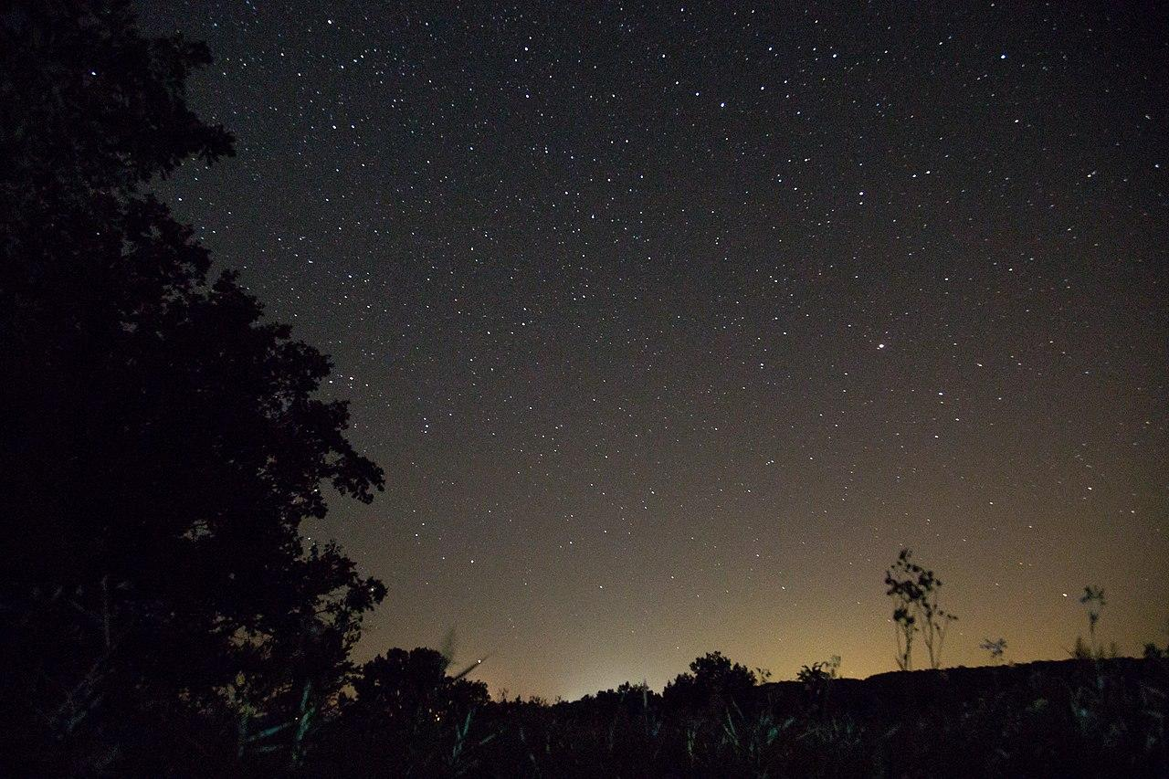
Hilding Neilson is an astrophysicist at the Memorial University of Newfoundland working in stellar astronomy. He studies the radiation spectra of stars to better understand their interaction with nearby exoplanets, as well as the common markers of their lifecycle.

Slide 2
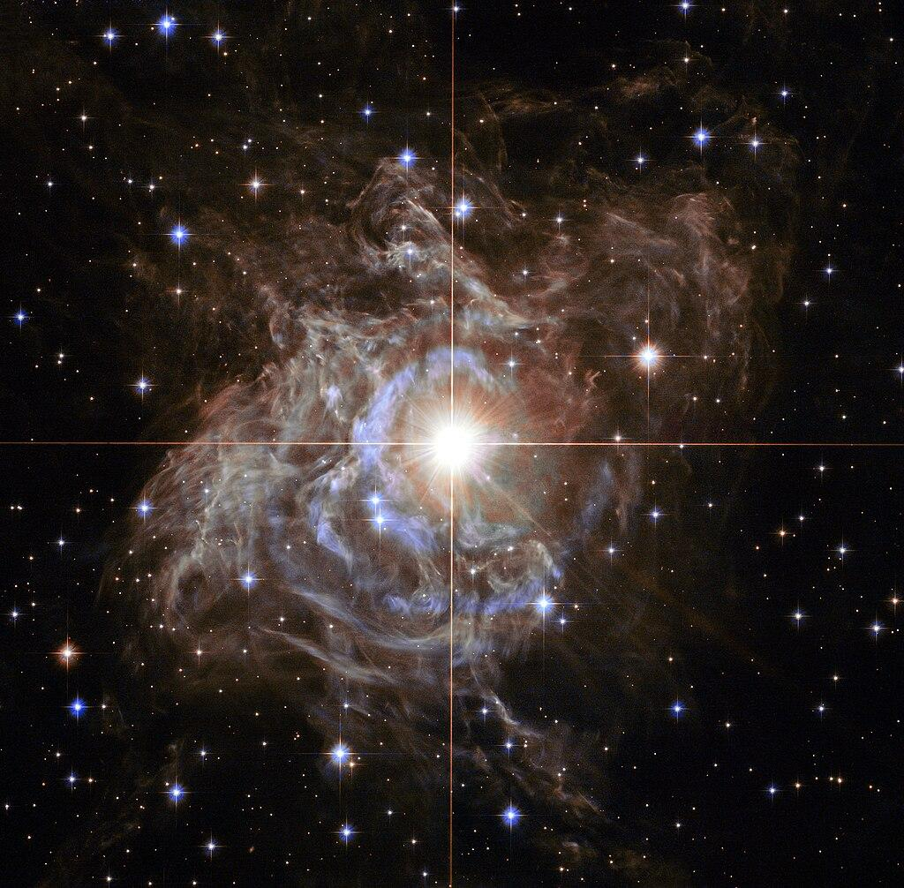
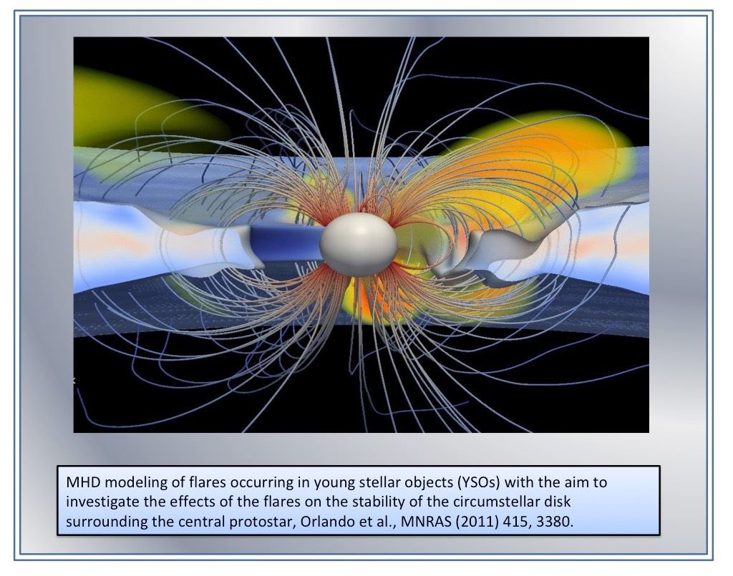
Hilding Neilson and Cepheids
Much of Neilson’s work involves the study of Cepheid variable stars, a type of star that brightens and dims periodically in a process known as stellar pulsation.
Neilson analyzes astronomical data using computer simulations, like PLUTO in order to model the evolution of stellar plasma.

Slide 3
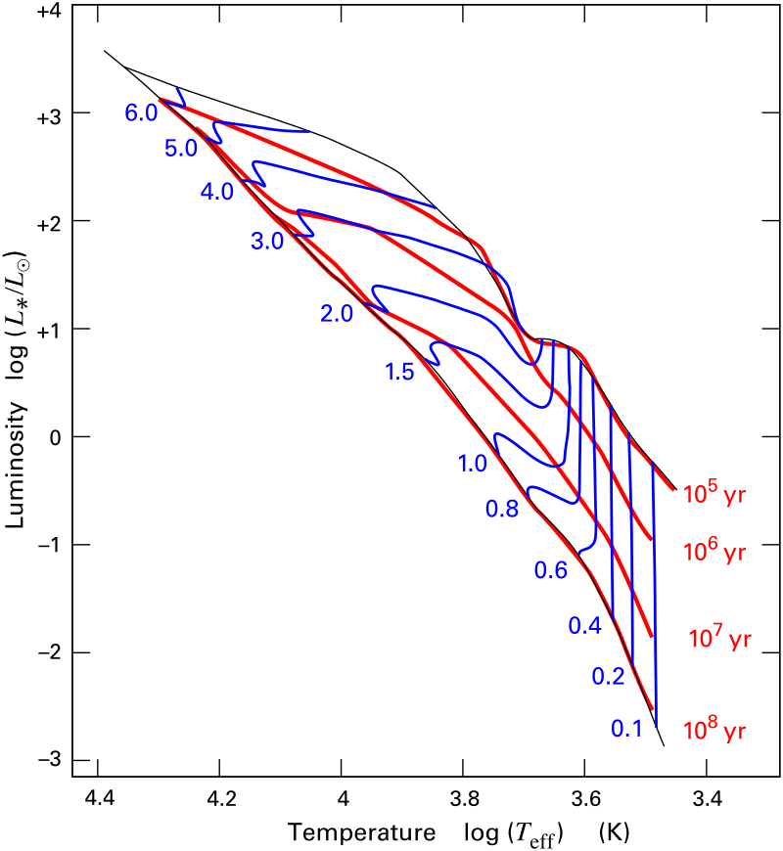
Computational Methods used by Hilding Neilson
A stellar evolution track–a graph of effective temperature versus luminosity–is a common tool used to visualize how a star’s size relates to its brightness over time.
The shape and position of the track depends on the star's mass and chemical composition. Using a 1D hydrodynamical model of stellar evolution called the Binary Evolution Code (BEC), Neilson was able to classify Cepheid behaviours and make improved predictions of the stars’ rotation, period changes, and convective dynamics.

Slide 4
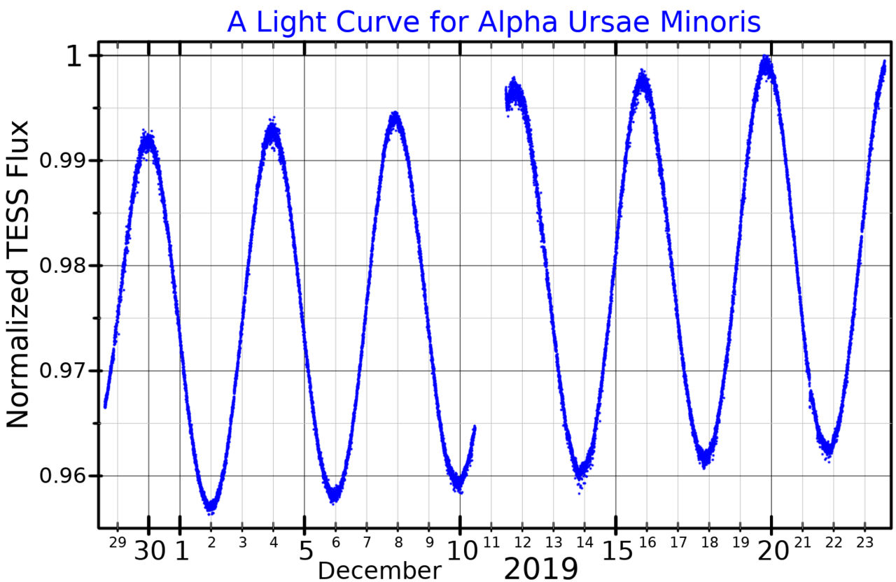
Rethinking Polaris
One of the most prominent Cepheid variable stars is Polaris, commonly known as the North Star.
In 2020, Neilson and his team found that some of the accepted properties of Polaris, like its age, mass, and distance from the Earth, were inaccurate. He proposed several alternative model for Polaris’ development, including the possibility that the star was a remnant of a stellar merger.

Slide 5
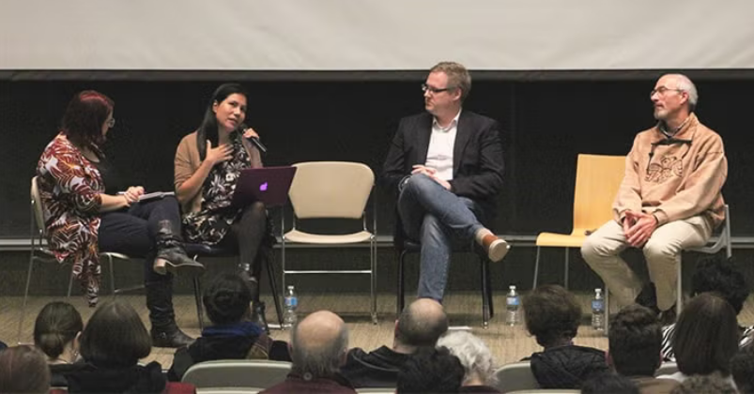
Neilson is an advocate for Indigenous voices in science. As a member of the Mi’kmaq, the indigenous inhabitants of the Atlantic provinces of Canada, he advocates for incorporating Indigenous knowledge systems into astronomical research, and emphasizes the value of diverse cultural perspectives in enriching our understanding of the universe.

Slide 6

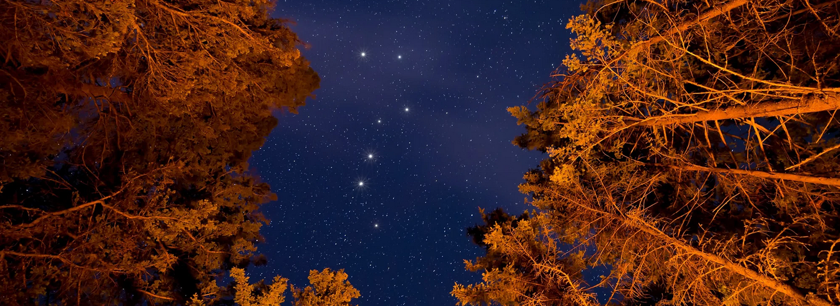
In a 2024 essay titled Indigenous knowledges and kinship as a model for our future in outer space, Neilson described Indigenous perspectives on objectivity and subjectivity in the physical sciences:
“For many Indigenous peoples, knowledge is not something universal but depends on the person learning and their perspectives [...] Knowledge is relational, because knowledge is something that is used [...] and to be shared ethically.”

Slide 7
Resources:
Neilson's Website: http://hildingneilson.com/
Decolonizing Astronomy: https://www.cbc.ca/news/canada/newfoundland-labrador/hilding-neilson-indigenizing-astronomy-1.6679072
Neilson’s essay: https://arxiv.org/pdf/2412.06669
Images:
Neilson headshot, http://hildingneilson.com/
Night sky 1: https://en.wikipedia.org/wiki/Night_sky
Cepheid variable star: https://en.wikipedia.org/wiki/Cepheid_variable
PLUTO simulation: https://plutocode.ph.unito.it/gallery/
Stellar evolution track: https://en.wikipedia.org/wiki/Hayashi_track
Polaris light curve: https://en.wikipedia.org/wiki/Polaris#
UofT panel: https://www.utoronto.ca/news/indigenous-star-lore-night-skies-over-turtle-island
University of Windsor, Neilson: https://www.uwindsor.ca/dailynews/2022-09-14/astronomer-inaugurate-indigenous-speaker-series
Night sky 2: https://www.ictinc.ca/blog/a-brief-look-at-indigenous-star-names

