Slide 1
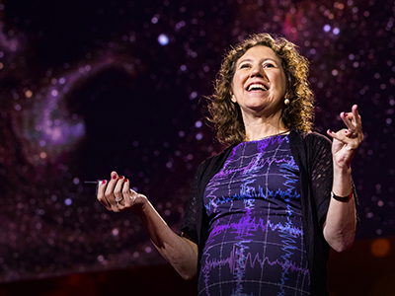
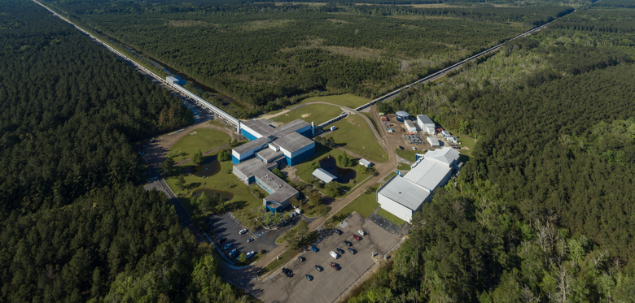
Gabriela Gonzáles is an Argentinian professor of physics and astronomy at Louisiana State University. She has been a member of the LIGO scientific collaboration since 1997, where she works on the detection of gravitational waves. She is a pioneer in the search for gravitational waves produced by compact binary systems in the last orbits of their lives, and was part of the team who detected the first of these signals in 2015.
LIGO Livingston

Slide 2
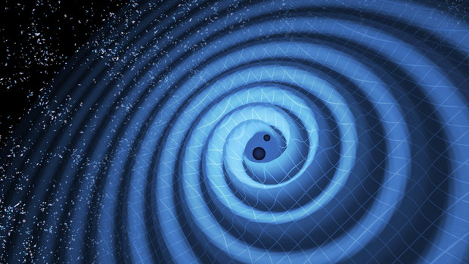
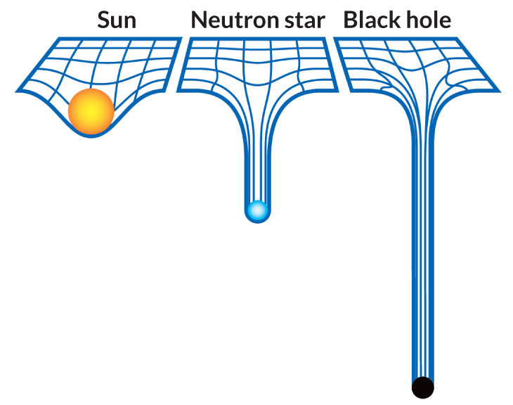
Gabriela Gonzáles studies gravitational waves
Predicted by the Theory of General Relativity (GR), gravitational waves are ripples in spacetime which arise when massive astronomical objects orbit around each other in close proximity, sometimes leading to mergers .
These waves propagate outward from their source, much like waves on a pond. Instead of water, they carry energy across the universe.
Visualization of gravitational waves
Objects causing such phenomena are usually black holes or neutron stars, compact objects usually found in binary systems.

Slide 3
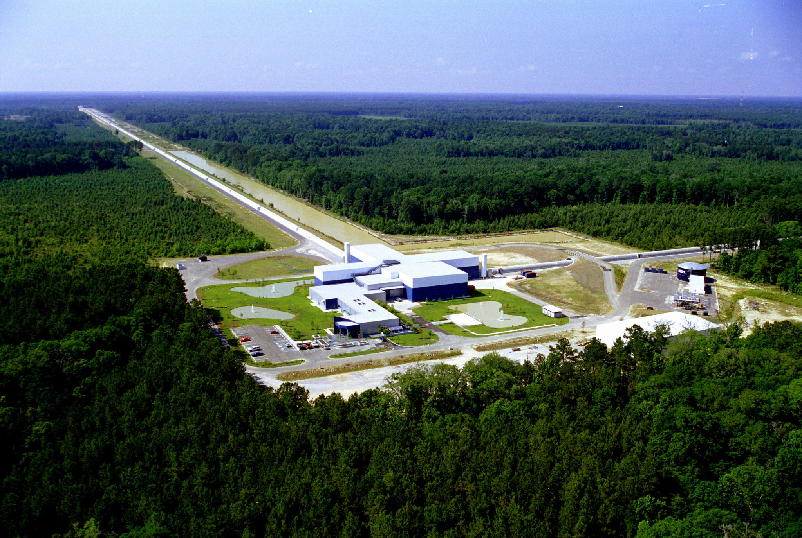
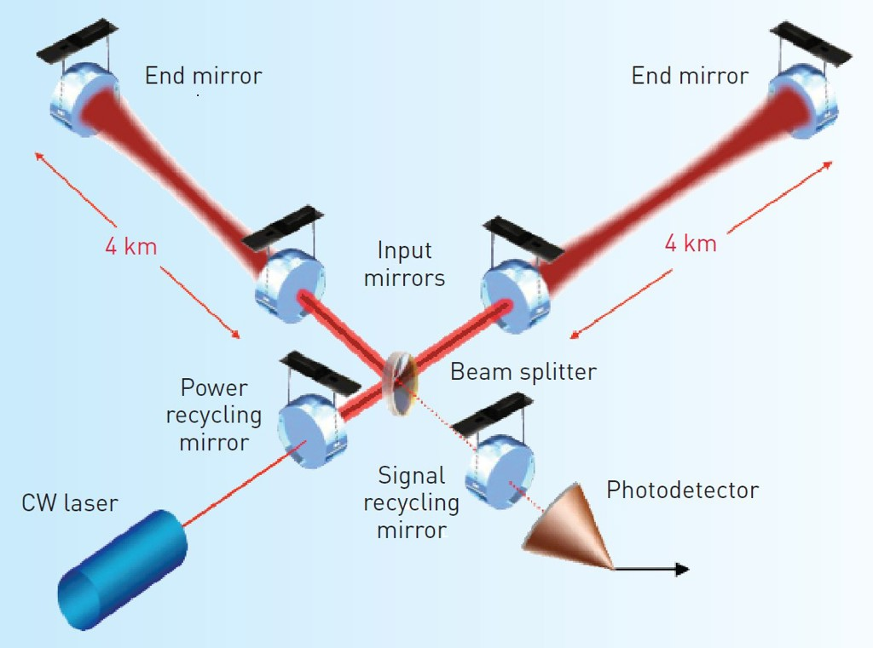
LIGO and Gabriela Gonzáles
LIGO Livingston
Gonzáles directly tests the theory of GR by using a giant interferometer known as the laser interferometer gravitational-wave observatory (LIGO). This is actually a set of two detectors located in Hanford, Washington and Livingston, Louisiana.
LIGO consists of two L-shaped arms, each 4 kilometers in length, arranged at a right angle to each other. The arms are placed in a vacuum to prevent interference from air particles or vibrations that could disrupt the precision measurements.
At the center of the L-shape, a laser is fired into a device called a beam splitter, which divides the laser into two beams. Each beam is sent down one of the two perpendicular arms.

Slide 4
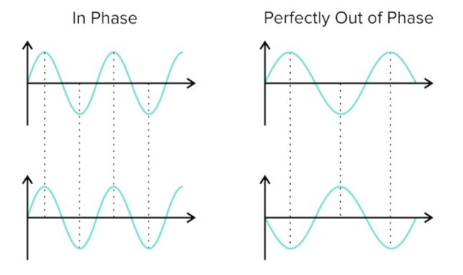
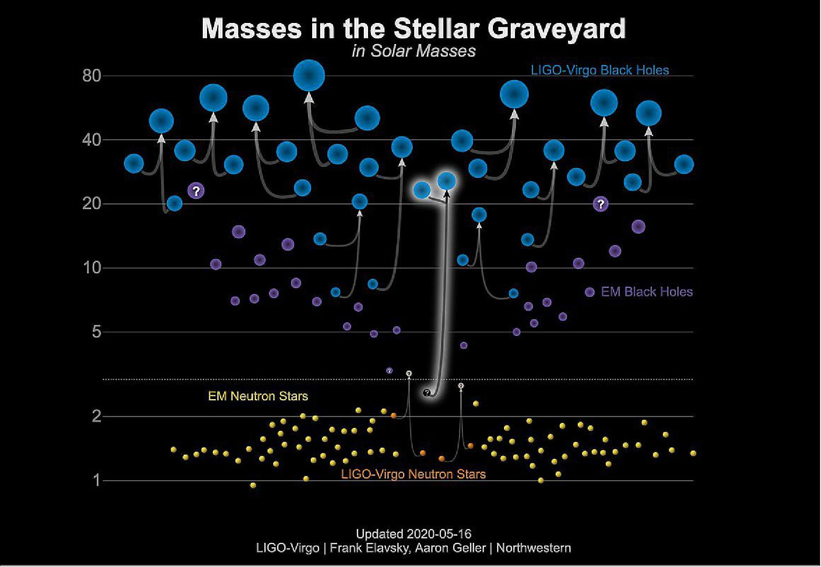
LIGO and Gabriela Gonzáles
The length of LIGO’s arms enables gravitational waves to stretch and compress these structure’s distances by incredibly small amounts, allowing for precise measurements to be made.
When a gravitational wave hits the Earth, the wobbling of the arms causes the laser to go in and out of phase periodically.
It is precisely these periodic measurements that Gabriela Gonzales uses to characterize binary systems and determine crucial information such as mass and orbital period.

Slide 5
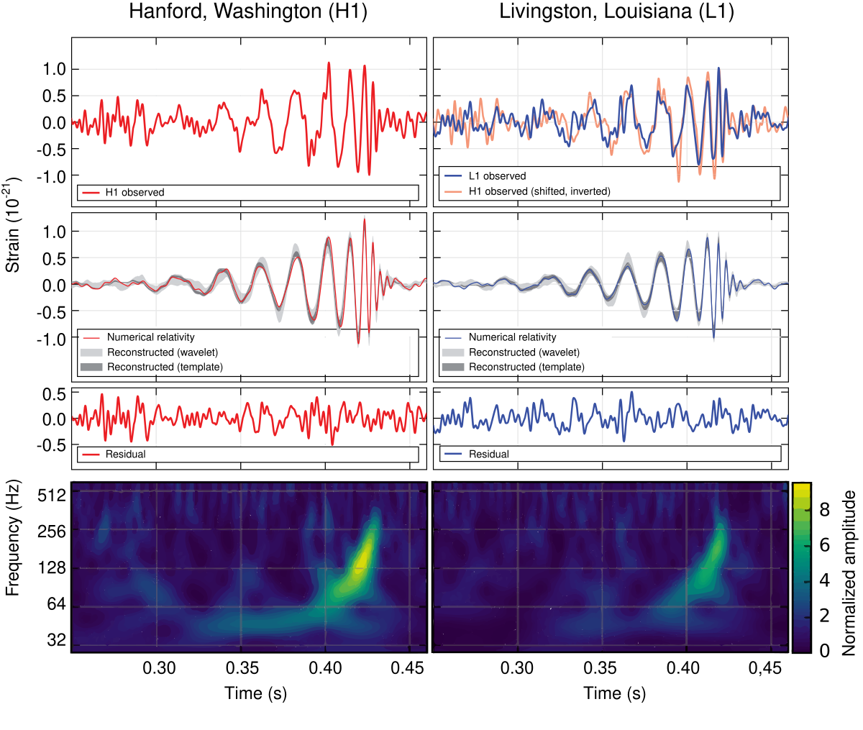
Gabriela Gonzáles’s contribution to the first gravitational wave detection
The first gravitational wave detection was made on the 14th of September 2015. Both LIGO observatories detected a waveform coming from a binary black hole merger (GW150914), matching the predictions of general relativity.
Gonzáles was a leading member of the team responsible for the data analysis of this detection. This required sophisticated algorithms such as Matched Filtering and Bayesian Inference to filter out noise and identify the faint signals corresponding to the actual source.
Additionally, as one of the spokespersons for the LIGO collaboration, González played an important role in communicating the significance of the discovery to the public.
2015 data

Slide 6
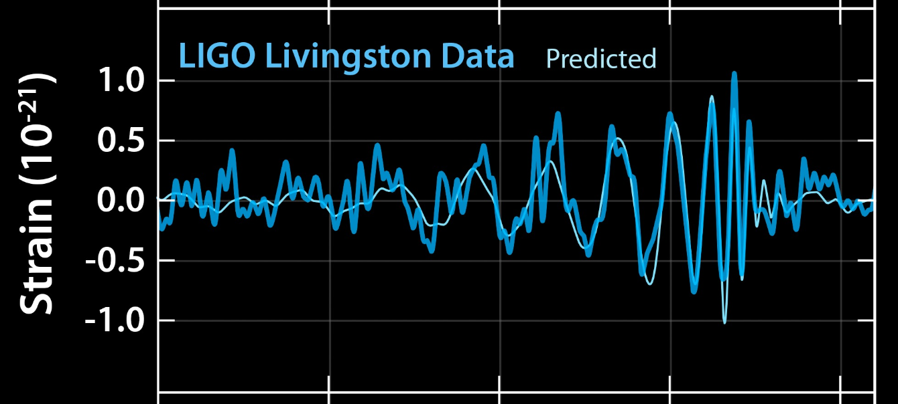
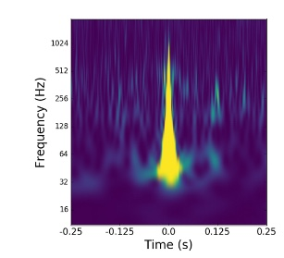
Gabriela Gonzáles work in data analysis and reduction
González has played a pivotal role in improving the sensitivity of LIGO detectors, reducing background noise and unwanted data captured by the instrument.
In a recent 2024 paper, she presented her team’s efforts to enhance the instrument’s sensitivity through multiple instrumental inspections, leading to a reduction in transient noise due to glitches.
She has also improved software tools used to analyze the detector’s data quality. This includes Machine Learning-Based Glitch Classification, where she uses neural networks to classify and identify various types of glitches.
Transient example

Slide 7
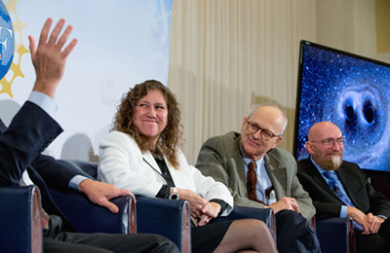
Gabriela González; a pioneer in her field
In 2008, Gonzales became the first woman to receive a full professorship in the department of physics at the Louisiana State University.
She has won a multitude of awards such as the Bouchet Award in 2007, the Bruno Rossi Prize in 2017 and the National Academy of Sciences Award for Scientific Discovery in 2017
She is a firm believer that science would be better off with an equal amount of women and men, along with other diverse groups, and advocates for the world to understand that physicists are regular people too.

Slide 8
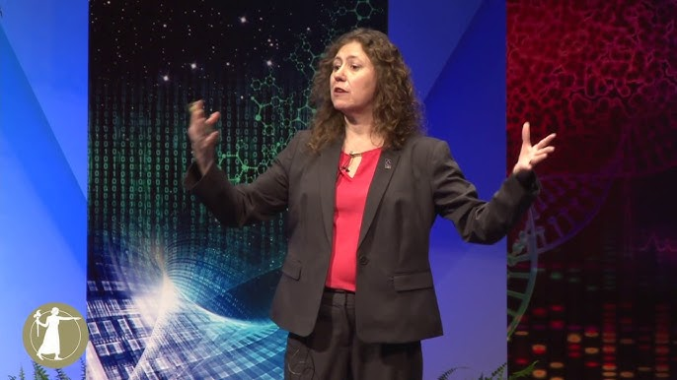
In an interview at Syracuse University, when asked about how she feels with regards to being a role model for young women and Latinas, she answered:
“I want to show them that not all physicists are geniuses—or are male, gray haired, or eccentric. Most of them are fairly normal people. We need to make sure young boys and girls don’t buy into the “mad scientist” stereotype. Instead, they need to understand that contributions to science—or any field, for that matter—require curiosity and hard work. This approach has served me well.”

Slide 9
Resources:
Gabriela Gonzales academic website: https://www.phys.lsu.edu/faculty/gonzalez/
Wiki: https://en.wikipedia.org/wiki/Gabriela_Gonz%C3%A1lez
Syracuse Article + slide 6 image: https://news.syr.edu/blog/2019/01/04/physicist-gabriela-gonzalez-g95-reveals-how-syracuse-prepared-her-to-make-science-history/
Ted Talk: https://www.ted.com/speakers/gabriela_gonzalez
2024 paper: https://www.researchgate.net/publication/383754065_LIGO_Detector_Characterization_in_the_first_half_of_the_fourth_Observing_run
Images:
Gabriela Gonzales, slide 1: https://news.syr.edu/blog/2019/01/04/physicist-gabriela-gonzalez-g95-reveals-how-syracuse-prepared-her-to-make-science-history/
LIGO, slide 1 and 3: https://www.ligo.caltech.edu/LA
Gravitational waves, slide 2: https://www.ligo.caltech.edu/LA
LIGO laser, slide 3: https://www.optica-opn.org/home/articles/volume_26/march_2015/features/ligo_finally_poised_to_catch_elusive_gravitational/
Waves, slide 4: https://www.shemmassianconsulting.com/blog/waves-and-sound-mcat
Stellar Graveyard, slide 4: https://www.ligo.caltech.edu/image/ligo20200902a
LIGO data, slide 5: https://en.wikipedia.org/wiki/First_observation_of_gravitational_waves
LIGO Livingston data, slide 6: https://www.ligo.caltech.edu/image/ligo20160211a
Gabriela Gonzales, slide 8: https://www.youtube.com/watch?v=DywnIbQZmvQ

