Slide 1

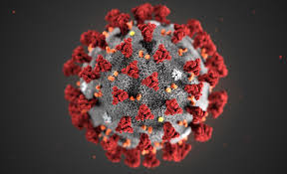
Rachel McKendry is a British professor of Biomedical Nanoscience who leads a research team which examines applications of nanotechnology, telecommunications, and big data to infectious diseases and public health. Her work focuses on virus detection, developing sensors for antimicrobial resistance, and applying deep learning to rapid testing protocols.

Slide 2

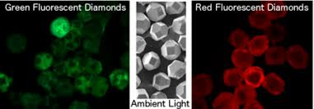
McKendry investigates the use of fluorescent nanodiamonds for biosensing in a test tube. This approach aims to improve the sensitivity of nanoparticle based disease detection. Using fluorescent nanodiamonds provides a low cost, high brightness material. McKendry & collaborators achieve a sensitivity of 10⁵ more sensitive than gold nanoparticles.
Nanodiamonds fluoresce when Nitrogen replaces the carbon in the crystal. Using microwaves to modulate the emission intensity can improve sensitivity
Notes:
Image from https://cymaris.com/technology/fluorescent-nano-diamonds/

Slide 3
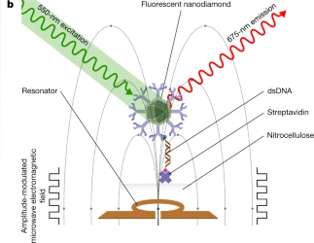
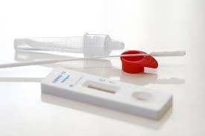
Using the spin down nitrogen defects in diamond to improve sensing:
While fluorescent biomarkers are useful for disease detection, in practical application the sensitivity is blunted by noise. Placing the nanodiamond in a resonant microwave amplifies the fluorescence. McKendry & collaborators demonstrated this for the first time in 2020.
This sensing method was demonstrated to be effective at detecting the presence of HIV in samples, and McKendry focusing on making similar devices available for rapid testing at clinics
Notes:
https://www.nature.com/articles/s41586-020-2917-1 image from paper

Slide 4
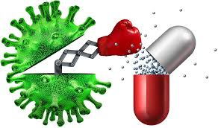
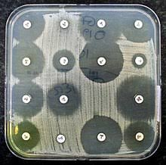
Measuring antimicrobial resistance (AMR)
AMR occurs when antimicrobials are introduced into an microbiome and introduces an evolutionary pressure which is preferential to microbes which can resist the antimicrobial. Antimicrobial resistant microbes present a serious threat to global health as typical treatments become ineffective.
Whether or not an infection is antimicrobial resistant has massive implications for treatment plans and therefore having rapid tests to detect AMR is vital. Current methods take 12-24 hours

Slide 5
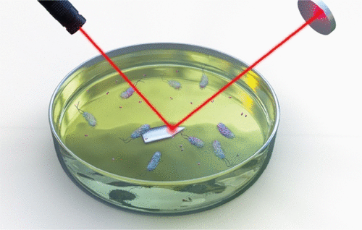

Rachel McKendry’s contribution to the AMR detection
In 2020, McKendry improved upon a proposed mechanical cantilever-based sensor which is capable of detecting AMR within ~45 minutes. It was demonstrated to be effective both in lab conditions and with clinical strains of AMR E. coli.
McKendry’s method is to shine a laser on a reflective cantilever, and measure interference caused by bacteria crossing the beam path. Introducing antibiotics to the solution and measuring the amount of interference can give a measure of the number of AMR bacteria in the sample. This method can measure a single bacterium crossing the beam path.
Notes:
Images from https://pubs.acs.org/doi/10.1021/acssensors.0c01216
And https://www.biology.utah.edu/mceb/structural-signatures-in-e-coli/

Slide 6
McKendry: a pioneer in her field
McKendry was the Director of the i-sense Interdisciplinary Research Collaboration (IRC), and was the first woman to lead an Engineering and Physical Sciences Research Council IRC. As of 2025, McKendry is the Executive Director of Discovery at Wellcome, a global charitable foundation.
She has received awards such as the Royal Society Rosalind Franklin Award, Royal Society Wolfson Research Merit Award and the Institute of Physics Paterson Medal

