Slide 1
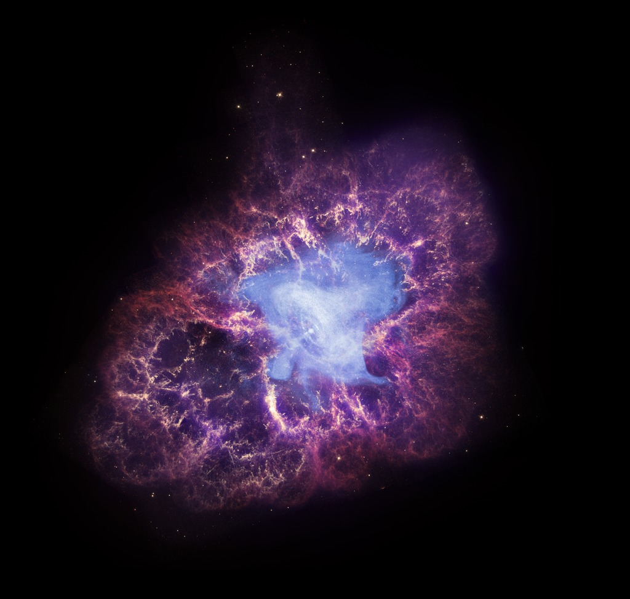
SN 1054: a multicultural perspective
Image: Spitzer/Caltech

Slide 2
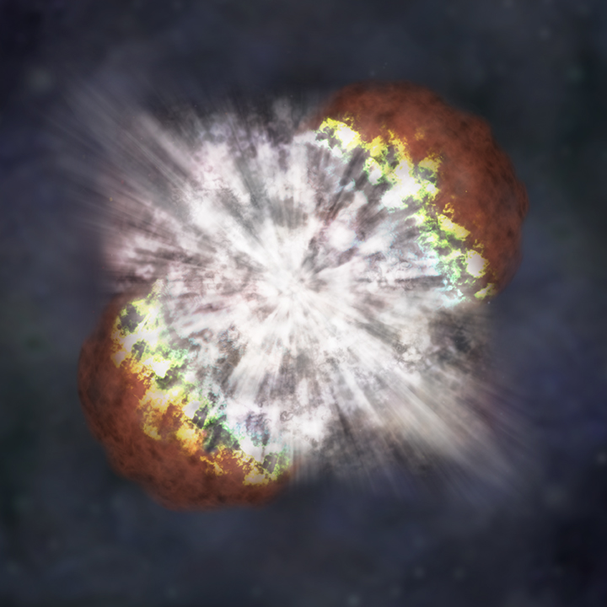
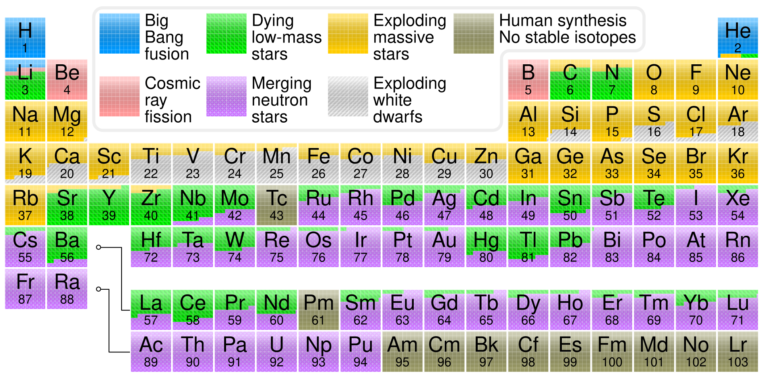
What is a supernova?
Supernovae are the explosions of massive stars (~8 - 40 M⨀) after they have exhausted their fuel and can no longer fuse new elements.
Supernovae nucleosynthesis creates many of the heavy elements in our universe through the r-process (see the yellow elements in the periodic table).
Artist’s impression of a supernova
Credit: NASA

Slide 3
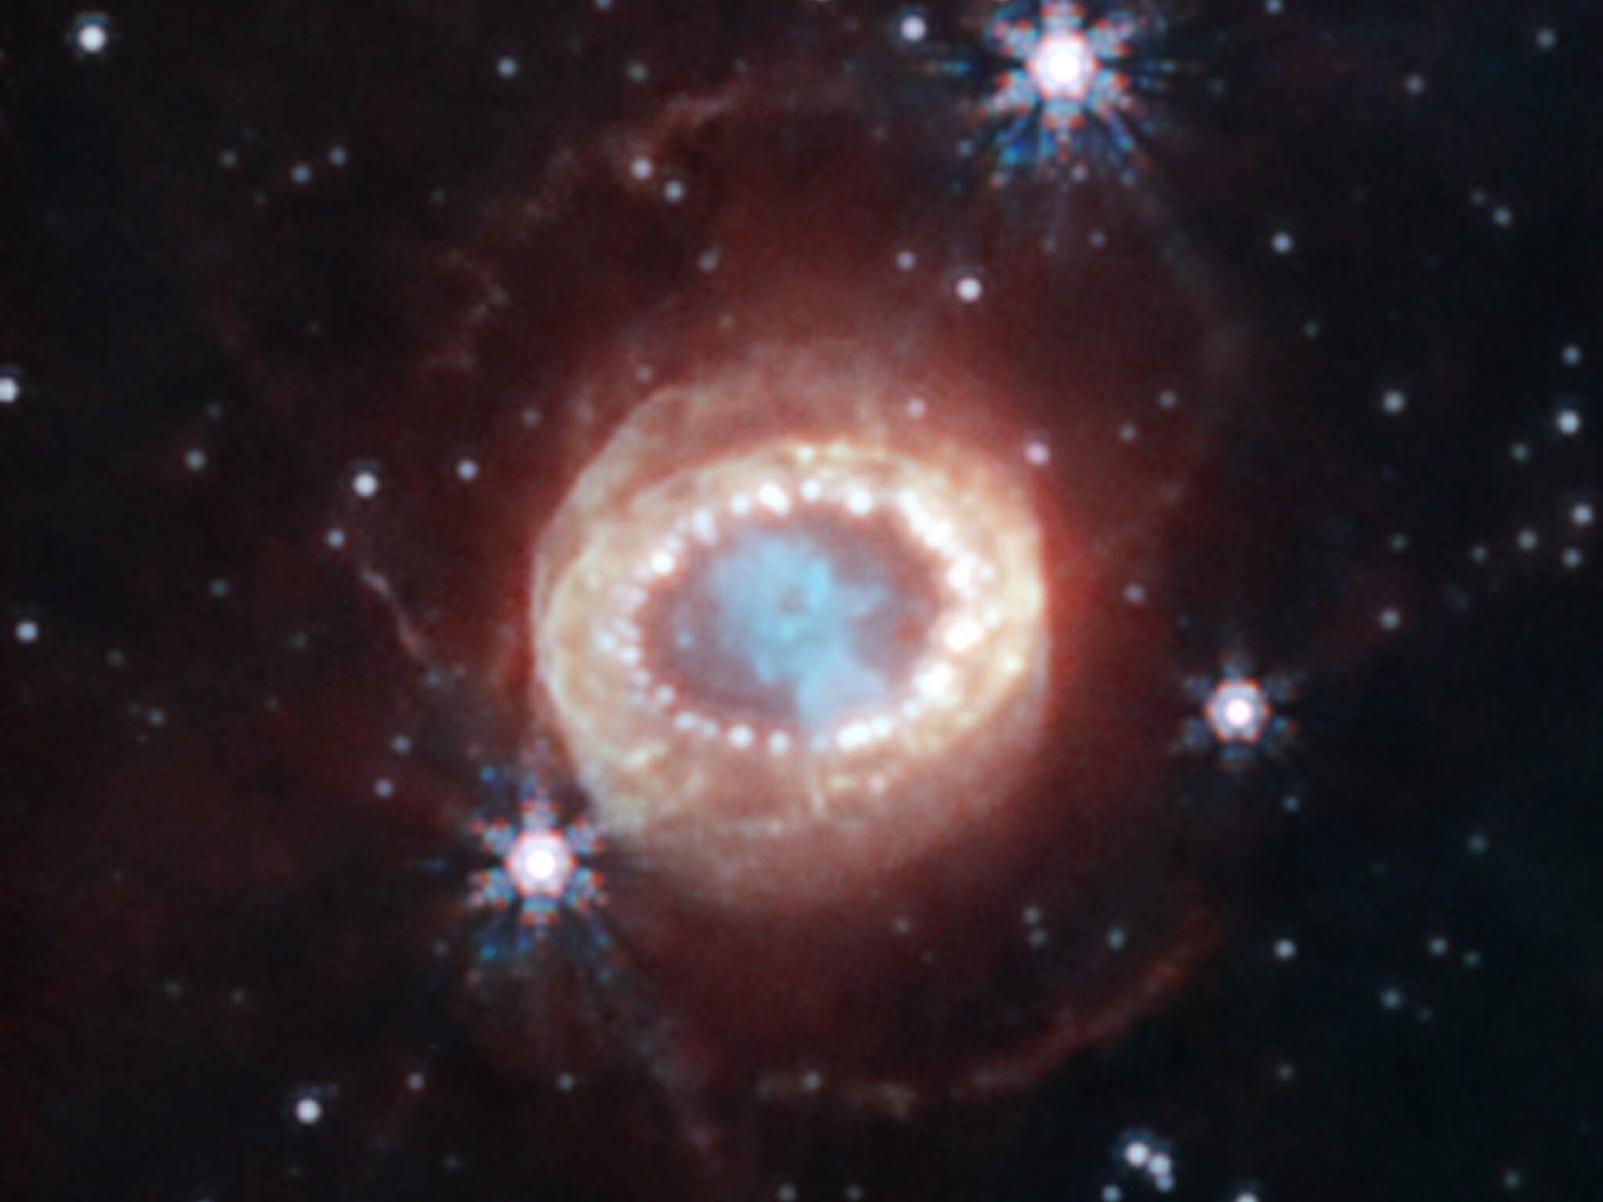
Supernovae for particle physicists
Supernovae are the only known astrophysical (high energy) neutrino sources – roughly 99% of the star’s gravitational binding energy is released as neutrinos during the first few seconds of the supernova explosion. This was observed directly from SN1987A, a supernova in the Large Magellanic Cloud.
The production of neutrinos in a supernova environment necessitates that the supernova is a hadronic source (capable of accelerating protons and nuclei), which means that supernovae are the only known sources of high energy cosmic rays.
SN1987A as seen by JWST’s NIRCam
Credit: ESA/Webb

Slide 4
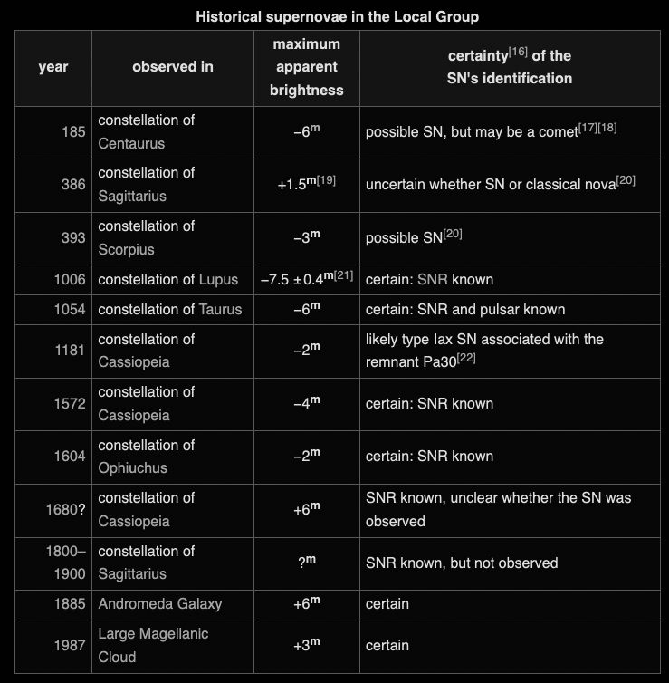
Historical supernovae
Wikipedia table of human-observed supernovae
Based on observations of supernovae in our own Milky Way and other galaxies, we expect the Galactic supernova rate to be ~1-3/century and the total all-sky rate in the observable universe, accessible by transient telescopes, like Vera Rubin to be >1/day!
The last Galactic supernova was seen over a century ago – we’re overdue for another one!
Nova is the Latin word for “new” – supernovae were originally thought to be new stars, which were so bright that they could be observed during the daytime for several months after the progenitor star’s explosion.

Slide 5
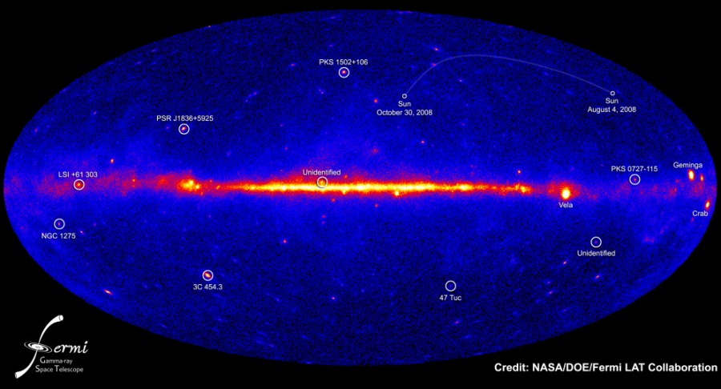
SN 1054 & the Crab nebula
The Crab nebula, which is the remnant of SN 1054 is one of the youngest and the closest supernova to Earth – it is exceptionally bright, particular in high energy gamma rays.
The stellar remnant left behind is a pulsar, a rapidly rotating and highly magnetized neutron star, which is one of the brightest pulsars across the electromagnetic spectrum
Image: Spitzer/Caltech

Slide 6
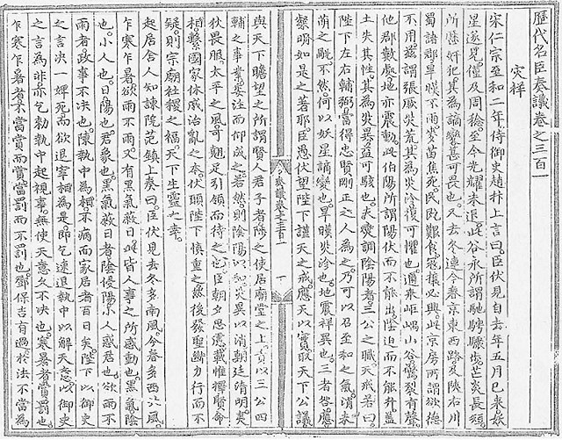
Chinese records of SN 1054
Chinese astronomers called temporary stars (anything from comets to supernovae) 客星, or “guest stars”
An account from the Song Huiyao (translates literally to "Collected important documents of the Song dynasty") states:
“Yang Weide declared: "I humbly observe that a guest star has appeared; above the star there is a feeble yellow glimmer. If one examines the divination regarding the Emperor, the interpretation [of the presence of this guest star] is the following: The fact that the star has not overrun Bi and that its brightness must represent a person of great value”
Then about two years later:
"The guest star has disappeared, which means the departure of the host [that it represents]."
The dates in this document line up exactly with the calculated date of SN 1054’s explosion. These records indicate that the supernova was visible during the day for 23 days and had a total period of (naked eye) visibility of 642 days.

Slide 7
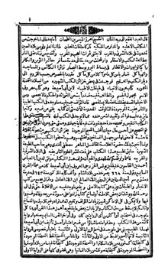
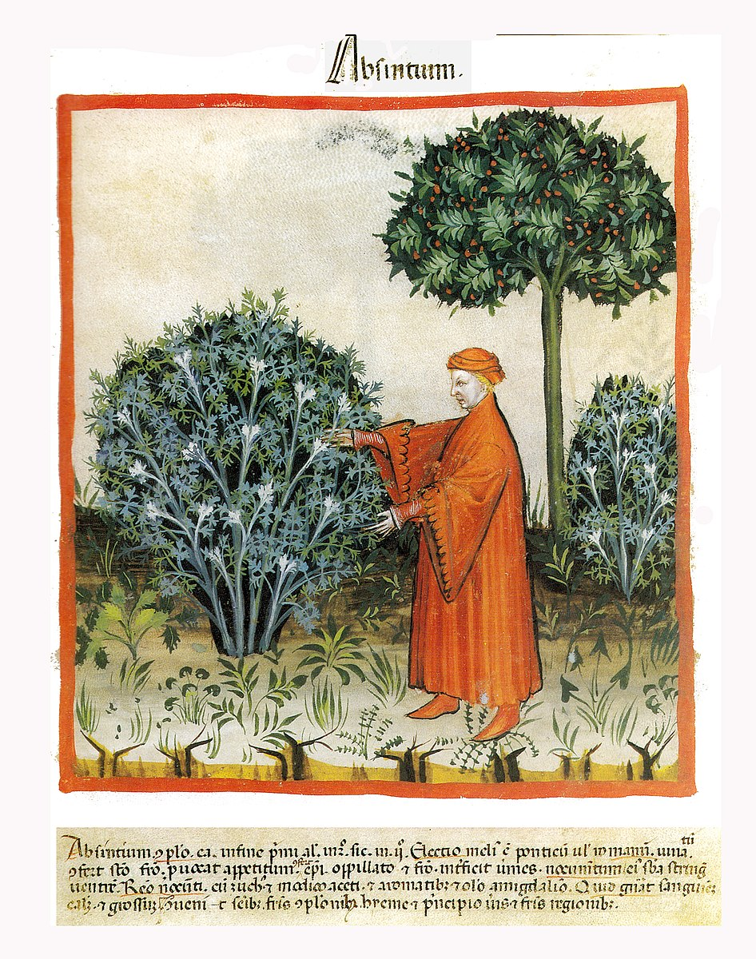
Arabic records of SN 1054
Ibn Butlan, a physician from Baghdad, documented natural disasters and cosmic events during his travels from Baghdad to Constantinople during the 1050s.
He reported on the apparition of a new star that appeared from 1054 - 1055:
“One of the well-known epidemics of our own time is that which occurred when the spectacular (athari) star (kawkab) appeared in Gemini in the year 446H [12 April 1054-1 April 1055]”
Butlan believed that the “star” caused a rapidly spreading epidemic to break out in Cairo.

Slide 8
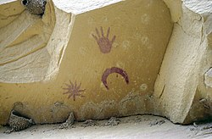
Petroglyphs of SN 1054
Many depictions of crescent Moons with nearby stars exist in North American rock art and petroglyphs. Anasazi rock art in Chaco Canyon, New Mexico depicts a crescent Moon with a nearby star. In this region, SN 1054 would’ve been visible rising to the East with the Moon on the first day the supernova was visible.
However, many archaeologists claim this is a misinterpretation of a depiction of the Moon and Venus and the age of this art is likely long after the supernova occurred.

Slide 9
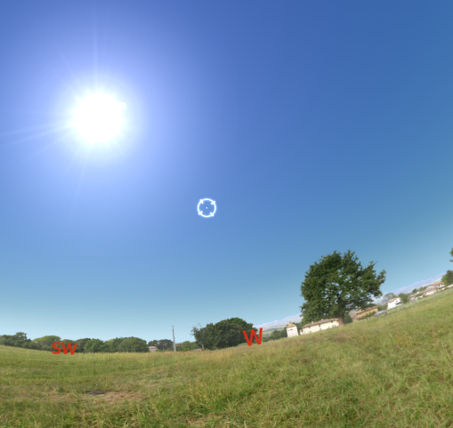
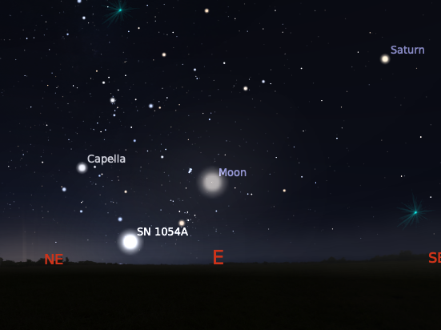
Activity: “observing” SN 1054
July 1054 (day)
Use Stellarium (free for Windows/Mac) with the historical supernova plugin enabled:
Go to the “Configuration” menu on the left side of your screen
Go to the “Plugins” menu, scroll to “Historical Supernovae” and tick the “Load at startup” box
Restart Stellarium
Go to the “Date and Time” menu on the left side of your screen and set the date to July 1054
Move forward in time and observe the supernova throughout the following year – note the location of the supernova compared to other bright night time object – what other objects could the supernova have been mistaken for? (Remember this was a time before light pollution!)
Go to some other locations (“Location” menu on the left side of your screen) – can you understand the observations in this presentation from a peek into their night sky?
July 1054 (night)

Slide 10
Resources & further reading
Hamacher, D. W., “Are supernovae recorded in indigenous astronomical traditions?”, Journal of Astronomical History and Heritage, vol. 17, no. 2, pp. 161–170, 2014. doi:10.48550/arXiv.1404.3253.
Breen, A. and McCarthy, D., “A Re-evaluation of the Eastern and Western Records of the Supernova of 1054”, Vistas in Astronomy, vol. 39, no. 3, pp. 363–379, 1995. doi:10.1016/0083-6656(95)96619-S.
Krupp, E. C. (2015). Crab Supernova Rock Art: A Comprehensive, Critical, and Definitive Review. Journal of Skyscape Archaeology, 1(2), 167-197. https://doi.org/10.1558/jsa.v1i2.28255

