Slide 1
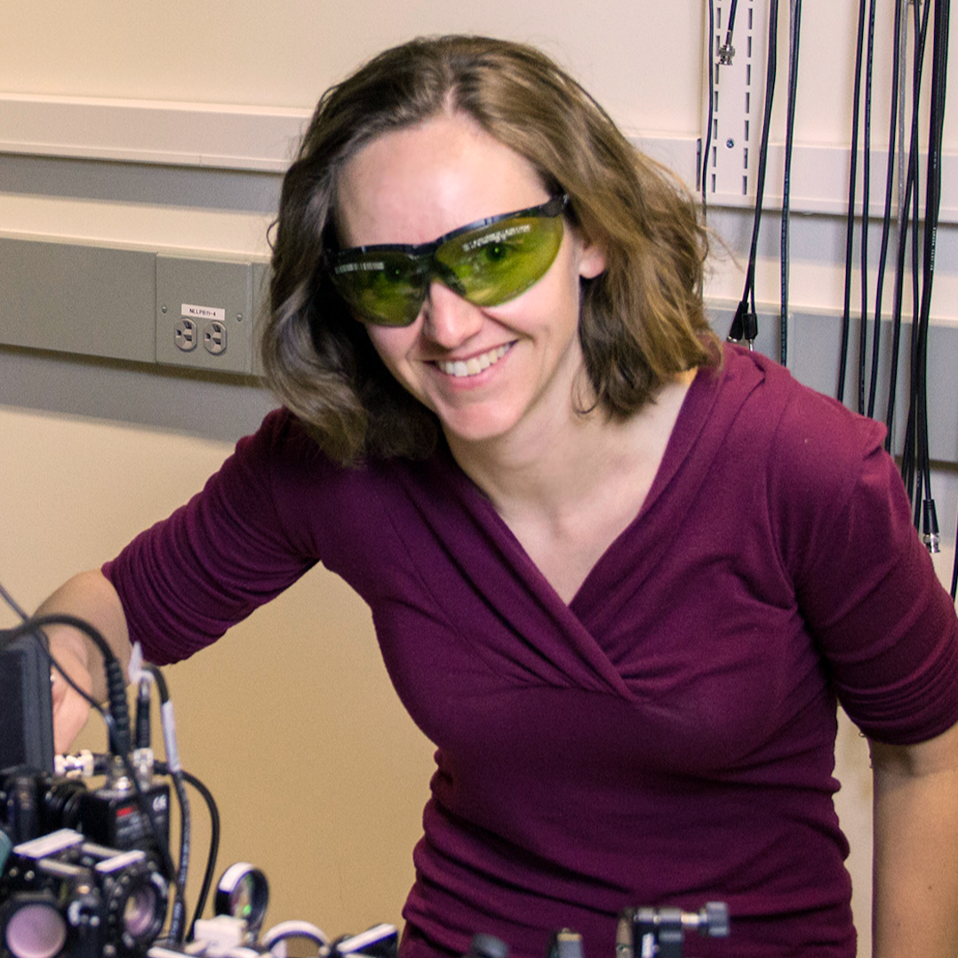
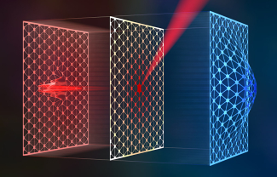
Cindy Regal is an American experimental physicist known for her work in ultracold fermionic condensates and quantum optics. She is an associate professor of physics at the University of Colorado, and a fellow of the Joint Institute for Laboratory Astrophysics. In her own words she aims “to engineer and explore new quantum systems with controlled connections for quantum information and quantum optics”
SiN Resonator under localized heating, Image from Steven Burrows/Regal group
Notes:
https://1400degrees.org/scientist/cindy-regal/

Slide 2
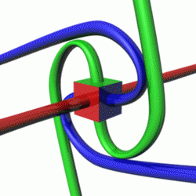
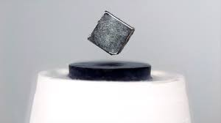
Cindy Regal is an American experimental physicist known for her work in quantum optics, and cavity optomechanics. She was part of the group which measured ultracold fermionic condensates for the first time.
Under specific circumstances, spin ½ particles (fermions), such as electrons, pair up to form integer spin particles, known as bosons. Rather than repelling each other, they collect to form a molecule. This allows fermions to occupy the same quantum state, which should otherwise be forbidden.
A fermionic condensate is a collection of particles all in the same quantum state. Probing the ultracold fermionic condensate can give insights into the creation of room temperature superconductors.

Slide 3
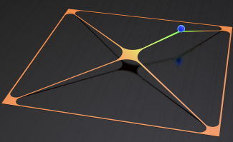
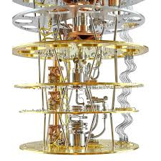
Cindy Regal is improving measurement precision and quantum state stabilization. Through laser cooling, her group measures displacements and forces at quantum limits which contributes to many-body physics.
Creating a system which stays in a given state for any length of time is exceedingly hard. The Regal group designs mechanical resonators for this purpose.
One of many motivations for this work is the applications to quantum information; the ability to place a system into a specific state for an extended period is important, for example, to converting qubit information to optical light.

Slide 4
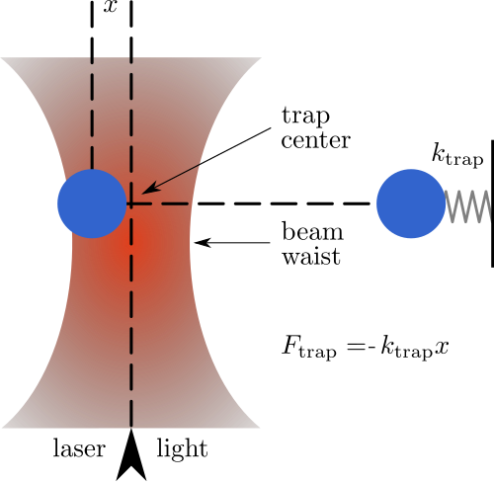
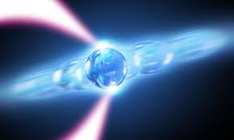
Regal uses optical tweezers to collide individual atoms
Optical tweezers use highly focused laser beams to manipulate nano-scale particles through micronewton forces created by radiation pressure. At the narrowest point of the beam, the amplitude of the electric field is largest.
The forces felt by the particle result from conservation of momentum after a change in momentum of the laser’s light. This happens when the light is bent due to reflection or refraction when it interacts with the particle.
Notes:
Images From:
https://www.rochester.edu/newscenter/optical-tweezers-nobel-prize-nanoparticles-367202/
https://en.wikipedia.org/wiki/Optical_tweezers

Slide 5
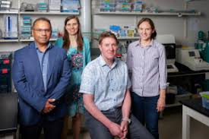
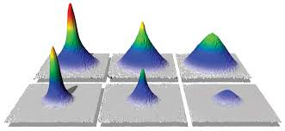
Cindy Regal is a pioneer in the field of atomic, molecular and optical physics. Her numerous contributions to her field have earned her the Presidential Early Career Award and a Packard Fellowship. Her early career work in ultracold fermionic condensates was groundbreaking and she continues to explore quantum systems with her eye on applications.
Notes:
https://1400degrees.org/scientist/cindy-regal/
https://bizwest.com/2024/06/25/cu-boulder-to-build-quantum-machine-shop-with-20m-from-nsf/
https://www.rle.mit.edu/cua_pub/ketterle_group_old/Projects_2007/Pubs_07/PhysicsWorld_Jun07.pdf

