Slide 1
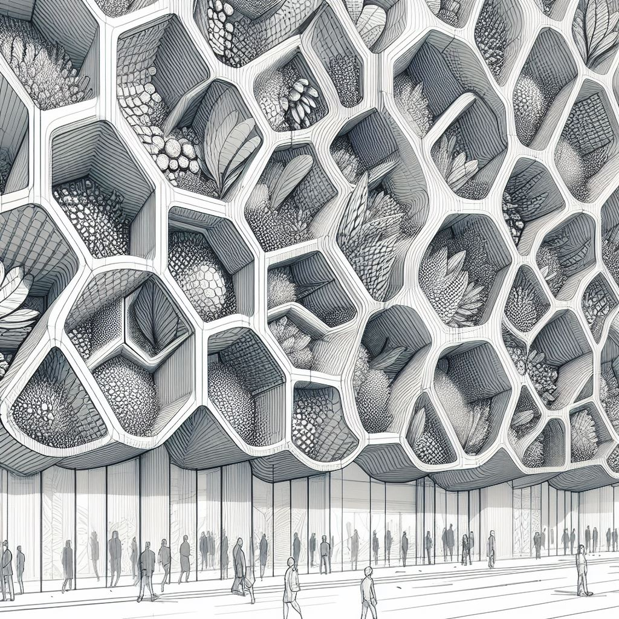
My Design Journal!
CEE 120B/220B Advanced Building Modeling Workshop | Winter 2024
Lavinia Pedrollo

Slide 2
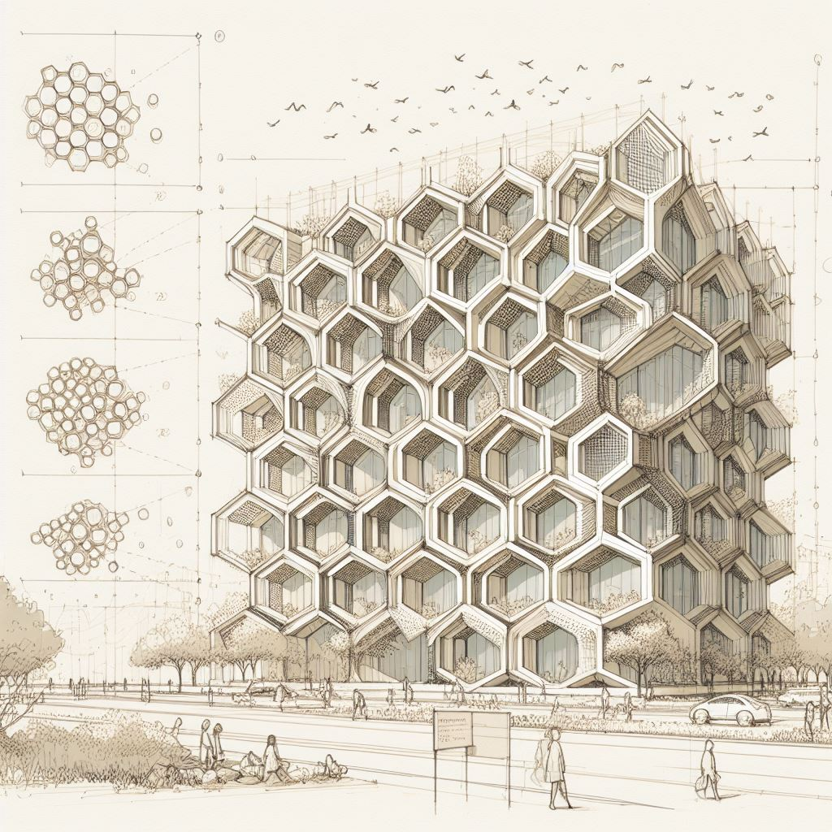

With this design journal, I aim to weave a narrative that not only chronicles the evolution of how I designed the Sustainable Built Environment Learning and Exhibition Center but also serves as an inspiring testament to the transformative power of sustainable design thinking, inviting readers to embark on a captivating journey through innovation, adaptation, and the limitless possibilities of green architecture!

Slide 3
Week 1
Notes:
https://www.notion.so/bearington/Module-1-Design-Project-Brief-Design-Inspirations-Big-Feature-Ideas-005adf086c6247908a09ef4a2b5ba8a6

Slide 4
ASSIGNMENT WEEK 1: What is expected
The assignment states:
“Our objective for this project is to design an elegant and functional building that exemplifies sustainable building practices and outstanding building performance.”
“Our clients want to create a building that serves as a model and inspiration for green building enthusiasts -- illustrating the exceptional results obtainable through smart performance-based design -- and provides a vibrant hub for sustainability-related activities.”
“The building should feature exhibition space and resources for visitors to explore the various possibilities/features in the green building world that can be used and replicated in other buildings. They want a very dynamic and exciting space that will appeal to visitors of all ages and varying degrees of interest and expertise in sustainable design.”

Slide 5

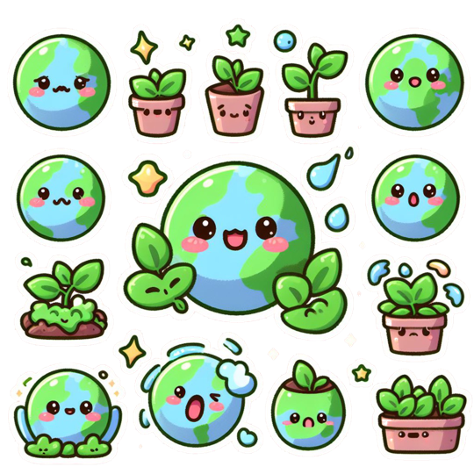
My thought process
In the upcoming slides, I will walk you through the questions that led me to my initial design ideas!

Slide 6
1. What is Sustainability?
?
?
First, I started by actually looking up what “sustainability” means!!
Sustainability is the ability to maintain or support a process over time.
Sustainability is often broken into three core concepts: economic, environmental, and social.
I am interested in the environmental part. Specifically, I want to understand “What is sustainable design in construction?”
Sustainable construction is the use of renewable and recyclable materials in construction to reduce energy consumption and wastage. Sustainable construction primarily exists to minimize the impact of construction on the environment.

Slide 7
2. What are Sustainable Design construction practices nowadays?
?
?
After understanding what sustainability means, I decided to have a look on how it is applied to construction today. Some of the sustainable design strategies are:
Passive design techniques
Energy-efficient technologies
Sustainable material selection
Design for circularity
In the following slides, I included real concrete examples of these design practices!! They are helpful to kickstart ideas for what my final design should include. Since the building is meant to be a lively hub for sustainability, the design itself needs to be sustainable!

Slide 8
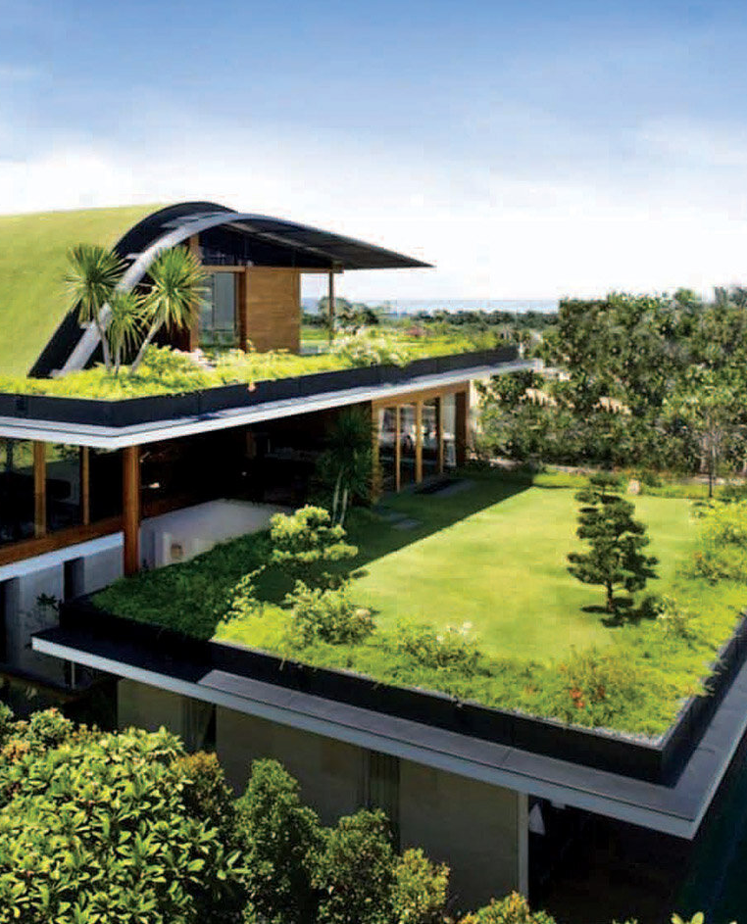
2. What are Sustainable Design practices nowadays?
Green Roof
A green roof is a roof that is partially or completely covered with vegetation and a growing medium, planted over a waterproofing membrane. It can help reduce the urban heat island effect, improve air quality, and provide a habitat for wildlife.
Design idea: incorporate a green roof into my design to showcase the benefits of green roofs and provide an attractive space for visitors to enjoy.

Slide 9
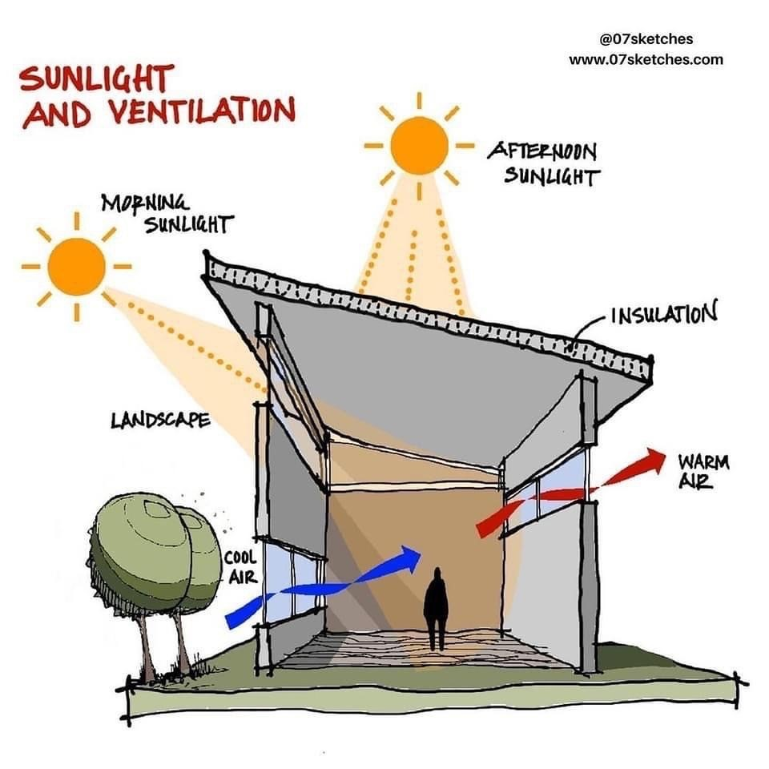
Passive Solar Design
2. What are Sustainable Design practices nowadays?
Passive solar design is a technique that uses the sun’s energy to heat and cool a building without the use of mechanical systems.
Design idea: incorporate passive solar design principles into my building to reduce energy consumption and create a comfortable indoor environment.

Slide 10
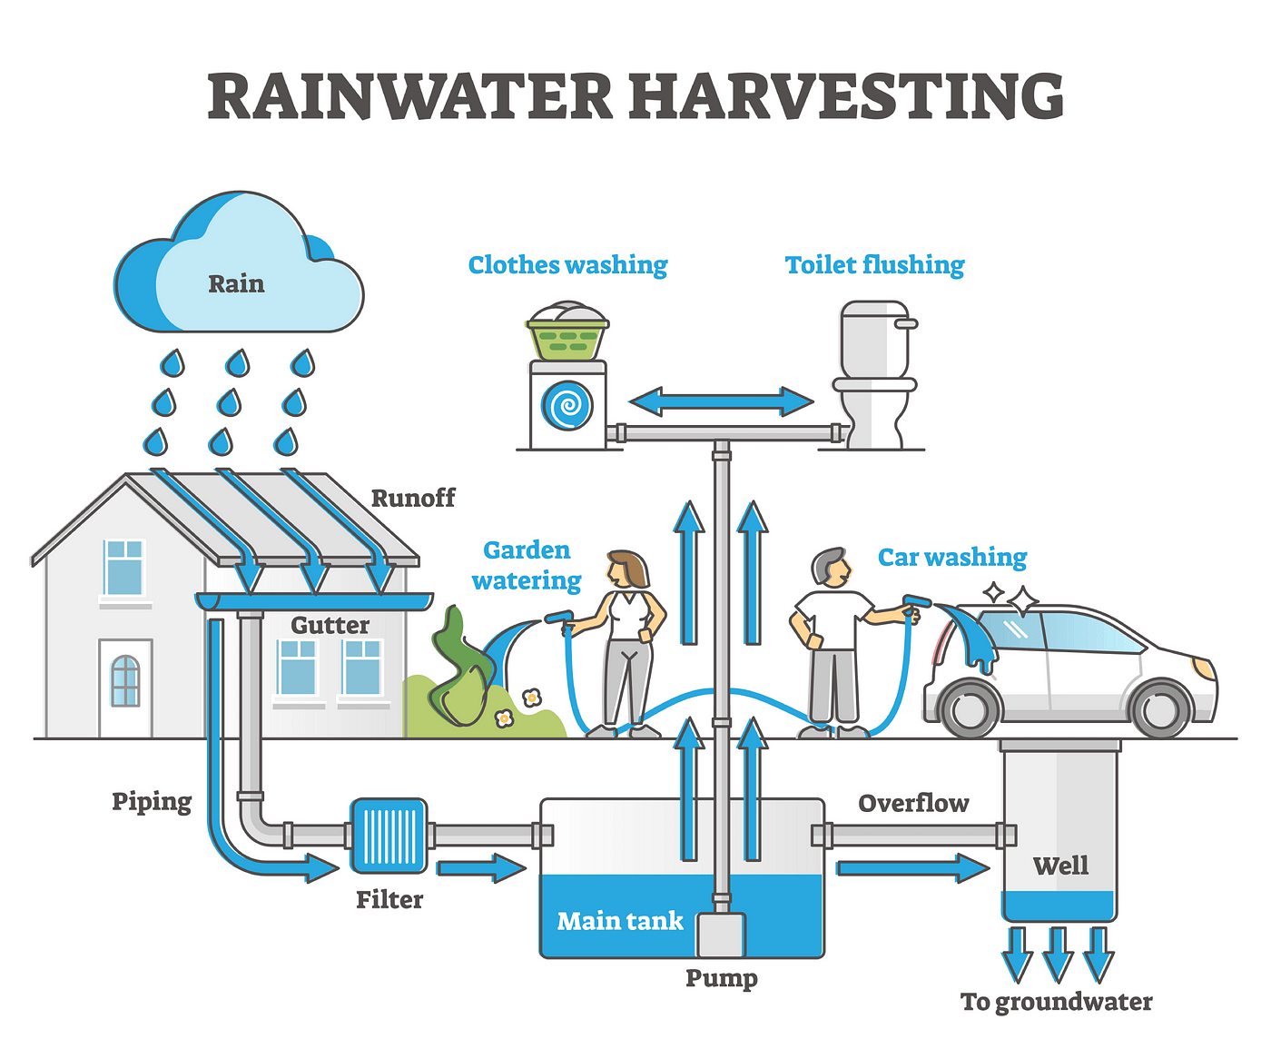
Rainwater Harvesting
2. What are Sustainable Design practices nowadays?
Rainwater harvesting is the collection and storage of rainwater for later use.
Design idea: incorporate a rainwater harvesting system into my design to reduce water consumption and demonstrate the benefits of sustainable water management.

Slide 11
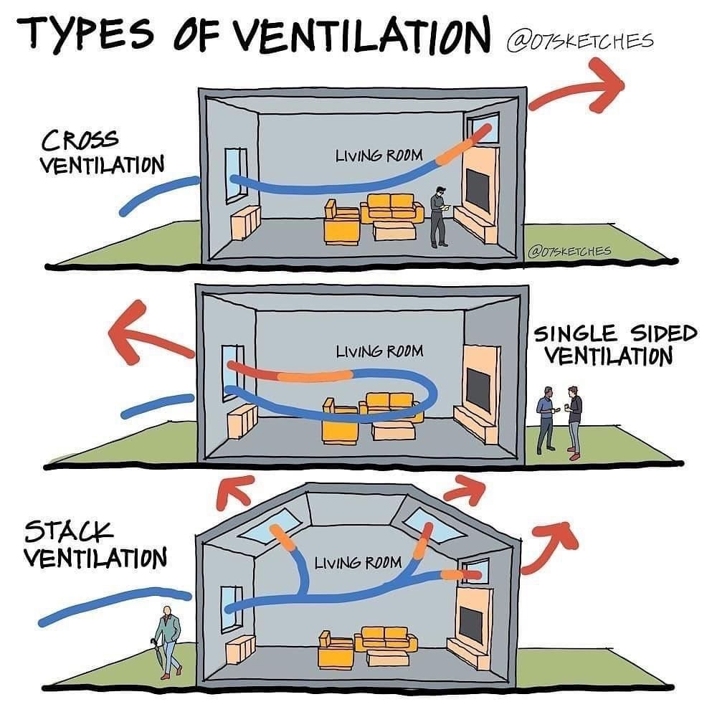
Natural Ventilation
2. What are Sustainable Design practices nowadays?
Natural ventilation is the process of supplying and removing air through an indoor space without using mechanical systems.
Design idea: incorporate natural ventilation into my building to improve indoor air quality and reduce energy consumption.

Slide 12
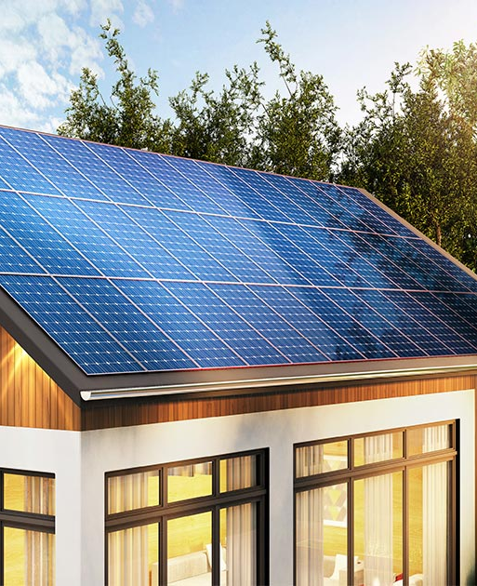
Solar Panels
2. What are Sustainable Design practices nowadays?
Solar panels are devices that convert sunlight into electricity.
Design idea: incorporate solar panels into my design to generate renewable energy and reduce my building’s carbon footprint.

Slide 13

3 Designs that could inspire me
Now that I have an idea of which design practices I could include in my building, I will have a look at some already existing sustainable buildings and get inspiration from them!

Slide 14
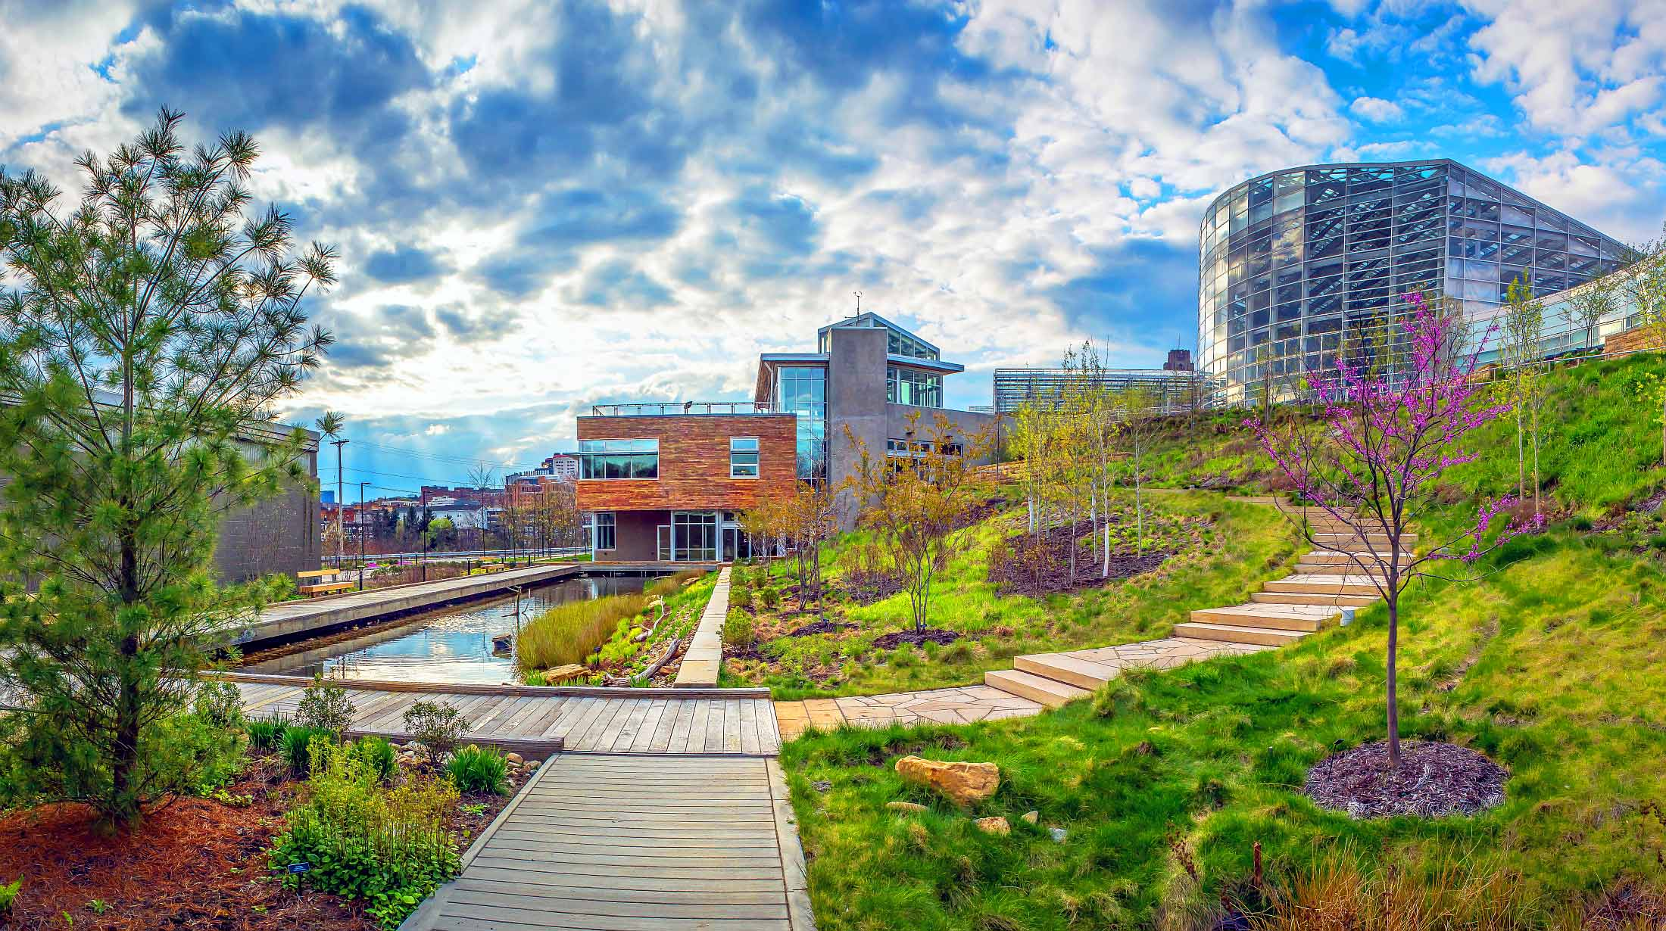
Center for Sustainable Landscapes (Pennsylvania, USA)
Notes:
https://www.phipps.conservatory.org/green-innovation/at-phipps/center-for-sustainable-landscapes-greenest-building-museum-garden-in-the-world

Slide 15
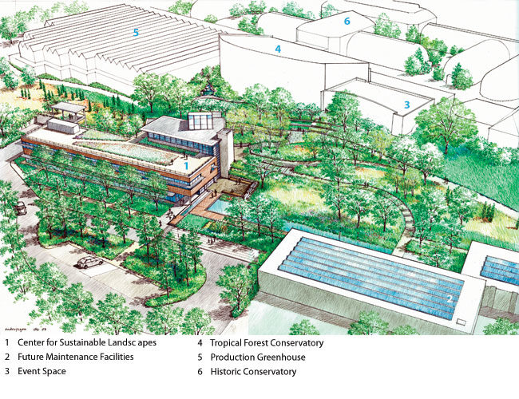
Center for Sustainable Landscapes
Located at Phipps Conservatory and Botanical Gardens (Pennsylvania)
This center is one of the greenest buildings in the world
Achieves the highest certifications from the Living Building Challenge, LEED Platinum, SITES Platinum, and WELL Platinum
The center features a net-zero energy and water system, a green roof, a solar array, a wind turbine, a geothermal system, a rain garden, a lagoon, and a constructed wetland.
Notes:
https://www.phipps.conservatory.org/green-innovation/at-phipps/center-for-sustainable-landscapes-greenest-building-museum-garden-in-the-world

Slide 16
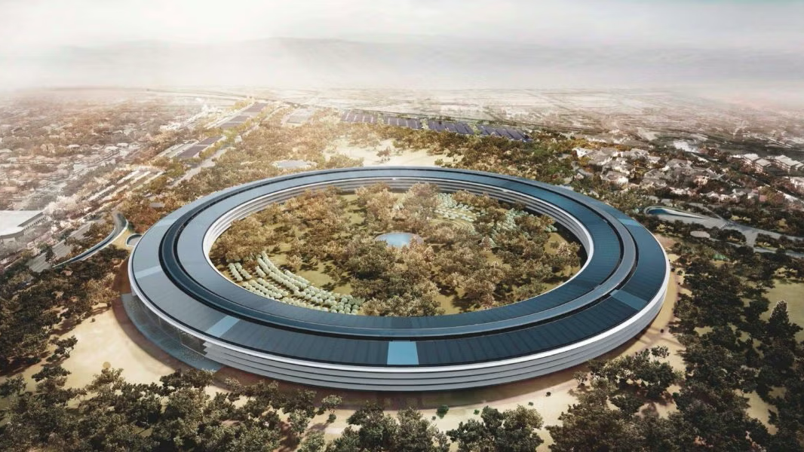
Apple Park ( California, USA)

Slide 17
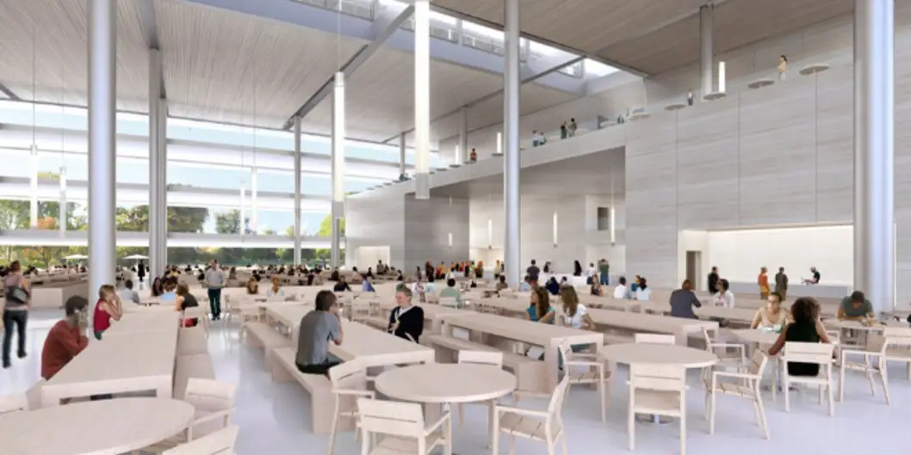
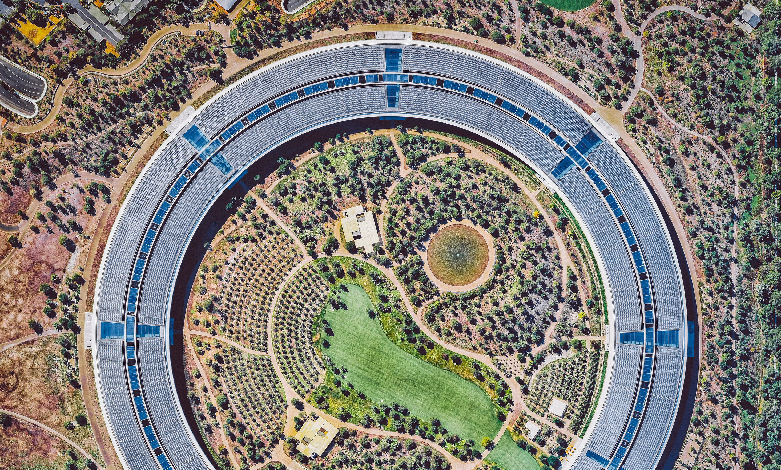
Apple Park
Located in Cupertino (California, USA)
The neo-futuristic complex is a ring-shaped building designed to run on sustainable energy from the solar panels on top of the structure.
The glare to the interiors is reduced by the canopies installed between each floor.
It is the largest LEED platinum-certified office building in North America with renewable energy, green spaces and innovative ventilation systems.
The Ring Building is not the only building on the complex. Within the inner circular compound lies the Visitors’ Center, Steve Jobs Theater and Fitness & Wellness Center.
Notes:
https://www.phipps.conservatory.org/green-innovation/at-phipps/center-for-sustainable-landscapes-greenest-building-museum-garden-in-the-world

Slide 18
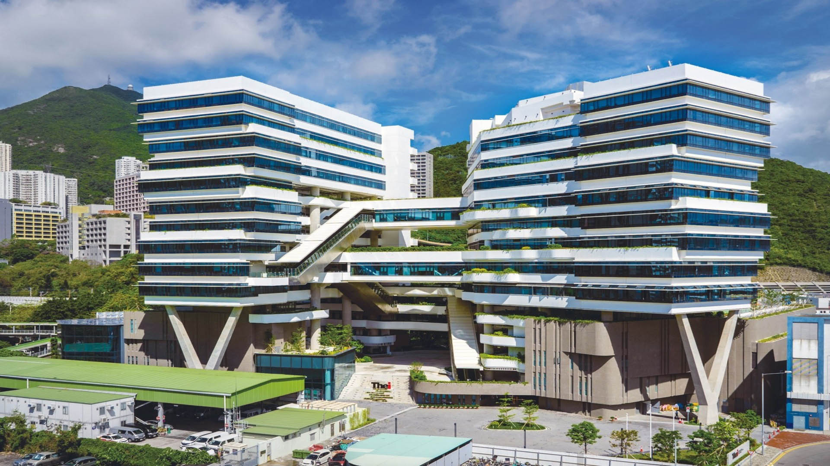
The Green Building Learning Zone at the Hong Kong Science Park in (Hong Kong, China)
Notes:
https://www.phipps.conservatory.org/green-innovation/at-phipps/center-for-sustainable-landscapes-greenest-building-museum-garden-in-the-world

Slide 19
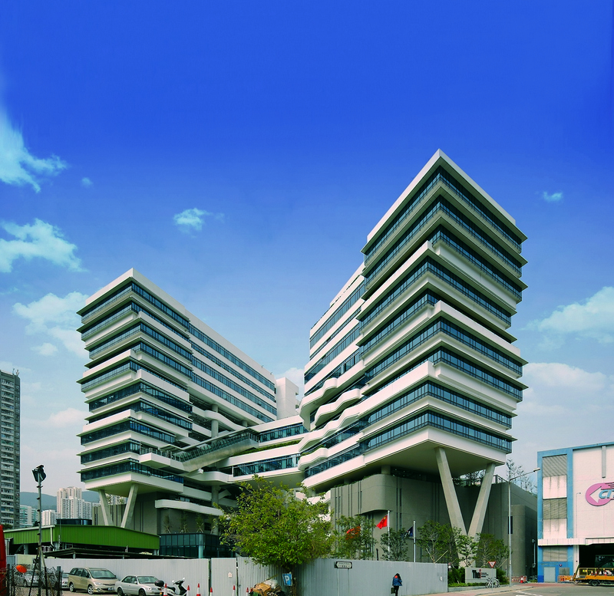
The Green Building Learning Zone
Located at the Hong Kong Science Park (Hong Kong, China)
This initiative is significant because Hong Kong is home to a large number of skyscrapers, which consume up to 90% of the city’s electricity and contribute to 60% of the city’s greenhouse gas emissions.
Hong Kong has a thriving green building movement and is committed to making its vast number of skyscrapers more energy-efficient. This includes the use of smart technologies for real-time energy consumption monitoring.
Notes:
https://www.phipps.conservatory.org/green-innovation/at-phipps/center-for-sustainable-landscapes-greenest-building-museum-garden-in-the-world

Slide 20
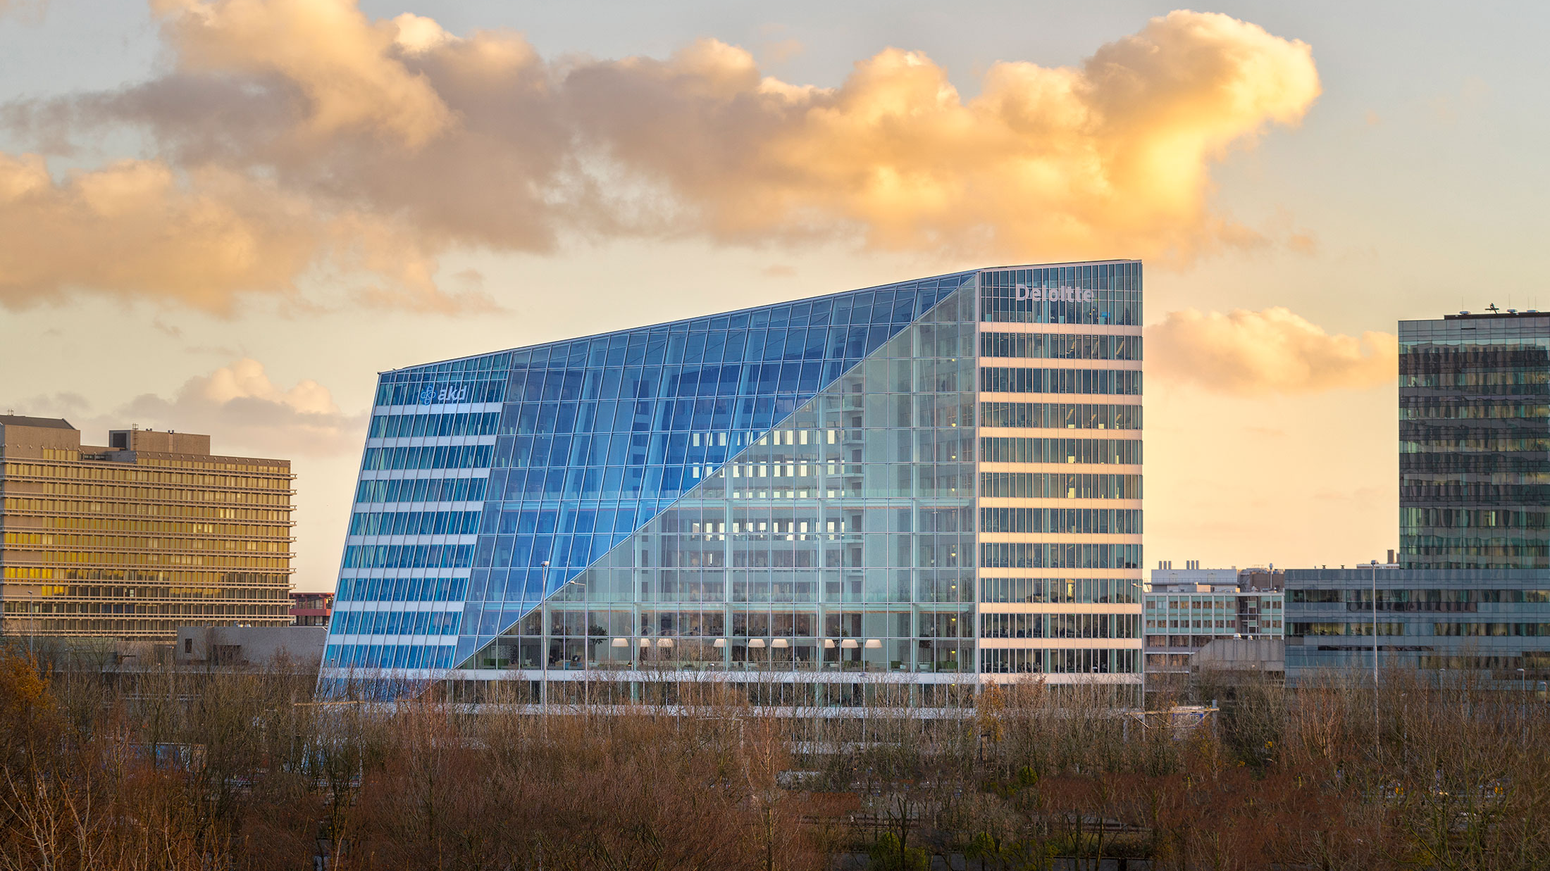
The Edge (Amsterdam, Netherlands)

Slide 21
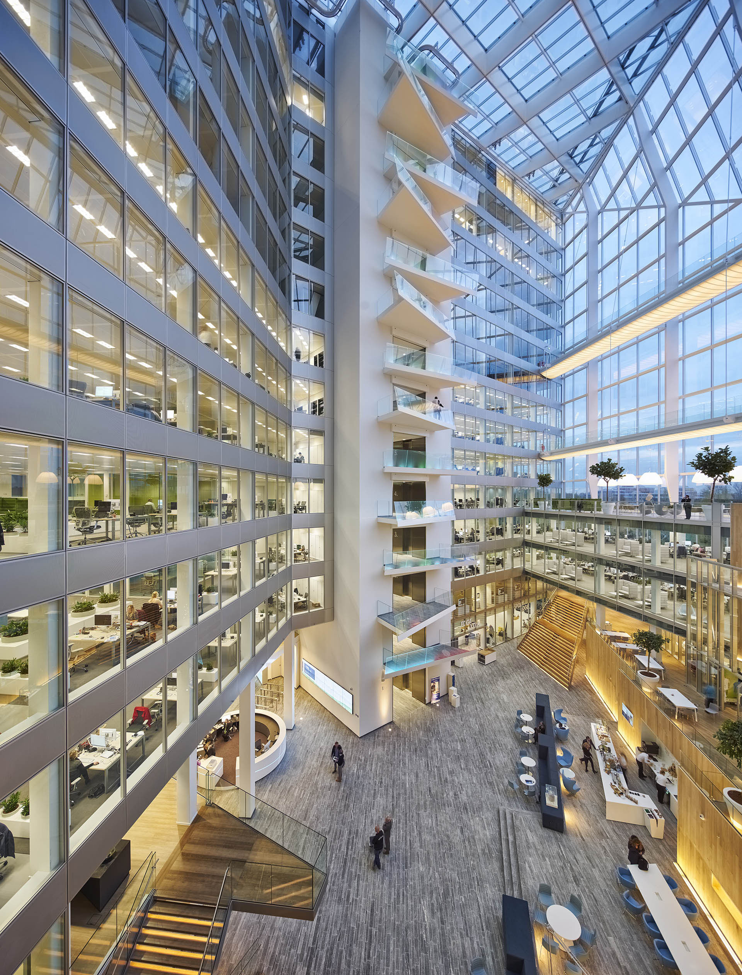
The Edge
Located in the city of Amsterdam (Netherlands):
Recognized as one of the greenest buildings globally, this center has attained the pinnacle of certifications, including Living Building Challenge, LEED Platinum, SITES Platinum, and WELL Platinum.
Embracing a holistic approach, the center boasts a net-zero energy and water system, minimizing its environmental footprint.
The starting point of the design is what the architects term a social condenser - a nucleus for the building in the form of an atrium interspersed with bridges and exposed lift cores, which act as nodes of horizontal and vertical activity.
Notes:
https://www.phipps.conservatory.org/green-innovation/at-phipps/center-for-sustainable-landscapes-greenest-building-museum-garden-in-the-world

Slide 22
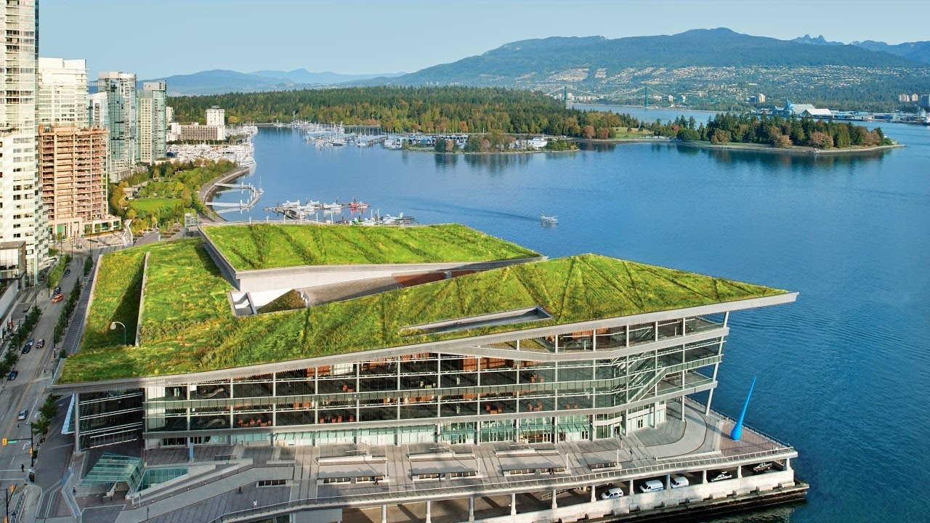
The Vancouver Convention Centre (British Columbia, Canada)

Slide 23
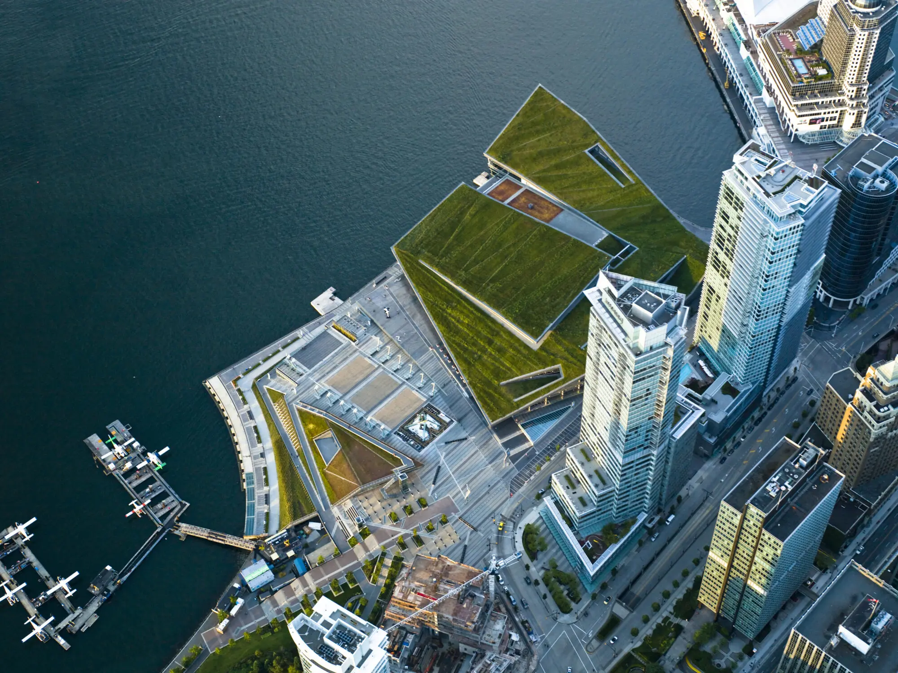
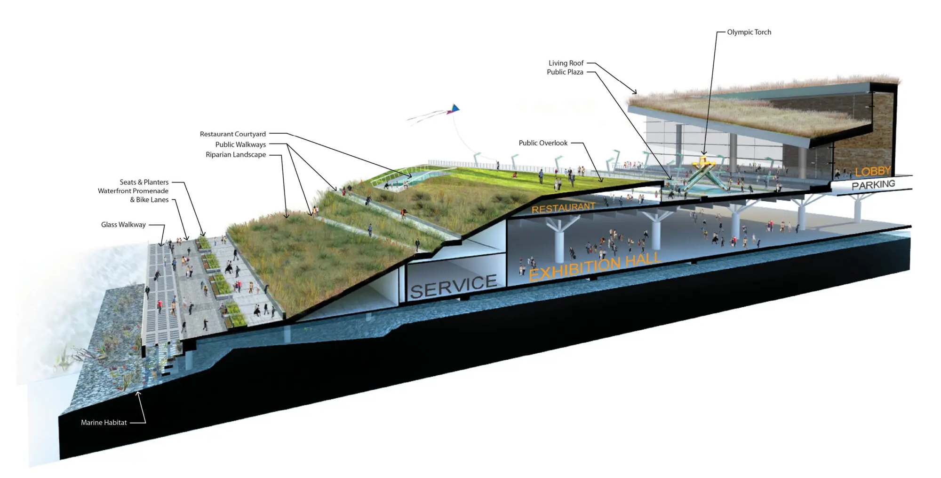
The Vancouver Convention Centre
Located in British Columbia, Canada:
The center is a landmark green building and a beacon of sustainability for conference centers across the world
The venue offers an expansive convention space of over 1,076,000 SF
It comprises a restored marine habitat embedded into the building’s foundation and a flourishing six-acre living roof irrigated by an onsite blackwater treatment plant
The living roof, seawater heating and cooling, on-site water treatment and fish habitat built into the foundation of the West Building make it one of the greenest convention centers in the world
The roof is home to 25 different species of plants, all indigenous to the West Coast
The center employs cutting-edge technologies that prioritize sustainability and environmental stewardship, from a geothermal system to a rain garden, lagoon, and constructed wetland
Notes:
https://www.phipps.conservatory.org/green-innovation/at-phipps/center-for-sustainable-landscapes-greenest-building-museum-garden-in-the-world

Slide 24

4 My design! Initial ideas
Now that I have gotten some inspiration from some of the most sustainable buildings in the world, I will sketch / define my initial design!

Slide 25
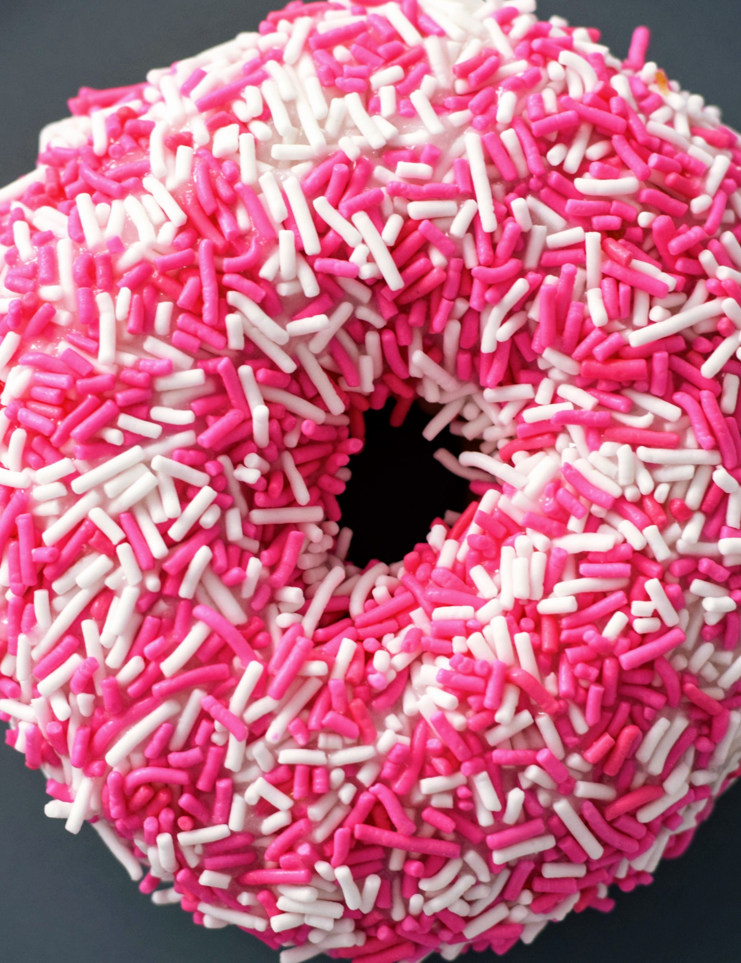
SHAPE First!
Of all the designs I have seen from the previous buildings, the donut shape is my favorite! Why?
It is simple and symmetric!
It allows ample light to enter the building, reducing the need for man-made light sources.
It allows good circulation of the air through the entrances and the courtyard.
A circular exterior has a lesser surface area compared to a square or rectangular perimeter, helping thermal conditions in cold climates
It has structural strength: more resistant to winds, snow, and earthquakes.
It promotes collaboration and fluidity. Given the curved form, residents have the opportunity to interact with neighbors across the rings as well as those in the central garden

Slide 26
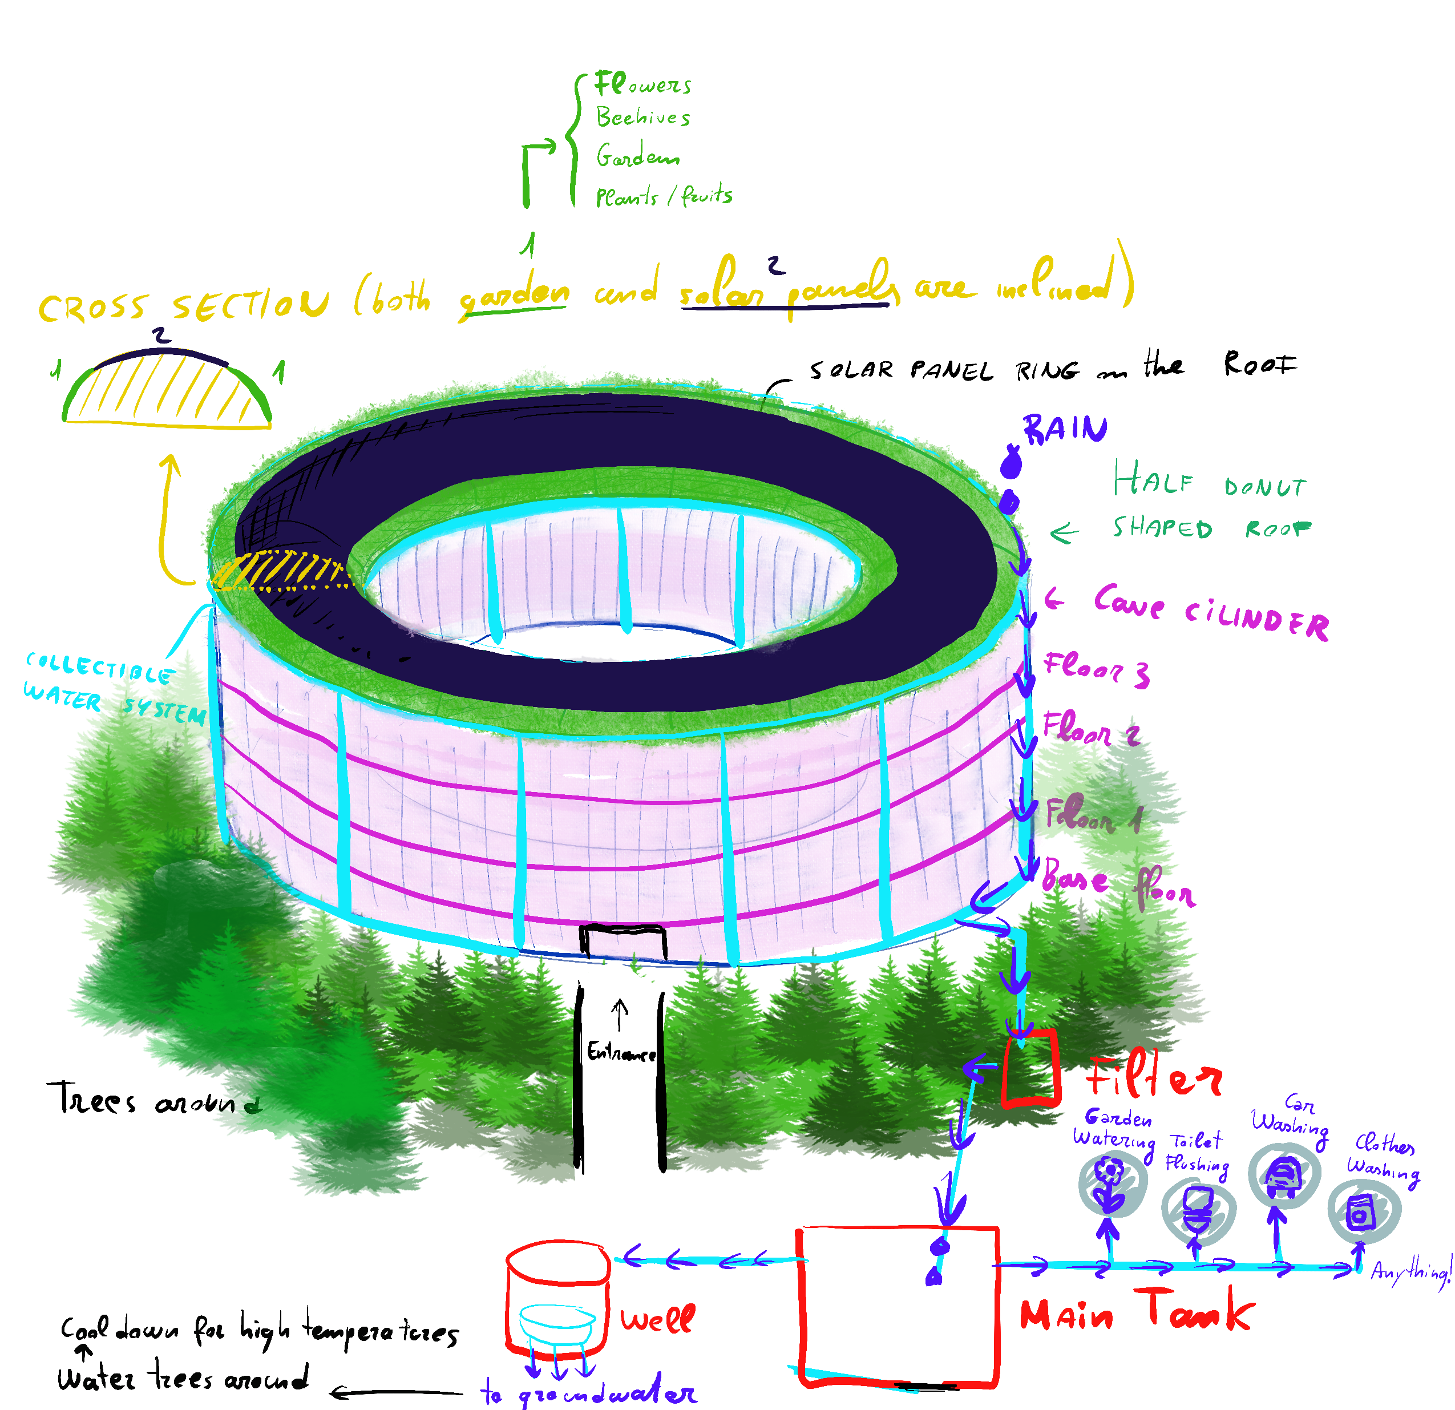
Secondly, the sustainable design practices that I will include in my building design!
For sure, I will include:
A roof garden
Solar panels
Rainwater collection system

Slide 27
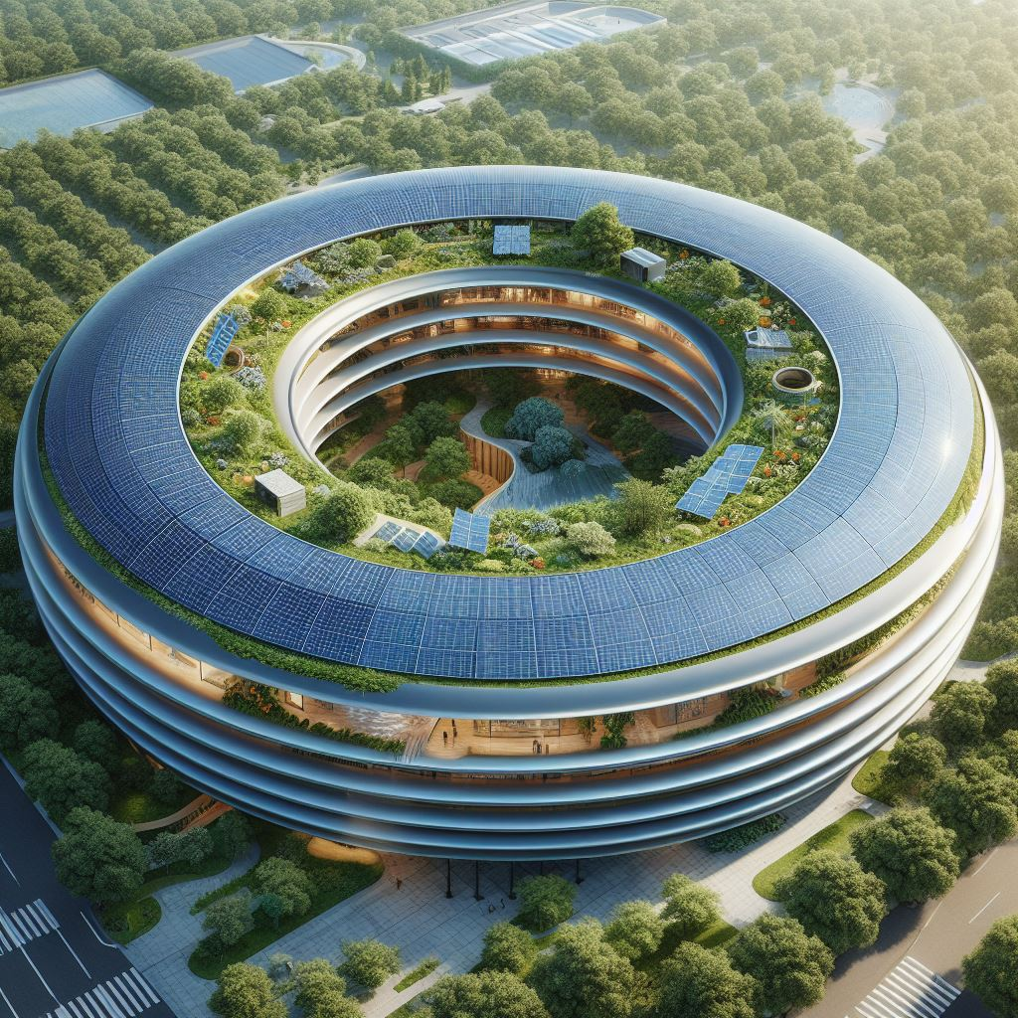
Third, a rough idea of how the final building could look like!!
I asked DALL-E to sketch a “donut-shaped sustainable building with solar panels on the roof, a rain collecting system, and a roof garden inspired by the Apple Park”.

Slide 28
Week 2
Notes:
https://www.notion.so/bearington/Module-1-Design-Project-Brief-Design-Inspirations-Big-Feature-Ideas-005adf086c6247908a09ef4a2b5ba8a6

Slide 29
ASSIGNMENT WEEK 2: What is expected
Focus: The focus of this exploratory stage in the process of creating your integrated design project is to identify:
Project Goals that will guide your design decision-making
Measures that can be used to quantify the performance of your design relative to each goal
Target Values for each of the measures
Strategies that you’d like to explore for achieving these targets
Recommended Approach: At this point in our design process, we’re still working with ideas (not models). So, feel free to use whatever tools help you map out and creatively think about these issues — sketches, mindmaps, outlines, tables, or text. Start by thinking about your overall project goals. Think broadly and creatively — these goals can be related to whether the project is:
Sustainable
Constructable
Operable
Useable
Other project goals that you’d like to explore
Using your initial list as a starting point, use these questions to help narrow down the list to three or four major goals that you’ll focus on to guide your design process. What are the big goals that you’d like to explore in you design? How would you measure them? What would be a minimally acceptable value for each measure? What would be an even better (more desirable) value that you’d like to target/achieve if possible? What design strategies could you consider (model and test) for achieving those targets?
Your endpoint should be a list of your three or four guiding design goals with this information provided for each goal:
  Design Goal: short description of the goal
  Measure: the metric that you’ll use to measure this goal
  Targets:
    minimally acceptable value
    desired / target value
  Strategies:
    one design strategy that I’d like to explore in my design to achieve this goal
    a second design strategy (have at least two for each goal)
    maybe a third or fourth strategy
Thinking Ahead: In the weeks ahead, we’ll develop these big ideas into a detailed building design. If it helps your creative process, you can start thinking ahead to: Building Form and Massing (Module 4):
Overall shape and form of your proposed design
What will work best for meeting the program requirements as well as supporting your sustainable design strategies
But don’t dive too deeply into those issues yet! Keep this practice exercise very high level and focussed on goals, targets, and strategies.
Practice Exercise: Create a new posting highlighting:
your design intent/goals
the measures and targets that you’ll use
the design strategies you’re considering as you think ahead

Slide 30

WEEK 1: CA Session Feedback
Some sustainable buildings lack aesthetics, for example, there is no need to place solar panels on the roof for a building to be aesthetically pleasing and sustainable at the same time.
Before thinking of a detailed design like the one proposed in Slide 26 (week 1), think of the following design considerations!
  Start from… Where is the building located? New York!
  Does the design integrate well with the surrounding buildings? For example, installing solar panels in a potential new skyscraper in NYC could not make sense because the other skyscrapers would partially cover my building’s roof (it is just 35000 SF, so it is not a very tall building)
  When designing the building, consider how people interact with the building!
Avoid focusing on the donut shape for now (and maybe forever 🫠).
Action Items:
  Research sustainable design goals specific to New York City.
  Experiment with different shapes in Autodesk Forma and conduct a solar analysis for each proposed shape.
Extra consideration: explore alternative locations for renewable energy sources and consider placing them nearby instead of on the building's top!
  🗽

Slide 31
DESIGN THINKING - PLAN for week 2!
I propose the following design thinking process before completing the assignment request (bullet point 5) :
What are the major sustainability issues in NYC? (Let’s start with understanding the specific sustainability problems that affect NYC!)
What are sustainable design practices that can be applied in NYC? (Once I understood the problem, I wanted to see if there were already sustainable design practices that are implemented in NYC…)
What are current sustainability policies in NYC? (… as well as sustainable policies...)
What are the most sustainable buildings currently in NYC? (… and buildings!)
I will then complete the “Practice Exercise: Create a new posting highlighting:
        your design intent/goals
        the measures and targets that you’ll use
        the design strategies you’re considering as you think ahead”
Note: points 1-2 have been strongly inspired by the publication available as a PDF here: [LINK]

Slide 32
1. NYC Sustainability Issues (2023-2024)
Large buildings (>25,000 SF) contribute significantly to carbon emissions.
Limited city-wide food waste recycling increases landfill waste.
Water regulations struggle to reduce harmful chemical concentrations.
Challenges in delivering high-quality water, wastewater, and stormwater services.
NYC Central Business District traffic causes pollution and lost productivity.
Rising dangers: heat waves, extreme precipitation, flash floods, and sea level rise.
Hindered sustainable transition due to inflation, mismanagement, NIMBY, and pandemics.
Struggles in making the energy grid more renewable and efficient.
Moderate air quality (US AQI 65), PM2.5 concentration 3.8 times WHO guideline.
Air pollution estimated to cause 670 deaths in NYC in 2024.
(In red are the issues that will severely affect my final design)

Slide 33
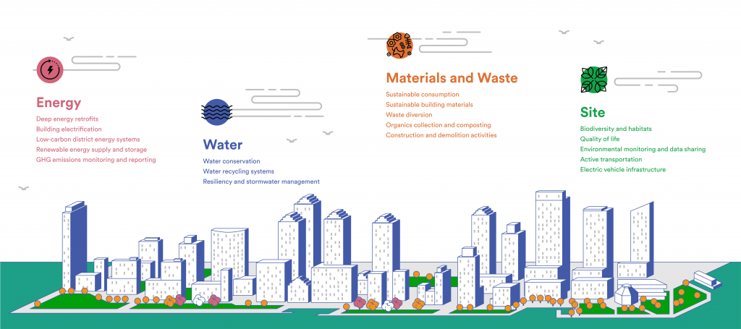
2. NYC sustainable design practices
https://bpca.ny.gov/community/climate-week-nyc-water/

Slide 34
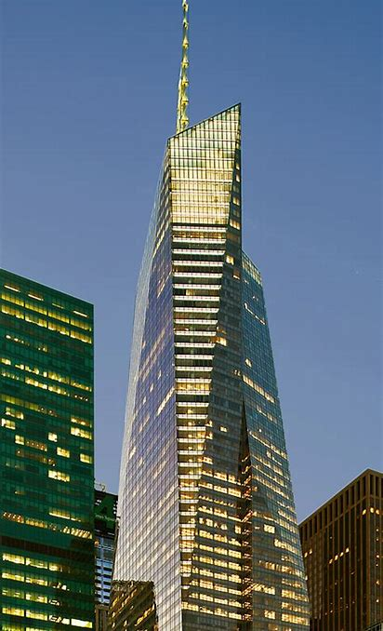
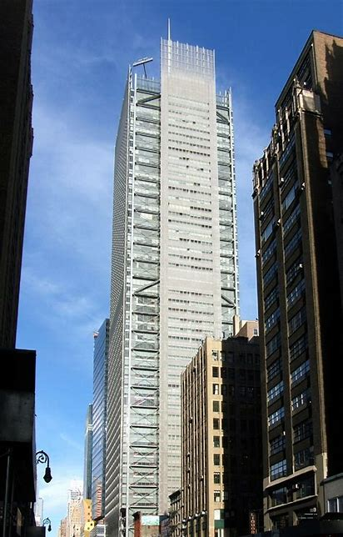
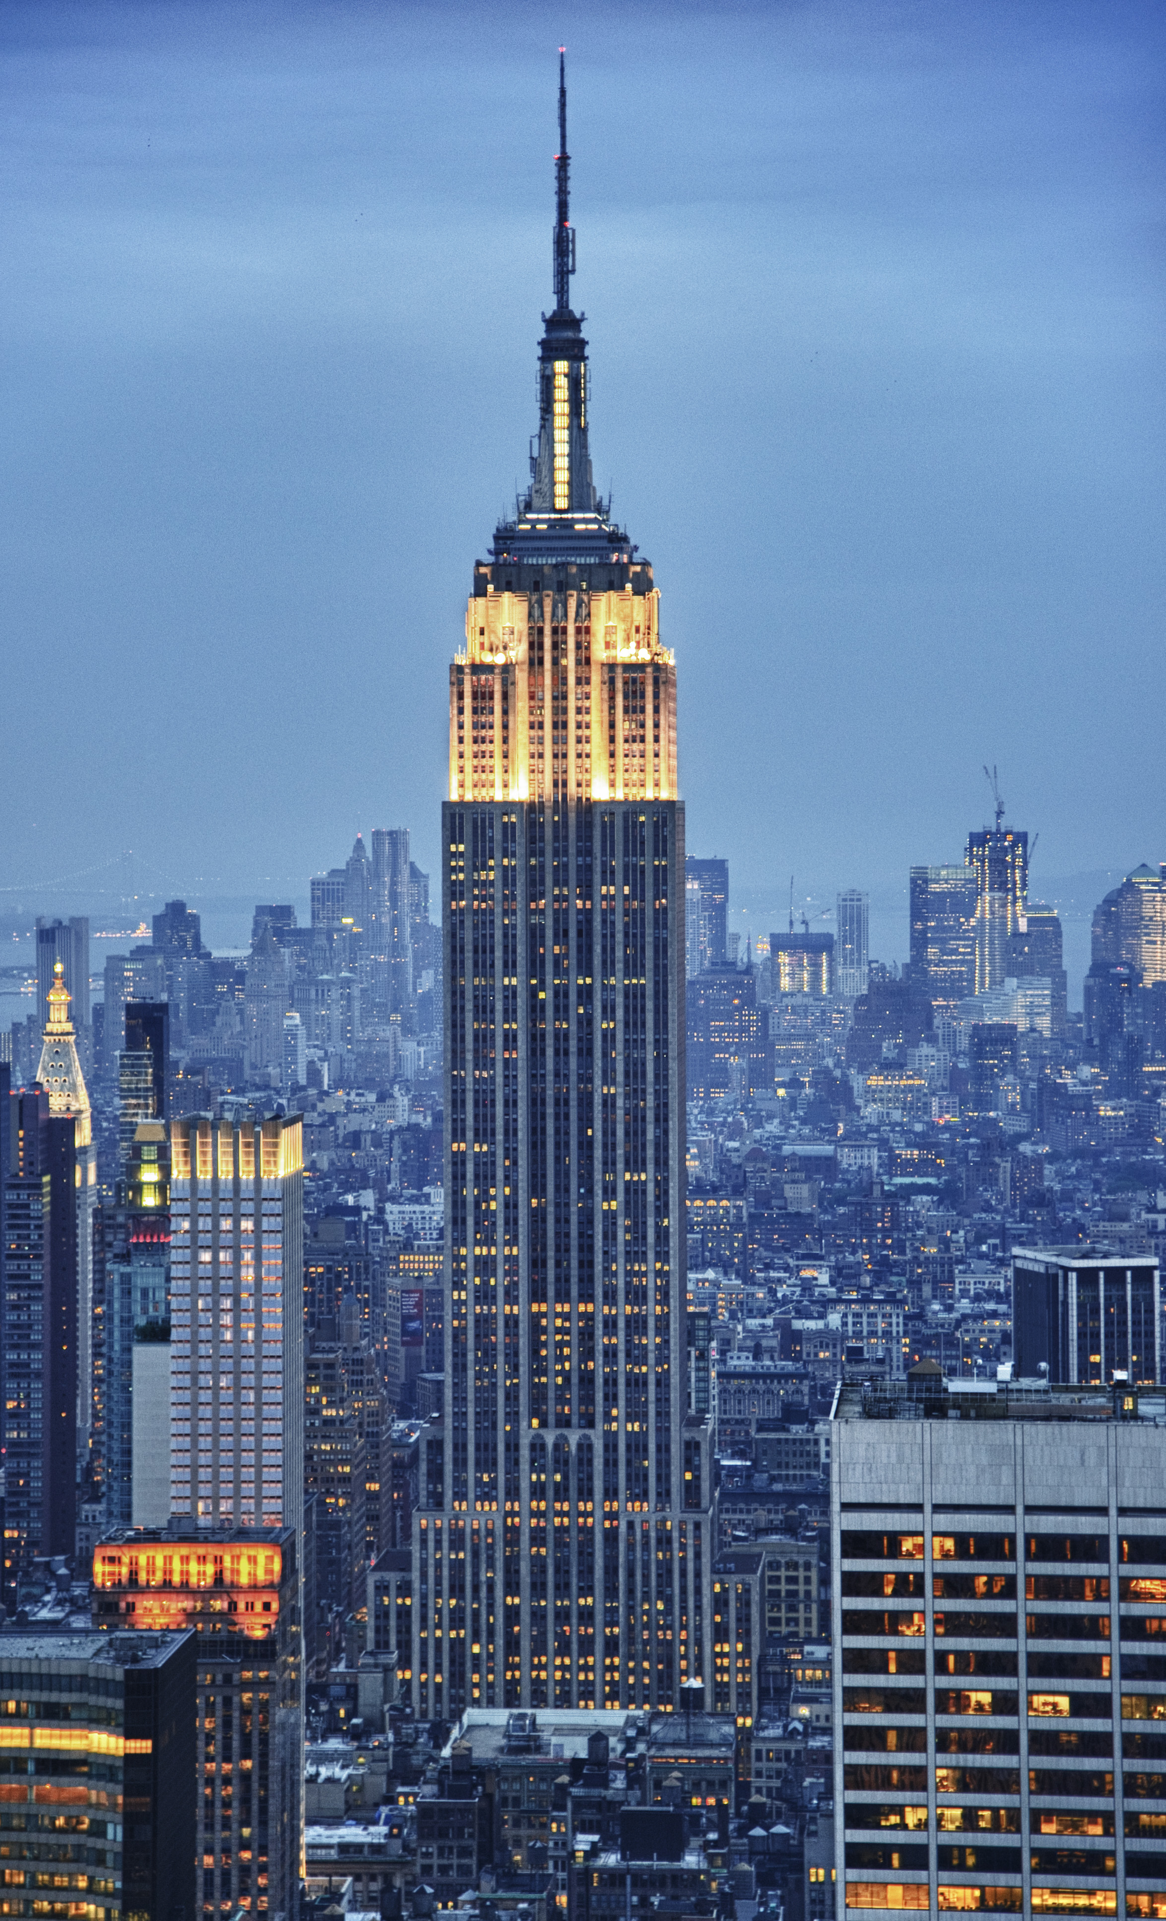
2. NYC sustainable design practices
The Bank of America Tower uses water-saving fixtures, green roofs, and energy-efficient technologies, making it one of the most environmentally friendly skyscrapers in the world
The New York Times Building retrofits used the Radiance lighting tool to design an automated shading system that controls glare and heat gain, reducing lighting demand and improving occupant thermal and visual comfort.
The Empire State Building underwent a major energy efficiency retrofit that included upgrading windows, lighting, HVAC, and controls, resulting in annual energy savings of 38% and $4.4 million

Slide 35
2. NYC sustainable design practices
Practice 1: Implement energy-efficient design and technologies to reduce the building’s energy consumption.
  Utilize high-efficiency equipment (boilers, geothermal heat pumps) and smart lighting/ventilation systems.
  Optimize building orientation, window placement, and shading for natural light to reduce energy load.
  Integrate green and cool roofs to cut energy costs and lower site temperatures.
  Embrace renewable technologies to domestically generate electricity, reducing reliance on fossil fuels.
.

Slide 36
2. NYC sustainable design practices
Water Efficiency: prioritize water infrastructure functionality and environmental impact mitigation.
  Integrate water-saving features like low-flow fixtures, rainwater harvesting, and greywater recycling systems.
  Achieve 25-35% potable water reduction through low-flow, high-efficiency fixtures in DDC building projects.
  Develop innovative rainwater management schemes to reduce potable water consumption and wastewater flow by nearly 65%.
  Maximize tree planting and vegetation for stormwater absorption and tree health.
  Address the 2030 population growth by conserving water through low-flow fixtures and native plant selections in DDC projects.

Slide 37
2. NYC sustainable design practices (pt 3)
Materials and resources: climate-disrupting greenhouse gases and other harmful emissions are directly and indirectly generated by raw extraction, production, transport, and disposal of materials across the globe. Impacts felt at the local level include deforestation, water contamination, and soil degradation.
    DDC’s careful selection and use of materials, such as concrete, fireproofing, insulation, gypsum board, carpets, and a variety of interior finishes and furnishings, can mitigate many adverse environmental effects. Using locally extracted and manufactured products and materials; incorporating materials generated by local salvage operations and recyclers; and creative reusing materials existing on-site can also greatly reduce energy use and harmful emissions associated with transporting construction materials while saving money.
    Responsible material and waste management also lessens burden on landfills, and DDC projects are required to implement a construction and demolition (C&D) waste- recycling plan as detailed in the specifications and the DDC C&D Waste manual.
    projects. The materials specified in DDC infrastructure projects are used across 20,000 paved lane miles, or approximately 1.2 billion square feet, guaranteeing that improvements to our specifications yield immediate and far-reaching benefits citywide.
    DDC is also using more sustainable materials on our roadway reconstruction projects. The materials specified in DDC infrastructure projects are used across 20,000 paved lane miles, or approximately 1.2 billion square feet, guaranteeing that improvements to our specifications yield immediate and far-reaching benefits citywide.

Slide 38
2. NYC sustainable design practices (pt 4)
Healthy Interiors: healthy interior spaces can improve worker productivity, increase children's learning ability, and contribute to occupant health and well-being.
    Materials can be carefully chosen for their extremely low potential to expose occupants to harmful toxins. At ACS, located in a congested Manhattan neighborhood, DDC located the air-intake units on the roof rather than at street level, minimizing the possibility of automobile exhaust and other pollutants entering the building.
    These DCC pilot projects led to the development of a complete set of standard specifications for low-toxicity building materials covering a range of products from adhesives to polyurethanes and varnishes.
    Most projects are also required to ensure that composite woods contain no urea-formaldehyde, and to certify that building air-delivery systems have been protected from dust

Slide 39
3. NYC sustainability policies
Greenhouse Gas Emissions Reduction: NYC has set a target of reducing greenhouse gas emissions by 80% by 2050. This target is in line with the global Paris Agreement goal of limiting global temperature rise to 1.5 degrees Celsius.
Building Efficiency: The vast majority of NYC’s greenhouse gas emissions come from buildings. In 2019, NYC passed the Climate Mobilization Act, a landmark set of laws that limit emissions from new and existing buildings over 25,000 square feet (Local Law 97) and require solar and green roofs for new building construction (Local Laws 92 and 94). These laws will reduce emissions from the city’s largest buildings by 40% by 2030 and 80% by 2050.
Clean Energy: The administration plans to convert government operations to 100% clean electricity.
Transportation: The city is working on reducing emissions from transportation. There are initiatives to prioritize public transit, walking, and biking, ensure every New Yorker can access a bike or scooter, and help New Yorkers who must drive to drive electric.
Waste Management: The city is also focusing on reducing emissions from waste.
NYC’s Green New Deal: This plan includes $14 billion in new and committed investments, legislation, and concrete action at the City level that will ensure a nearly 30 percent additional reduction in emissions by 2030.

Slide 40
4. NYC most sustainable buildings
The Greenwich Lane
  LEED Gold Certified
  Uses efficient plumbing fixtures
  Employs a stormwater collection process
  Uses eco-friendly materials including recycled content, local materials, low-emitting adhesives, paints, substrates, and flooring
  Uses high-efficiency LED lighting fixtures
Hearst Tower
  The first building in NYC to receive Gold LEED rating for core, shell, and interiors
  Reduced energy consumption by more than 40%
  Composts 100% of its wet food waste
  Reduced total waste to the landfill by more than 80%
  Lowered water usage by almost a third
One World Trade Center
  LEED Gold Certified
  Uses an insulated spandrel, allowing natural light into more than 90% of the office areas
  Designed with a low-E glass coating that minimized heat gain
Perch Harlem
  Manhattan’s first passive house development
  Consumes 80% less energy than a building of a similar size
  Uses heavily insulated walls and triple-pane windows
  Equipped with appliances that are Energy Star certified

Slide 41
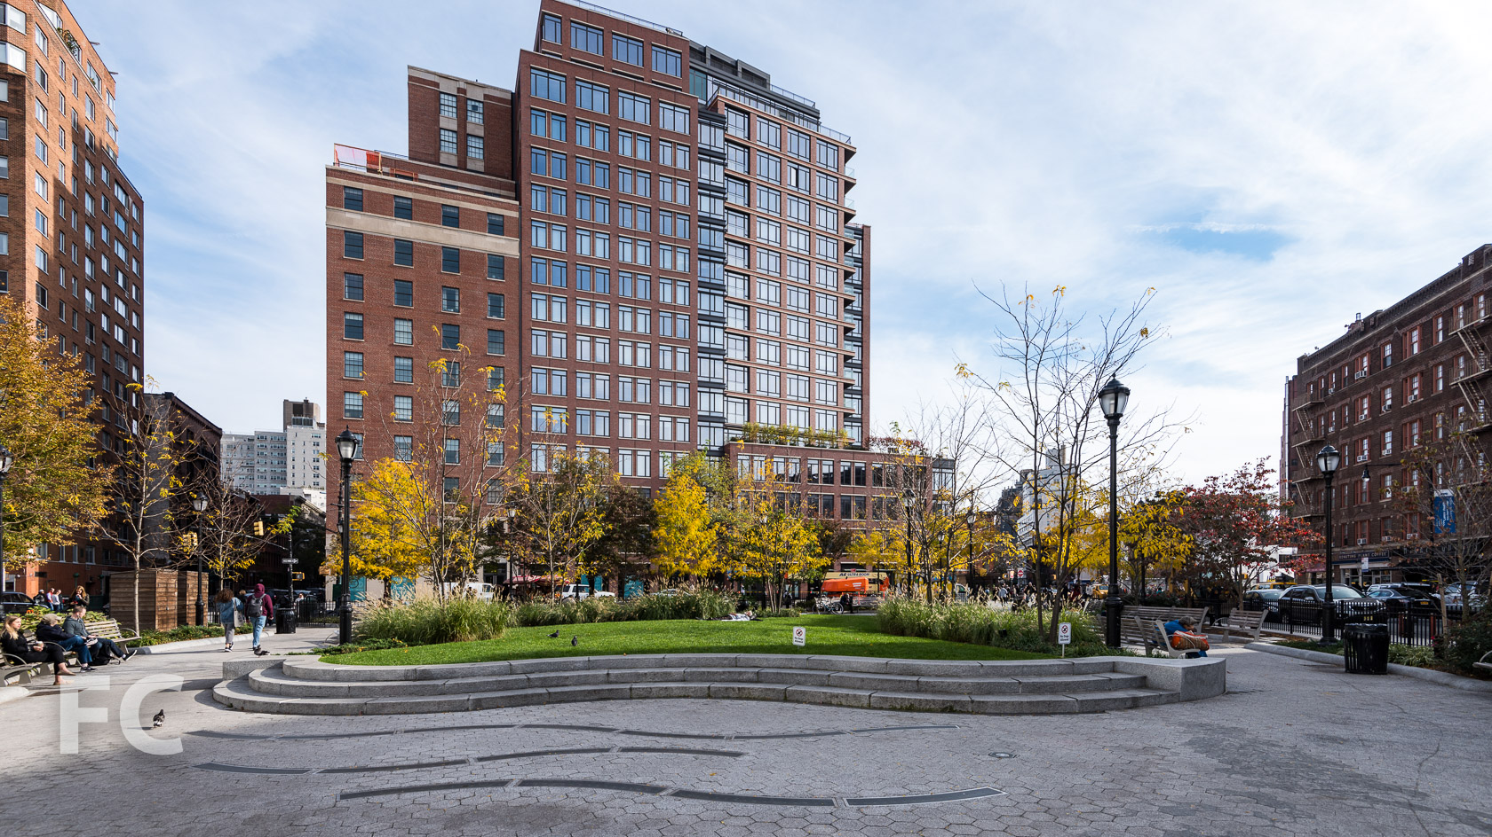
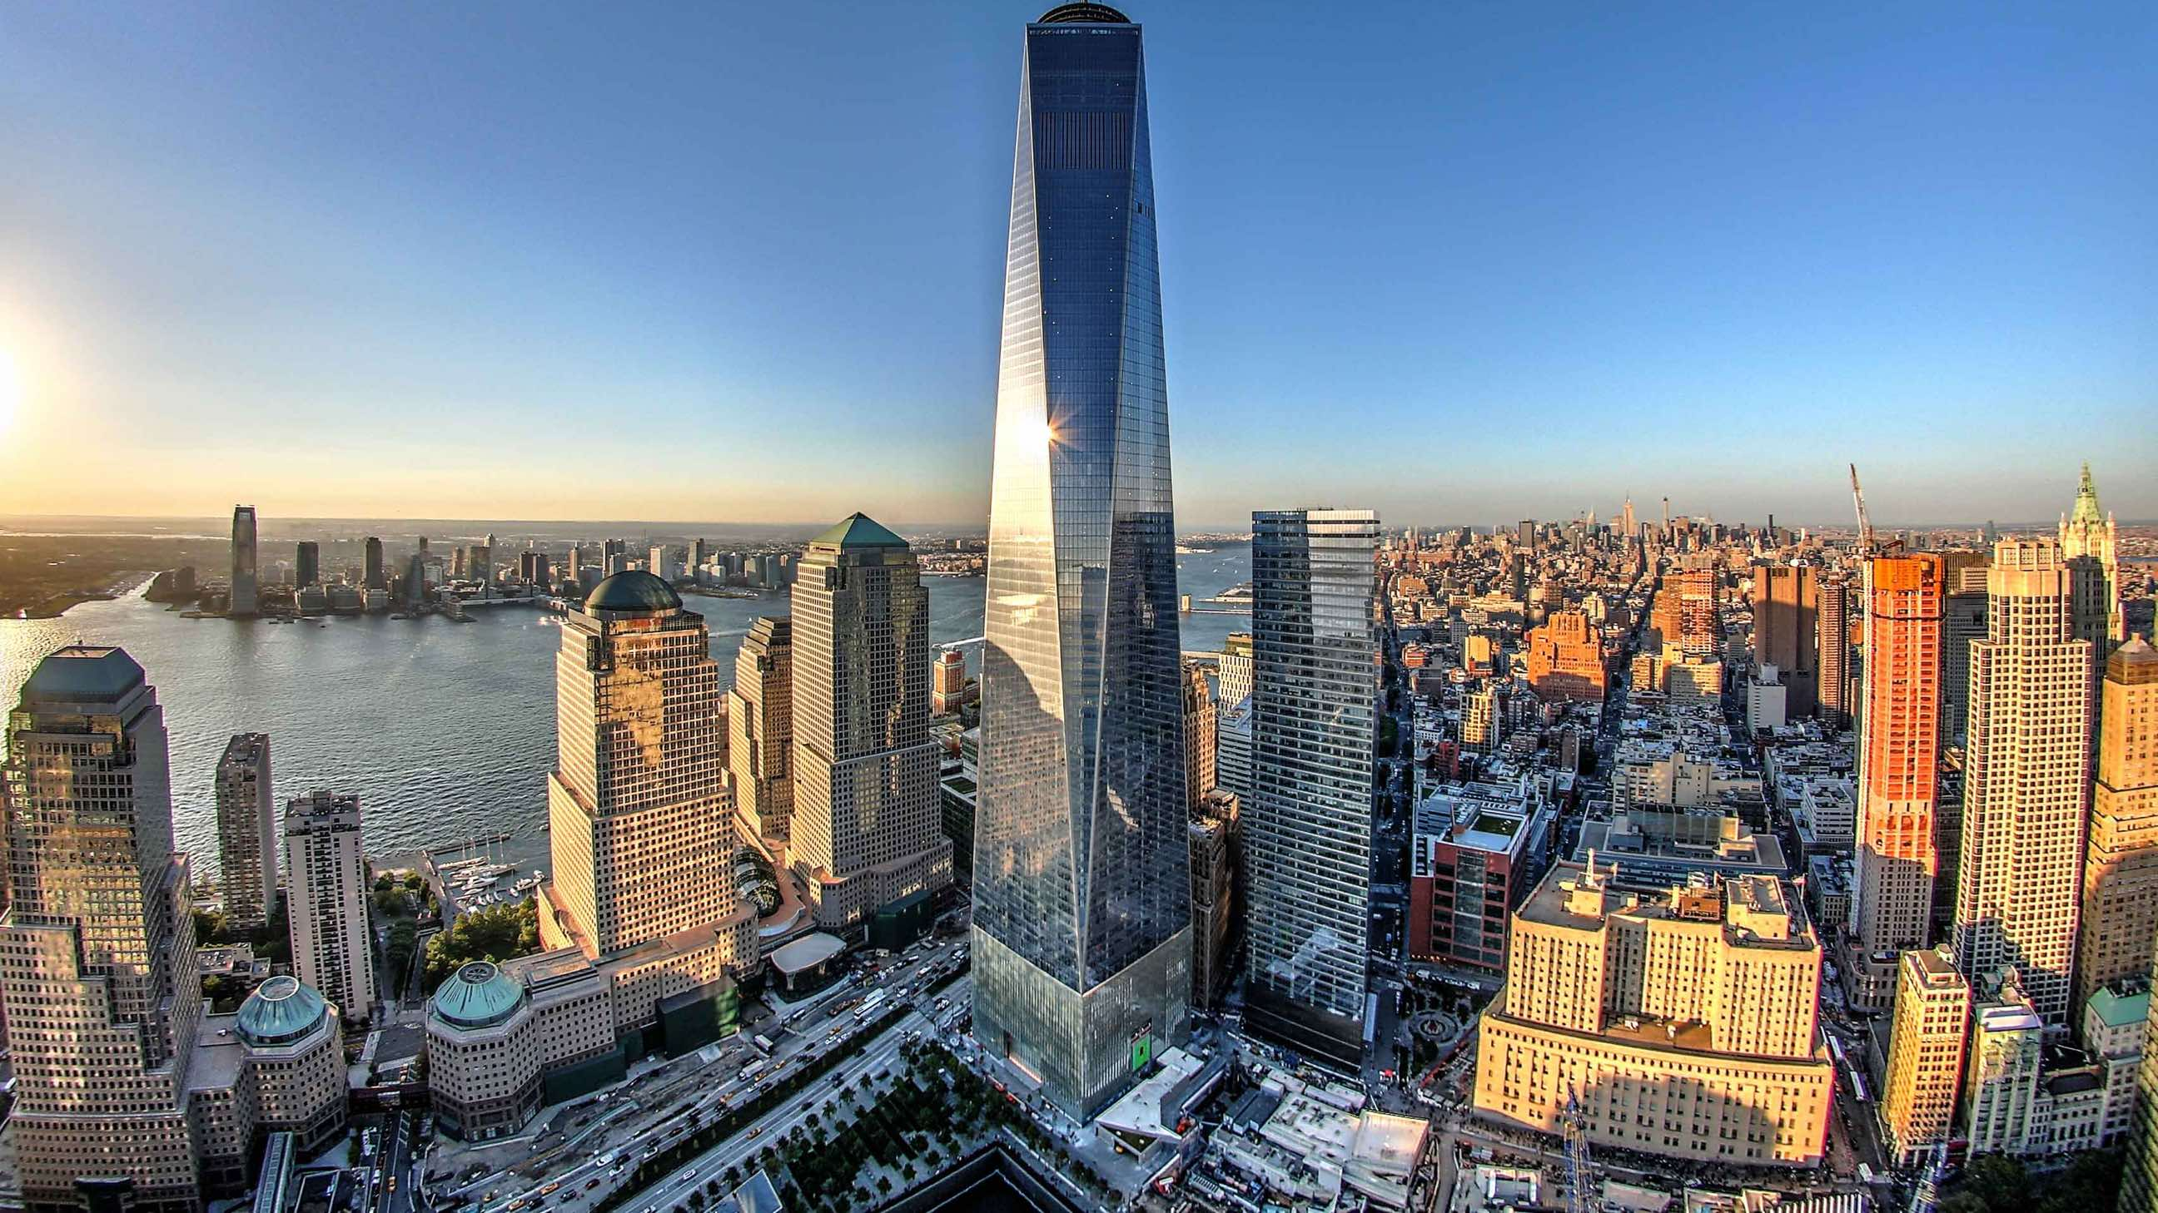
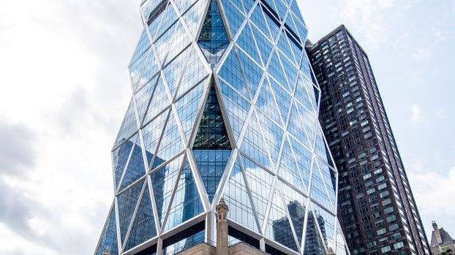
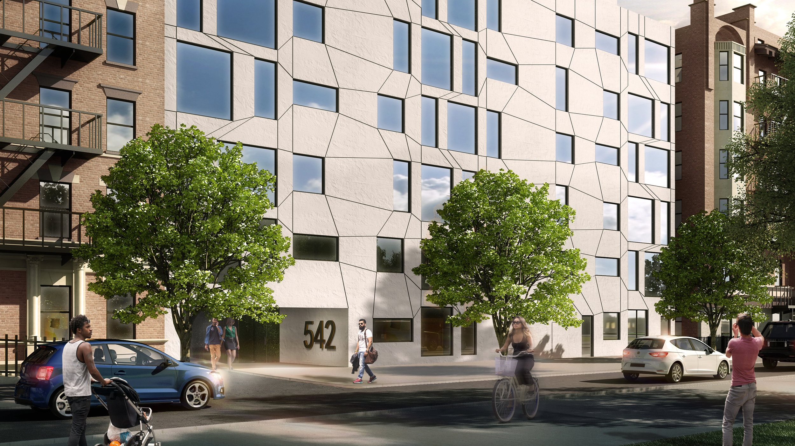
The Greenwich Lane
3. One World Trade Center
Hearst Tower
4. Perch Harlem

Slide 42
5. PRACTICE EXERCISE – GOAL 1
Design Goal: Total GCH Emissions Reduction
Measure: Global greenhouse gas (GHG) emissions, measured in metric tons CO₂e/yr
Targets:
    Baseline value: 97 metric tons CO₂e/yr (see ZeroTool Calculations)
    Minimally acceptable value: 30% of 97 metric tons CO₂e/yr = 29 metric tons CO₂e/yr
    Desired / target value: 0 metric tons CO₂e/yr
Strategies:
    Use of energy-efficient appliances and systems to reduce energy consumption
    Incorporation of renewable energy sources to reduce reliance on fossil fuels (especially offsite due to space limitations)
    Implementation of carbon capture technologies, like giant air filters or ionic liquids

Slide 43
5. PRACTICE EXERCISE – GOAL 2
Design Goal: Site EUI Reduction
Measure: Site Energy Use Intensity (EUI), measured in kBtu/ft²/yr
Targets:
    Baseline value: 47 kBtu/ft²/yr (see ZeroTool Calculations)
    Minimally acceptable value: 30% of 47 kBtu/ft²/yr = 14.1 kBtu/ft²/yr
    Desired / target value: 0 kBtu/ft²/yr
Strategies:
    Improve the building envelope with high-performance windows, insulation, and sealing to reduce heat loss in winter and heat gain in summer.
    Upgrade to high-efficiency HVAC systems, like using variable refrigerant flow (VRF) systems
    Use LED lights as artificial lighting, which uses significantly less energy + implement daylighting controls that adjust the amount of artificial light based on the amount of natural light available
    Use ENERGY STAR-certified appliances which are more energy-efficient.
    Install an energy management system to monitor and control energy usage in real time. This can help identify inefficiencies and adjust systems for optimal performance.
    Incorporate of renewable energy sources to reduce reliance on fossil fuels (especially offsite due to space limitations) and/or install solar panels or wind turbines on-site to generate renewable energy and offset energy consumption

Slide 44
5. PRACTICE EXERCISE – GOAL 3
Design Goal: Water Conservation
Measure: Water usage, measured in gallons per day (gpd)
Targets:
    Baseline value: 70 gpd per person
    Minimally acceptable value: 50% of 70 gpd per person = 35 gdp per person
    Desired / target value: 20 gpd per person. This is a more ambitious goal that would require extensive water conservation measures, but it’s not unheard of in high-efficiency buildings
Strategies:
    Install low-flow fixtures and appliances to reduce water usage.
    Implement a rainwater harvesting system to collect and use rainwater.
    Install a greywater recycling system to reuse water from sinks, showers, and laundry.
    Use native and drought-resistant plants for landscaping to reduce irrigation needs.
    Install a water meter for real-time monitoring and control of water usage.

Slide 45
5. PRACTICE EXERCISE – GOAL 4 (Optional)
Design Goal: Improve indoor air quality.
Measure: Indoor temperature, measured in degrees Fahrenheit (°F)
Targets:
    Baseline value: 72°F per room
    Minimally acceptable value: 68°F - 76°F per room. This is the generally accepted range for thermal comfort.
    Desired / target value: 70°F per room. This is a more ambitious goal that would require extensive thermal control measures, but it’s not unheard of in high-efficiency buildings.
  Strategies:
    Install high-efficiency HVAC systems to maintain optimal indoor temperatures.
    Implement a building insulation system to reduce heat loss in winter and heat gain in summer.
    Install energy-efficient windows to minimize heat transfer.
    Use smart thermostats for real-time monitoring and control of indoor temperatures.
    (Optional) use of passive solar design techniques to take advantage of the sun’s energy for heating and cooling the building.

Slide 46
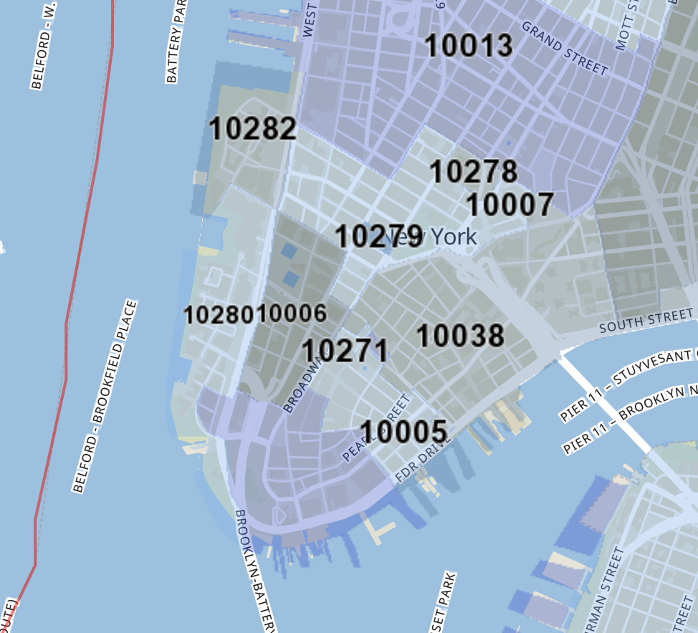
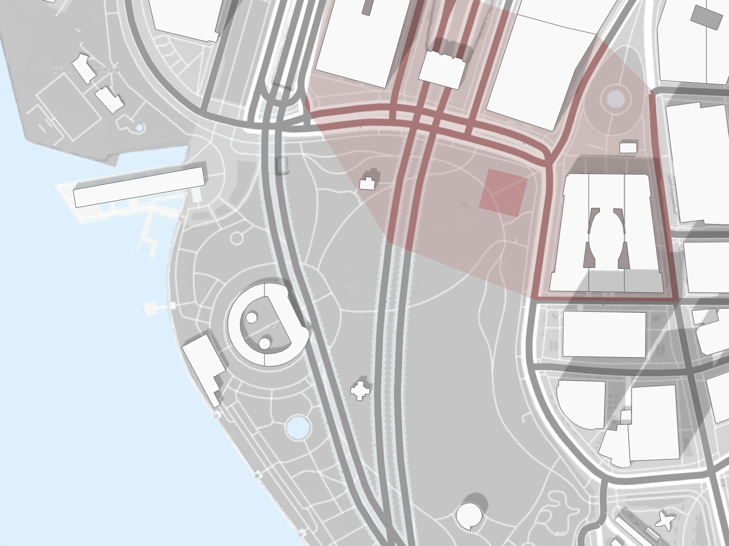
Site location zip code: 10004
(Need this info in ZeroTools)
10004
https://www.unitedstateszipcodes.org/10004/

Slide 47
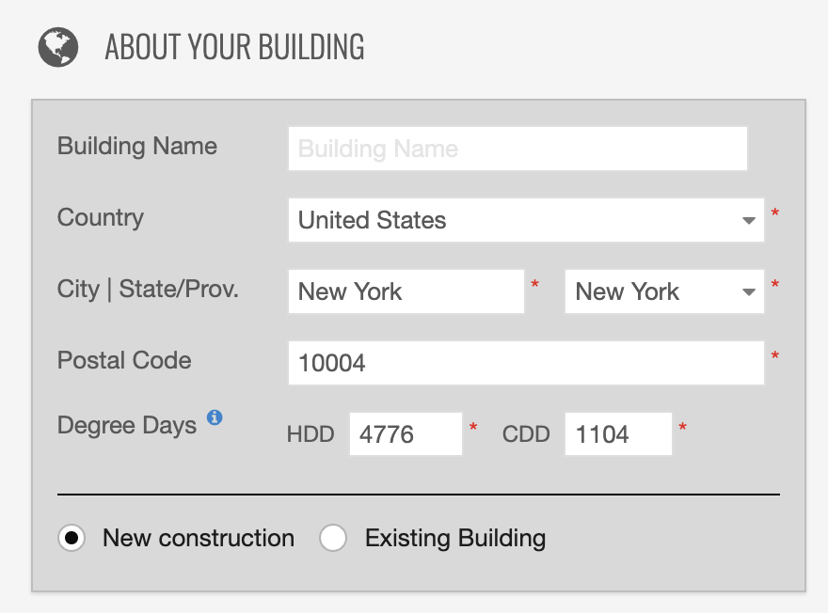
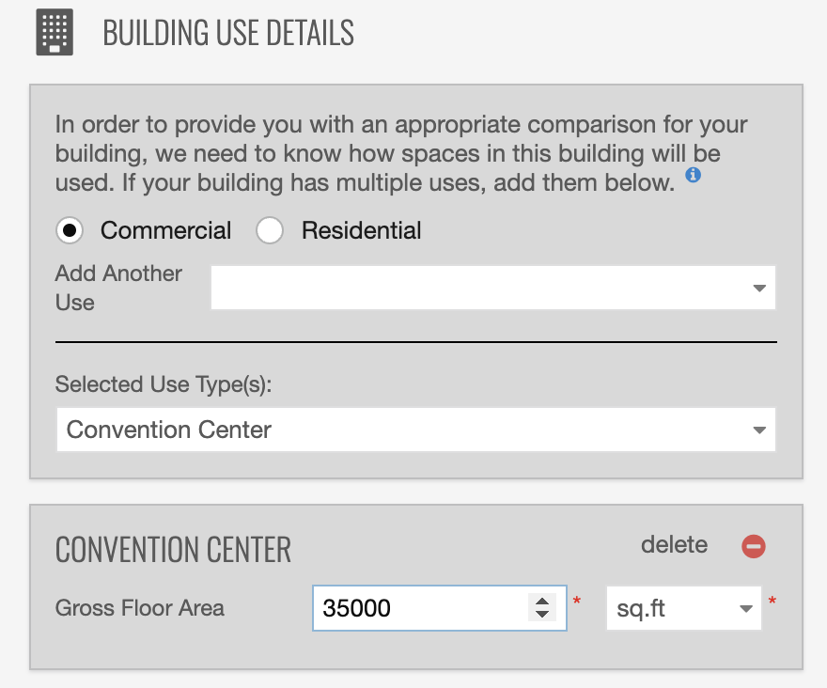
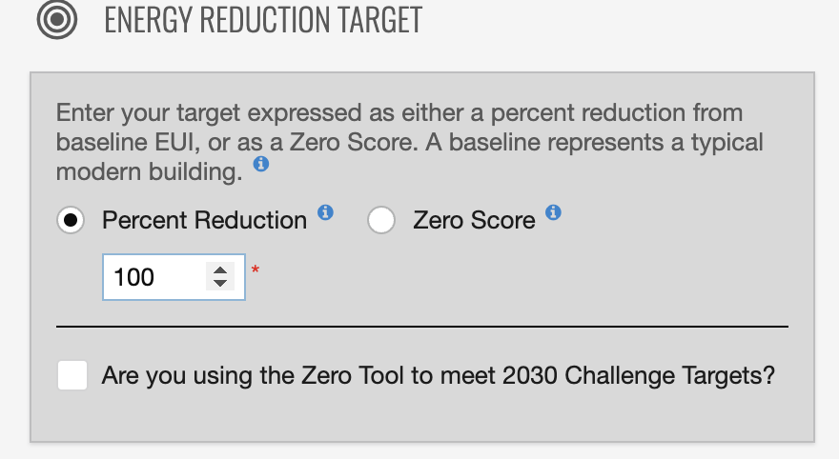
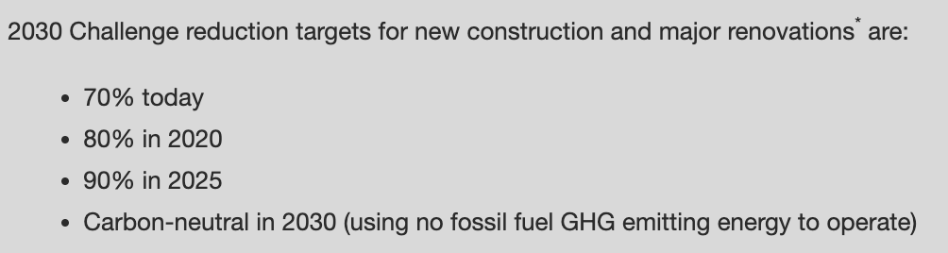
Using zip code 10004 in ZeroTools (https://www.zerotool.org/) to calculate the energy reduction baselines and targets a new construction building of type “convention center” of gross floor area of 35000 SF.
My target: being carbon neutral in 2030 (100% Reduction)

Slide 48
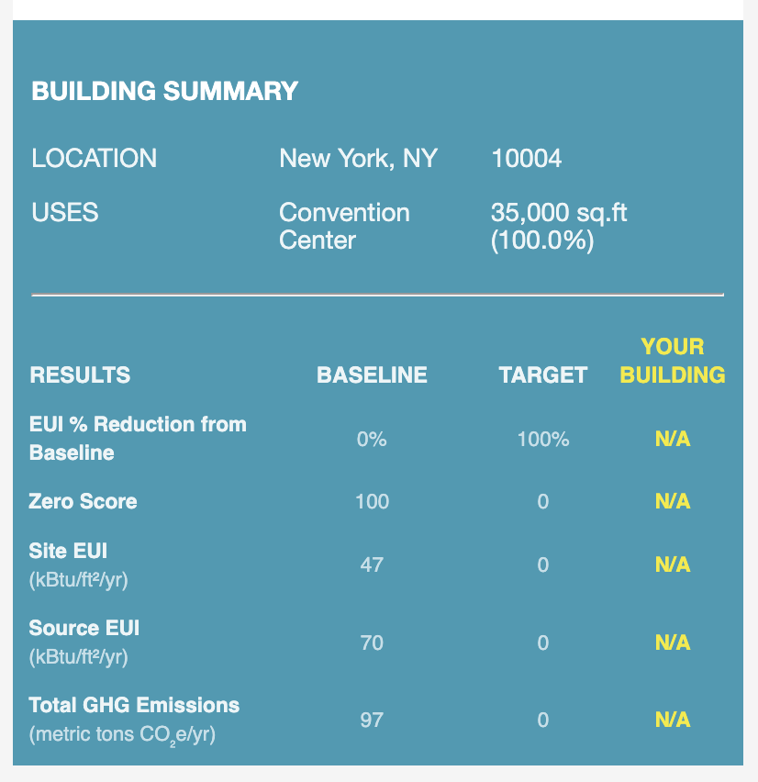
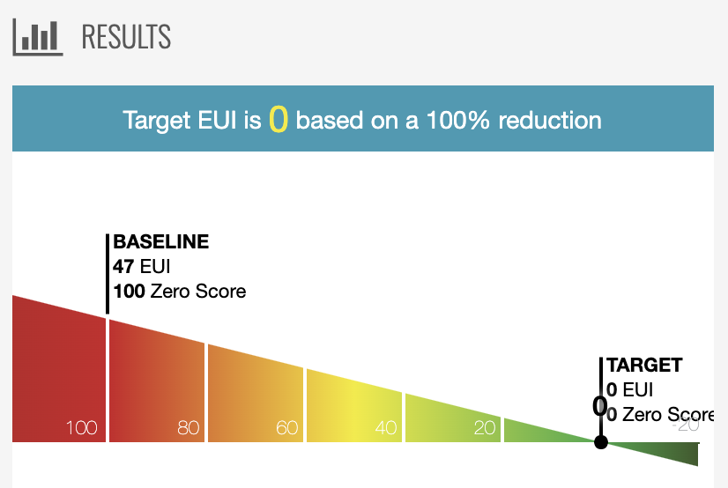
ZeroTool Calculations Results

Slide 49
Week 3
To be continued…
Notes:
https://www.notion.so/bearington/Module-1-Design-Project-Brief-Design-Inspirations-Big-Feature-Ideas-005adf086c6247908a09ef4a2b5ba8a6

