Slide 1

AI optimization tool for architecture design
Klay Li
03/06/2024

Slide 2
Design motivation
Architects face challenges in efficiently choosing the right materials, balancing costs, and meeting code requirements, leading to complex design processes.
Point of view
Decision makers need to improve their decisions and workflows based on more efficient optimized design tools.
Time
Cost
Quality
Notes:
Architects face challenges in efficiently choosing the right materials, balancing costs, and meeting code requirements, leading to complex design processes.
In a reality design work, time, cost and quality, people can maximumly take two of them. The purpose of this design job is to find an optimum balance point to make our design job more efficient to save a lot of redundant inspection work in latertime.

Slide 3
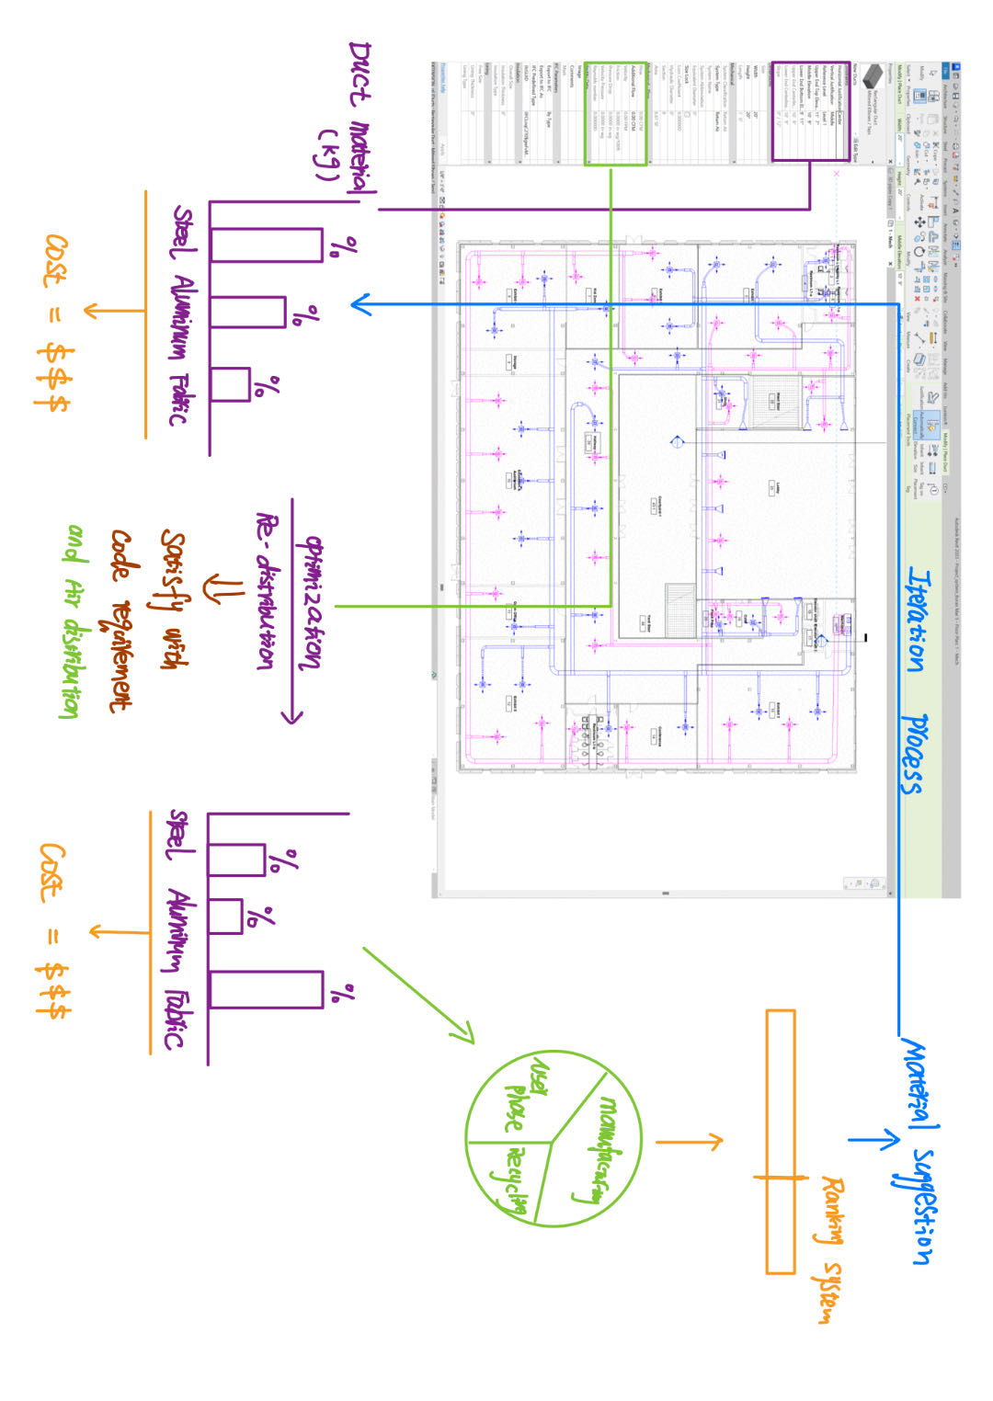
Design ideas
Notes:
As shown in this slide, this is a typical HVAC

Slide 4
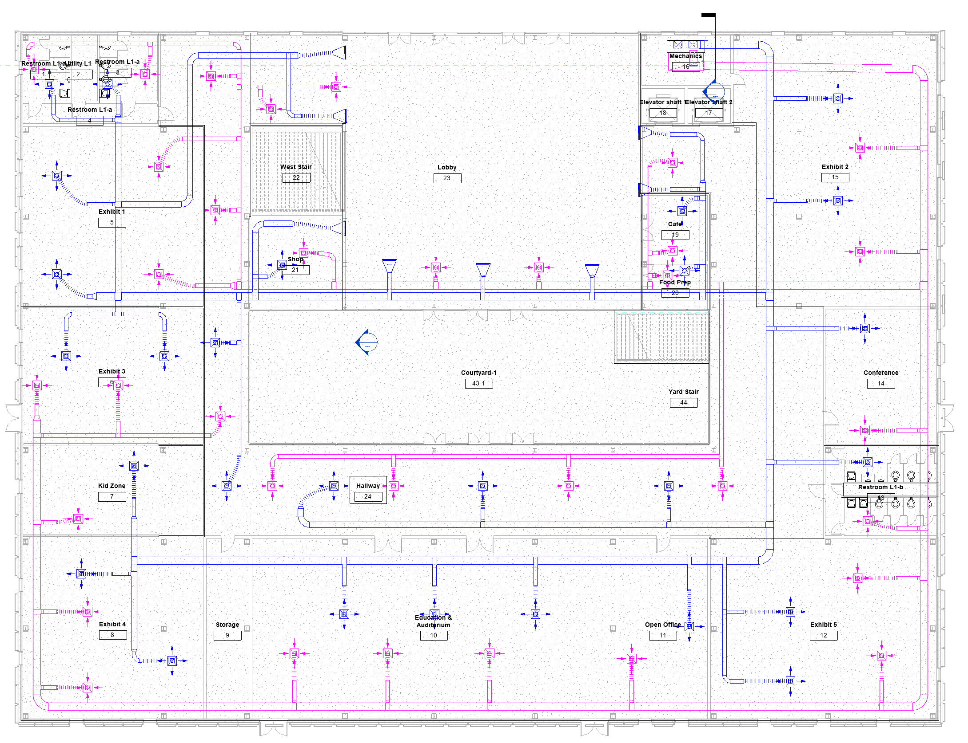

Design optimization tool user interface
Combined score
80/100
Worst
Best
Evaluations for current
Cost: $100,000
Maintenance years: 5yrs
CO2: 23 Tons
Acoustics: 85 db
Temperature range: 18 – 25 C
Humidity: 30% - 50%
Goals
Cost:
Maintenance years:
CO2: <=
Acoustics:
Temperature range:
Humidity:
Optimized evaluation
Cost: $90,000
Maintenance years: 8yrs
CO2: 20 Tons
Acoustics: 80 db
Temperature range: 18 – 25 C
Humidity: 20% - 40%
User defined weighting
Design choices
Other restrictions
Dorm
Open area
Kitchen
Common room
Etc.(library)
Glass
Wood
Fabric
Plastic
Concrete
Steel
Etc.(library)
Glass area:
Solid walls area:
Concrete volume:
Piping material:
Wire material:
Lighting options:
Code options:
Min Max
Notes:
After some improvement from last slide, this slide shows the user interface of the design optimization tool.
As shown in the upper left corner, this is our original HVAC design. The optimization tool will evaluate the user defined indexes according to the construction material selected. (i.e. Cost, maintenance year, CO2, etc…)
The user can self-define the goals that their design should meet. After that, the design optimization tool will generate an optimum evaluated solution to show the results of those indexes. For example, if we want to lower our total cost for 10%,
We just type the cost range in the yellow box, the optimization tool will re-distribute the material usage to achieve the goal.
Most importantly, the user can set their own weighting and scoring based on their own needs. For example, If it’s a dorm area, Acoustics should be weighting more.
In the bottom row, it shows the design choices and other requirements that the user want to take. There is a scrolling menu to let the user select the “function” of their design in a more detailed way. They can define the material areas, the code versions, and even some lighting options.
According to the last defined system, there will be a combined scoring system to overall evaluate your design. You will know your overall scores regarding the evaluation of time, cost and qualities.

Slide 5
Challenges and future works
How to make AI understand human natures?
How to make AI better understand the functioning purpose of the design?
Can AI make decision for people?
Notes:
The human nature, for example, like where people want to set their bedrooms, or different age people could make totally opposite decisions.
It’s worth to study the design uncertainties that people can maximumly accept cuz everyone is different.

