Slide 1

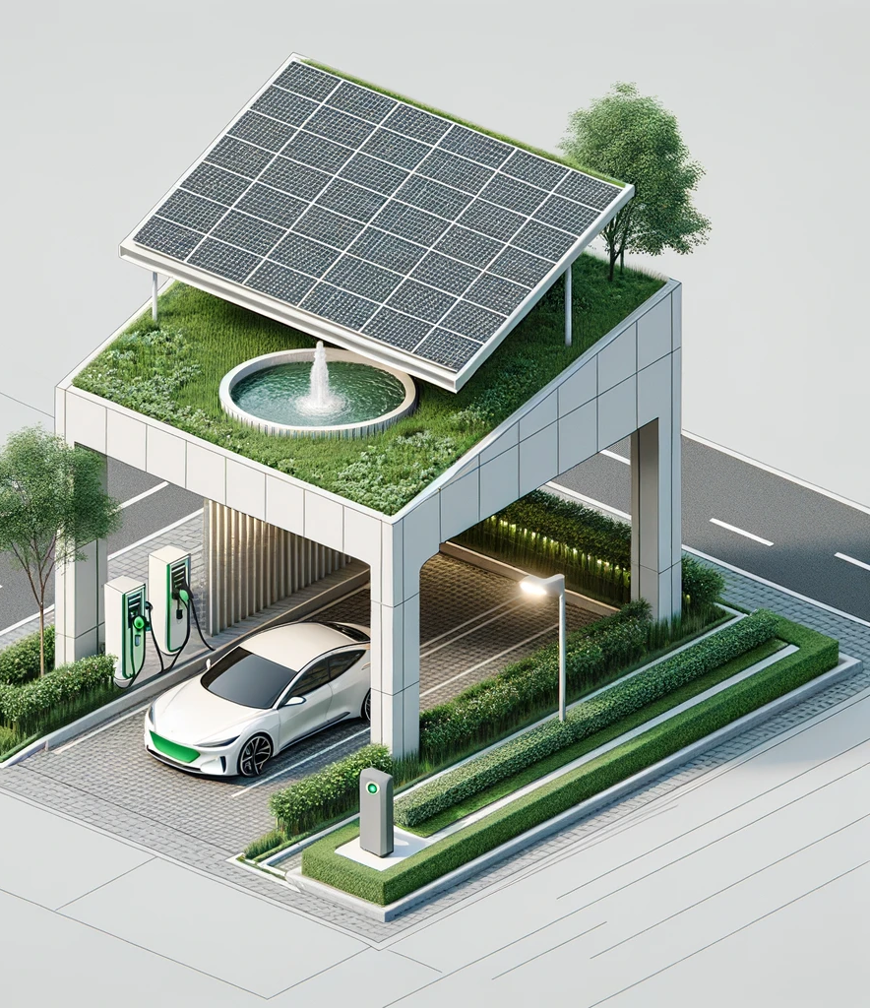
Smart Green Roof
Klay Li
3/14/2024

Slide 2
Key features
100% sustainable energy supply
Rotatable solar panel roof
Solar-Powered Car Charging Station
Fountain area for rain collection
Zero pollutions

Slide 3
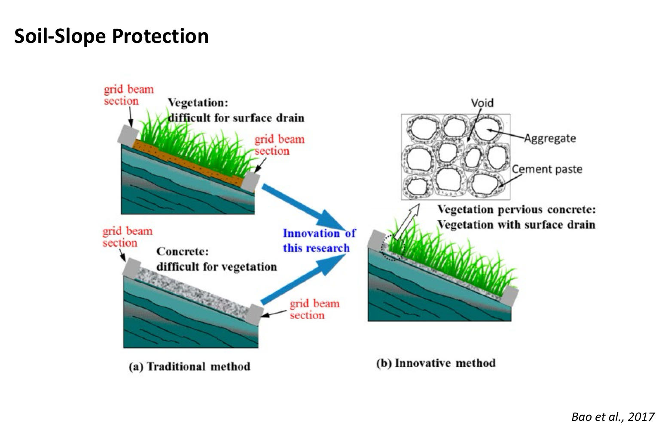
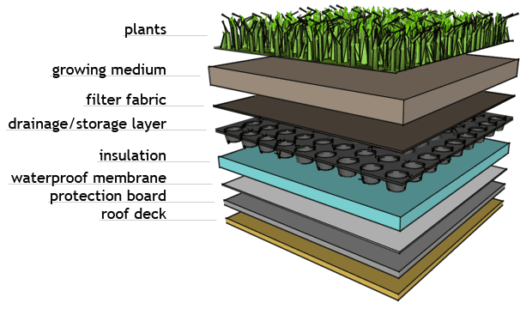
Considerations
Soil-slope protection
Plant type
Heat islands effect
Cost

Slide 4




Questions?

