Slide 1
Healthy Paws Mobile App (v3.1.5)
User Testing Report R3
Inexperienced Group - 4/12/2023

Slide 2
Agenda
Testing Details
Statistics & Discoveries
Takeaways and Next Steps

Slide 3
Testing Details

Slide 4
Testing Overview
Test existing Healthy Paws mobile app (v3.1.5).
Participants will test prototypes, not the actual app.

Slide 5
Testing Details - Pet Insurance Inexperienced Group
Participant Demographics
Age: 25-50
Annual household income: $100K - $150K+
Gender: Female
Device: Mobile
Test Date:
  4/12/2021 - 5 participants
Screener Questions
Do you have a dog? (Accept: Yes)
Do you currently have pet insurance or previously had one? (Accept: No)
Tasks
Mobile app sign in.
Homepage impression.
Change claim reimbursement type.
Reimbursement term preference.
Submit a claim.
Multi-invoice submission preference.
Password reset.
Password update preference.
Update your billing information.
Dual authentication preference.
Rate your experience.

Slide 6
Statistics & Discoveries

Slide 7
Net Promoter Score (NPS*)
Overall the inexperienced group task success rate and overall satisfaction rate have been increased due to task reorganization.
NSP score | 40
Detractors | 20%
Passives | 20%
Promoters | 60%
*NPS: This measures the likelihood of users to recommend your product or services. Scores range from -100 to 100 and include all contributors.

Slide 8
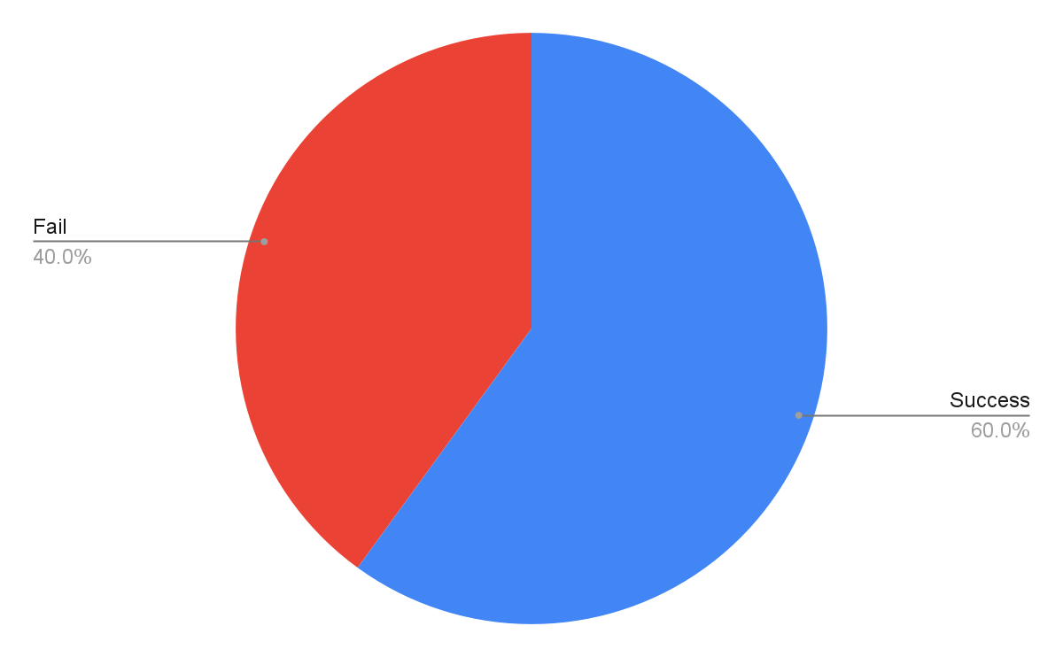
Task 1 - Change Reimbursement
Objective: To identify how a participant finds hidden navigation objects and understand the meaning of the term claim reimbursement.
Discovery: 60% of the participants could not find the change reimbursement menu in the app and moved to the customer center to finish the task.

Slide 9
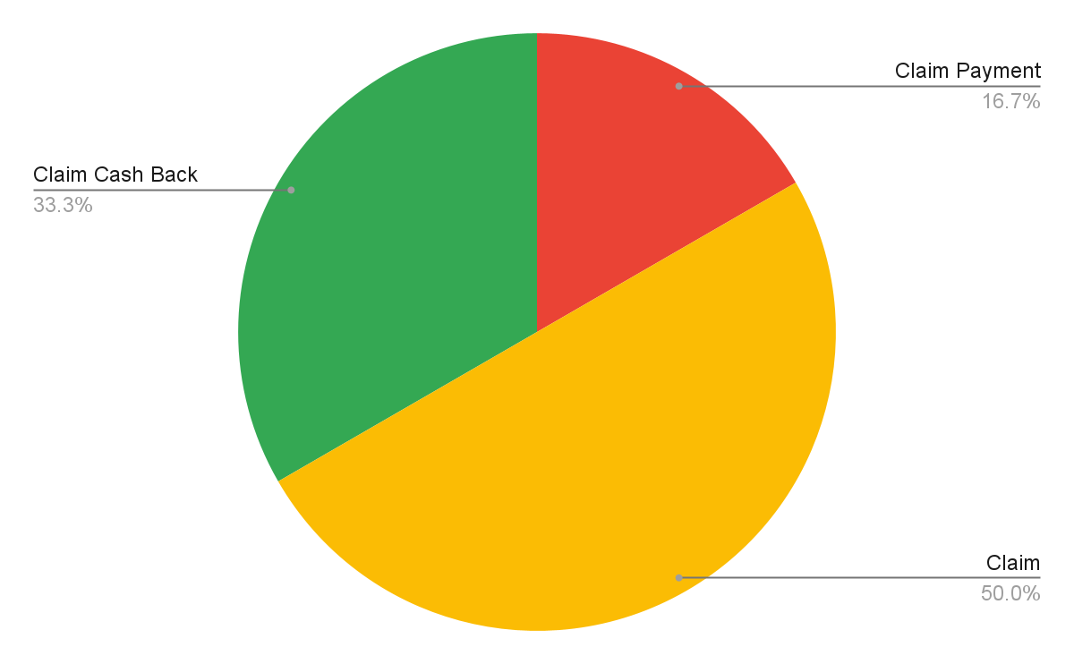
Task 2 - Reimbursement Terminology Preference
Objective: To identify proper terminology for the claim reimbursement.
Reimbur…

Slide 10
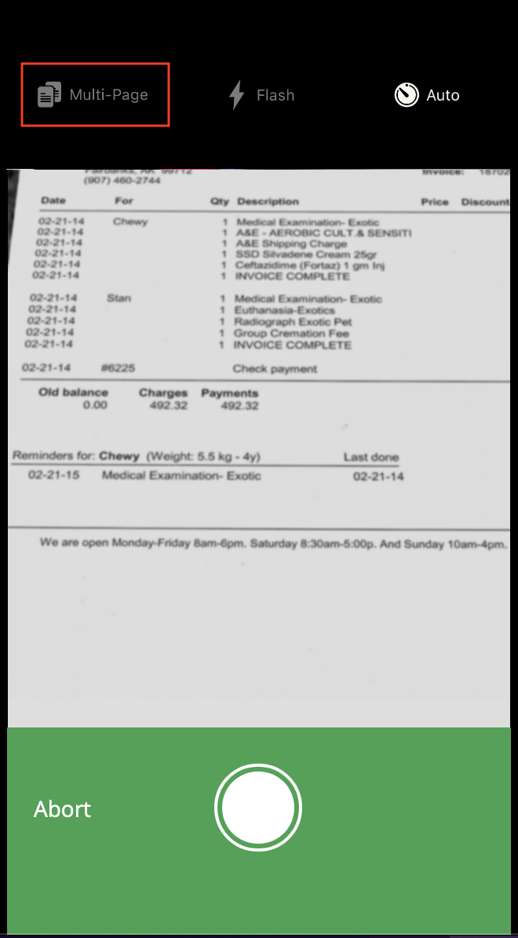
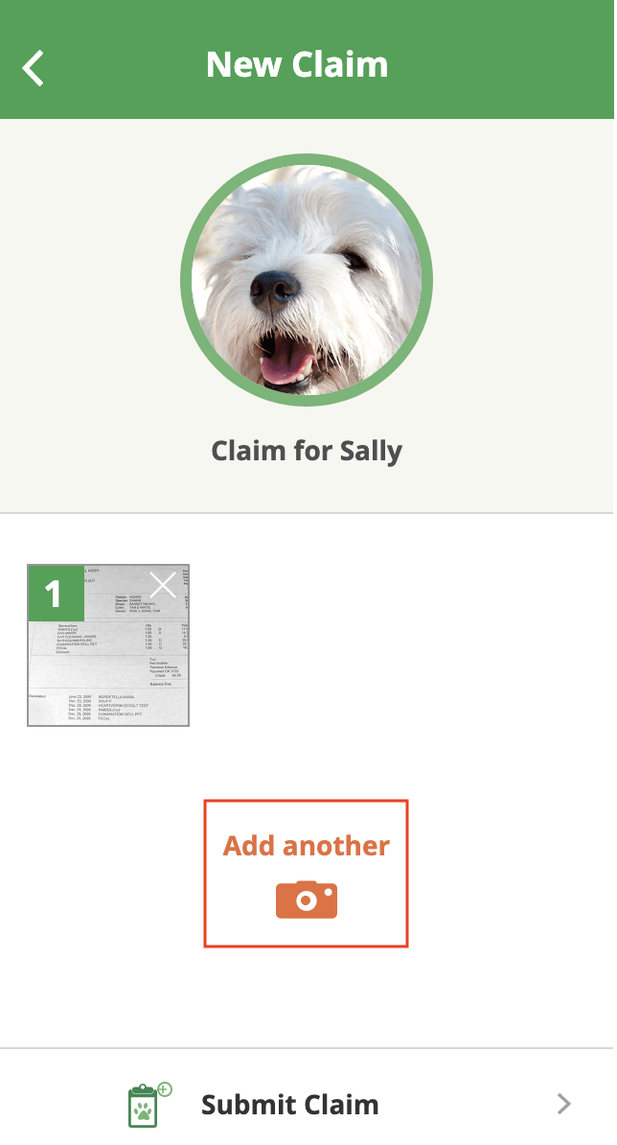
Task 3 - Claim Submission Camera Functionality
Objective: To identify issues from the multi-invoice claim submission process.
Discovery: 100% of the participants could not identify multi-photo shooting functionality during the taking photo process. All participants used the “Add Photo” button from the thumbnail page to go back to the camera to add additional invoices.

Slide 11
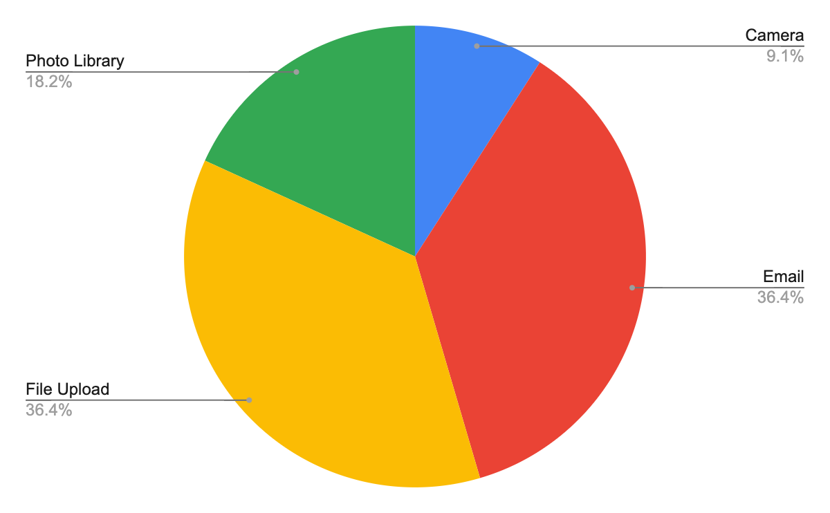
Task 4 - Multi-invoice Claim Submission Preference
Objective: To identify suitable functionality for multi-invoice claim submission.

Slide 12

Task 5 - Password Reset
Objective: To identify issues from the mobile app password reset process.
Discovery: 100% of the participants completed the password reset test successfully.

Slide 13

Task 6 - Password Update Preference
Objective: To identify the timing of updating a password after regaining access to the customer portal.
Discovery: 100% of the participants were willing to update their passwords promptly once they regained access to the customer portal.

Slide 14
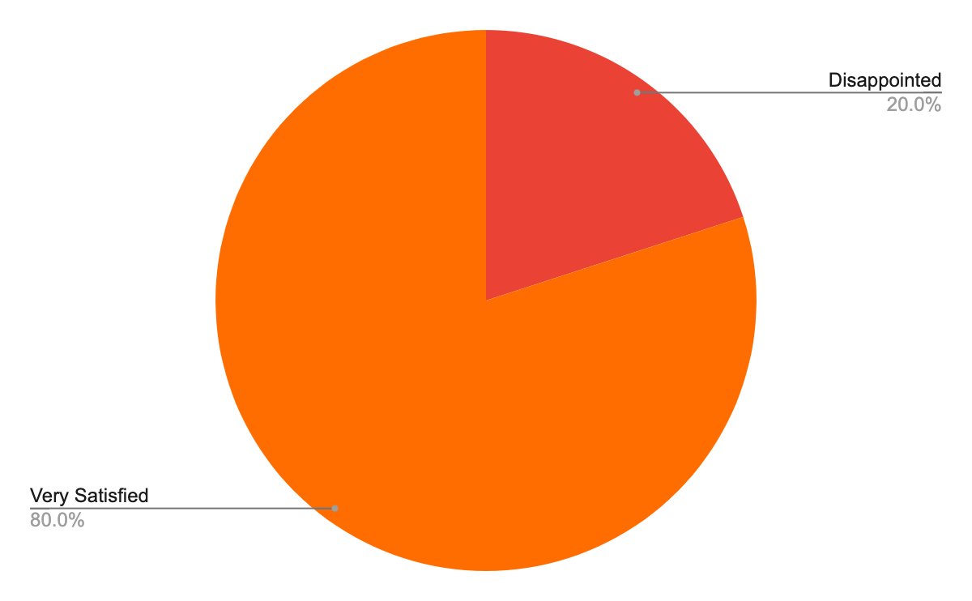
Task 7 - Rate Dual Authentication
Objective: To identify issues from dual app authentication situations.

Slide 15
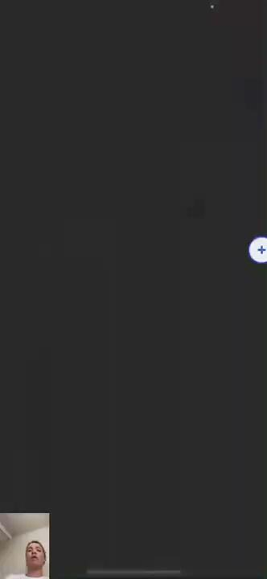
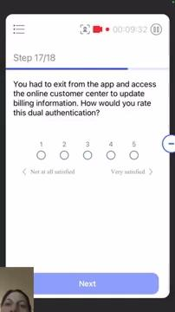
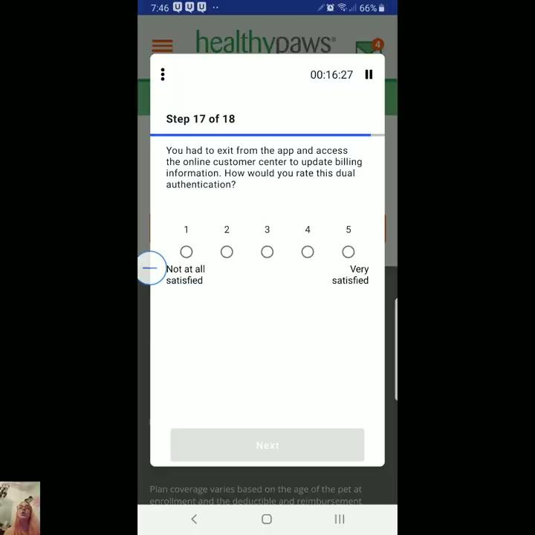
Task 7 - Rate Dual Authentication
Discovery: 60% of the participants understood dual authentication as an intentional extra security measure.

Slide 16
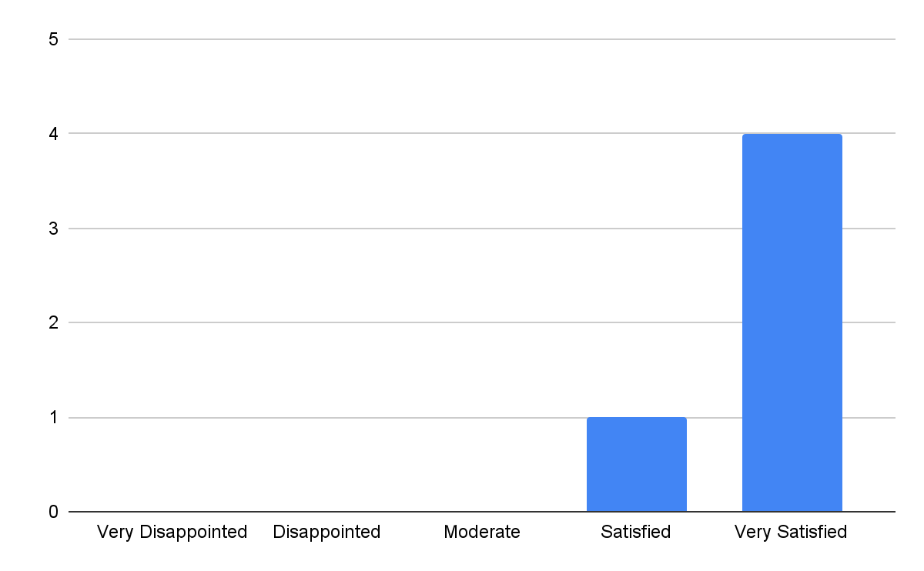
Task 8 - How was overall experience?
Objective: To determine overall Healthy Paws mobile app experience.

Slide 17
Takeaways
Takeaways:
The term “reimbursement” seems most suitable word even though people had hard time to scan it.
A user have to visit the thumbnail page when they submit another invoice instead of using multi-shot camera functionality
Users tend to prefer a high level of security.
The inexperienced group’s NPS is 40%, but the overall experience rate was 96%.

