Slide 1
Healthy Paws Mobile App (v3.1.5)
User Testing Report R3
Experienced Group - 4/13/2023

Slide 2
Agenda
Testing Details
Statistics & Discoveries
Takeaways and Next Steps

Slide 3
Testing Details

Slide 4
Testing Overview
Test existing Healthy Paws mobile app (v3.1.5).
Participants will test prototypes, not the actual app.

Slide 5
Testing Details - Pet Insurance Experienced Group
Participant Demographics
Age: 25-50
Annual household income: $100K - $150K+
Gender: Female
Device: Mobile
Test Date:
  4/13/2021 - 5 participants
Screener Questions
Do you have a dog and do you own pet insurance? (Accept: Yes)
Are you enrolled in Healthy Paws? (Accept: No)
Tasks
What is your current pet insurance?
What is your overall experience with your current insurance app?
Mobile app sign in.
Homepage impression.
Change claim payment method.
Reimbursement term preference.
Submit a claim.
Multi-invoice submission preference.
Password reset.
Password update preference.
Update your billing information.
Dual authentication preference.
Rate your experience.
Compare the Healthy Paws app with yours.

Slide 6
Statistics & Discoveries

Slide 7
Net Promoter Score (NPS*)
Overall the inexperienced group task success rate and overall satisfaction rate have been increased due to task reorganization.
NSP score | 20
Detractors | 20%
Passives | 40%
Promoters | 40%
*NPS: This measures the likelihood of users to recommend your product or services. Scores range from -100 to 100 and include all contributors.

Slide 8
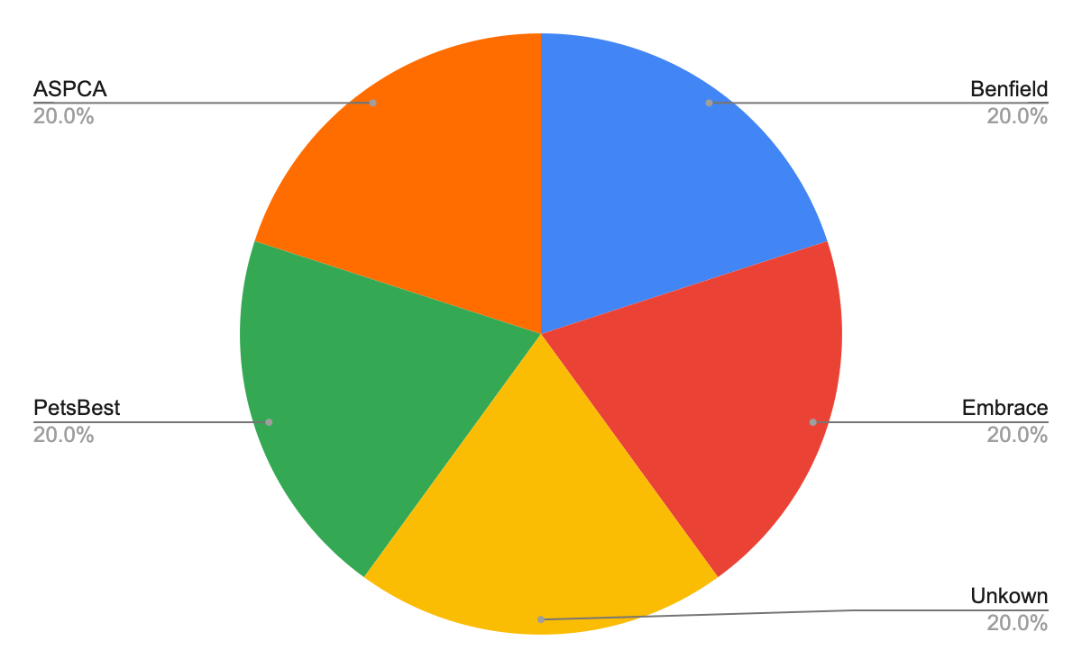
Question 1 - What’s Your Current Pet Insurance?
Objective: To determine what is participants’ current or previous pet insurance.

Slide 9
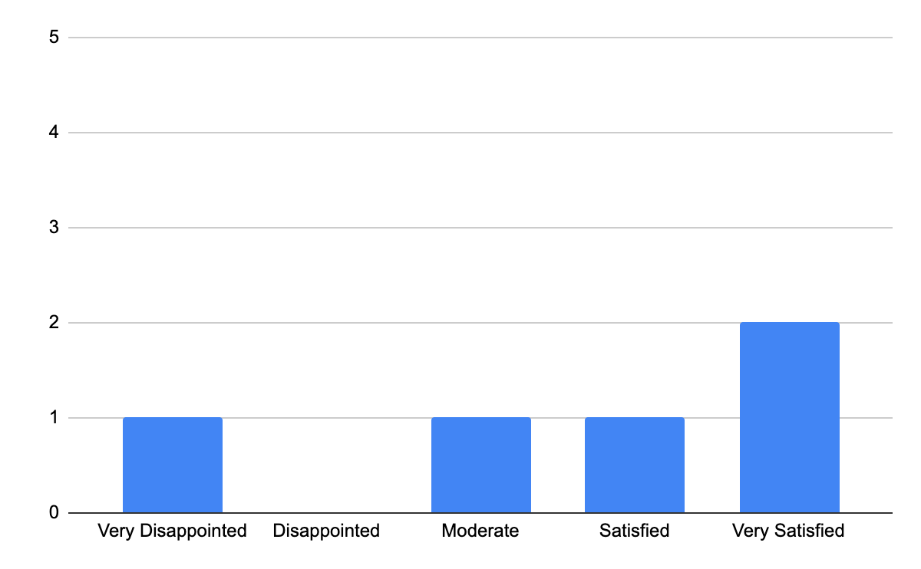
Question 2 - Rate the Overall Experience of the App.
Objective: To determine overall experience of current or previous pet insurance mobile app.

Slide 10
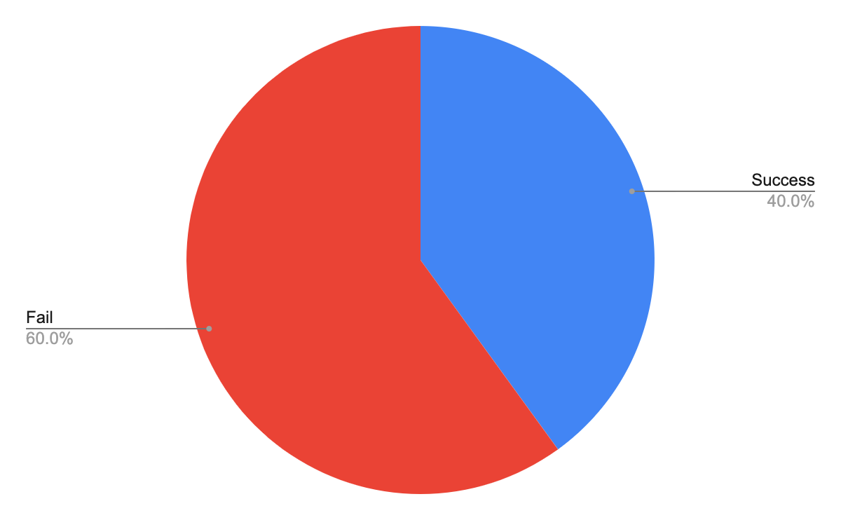
Task 1 - Change Reimbursement
Objective: To identify how a participant finds hidden navigation objects and understand the meaning of the term claim reimbursement.
Task Success Rate
Discovery: 60% of the participants had trouble navigating the change reimbursement.

Slide 11
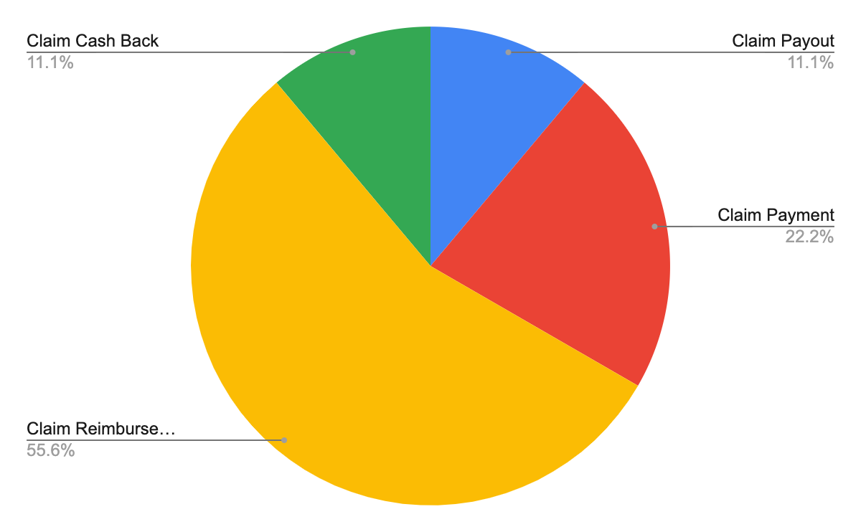
Task 2 - Reimbursement Terminology Preference
Objective: To identify proper terminology for the claim reimbursement.

Slide 12
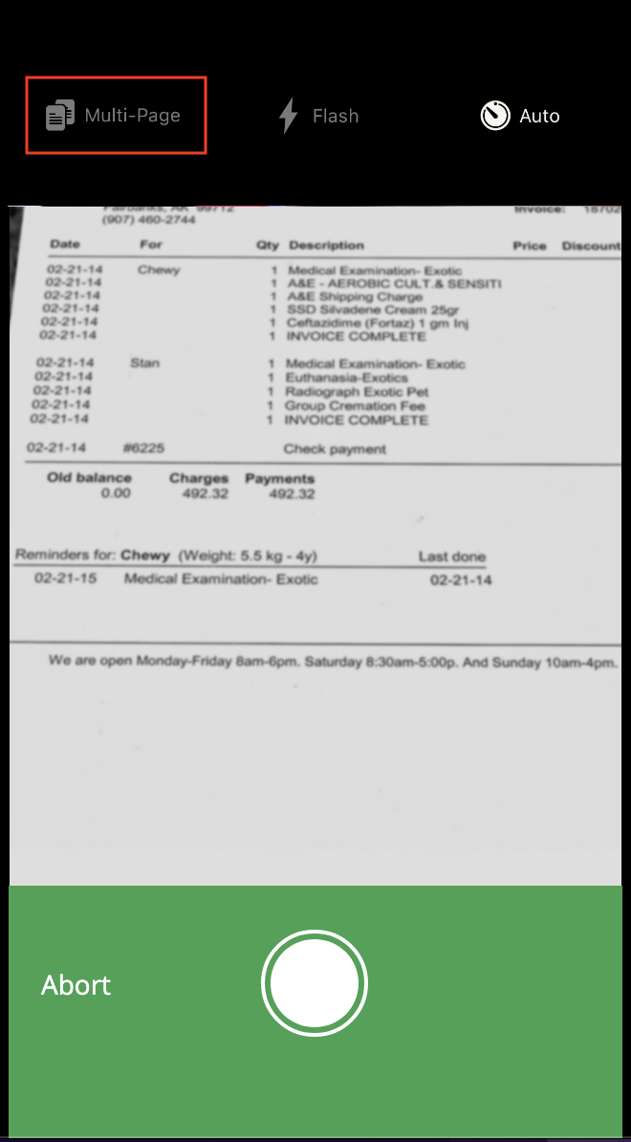
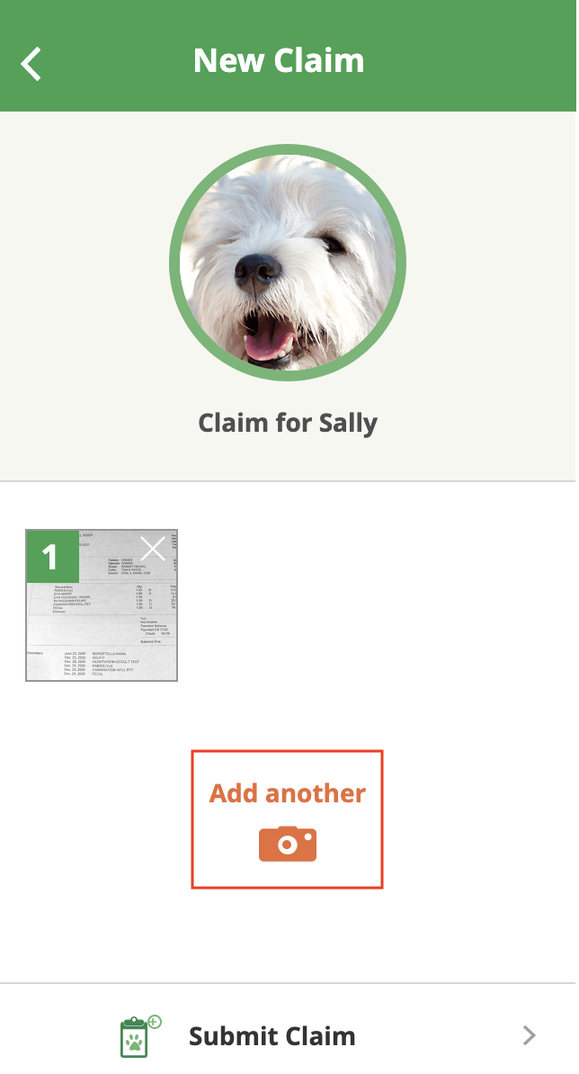
Task 3 - Claim Submission Camera Functionality
Objective: To identify issues from the multi-invoice claim submission process.
Discovery: 100% of the participants could not identify multi-photo shooting functionality during the taking photo process. All participants used the “Add Photo” button from the thumbnail page to go back to the camera to add additional invoices.

Slide 13
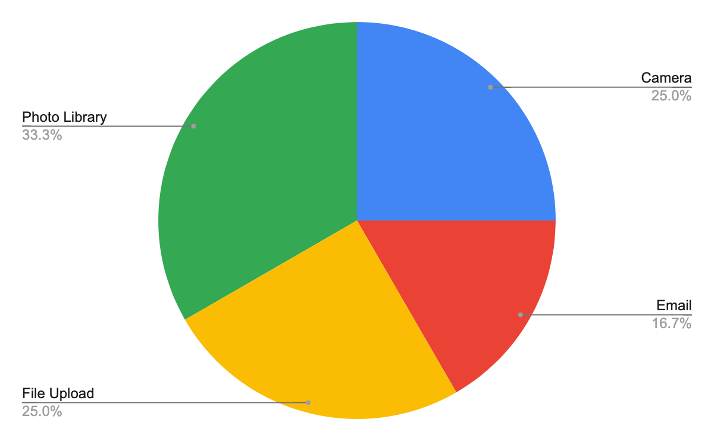
Task 4 - Multi-invoice Claim Submission Preference
Objective: To identify suitable functionality for multi-invoice claim submission.

Slide 14

Task 6 - Password Update Preference
Objective: To identify the timing of updating a password after regaining access to the customer portal.
Discovery: 100% of the participants were willing to update their passwords promptly once they regained access to the customer portal.

Slide 15
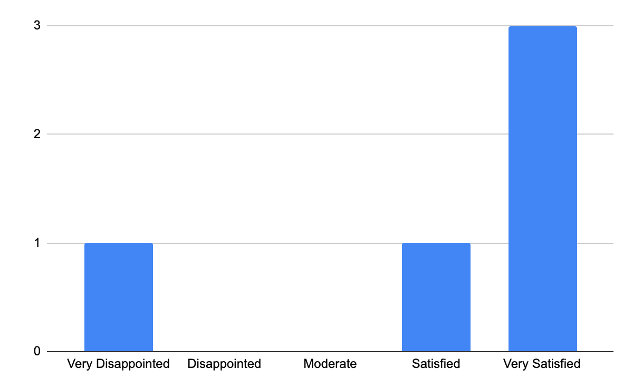
Task 7 - Rate Dual Authentication
Objective: To identify issues from dual app authentication situations.

Slide 16
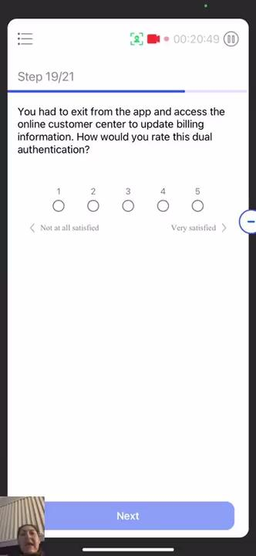
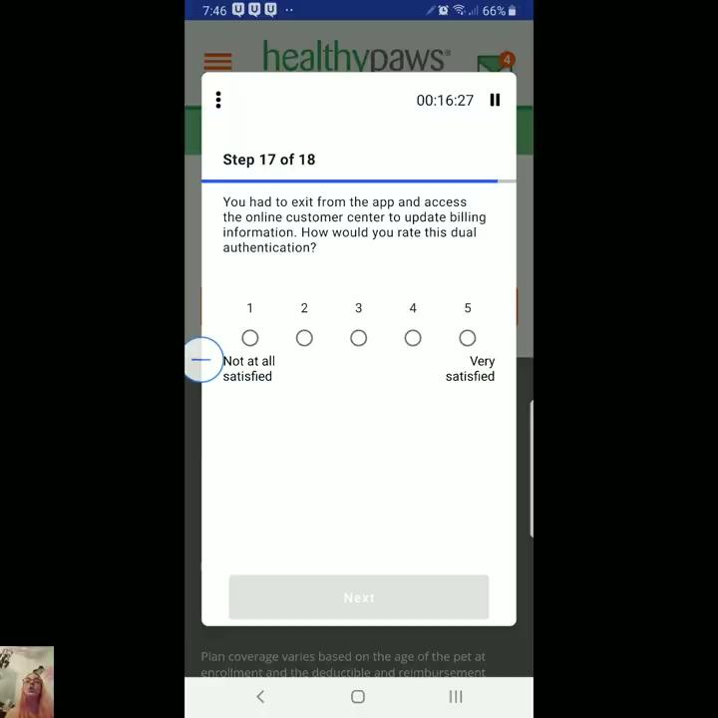
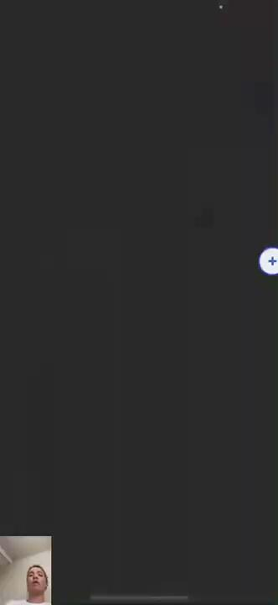
Task 7 - Rate Dual Authentication
Discovery: 60% of the participants were confused about dual authentication UX. They consider dual authentication as an extra security measure or two-way authentication.

Slide 17
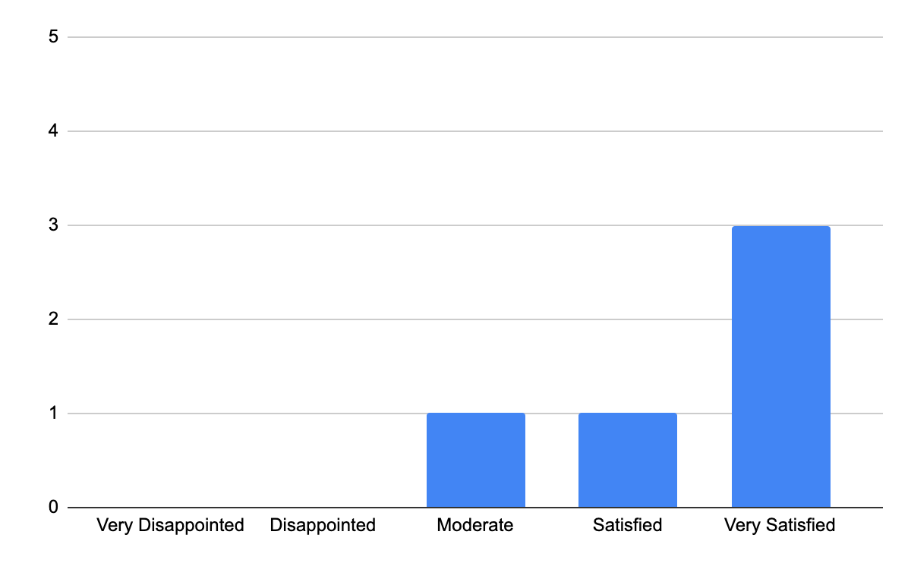
Task 5 - How was overall experience?
Objective: To determine overall Healthy Paws mobile app experience.

Slide 18
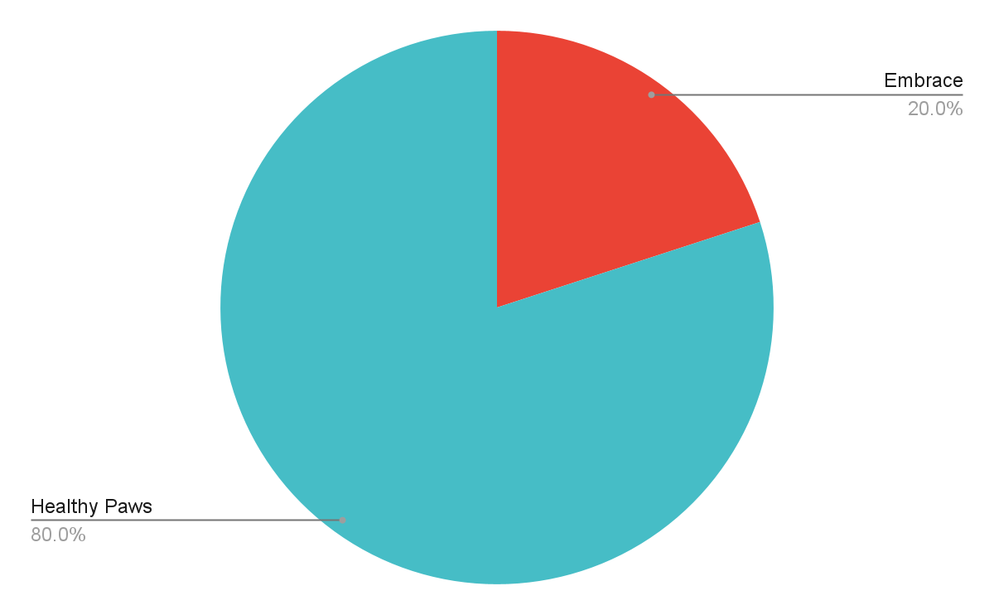
Task 6 - Comparison: Healthy Paws vs Current App?
Objective: To determine the preference between Healthy Paws vs the current pet insurance mobile app.

Slide 19
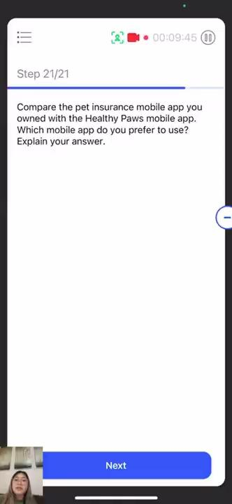
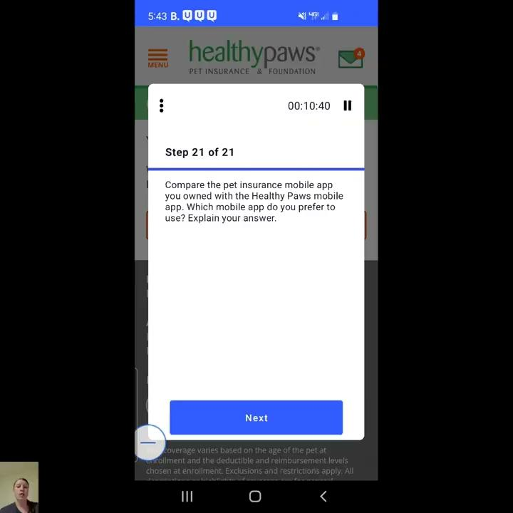
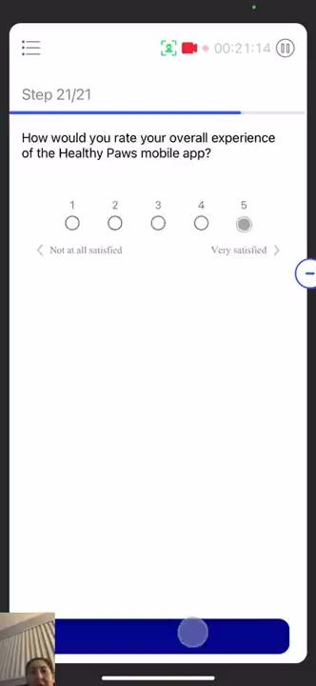
Task 6 - Comparison: Healthy Paws vs Current App?
Discovery: 80% of the participant choose the Healthy Paws mobile app instead of their apps.

Slide 20
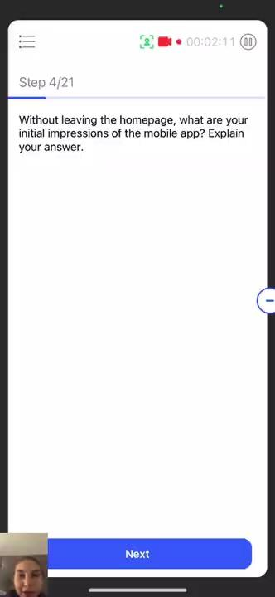
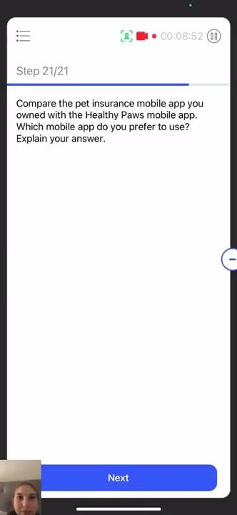

Overall Mobile App Design Impressions
Objective: 40% of the young participants (Age 20s) from the experienced group mentioned that design or functionality needs to be improved.

Slide 21
Takeaways
Takeaways:
Participants have an issue copying a temporary PW due to the touch screen.
All participants click the hyperlink to PW reset page due to the PW email layout issue before copying a temporary PW.
The term “reimbursement” seems the most appropriate word for claim payout, even though people had a hard time scanning it.
A user has to visit the thumbnail page when they submit another invoice instead of using multi-shot camera functionality
Users tend to prefer a high level of security and are willing to accept dual authentication if they have to.
Younger users tend to dislike the overall design of the HP app and looking for extra functionalities.
Older users tend to prefer simpler design navigation.
40% of participants from the experienced group liked the home page personalization.
The experienced group’s NPS is 20%, but the overall experience rate was 84%.

