Slide 1
Business case
Paul Tourrolier

Slide 2
Agenda
Meeting with BDR Manager and Head of Sales
Chief of Staff Roadmap

Slide 3
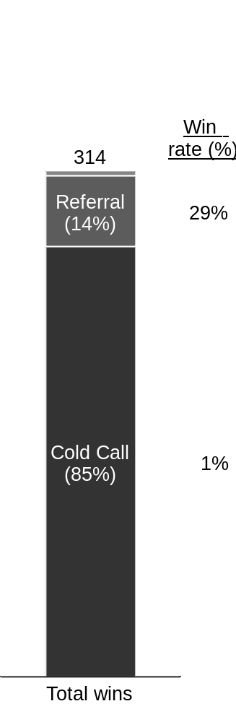
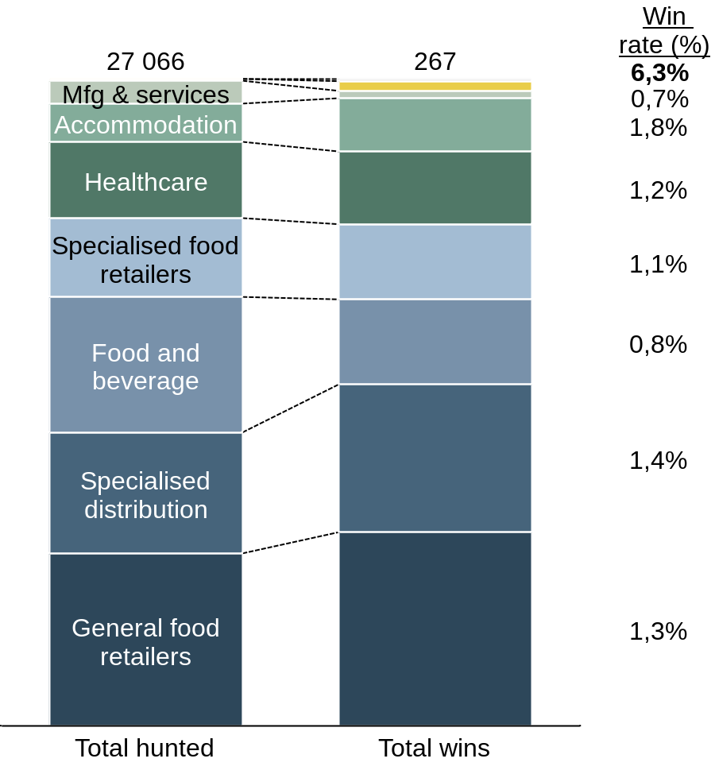
Key insights | Cold calls contribute to ~85% of wins, but the win rate is low/ declining due to lower qualification rates and hunting efforts: opportunity in Wellness & Leisure
Wins by channel¹
(Oct-20 to Sep-21)
Cold calls – Performance by vertical
(Accounts attributed in last 12 months: Oct-20 to Sep-21)
Cold calls – Overall performance drivers
(Accounts attributed in the last 12 months: by attribution date)
  Wellness & Leisure
 | Q4 2020 | Q1 2021 | Q2 2021 | Q3 2021
Total hunted | 6 213 | 6 562 | 11 340 | 2 952
Qualification rate² | 17% | 11% | 4% | 4%
Conversion rate³ | 11% | 16% | 19% | 34%
Total wins¹ Win rate | 99 1,9% | 92 1,6% | 56 0,6% | 20 0,9%
Note: (1) Including only accounts attributed in the last 12 months, from Oct-20 to Sep-21; (2) Excluding accounts not qualified or lost yet; (3) Excluding accounts not closed yet

Slide 4



Preliminary recommendations, further questions and next steps
Preliminary recommendations
(for discussion, depending
on answers to key questions)
Channel
Focus on best-converting channels to date, especially referrals, for instance by increasing referral bonus
Develop new acquisition channels (ex. auto-enrollment leveraging digital marketing capabilities)
Hunting (cold calls)
Redirect hunting efforts on verticals with high untapped opportunity, especially Wellness & Leisure (high win rate but limited hunting efforts so far) and new verticals (ex. public sector, transport)
Follow-up with prospects still in-progress for 6+ months (931 prospects with last activity earlier than 2021)
Qualification (cold calls)
Train BDR team on how to maximize prospective customer’s interest during cold calls
Build new product features and offer additional commercial incentives for the BDR team to leverage during cold calls (ex. free trial for new customers, possibility to hit pause on subscription for seasonal businesses, mobile app. enhancement, new modules & services like Smart Planner/ employee satisfaction measurement/ partnerships with temp. agencies/ etc.)
Key questions
What is the reason for decreasing hunting efforts in Q3 2021? – is it only due to seasonality?
How can we explain continuously decreasing qualification rates between Q4 2020 and Q3 2021? - also, why are few qualified leads not categorized at all in Salesforce?
What is the current process for following-up with undecided accounts?
Next steps
Build a business case (costs & implementation efforts vs. benefits) and roadmap for above recommendations, obtain Executive team’s validation and onboard key owners for delivery
Perform similar performance analysis with key accounts (where untapped opportunity is likely higher)

Slide 5
Agenda
Meeting with BDR Manager and Head of Sales
Chief of Staff Roadmap

Slide 6
Chief of Staff | Job specifications
For Discussion
Operational drumbeat
Own OKR:
  Co-define long-term company goals with the Board and functional OKR with Team Leads (making sure they contribute to the achievement of Skello long-term goals and ensuring adoption of best practices)
  Monitor and share OKR on a regular basis (monthly)
  Challenge/ support Team Leads in achieving expected results (making sure to detect roadblocks early, participate in their resolution and inform/ escalate issues to Skello co-founders)
Fill temporary gaps in the organization
Strategy
Co-construct Skello strategy and identify / prioritize most impactful projects (including market research, detailed business cases, design workshops with team leads/ the Board, etc.)
Kick-start and ensure delivery of strategic projects: especially cross-functional and organizational projects, country launches, partnerships, M&A, etc.
Communication
Own and prepare internal communication, especially Board meetings and Town Halls (agenda, objectives, materials, minutes, follow-up)
Prepare communication with investors and assist co-founders in day-to-day investor relationships
OKR is #1 priority as they feed internal & external communication and help inform strategic projects’ prioritization

Slide 7
Chief of Staff | First 3 months high-level roadmap
For Discussion
30 days
60 days
90 days
Operational drumbeat
Set-up a recurring process with CEO
Build Chief of Staff roadmap for the year
Start filling gaps in organization (ad-hoc)
Schedule 1:1 with Team leads, build trust and understand their needs/ challenges
Review yearly company goals
Automate data extraction and analysis of Key Performance Indicators
Redefine OKR list and process with Team Leads, making sure to have buy-in, that OKR contribute to company goals and to adopt best practices (ex. max 5 OKR per Dpt.)
Review current OKR process and identify gaps / areas of improvement
Monitor and share OKR, both with the Board (monthly) and company (quarterly), support and challenge Team Leads (voicing issues)
Strategy
Gather list and information on existing projects and review progress
Build yearly strategy roadmap for Skello
Implement quick wins
(low effort/ medium-to-high impact projects)
Build a business case and roadmap (with key milestones/ owners) for priority projects
Collect external & internal data and start to prioritize list of on-going & future projects
Kick-start long-term projects (high impact/ high effort), set-up PMO & onboard owners
Set-up process to collect market insights
Communication
Attend key internal & external meetings and start to become the coordinator
Own internal communications (ensure clear objectives and agenda, focus on most important topics, clear next steps, follow-up with owners, etc.)
Revisit template and create agenda/ shell of materials for upcoming meetings
Own presentation materials to investors (build agenda, collect data from Team leads, prepare high impact materials, etc.)
Expected impact on CEO perf.
View on gaps and improvement opportunities as regards OKR
Prioritized list of strategic projects
More time to focus on vision/ delivery vs. presentation material production
Confidence that the revisited OKR list & process will translate into results
View on opportunity vs. trade-offs from strat. projects, enabling informed decisions
Ability to leverage high impact communication materials
Ability to easily monitor OKR and KPIs and early information on roadblocks
Tangible results from quick-wins and view on progress for long-term projects
Reliance in execution of key decisions following internal/ external meetings

