Slide 1
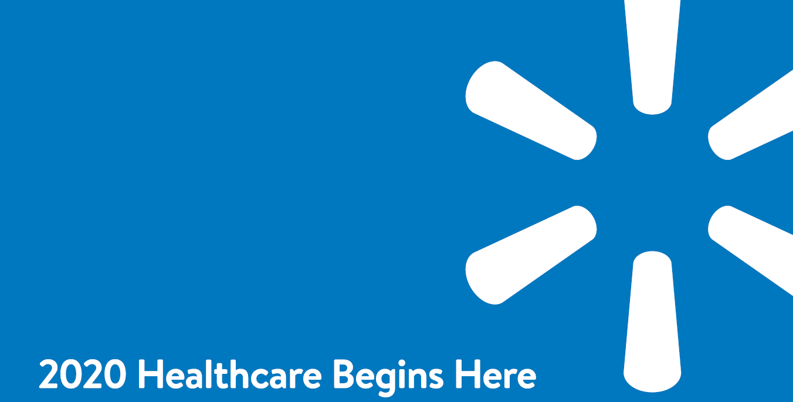

2024 MP Retail Portal
2024 Healthcare Begins Here
MarketPoint
Notes:
As I mentioned earlier we do have a new agent portal. I am really excited to get this up and running.

Slide 2
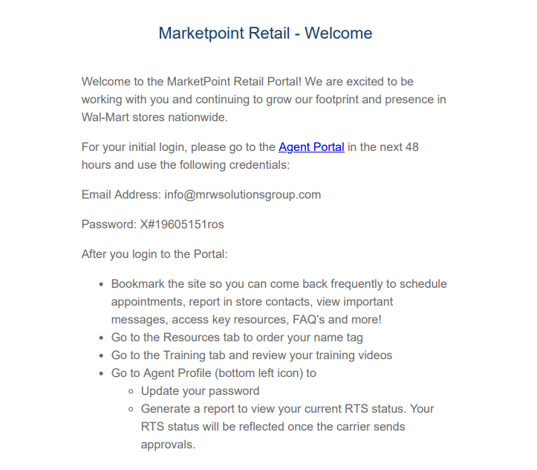
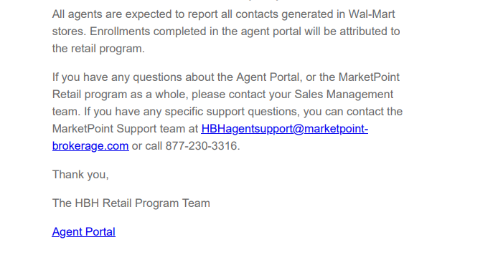
MarketPoint Retail Welcome Email
The system is case sensitive!
The url, user ID and password the agent uses to login must be in lower case only. If it has capital letters it will cause challenges in logging in as well as functionality.
MarketPoint
Notes:
Complete all carrier specific product training and certification for each of the top participating Medicare Advantage products you will represent in store by September 1st!
Complete your AHIP training module
Arrange a meeting with your Walmart Store manager and the HBH Champion
Discuss expectations and hours of operation and passive status
Exchange business cards/contact information
Know who to call if you are delayed or have any problem

Slide 3
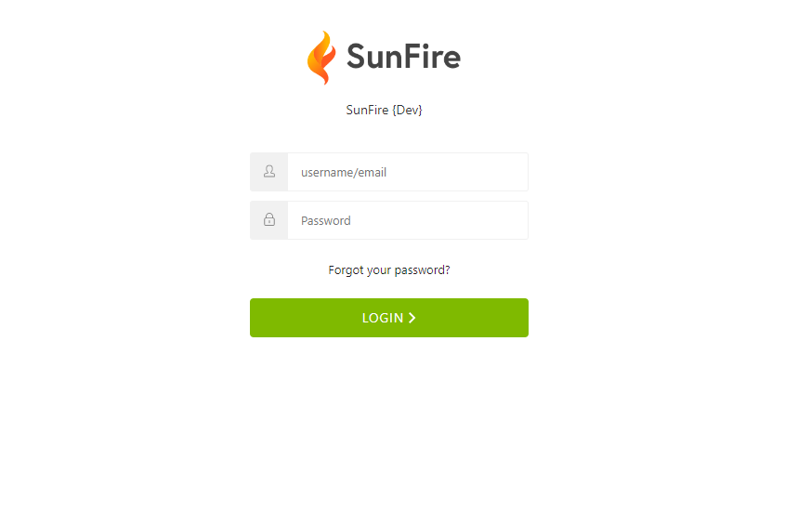
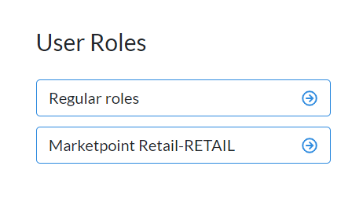
MarketPoint Retail Portal Login
Enter your User ID and password
Please note: If you have login credentials with Sunfire via your FMO, you will have a choice of your regular role or the retail role. When using the portal for the retail opportunity, please make sure to select the “Retail Role”.
Your login credentials will be sent to you via email. You will receive your welcome email from donotreply@sunfirematrix.com
Select your user role: Retail Program
MarketPoint

Slide 4
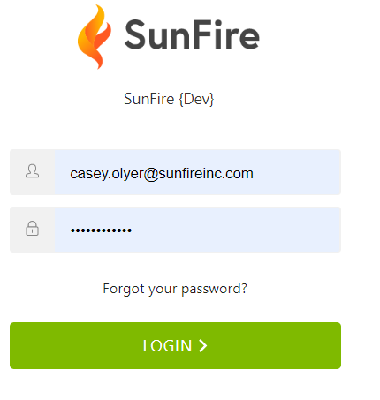
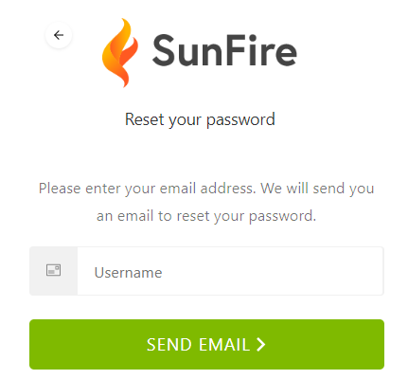
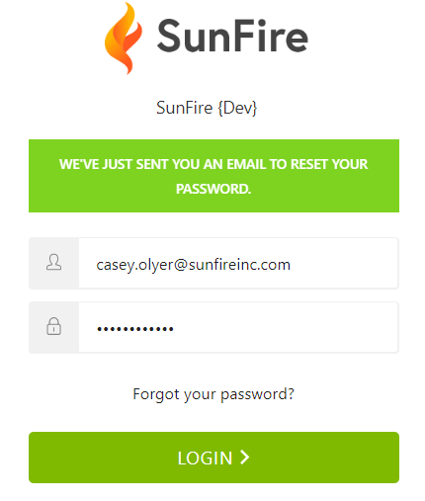
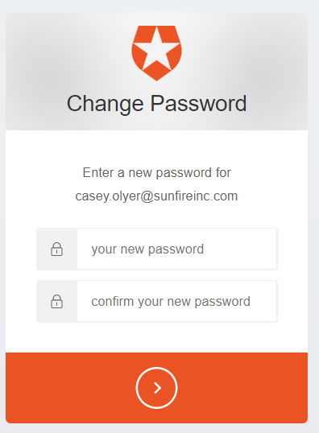
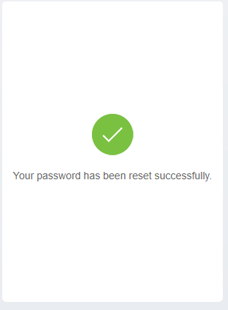

Forgot Password
MarketPoint

Slide 5
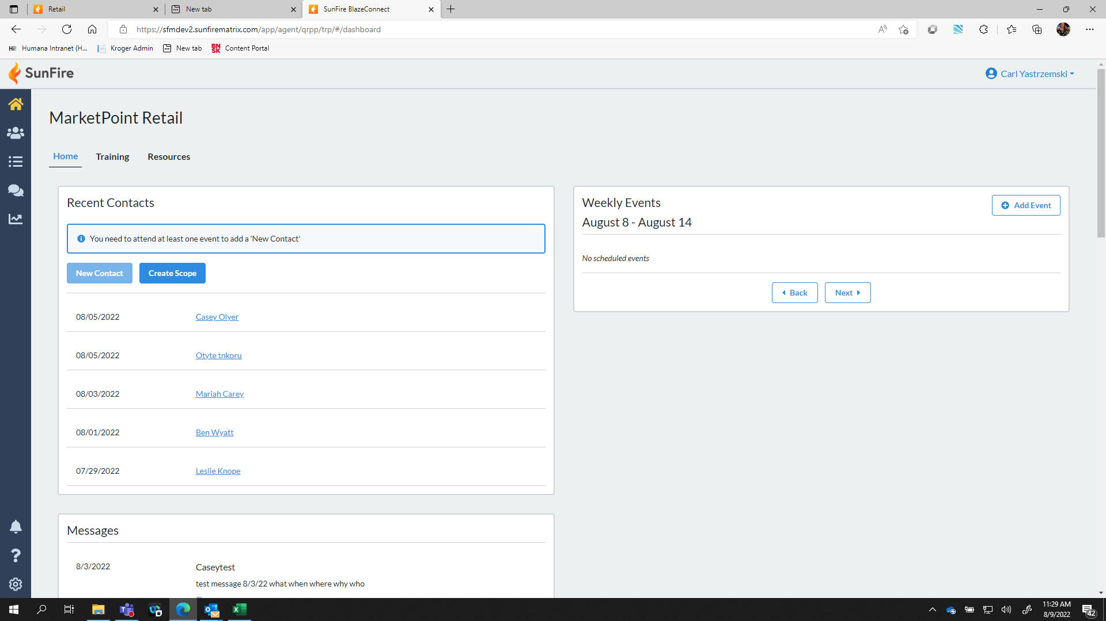

MarketPoint Retail Portal Navigation Bar
Home / Dashboard
Add/View/Search Contacts
Quote and Enroll
Scope of Appointment
Enrollment Reporting
MarketPoint

Slide 6
MarketPoint Retail Portal Navigation Bar
Notifications
FAQ
Agent Profile
MarketPoint

Slide 7
MarketPoint Retail Portal Homepage
Agent Program Training
Add an Event
Agent Program Resources
Add Contacts
Create a Scope of Appointment
Important Messages
MarketPoint

Slide 8
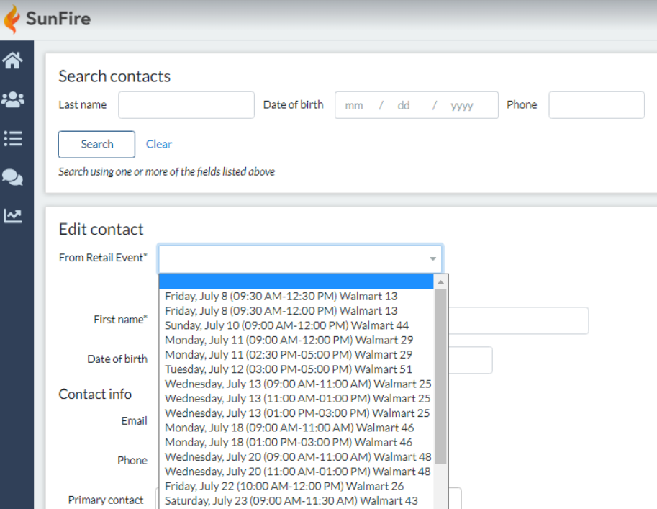
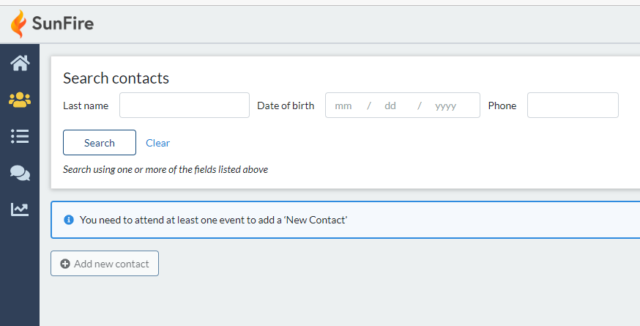
Create or Search for a contact
Add Contacts
Search Features
When entering a contact, agents will need to choose from the events where they obtained the contact.
Add Contacts
MarketPoint

Slide 9
Create a Scope of Appointment
Create a Scope of Appointment
MarketPoint

Slide 10
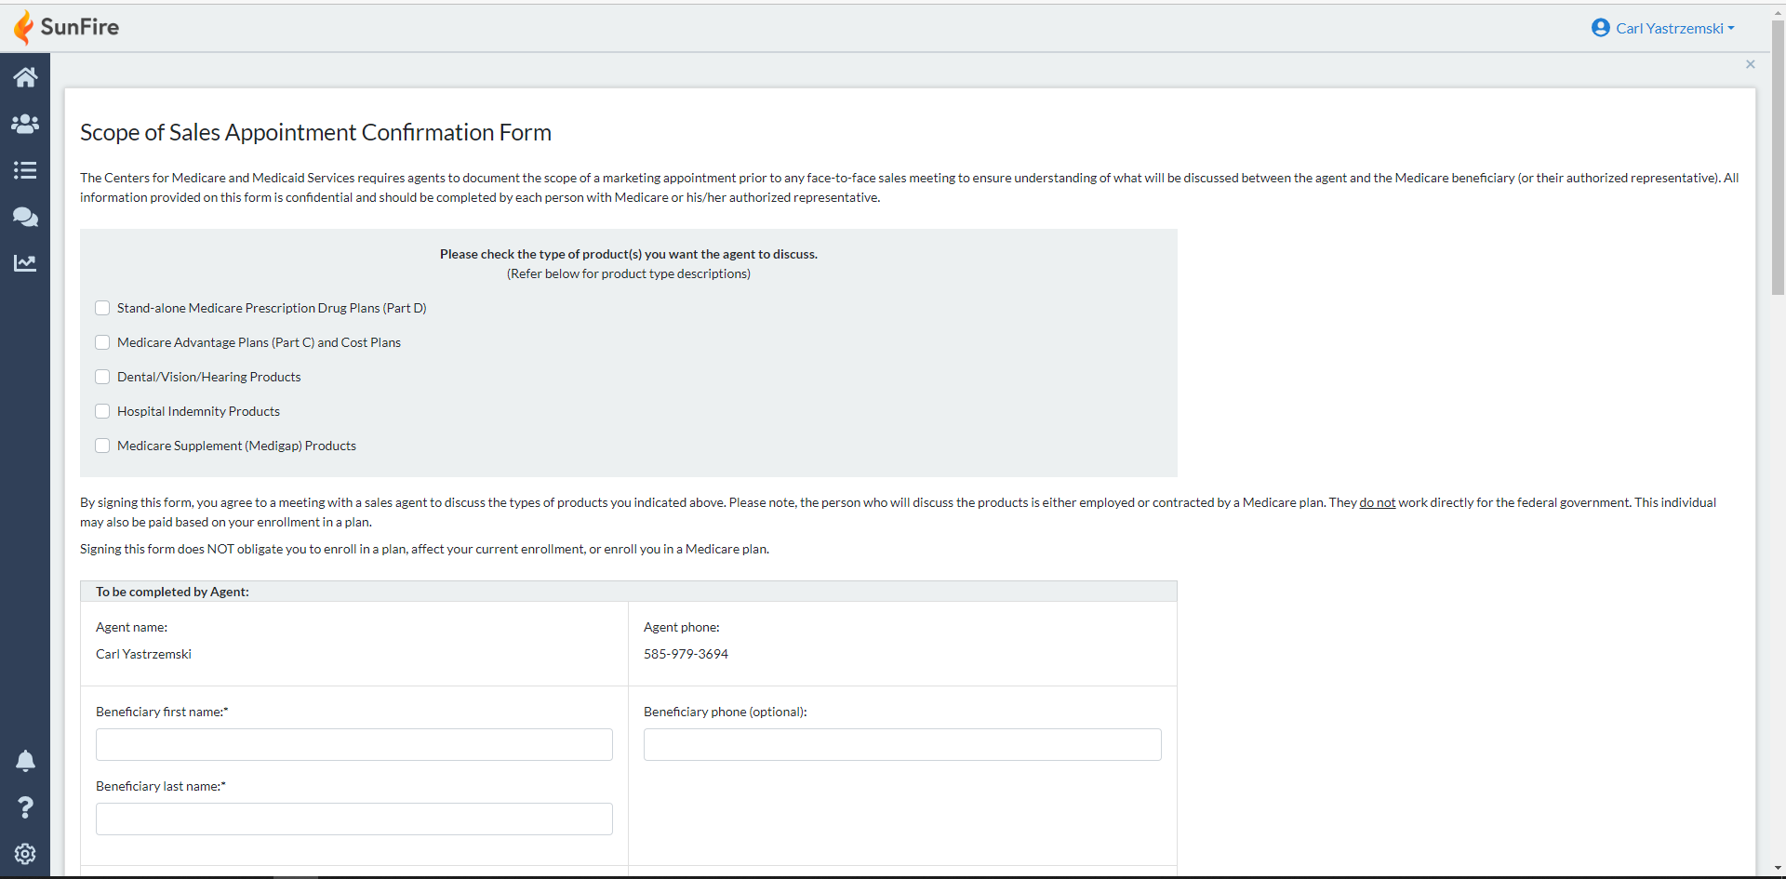
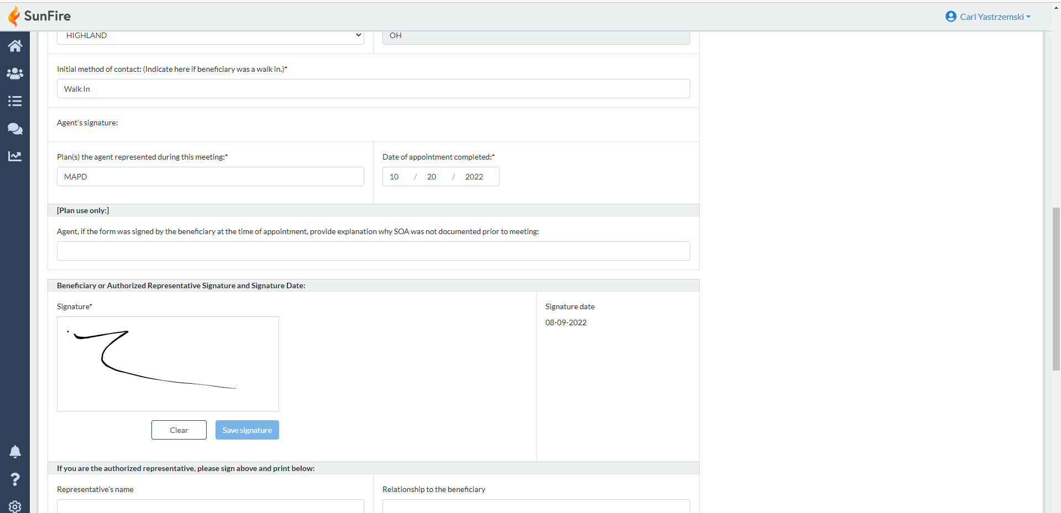
Create a Scope of Appointment
Enter the requested data
Obtain the client signature and save
MarketPoint

Slide 11
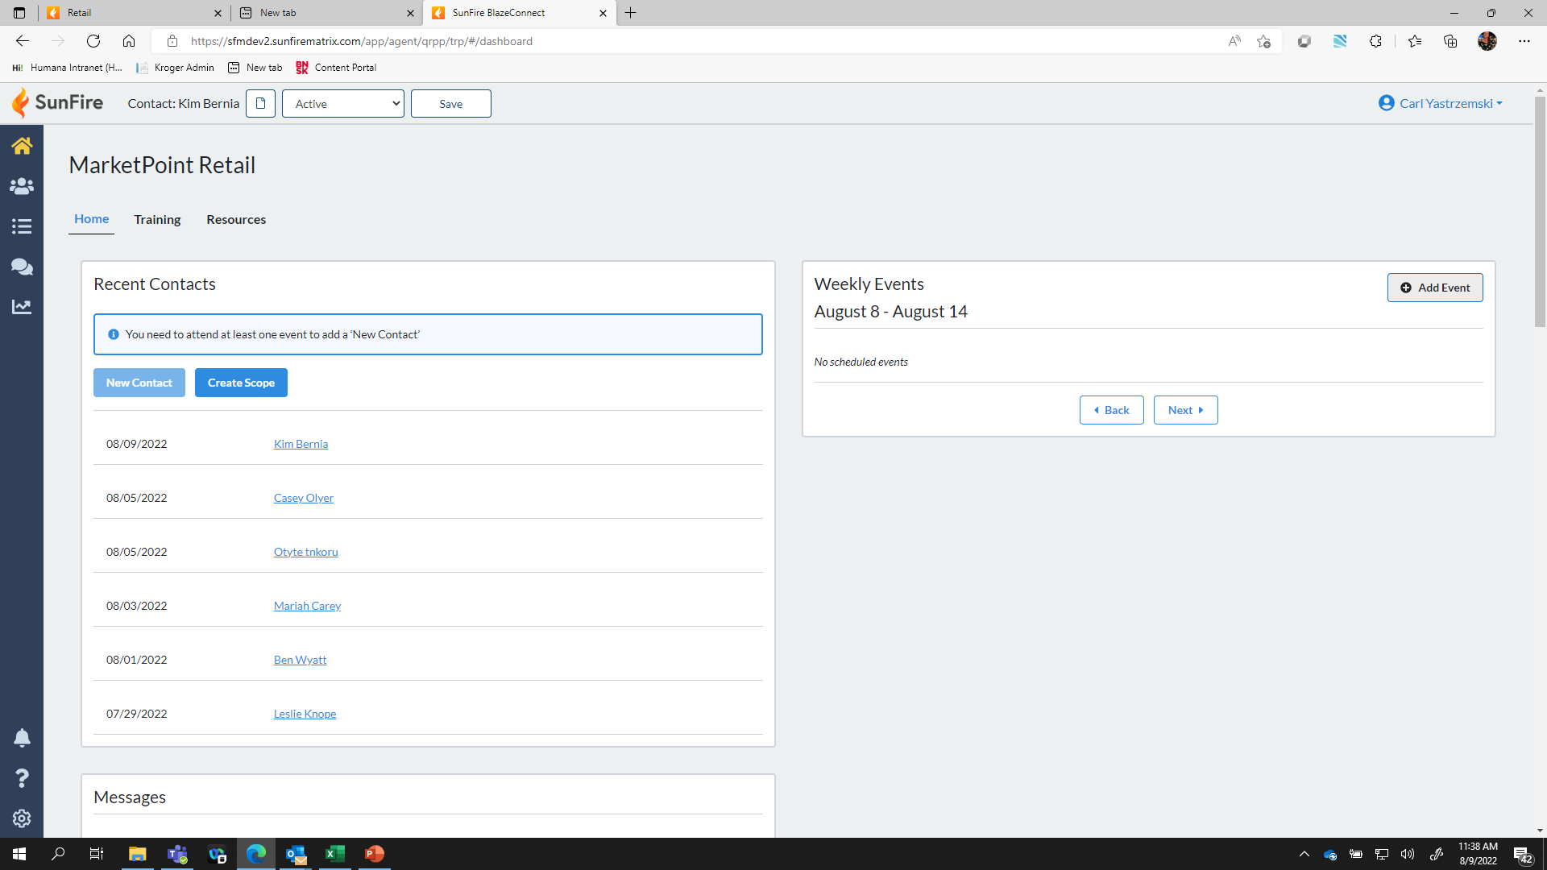
Schedule an Event
Home Page:
Add an Event
MarketPoint

Slide 12
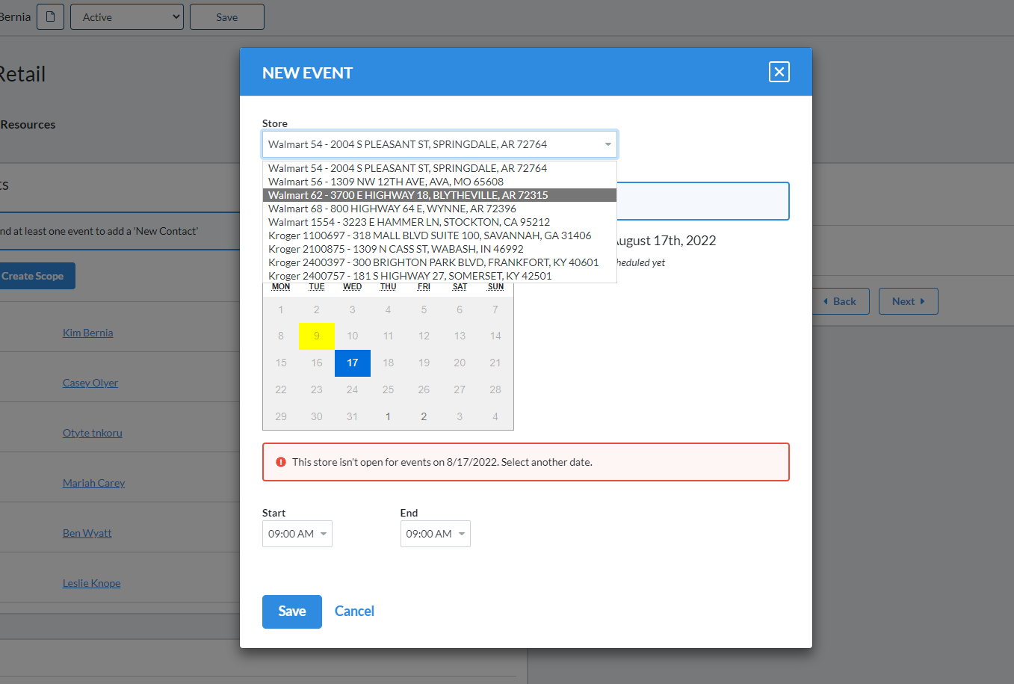
Enter your schedule – Easy as 1.2.3.4….
1) Select the store location for the event
2) Select the date on the calendar for the event
3) Select the start and end time of the event
(2 hour minimum)
4) Save the event!
MarketPoint

Slide 13
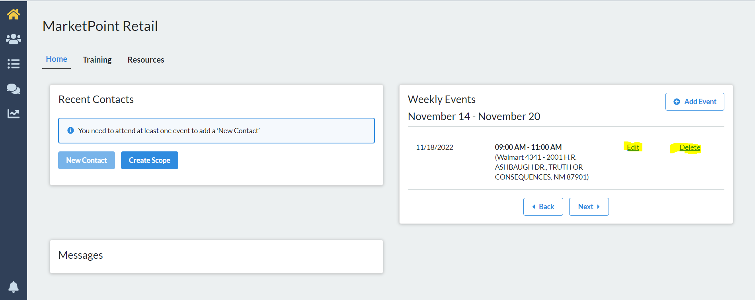
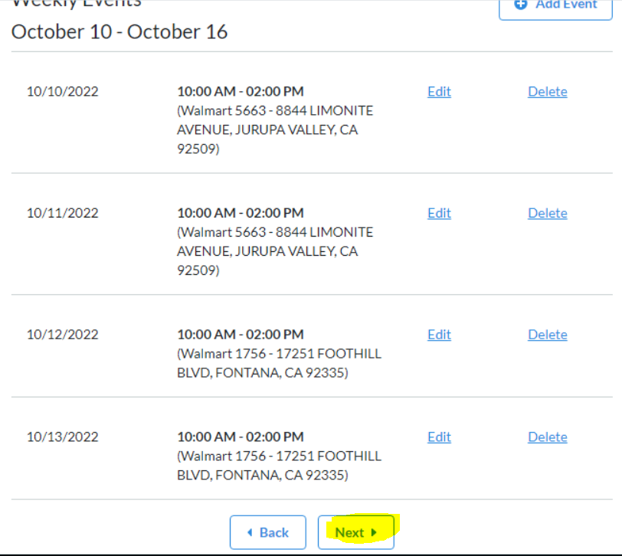
Change your schedule
Scroll to find your event and edit or delete
Reminder:
Schedules must be entered a minimum of 4 days in advance to be approved
Click Next to view the remainder of your events
If you need assistance with scheduling please contact the Agent Support Unit at: HBHagentsupport@MarketPoint-brokerage.com
877-230-3316
MarketPoint

Slide 14
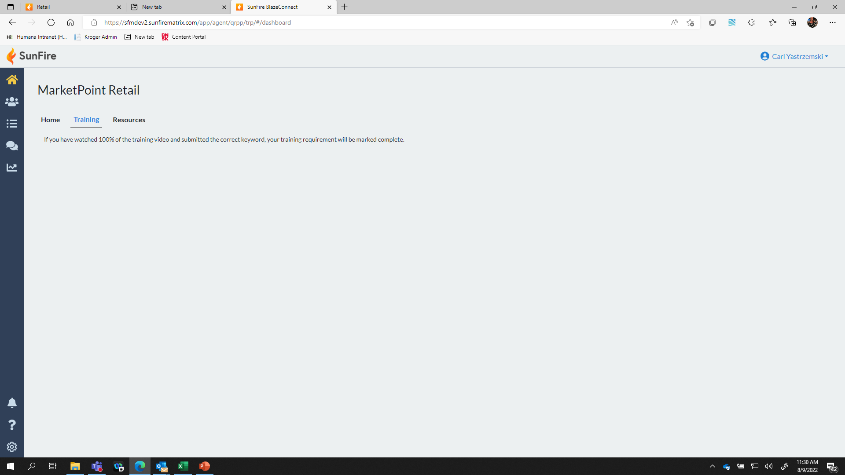
MarketPoint Retail Training Program
Agent Program Training
Training Link
In an effort to minimize the number of portal connections we have added a link to the training program.
MarketPoint

Slide 15
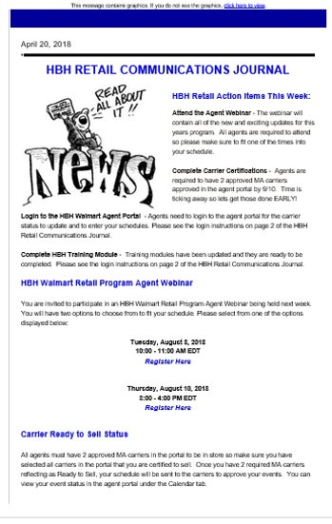
Program Communications and Messaging
Important Messages
IMPORTANT!
Program communications will continue to be delivered via the HBH Retail Communications Journal however we will also post important messages on the Messages section of the MarketPoint Retail Portal.
MarketPoint

Slide 16
Agent Program Resources
Home
Agent Program Resources
MarketPoint

Slide 17
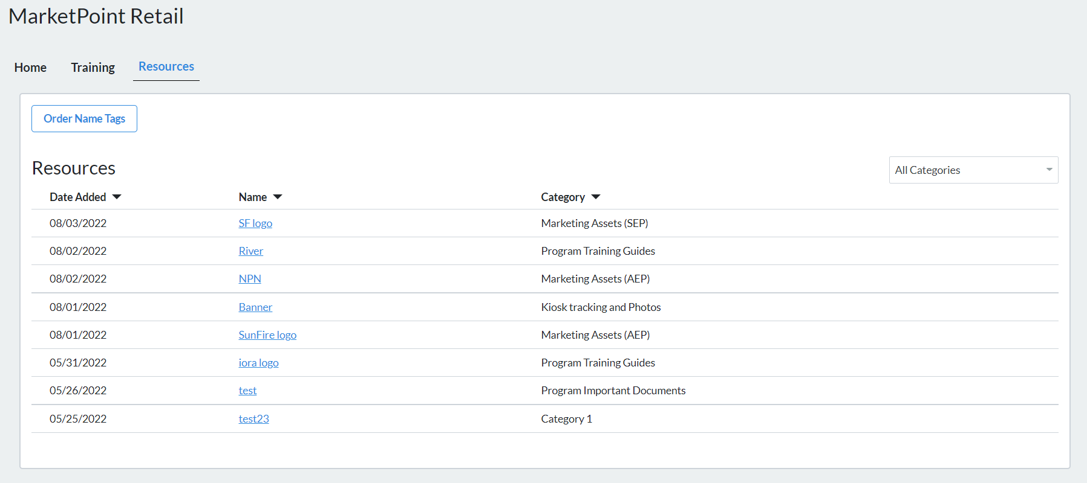
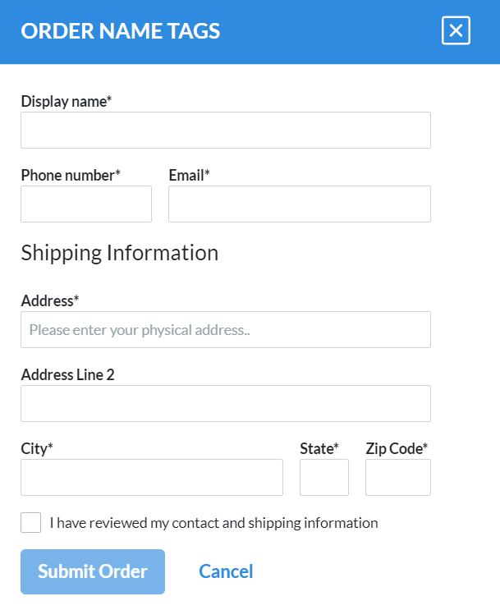

Agent Program Resources – Order Name Tags
Click on “Order Name Tags” to complete your name tag order
Complete the Name Tag order details and submit your order.
MarketPoint

Slide 18
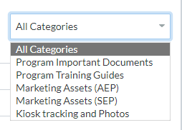
Agent Program Resources
Select your resources based on Name
Select your resources based on category
The MarketPoint team has refreshed the marketing assets that are available to the agents participating in the MarketPoint Retail Program. Please take the time to see what may work for you!
MarketPoint

Slide 19
Enrollment Quote
Quote and Enroll
MarketPoint

Slide 20
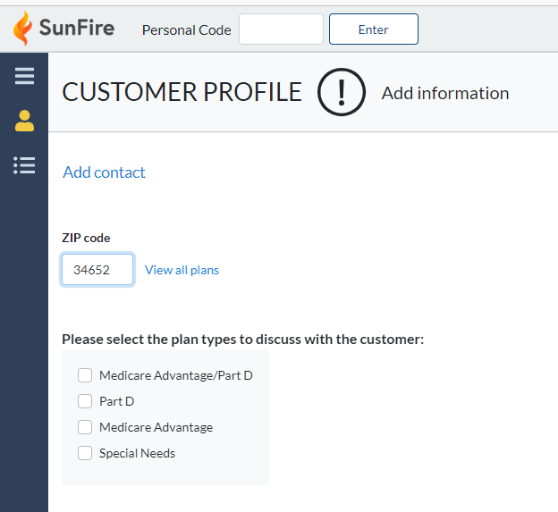
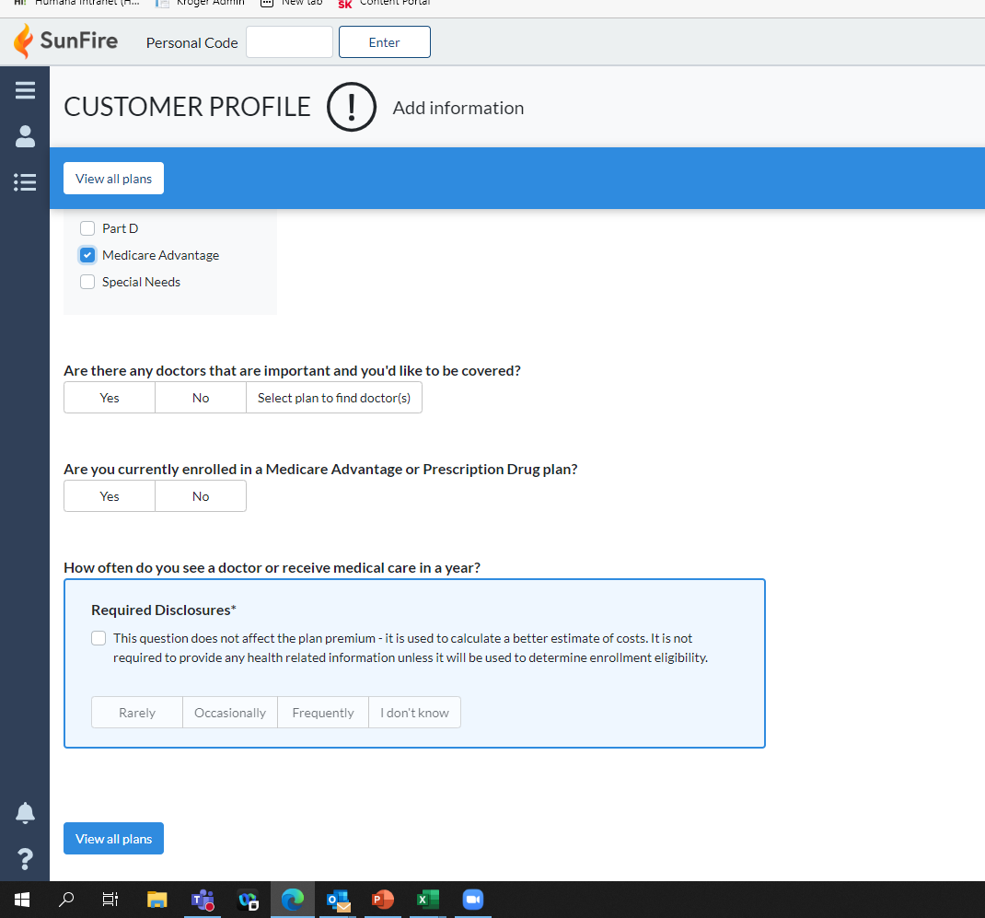
Enrollment Quote
Enter the client zip code
Select the plan type to discuss
Once you select the plan type, the needs assessment will populate. Answer everything the beneficiary is comfortable providing and click "View all plans"
MarketPoint

Slide 21
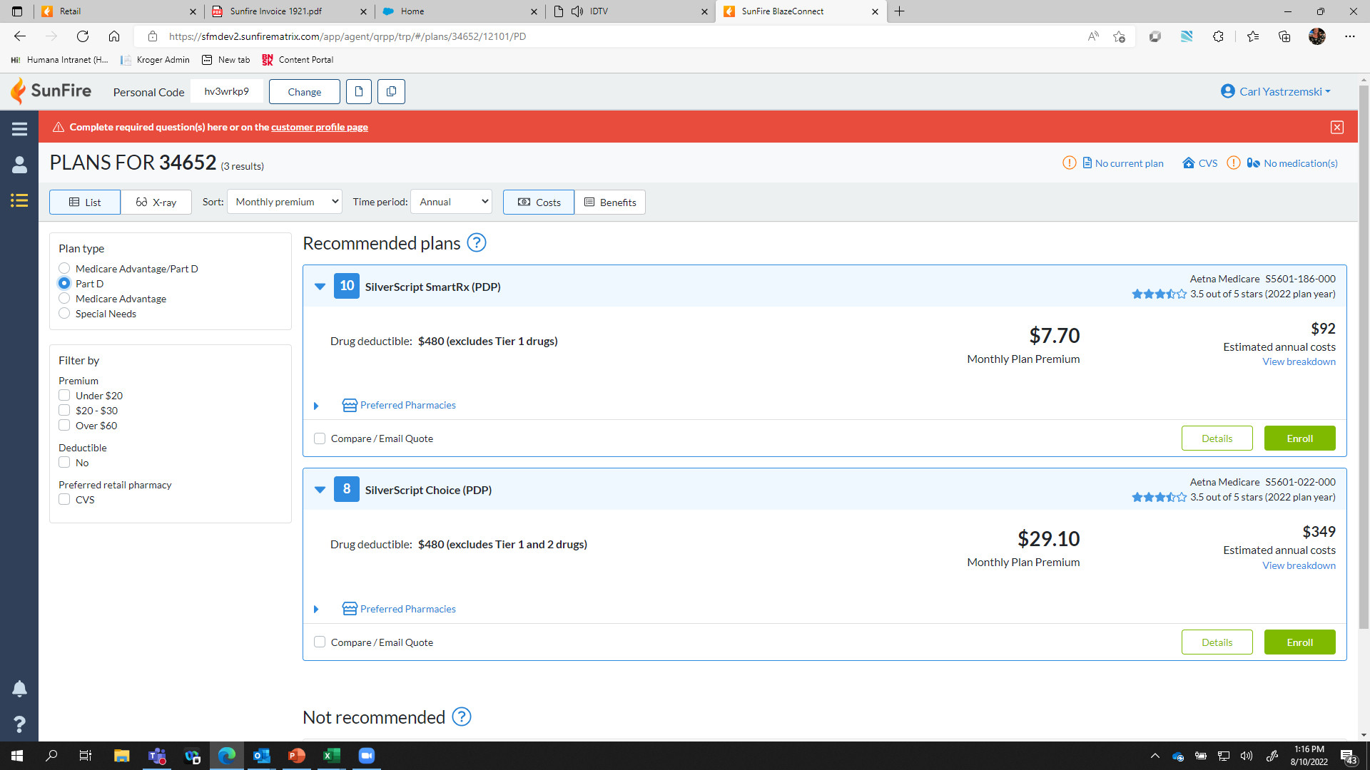
Enrolling in a Plan
All available plans for the participating carriers in the client’s zip code appear. Once the client has made a decision, simply click the “enroll” button and complete the application.
MarketPoint

Slide 22
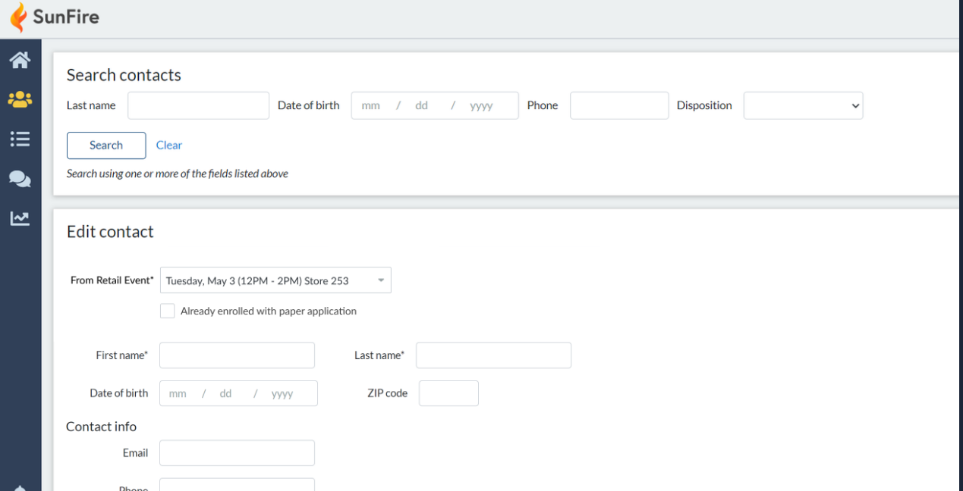
Enrolling in a Plan
In the event you are unable to complete the enrollment via the portal, please make sure to click in the contacts that you have completed a paper application. That will count towards your enrollment totals.
MarketPoint

Slide 23
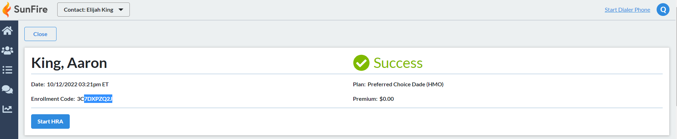
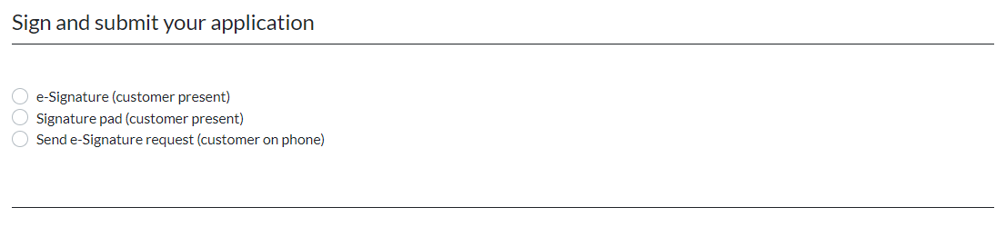

Slide 24
Retail Program Reporting
Reporting
MarketPoint

Slide 25
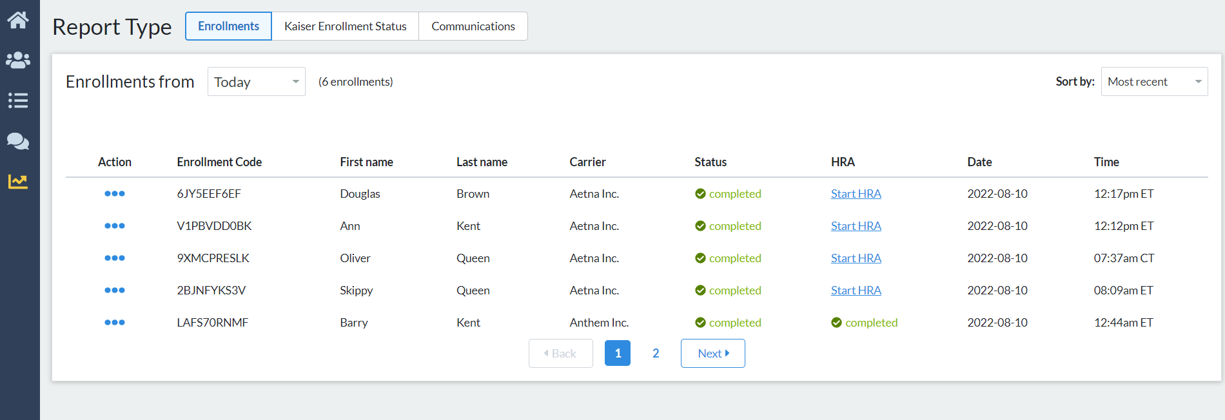
Retail Program Enrollment Reporting
Once enrollments have begun, you will see all of your enrollment activity in the reporting tab!
MarketPoint
Notes:
Carriers that we are linking out to since they are not existing SF partners:
HealthFirst
Community Care
Global – should be live in SF by 10/15.
Prominence
BCBS Arkansas
BSBS Arizona
BCBS South Carolina
Capital BCBS
HRAs – these will only be available if an FMO has an existing contract in place to complete HRAs for these carriers. For the MarketPoint only partners, that do not use SunFire outside of the Retail portal, we would need to know who they have an existing contract with. We cannot turn it on for everyone.
Anthem
Aetna
Wellcare
UHC

Slide 26
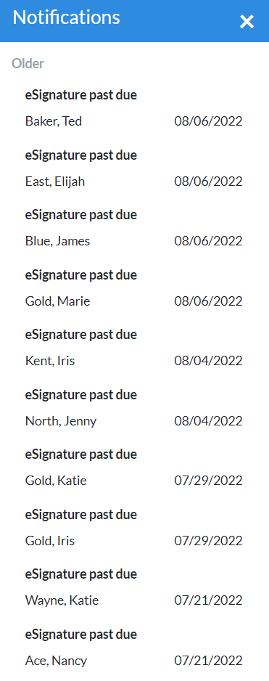
Program Notifications
Notifications
MarketPoint

Slide 27
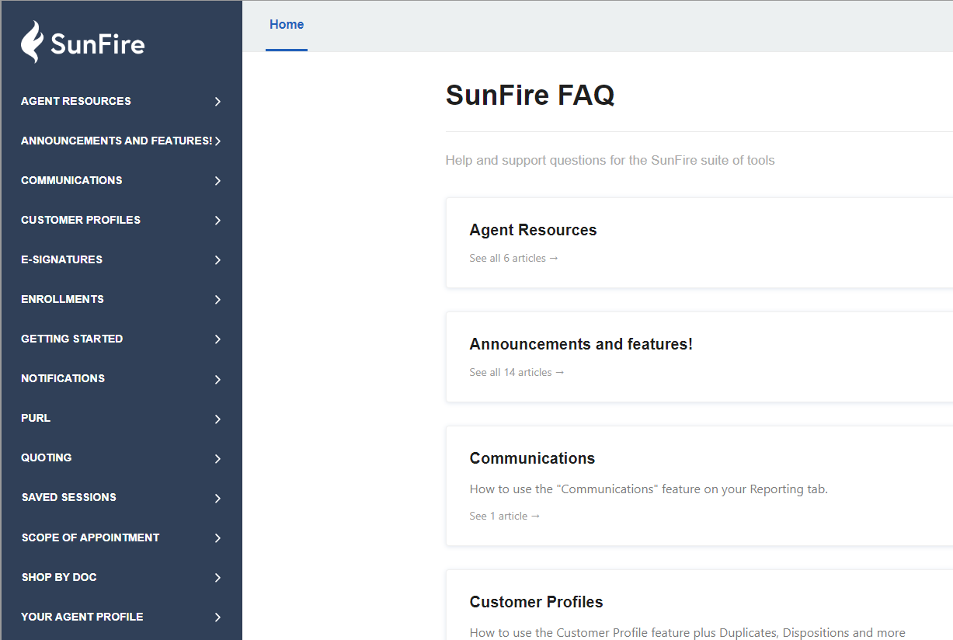
Frequently Asked Questions?
FAQ
MarketPoint

Slide 28

Agent Profile Settings
Agent Profile Settings
MarketPoint

Slide 29
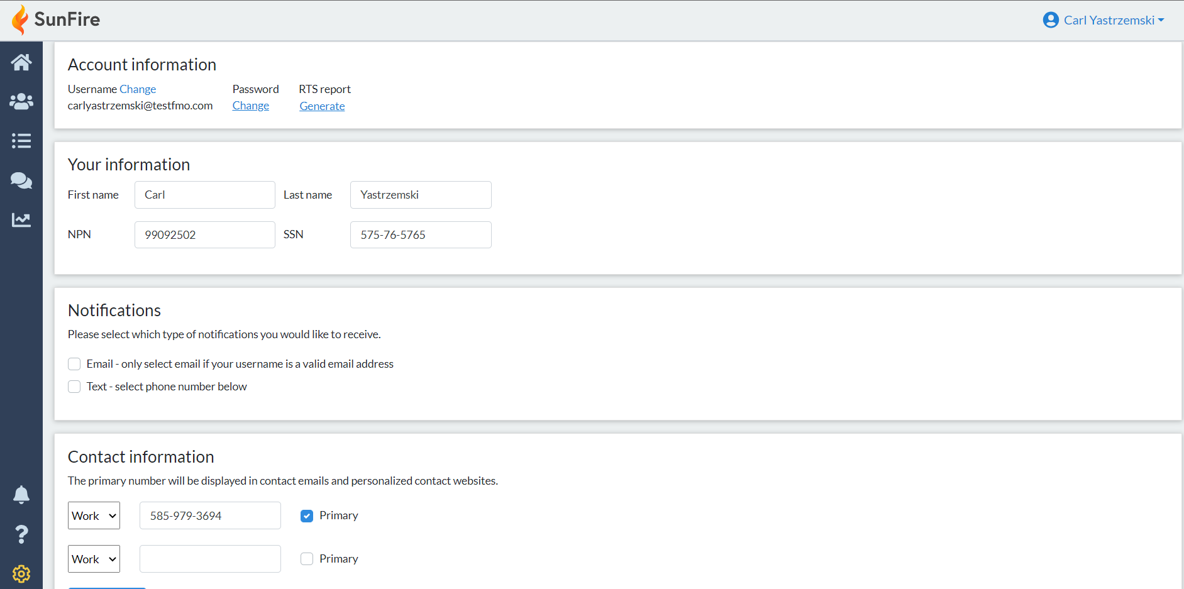
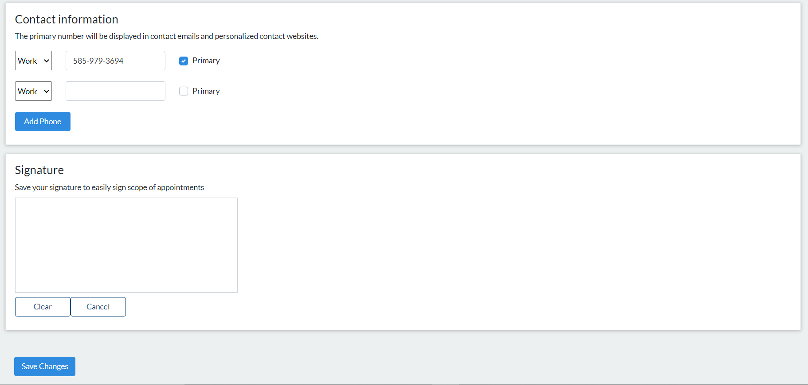
Agent Profile Settings
Please make sure to update your personal profile settings including your contact details and signature.
MarketPoint

Slide 30
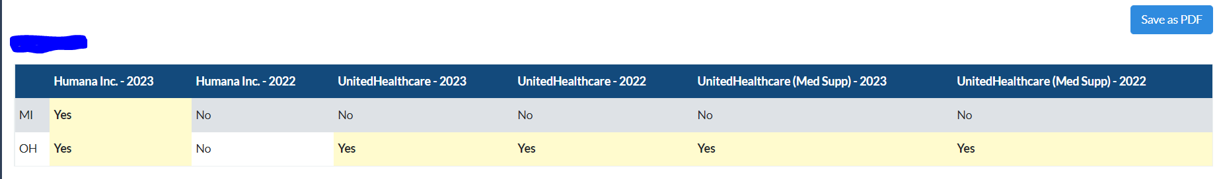
Agent Profile Settings
Agents can generate a RTS report for themselves by clicking the “Generate” link. Please see the example report below:
MarketPoint
Notes:
In this training module we will review the following topics
The 2023 Program Overview
Key Changes
In-Store Experience and what you can expect
The code of conduct
The Upgraded Marketing Materials
Everyone’s favorite topic, Compliance
The ASU, Agent Support Unit
How to be successful in a retail Setting

Slide 31


HBH Agent Support Unit (ASU)
Hours of Operation
HBHagentsupport@MarketPoint-brokerage.com
877-230-3316
Hours of Operation are as follows:
Now until September 30th 9:00 am - 5:30 pm, Monday - Friday
October 1st – December 7th 8:00 am – 7:00 pm, Monday – Friday
December 8th – December 31st 9:00 am - 5:30pm

Slide 32
Thank You!
2024 Healthcare Begins Here
MarketPoint
Notes:
Thank you all for attending and I wish you all a fabulous 2023 Season

