Slide 1
Welcome to
Broker Appreciation Night

Slide 2
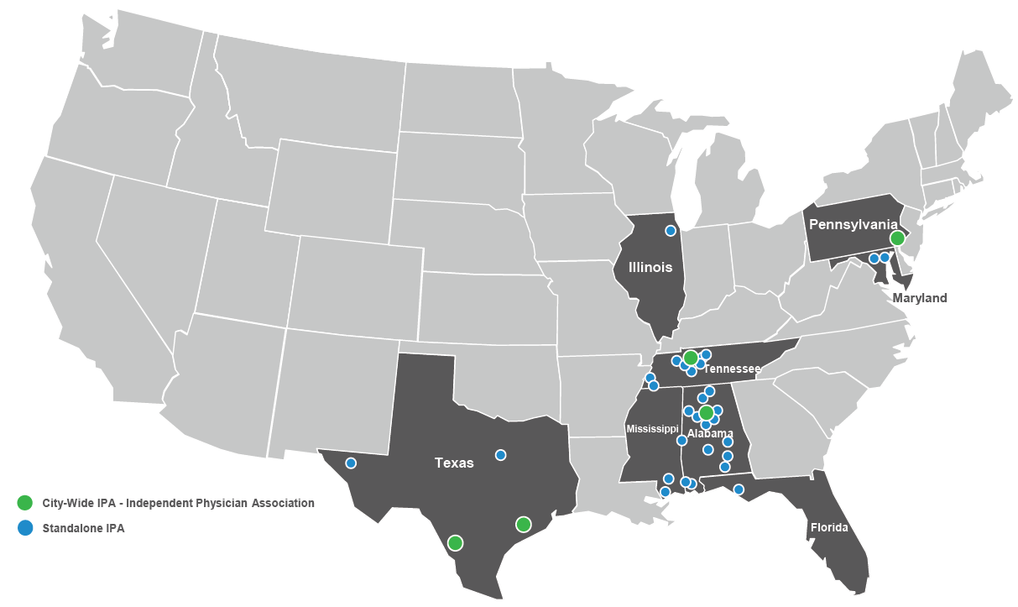
Get to know CareAllies
QUICK FACTS
WHAT MAKES PROVIDERS IN OUR CONTRACTED IPAS DIFFERENT
87
1,773
Exceptional experience and value-based care for your customers at no additional cost.
Affordability: Competitively differentiated affordability based on claims/premium and contracted rates. Contributes to better contracted payor MLR.
Reduced Service Calls: All new patients are communicated to their doctors as a top priority to become established within the first 60 days. Strong physician/patient relationships correlate to retention.
Patient Satisfaction with their Physician: 96% of surveyed patients indicated they were highly satisfied (90%) or satisfied (6%) with their CareAllies’ aligned physician.
Independent Physician Associations (IPAs)
IPA Primary Care Providers
72.3%
455,000+
Medical Loss Ratio¹
Members Across Multiple Payers
LOCATIONS
GROWTH FOCUS
High Physician Engagement in Outcomes: Physicians in CareAllies-contracted provider organizations own and operate the IPA business. Physicians have a vested interest in the success of their business without compromising patient outcomes nor prioritizing revenue over patient experience.
Growth Leads: Each IPA has a dedicated growth lead (or committee) to help drive success for growth.
Physician Engagement in Marketing: All physicians have a Marketing Tier indicative of their panel status and marketing engagement level. 78% of PCPs have open panels and 74% want to work with a local licensed agent to support patient education, retention and growth activities.
BETTER OUTCOMES
33%
More
HbA1c Control²
23%
Better
Blood Pressure Control²
9%
More Colorectal Screenings²
4%
More
Breast Cancer Screenings²
8%
Fewer
Potentially Avoidable ER Visits²
¹January – June, 2022
²CareAllies Informatics. Cigna Book of Business Analysis for members utilizing IPA providers compared to non-IPA plan members in the same markets, 2021

Slide 3
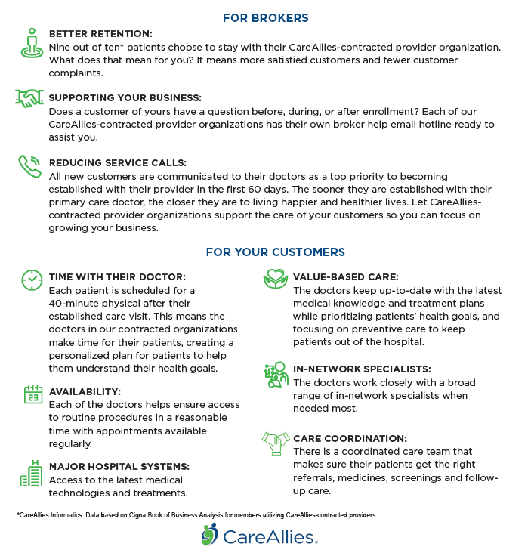
Exceptional experience and value-based care for your customers at no additional cost.
CareAllies-contracted provider organizations provide care specifically designed for Medicare-Advantage enrollees. This provides benefits to both you and your customers.

Slide 4
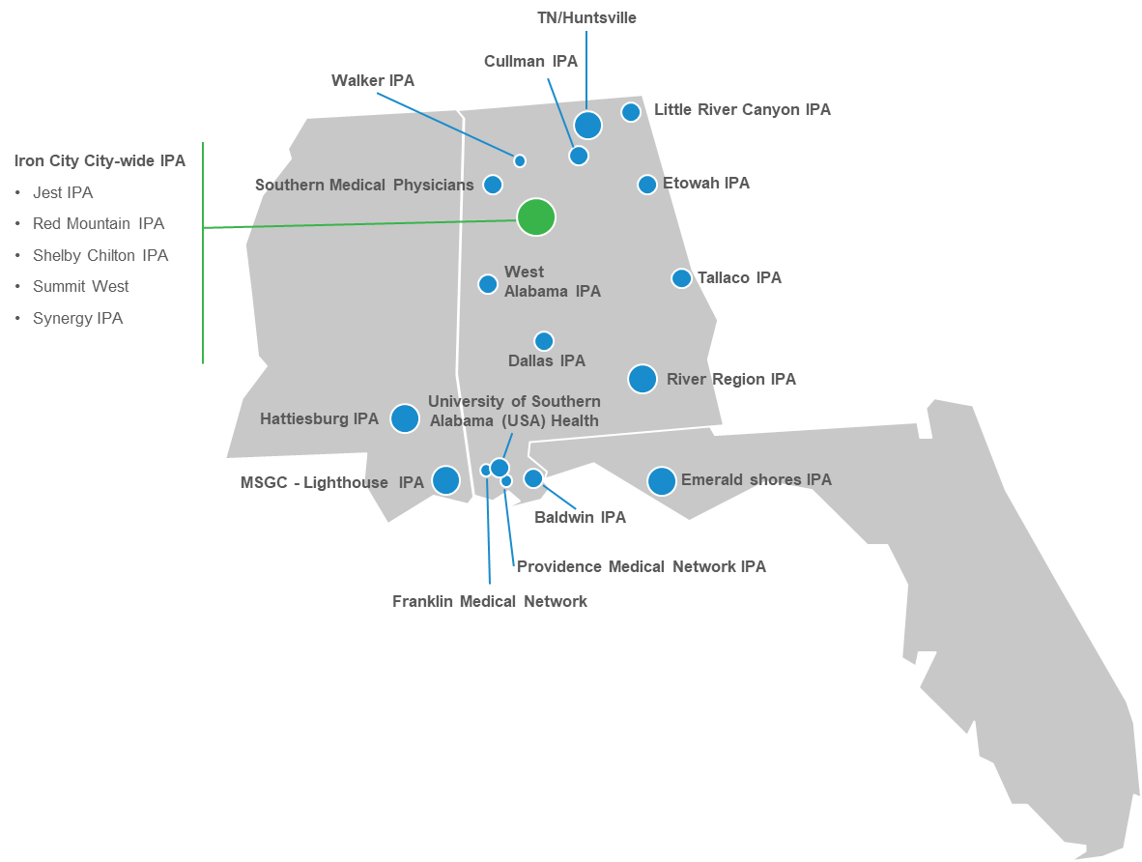
Our Florida-Mississippi-Alabama IPA footprint
City-wide IPA (member count >8000)
Standalone IPA (member count <1000)
Standalone IPA (member count <2500)
Standalone IPA (member count >2500)

