Slide 1
Cigna Medicare Retail & Event Solutions
AEP 2024 Updates

Slide 2

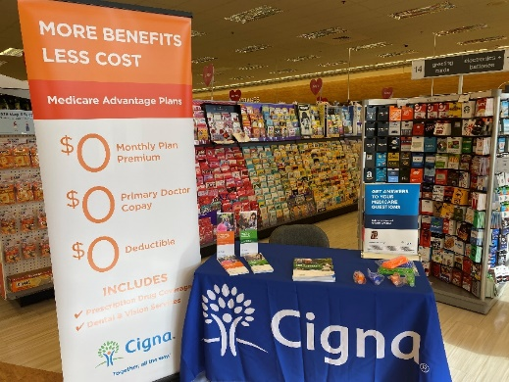
In-store Broker Program – Convenience & Education
This Cigna-led initiative provides a free service to a retailers’ large senior customer segment by providing education and easy access on a topic that is critically important to seniors
Value to Retailers
The program provides a structured and free service to senior customers that helps seniors navigate one of the most important financial decisions a typical senior will make all year
Our brokers display Cigna’s Healthy Today Card imagery to remind both your customers of the Cigna OTC benefits redeemable in stores
Value to Customers
Seniors gain convenient access to licensed Cigna agents at the retailer they are already frequenting.
Value to Cigna
This broker-customer interaction in the communities we serve helps to generate leads, leading to Cigna MA growth.
Veteran-focused materials are always available to provide education on available resources, particularly in veteran-heavy communities
Seniors gain answers to their Medicare questions, and sometimes schedule a personal appointment for a later time

Slide 3
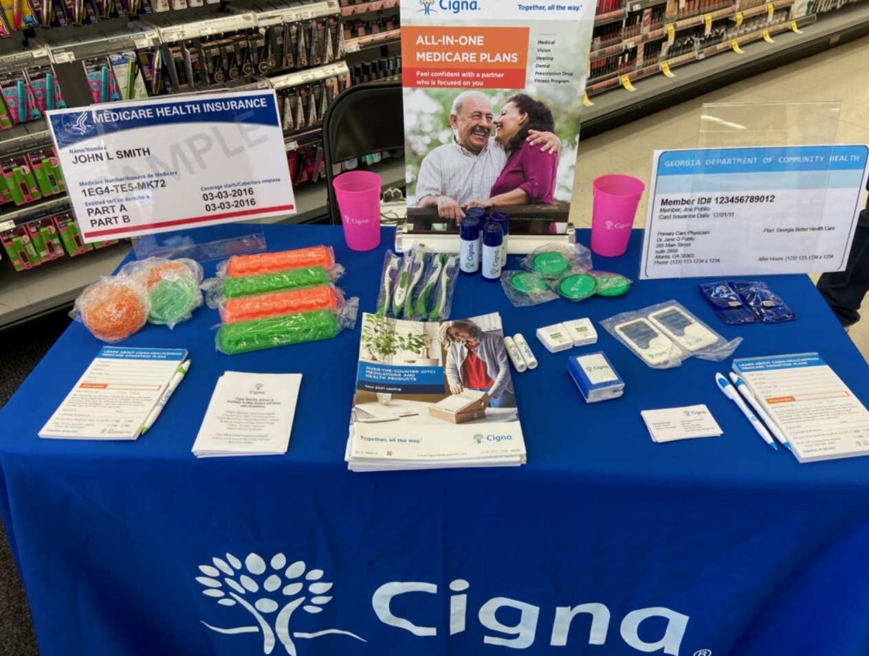
Retail Program Updates and Salesforce Enhancements
Previous AEP’s
AEP 2024
Additional retail training was required to participate
The Events Solutions team ran reporting to request access for agents to schedule retail events
The Salesforce team manually updated agent profiles with Retail scheduling capabilities and Marketing user rights
Retail events could not be cloned or rescheduled, only created as new events or canceled outright
All Cigna-certified, Ready to Sell brokers will now see the “New Retail Event” button as a standard feature in Salesforce
Additional Retail training is no longer required
Visibility issues due to “Micromarket” mismatch between agents and stores has been resolved
Cloning functionality has been added for easier, more convenient event creation
Creating an event in Salesforce will now trigger a three-part automated email system.
  Email 1: New Retail Event confirmation
  Email 2: 24-Hour Upcoming Event reminder
  Email 3: Thank you and Reminder for Reporting
Pop-up warnings will now appear in Salesforce for late reporting

Slide 4
What’s next leading up to AEP?
Important Dates
8/18 - Cigna’s deadline to confirm AEP broker staffing for Walgreens
10/2 - Walgreens in-store program launch
10/3 – Cigna-Walgreens Seniors Day
10/3 - HEB in-store program will launch
Salesforce enhancements are being finalized in early August
  Event Solutions is working to update Retail reference materials for upload to Producers University
As of today, Walgreens / Duane Reade, HEB, and Giant Eagle are confirmed for AEP
  Broker staffing for Walgreens must be confirmed
  Giant Eagle has offered two program options
    Traditional multi-carrier program, OR
    Carrier-exclusive program at a cost per store.
Marketing is helping us create bundled purchasing options for Retail event supplies in Custom Point, similar to Event in a Box.
Veteran-focused special Retail events are being planned with Albertsons and Walgreens for Veterans Day this November
Please contact our team at EventSolutions@CignaHealthcare.com with any questions!

Slide 5
In-Store Broker Guidance for Walgreens
Brokers will need to contact the Walgreens store manager for their selected location a minimum of ten days in advance. In-store setup location, time, and schedule need to be approved by the store manager and are subject to weather, store schedules, promotions, etc.
  Tuesdays and Thursdays from 9am-1pm or 10am-2pm are generally recommended, with a minimum of the in-store broker staffing the store once a week. Walgreens store managers will be able to advise when their store sees the heaviest senior traffic
  If the location features a VillageMD clinic, we ask that the broker also introduce themselves to clinic staff
Brokers will need to set up their events in Salesforce at least ten days in advance.
Brokers are responsible for bringing their own supplies and cleaning up their station once their event ends.
Only informal, one-on-one customer meetings will be held at a Walgreens store (no “formal” or group sales presentations)
  Brokers will need to report the number of customer interactions, leads, appointments and enrollments in Salesforce within a timely manner. This reporting shows both Cigna leadership and Walgreens that these events are productive, which allows us to continue offering them.
All agent/broker activities will be conducted in compliance with Walgreens’ complete Rules of Engagement. Brokers will likewise need to be familiar and comply with all CMS marketing guidelines and all applicable federal and state laws, including laws applicable to insurance marketing activities
Retail program reference materials, including Walgreens’ Rules of Engagement, can be found on Producers University (2024 AEP updates are pending). Please contact EventSolutions@CignaHealthcare.com with any questions.

